Slide 1
Border node
(permanently inaccessible)
Walls
Cells
Walls
Cells
Graph
Grid

Slide 2
3
4
1
2
Plane
(floor and ceiling)
Cuboid / Box
(walls)

Slide 3
Depth 0
Depth 1
Depth 2

Slide 4
D
D
A
B
C
A
B
C
Single Maze
3 independent mazes

Slide 5
Identify a dead-end
Perform DFS search
Result: Loop added

Slide 6
Launcher.jar
.dungenprofile File
DunGen.exe
X=
Program arguments
Streams stdout

Slide 7
Generate maze
Reduce density
Add loops
Add rooms and doors

Slide 8
Input
GraphicsContext
Application
Timing
GameLogic
Renderer
SceneSpace
Camera
RendererPipeline
SceneDynamic
SceneObject
Mesh
Material
Texture
File

Slide 9
VertexFactory
MazeBVHNode
MeshMaker
BasicMeshMaker
MazeBVH
MazeBVHCollider
MazeMesh
MazeCell
Maze
UniformRandom
RandomF
MazeWall
RandomTurner
RandomI
Digger
DFSDigger
PrimDigger
BinaryTreeDigger
DeadEndDigger
RoomDigger
WeighedRoomDigger

Slide 10
RandomComboBoxListener
ComboItemRemovedListener
DunGen.exe
(External Program)
< listen to >
FooterListener
< executes >
MenuListener
ProcessManager
LaunchFrame
GraphicsTabListener
FileOutputManager
DiggerList
OutputTabListener
< uses >
LaunchFrameListener
DungenDialog
GeneratorTabListener
< extend >
< uses >
DFSDialog
KruskalDialog
PrimDialog
LoopDialog
RoomDialog
WeighedRoomDialog
DeadEndDialog
StartEndDialog
TurnerDialog
UniformDialog

Slide 11
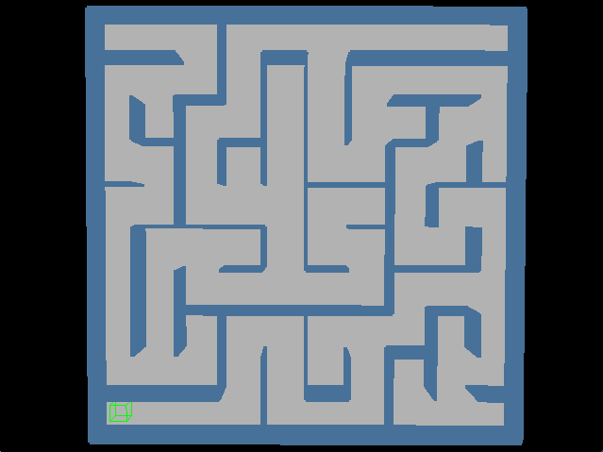
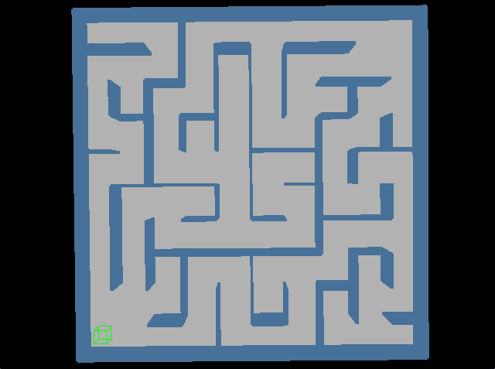
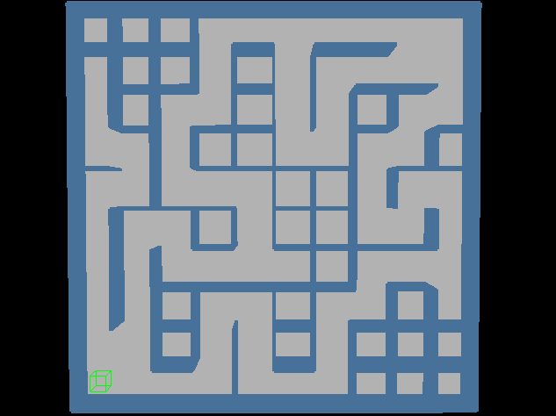
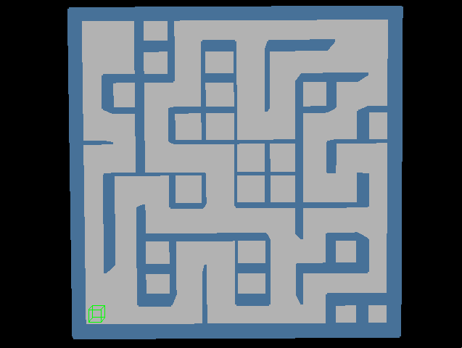
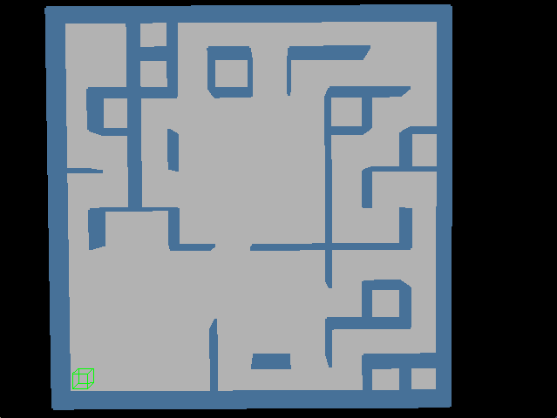
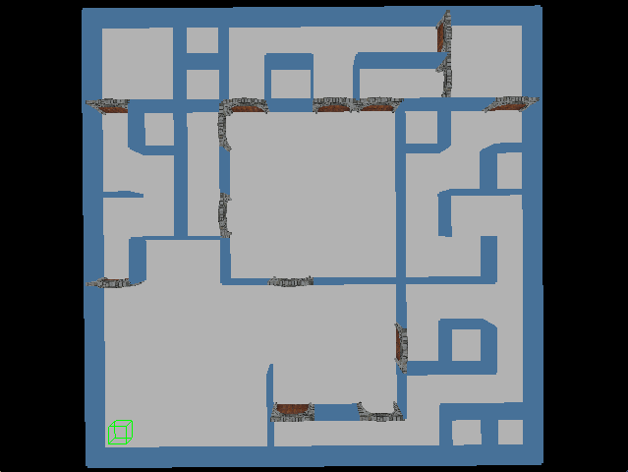
Generate perfect maze
Add start and end rooms
Reduce density
Add loops
Add rooms
Add doors and decorations

Slide 12
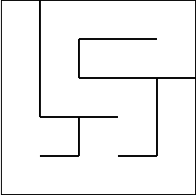
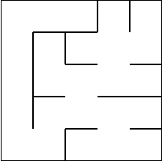
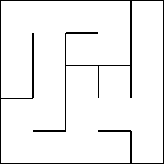
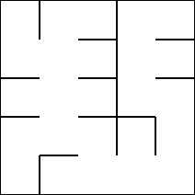
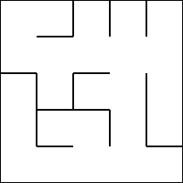
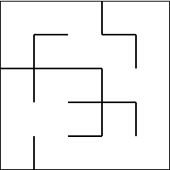
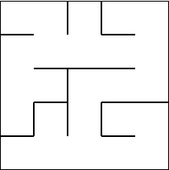
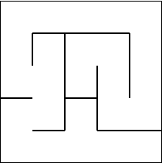
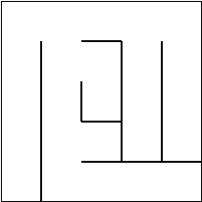
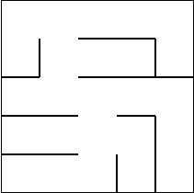
DFS
Prim
Kruskal
Recursive Divider
Eller
Aldous-Broder
Wilson
Hunt and Kill
Binary Tree
Sidewinder

Slide 13
