Slide 1
Random Dungeon Generation
CMPSMP2Y – Proposal
Olivier Legat
[Supervisor: Prof. A. Day]

Slide 2
Introduction
What is Procedural Content Generation (PCG)?
It involves random generation of content.
Content includes
Game level (static terrain)
Enemy distribution
Interact-able features (e.g. doors, treasure chest)

Slide 3
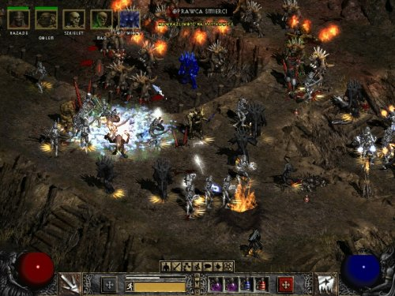
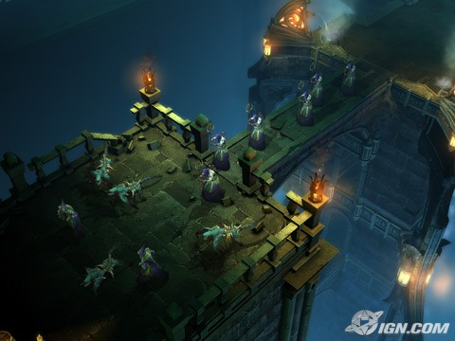


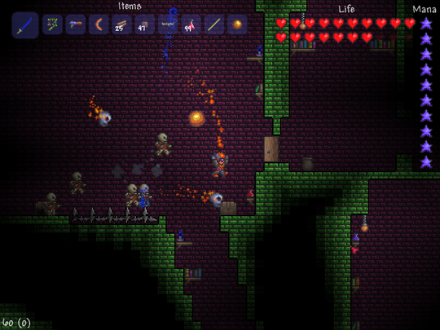
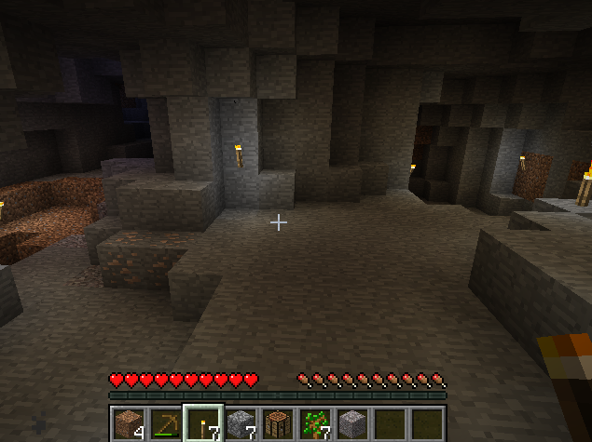
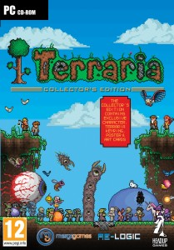
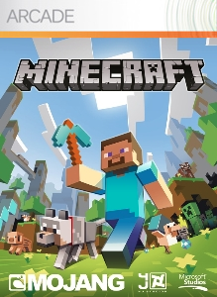
Some examples

Slide 4
Statement of problem
Most level generators are 2-dimensional
Lack of generalised algorithm
Commercial game developers don’t openly distribute their algorithms.
Even if they did, those algorithms probably wouldn’t be reusable.

Slide 5
Aims and Objectives
Develop a 3D-based level generator
Take game elements into consideration
Maintain independency and generalisation.
Render a convincing man-made structure
Seed
Generate
Level
Mesh
Render
Level
Other Inputs

Slide 6
Methods, techniques and tools
Genetic algorithms
Occupancy-regulation
Procedural Modelling

Slide 7
Genetic algorithms
Initialise
Population
Done?
Yes
Best result
Genetic operators
Mutate
Cross-over
No
Selection
Fitness function
Reproduce

Slide 8
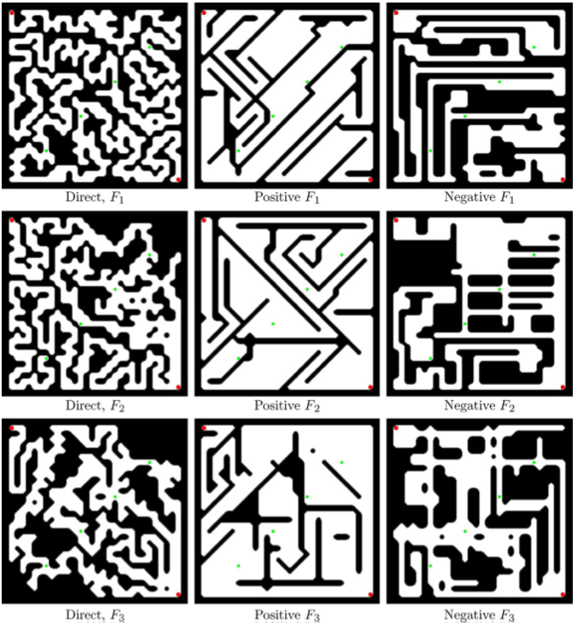
Genetic algorithms

Slide 9
Genetic algorithms
Advantages
Provides decent result
Good abstraction
Disadvantages
Notoriously slow
Initial population required

Slide 10
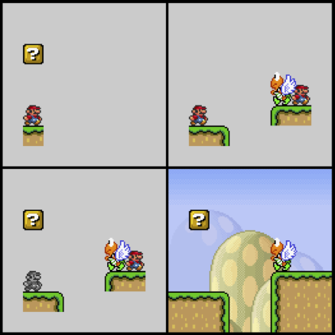
Methods, techniques and tools
Occupancy-regulated algorithms
Chunk 1
Mixed Chunk
Result
Post-process
Join at
anchors
+
Chunk 2

Slide 11
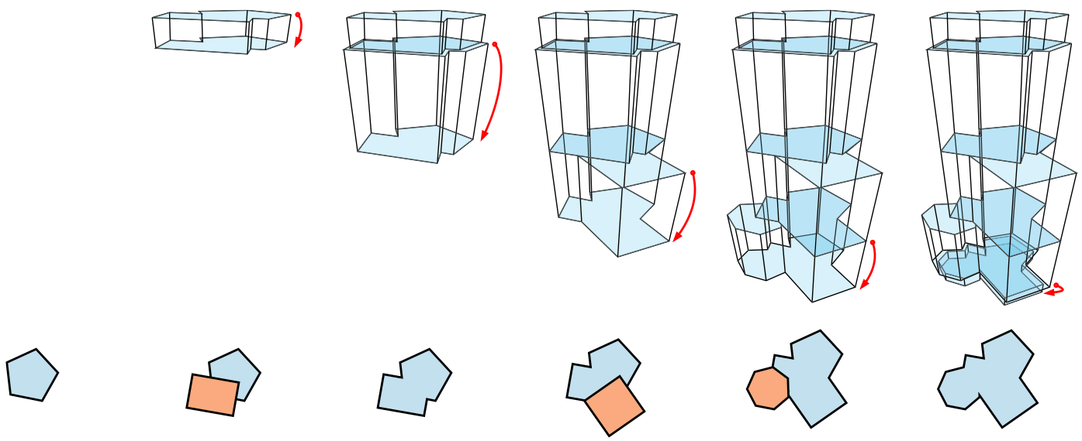
Procedural Modelling

Slide 12
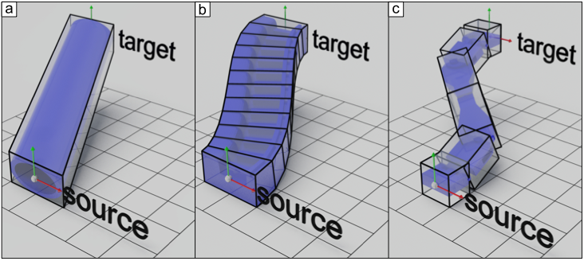
Interconnecting Structures
Linear interpolation
Deformable beams
Using Inverse Kinematics (IK)

Slide 13
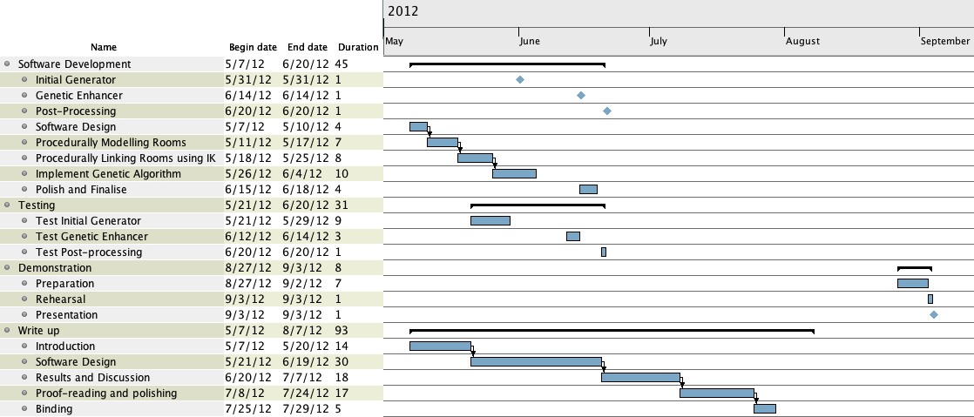
Project Plan

Slide 14
Risk Analysis
Risk Type | Probability | Severity | Prevention
Hard-Disk Failure | Low | Very High | Keeping backup on a 2nd hard-disk. [preferable] Keeping the project under a version-control server (SVN).
Software development delay | High | Medium | [preferable] Reserving spare days on the project plan to catch up. Cutting up some functionalities
Overly complex task | Medium | High | Add constraints to the problem.
Minor Illness | Medium | Low | Reserve spare days to compensate.

Slide 15
Any questions?

