Slide 1
Java for Automation

Slide 2
Java provides a rich set of operators to manipulate variables
Arithmetic operators
Relational operators
Bitwise operators
Logical operators
Assignment operators
Misc Operators
Basic Operators

Slide 3
+ (Addition) Adds values on either side of the operator
- (Subtraction) Subtracts right hand operand from left hand operand
* (Multiplication) Multiplies values on either side of the operator
/ (Division) Divides left hand operand by right hand operand
% (Modulus) Divides left hand operand by right hand and return remainder
++ (Increment) Increases the value of operand by 1
-- (Decrement) Decreases the value of operand by 1
Basic Operators – Arithmetic operators

Slide 4
== (equal to)
!= (not equal to)
> (greater than)
< (less than)
>= (greater than or equal to)
<= (less than or equal to)
Basic Operators – Relational Operators

Slide 5
Basic Operators - Logical operators
&& (logical AND)
|| (logical OR)
! (Logical NOT)
X | Y | && | || | !X | !Y
False | False | False | False | True | True
True | False | False | True | False | True
False | True | False | True | True | False
True | True | True | True | False | False

Slide 6
& (bitwise and) Binary AND operator copies a bit to the result if it exists in both operands
| (bitwise or) Binary OR operator copies a bit to the result if it exists in either operand
^ (bitwise XOR) Binary XOR operator copies the bit if it is set in one operand but not both
~ (bitwise compliment) Binary Ones Complement Operator is unary and has the effect of ‘flipping’ bits
<< (left shift) Binary Left Shift Operator. Left operands value is moved left by the number of bits specified by the right operand
>> (right shift) Binary Right Shift Operator. Left operands value is moved right by the number of bits specified by the right operand
>>> (zero fill right shift) Shift right zero fill operator. The left operands value is moved right by the number of bits specified by the right operand and shifted values are filled up with zeros
Basic Operators – Bitwise Operators

Slide 7
= Simple assignment operator
+= Add and assignment operator
-= Subtract and assignment operator
*= Multiply and assignment operator
/= Divide and assignment operator
%= Modulus and assignment operator
<<= Left shift and assignment operator
>>= Right shift and assignment operator
&= Bitwise and assignment operator
^= bitwise exclusive OR assignment operator
|= bitwise inclusive OR and assignment operator
Basic Operators – Assignment operators

Slide 8
The separators { and } signify a code block and a new scope. Class members and the body of the method are examples of what can live inside these braces in various contexts
Inside of method bodies, you can use braces to create new scopes.
Code blocks

Slide 9
Packages
This part explains how to bundle classes and interfaces into packages, how to use classes that are in packages, and how to arrange you file system so that the compiler can find your source files.
Packaging classes

Slide 10
Packages are a part of a class name and they are used to group and/or distinguish named entities from other ones.
Another purpose of packages is to govern code access together with access modifiers
A package is declared at the start of the file with the package declaration
Packages

Slide 11
Primitive Data Types
Based on the data type of a variable, the operation system allocates memory and decides what can be stored in the reserved memory. Therefore, by assigning different data types to variables, you can story integers, decimals or characters in these variables
Arrays
An array is a container object that holds a fixed number of values of a single type
Variables

Slide 12
There are eight data types supported by Java
byte: the byte data is an 8-bit signed two’s complement integer. It has a minimum value of -128 and a maximum value of 127 (inclusive)
short: the short data type is a 16-bit signed two’s complement integer. It has a minimum value of -32,768 and a maximum value of 32,767 (inclusive)
int: By default, the int data type is a 32-bit signed two’s complement integer
long: the long data type is a 64-bit two’s complement integer
float: the float data type is single-precision 32-bit with floating point
double: the double data type is a double-precision 64-bit with floating point
boolean: the Boolean data types has only two possible values: true and false
сhar: The char data type is a single 16-bit Unicode character
Primitive Data Types

Slide 13
A literal is the source code representation of a fixed value; literals are represented directly in your code without requiring computation:
boolean result = true;
char capitalC = ‘C’;
byte b = 100;
short s = 10000;
int I = 100000;
float = .1;
Literals

Slide 14
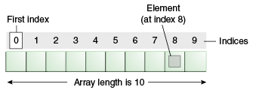
An array is a container object that holds a fixed number of values of a single type
The length of an array is established when the array is created. After creation, its length is fixed.
Arrays

Slide 15
An if statement consist of a Boolean expression followed by one or more statements if(Boolean_expression){ //Statements will execute if the Boolean expression is true }
An if statement can be followed by an optional else statement, which executes when the Boolean expression is false if(Boolean_expression){ //Executes when the Boolean expression is true } else{ //executes when the Boolean expression is false }
If statements

Slide 16
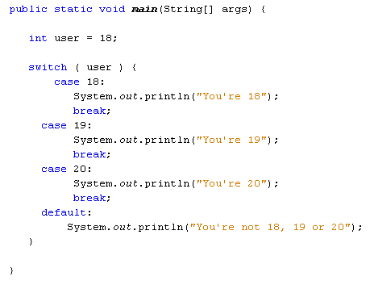
A switch statement allows a variable to be tested for equality against a list of values
Each value is called a case, and the variable being switched on is checked for each case
Switch statement in Java

Slide 17
A while loop statement in java programming language repeatedly executes a target statement as long as a given condition is true.
While Loop

Slide 18
A for loop is a repetition control structure that allows you to efficiently write a loop that needs to execute a specific number of times
A for loop is useful when you know how many times a task is to be repeated
For loop

Slide 19
A do…while loop is similar to a while loop, except that a do…while loop is guaranteed to execute at least one time
Do while loop

