Slide 1
Greenhouse robot for harvesting
Presented by:
Ostapovich Oleg
MS-RO-01

Slide 2
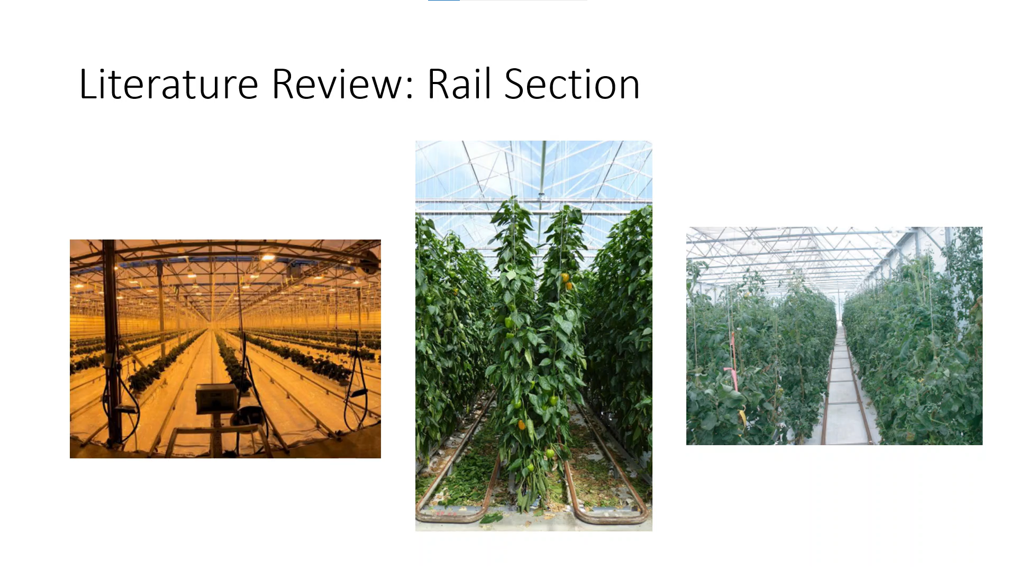

Slide 3
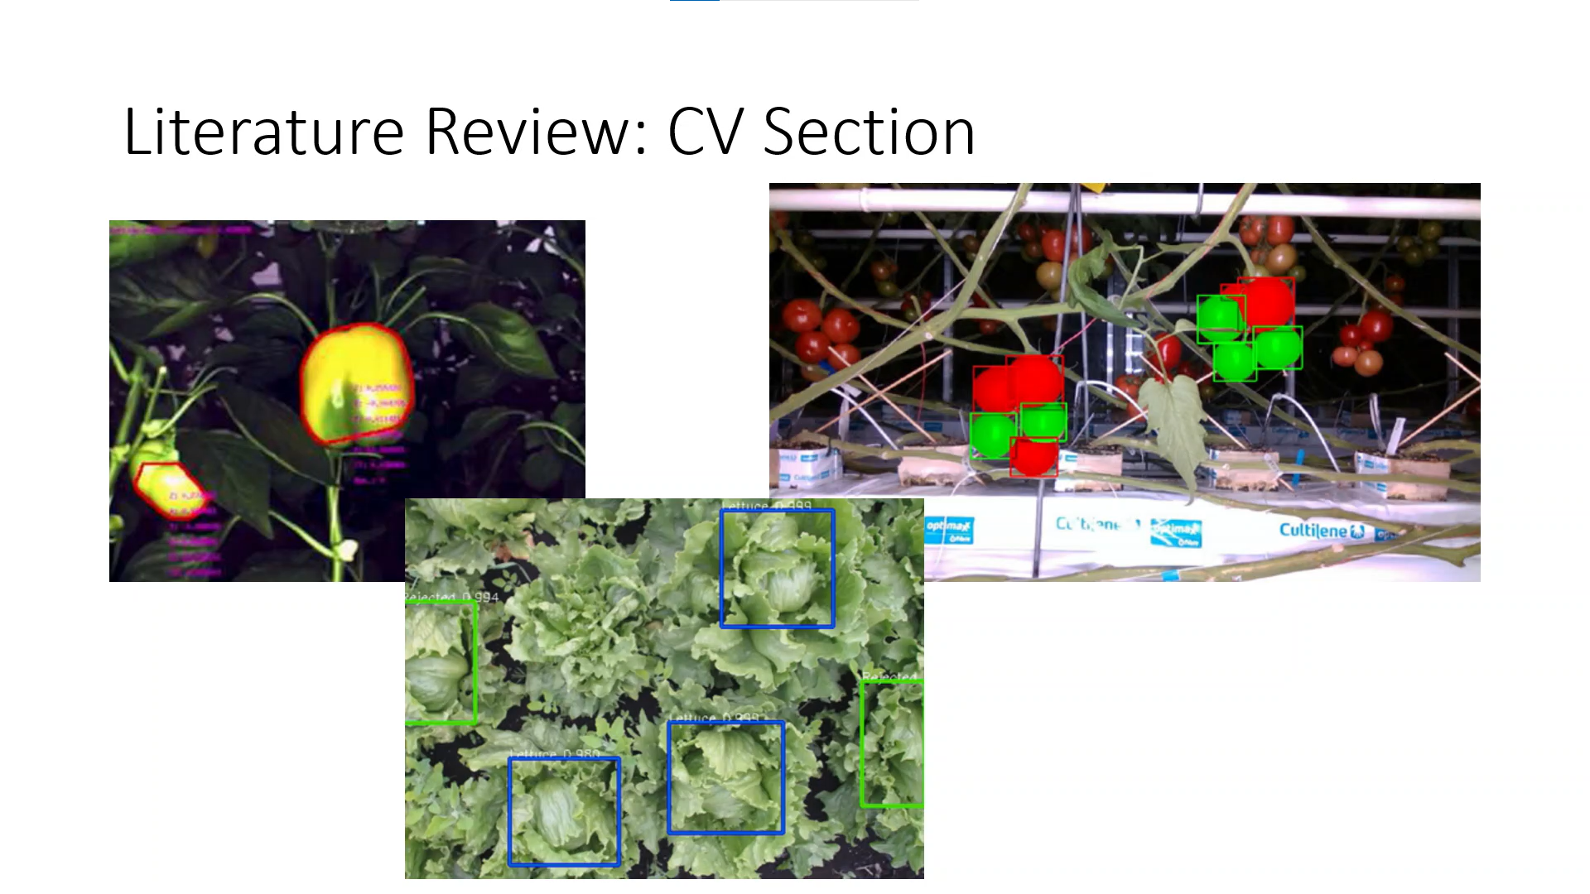

Slide 4
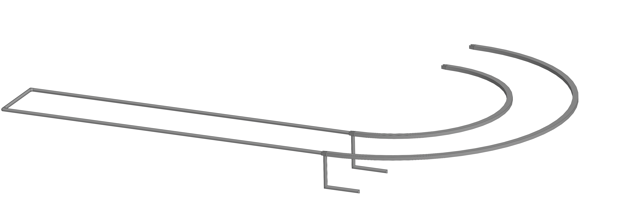
Proposed Method: Rails combined with heating pipes

Slide 5
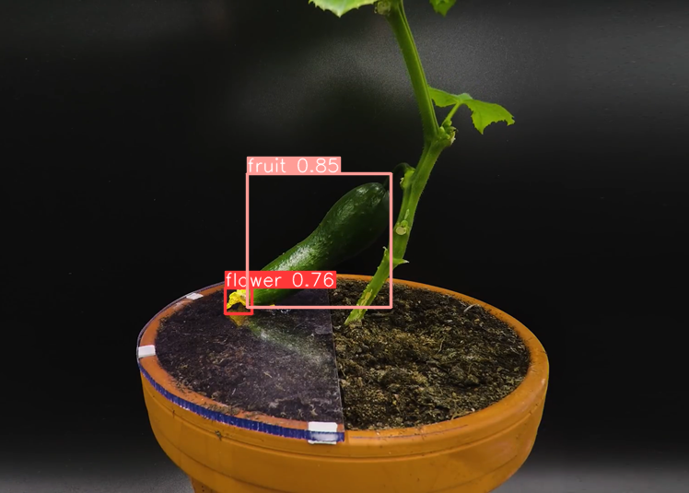
Proposed Method: YOLOv5

Slide 6
References
Grimstad, Lars & Zakaria, Remy & Le, Tuan & From, Pål. (2018). A Novel Autonomous Robot for Greenhouse Applications. 1-9.
Arad, Boaz & Balendonck, Jos & Barth, Ruud & Ben-Shahar, Ohad & Edan, Yael & Hellström, Thomas & Hemming, Jochen & Kurtser, Polina & Ringdahl, Ola & Tielen, Toon & Tuijl, Bart. (2020). Development of a sweet pepper harvesting robot. Journal of Field Robotics. 37.
Heravi, Amid & Ahmad, Desa & Hameed, Ibrahim & Shamshiri, Redmond & Balasundram, Siva & Yamin, Muhammad. (2018). Development of a Field Robot Platform for Mechanical Weed Control in Greenhouse Cultivation of Cucumber.
Rong, Jiacheng & Wang, Pengbo & Yang, Qian & Huang, Feng. (2021). A Field-Tested Harvesting Robot for Oyster Mushroom in Greenhouse. Agronomy.
Wang, L.L. & Zhao, B. & Fan, J.W. & Hu, X.A. & Wei, S. & Li, Y.S. & Zhou, Q.B. & Wei, C.F.. (2017). Development of a tomato harvesting robot used in greenhouse. International Journal of Agricultural and Biological Engineering.
Afonso, Manya & Fonteijn, Hubert & Schadeck Fiorentin, Felipe & Lensink, Dick & Mooij, Marcel & Faber, Nanne & Polder, Gerrit & Wehrens, Ron. (2020). Tomato Fruit Detection and Counting in Greenhouses Using Deep Learning. Frontiers in Plant Science.
Birrell, Simon & Hughes, Josie & Cai, Julia & Iida, Fumiya. (2019). A field‐tested robotic harvesting system for iceberg lettuce. Journal of Field Robotics.

