Slide 1

Neural operators for 2D steady-state diffusion
Geostatistics – 2025 Final project
Instructor: prof. Dmitriy Koroteev
Co-instructor: prof. Denis Orlov
TA: Marsel Ishimbaev.
Students: Ildar Saiapov, Oleg Rakhmatullin,
Dmitriy Kornienko
Skoltech 2025

Slide 2



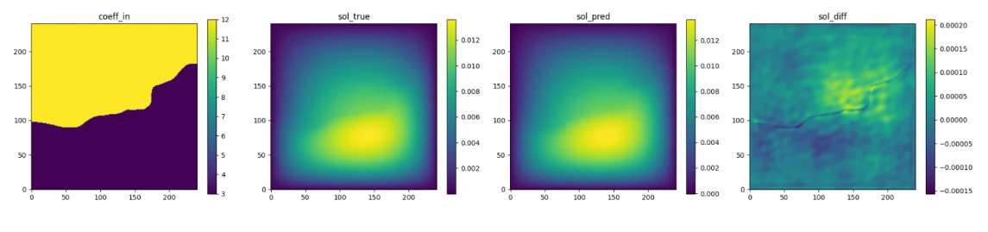
ConDiff dataset
cover a set of PDEs, both steady-state and time-dependent, with different resolutions and time lengths
We consider a 2D steady-state diffusion equation
In our project we have considered the next solvers:
FNO and it`s modified AFNO and IAFNO
DilResNet
CNN + transformer
PITT
(Left to right) Input permeability, true pressure, predicted pressure, error

Slide 3
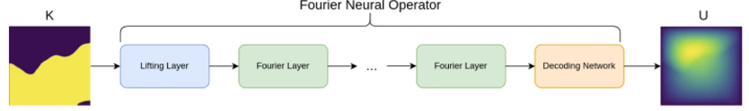


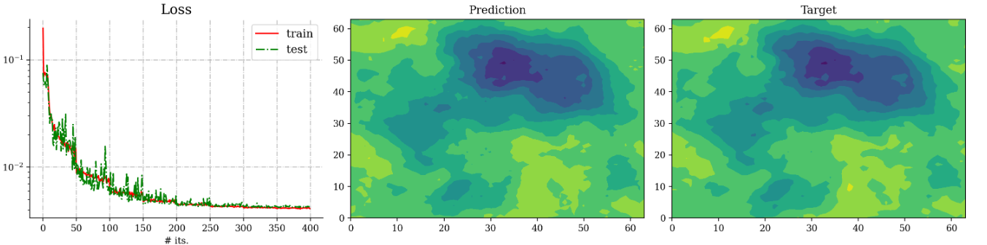
Fourier Neural Operator
Key features
data-driven architecture
the spectral convolutions
skip connections
FNO surrogate model for 2D Darcy flow
1) The spectral convolution (Fourier integral operator)
Result of the training:
2) The FNO model is a the composition of the next:
Decoding network
L spectral convolutions
Lifting” layer

Slide 4
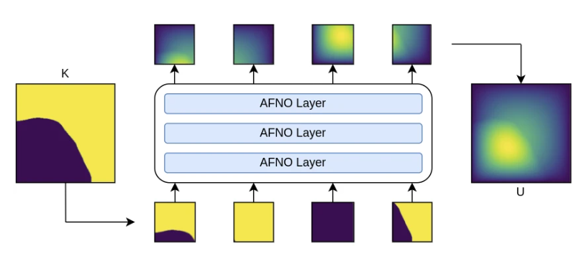




Adaptive Fourier Neural Operator
Key features
For high-resolution inputs
Combines FNO with the Vision Transformer (ViT)
The own self-attention mechanism
The AFNO architecture implements the following operations in each layer:
1) TT transformed in FD
2) Token weighting in FD and promoting sparsity
AFNO surrogate model for 2D Darcy flow
3) The last operation in a ANFO layer is an inverse Fourier to transform back
Result:
Key tuned hyperparameters:
num_blocks
λ (sparsity)
n_layers
….

Slide 5
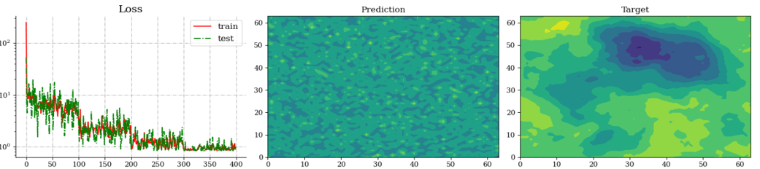
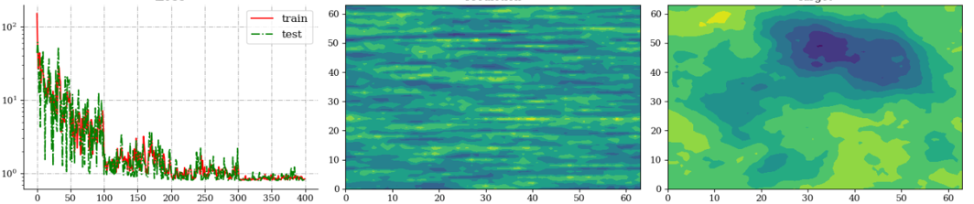
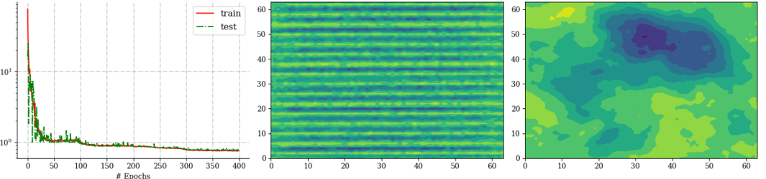

Slide 6
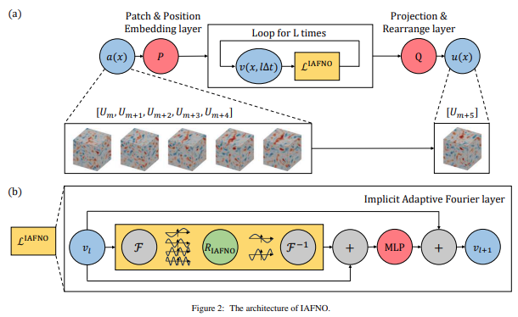


Implicit Adaptive Fourier Neural Operator
Key features
Implicit Adaptive Fourier Layer
Each block runs n_{imp} fixed-point iterations
combining adaptive spectral modes (contrast-driven sparsity) with residual updates
Curriculum learning by contrast
Training starts on low-contrast permeability maps and gradually introduces harder, high-contrast cases
Coefficient-field augmentation
Random flips and transposes on the input maps boost robustness to geometric variations
Define Z₀ = Cᵢₙ(X) For each block l=1…D do: S = Spec(Z_{l−1}); L = Loc(Z_{l−1}); V = S + L; M = MLP(V) T = θ·Z_{l−1} + (1–θ)·M Z_l = N(T) Finally, Y = Cₒᵤₜ(Z_D + Z₀)
Legend: X – input tensor (forcing term + coords) Cᵢₙ – initial 1×1 convolution Spec – adaptive FFT-based spectral convolution Loc – 3×3 local convolution MLP – two 1×1 convolutions with GELU θ – learnable gating scalar N – GroupNorm Cₒᵤₜ – final 1×1 convolution Y – model output
Physics-Informed Loss

Slide 7
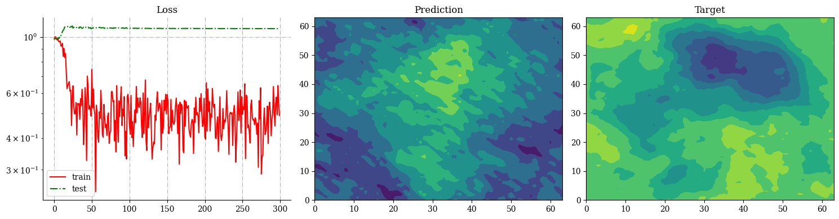
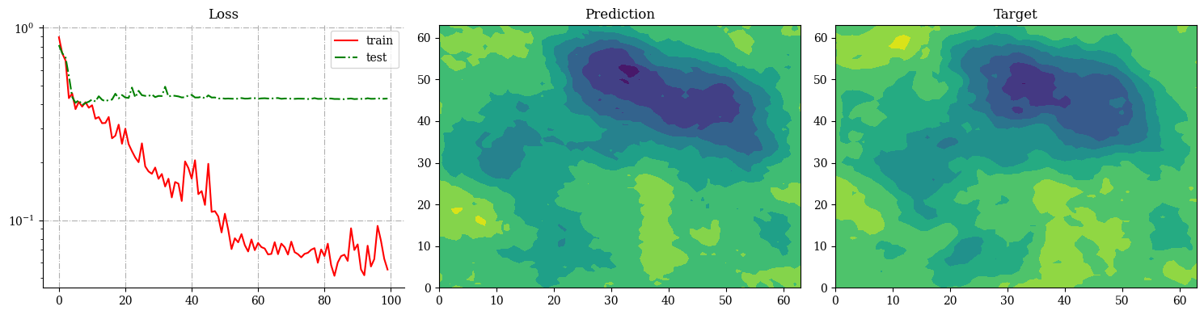
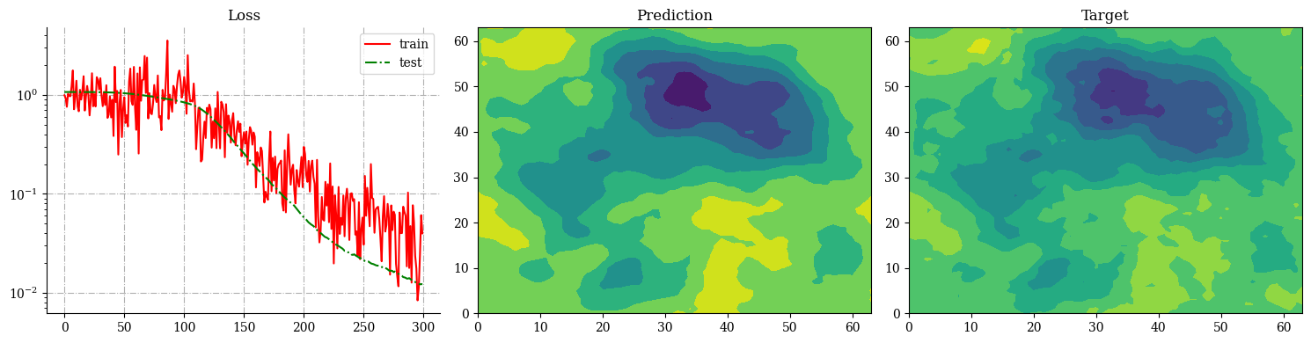
IAFNO test error: 0.676 ± 0.132
IAFNO test error: 0.429 ± 0.155
IAFNO test error: 0.152 ± 0.043

Slide 8
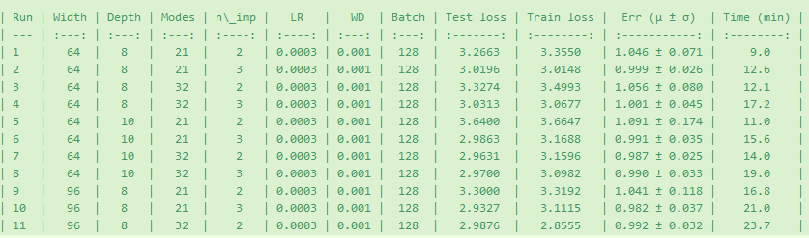

Slide 9
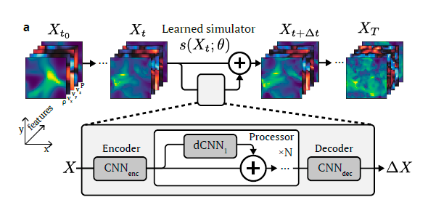
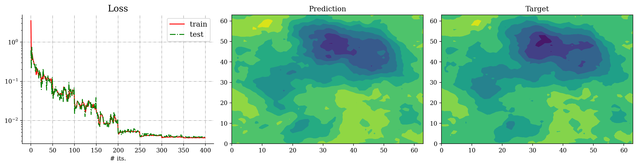
DilResNet
Key features
Extended convolutions to increase the field of perception without increasing the number of parameters.
Residual connections to facilitate deep network training and prevent disappearing gradients.
Architecture:
It consists of several convolutional layers with increasing expansion coefficients
Residual blocks to maintain the flow of gradients.
The final output layer generates a 2D diffusion field.
Result:
Model size: 259841Train relative error: 0.066 ± 0.02, Test relative error: 0.07100000000000001 ± 0.02
Key tuned hyperparameters:
Learning rate: 0.001
Number of epochs: 200
Batch size: 32
Expansion coefficients: 1, 2, 4, 8

Slide 10
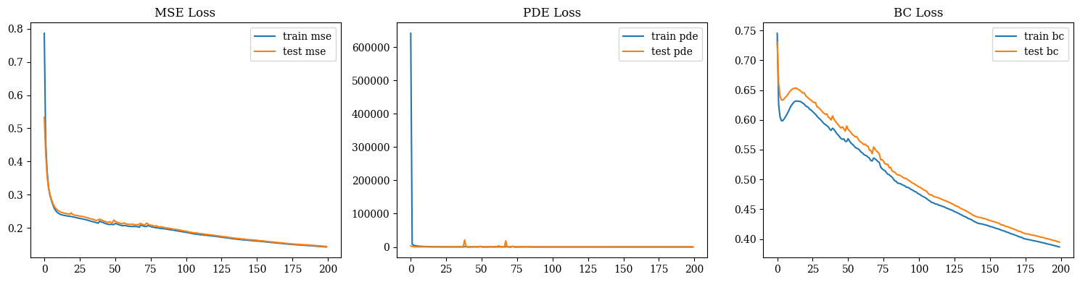
Hybrid neural network
Key features
CNN encoder with bandwidth connections for storing local information.
A transformer with a self-attention mechanism for processing the global context.
Positional coding to account for spatial positions.
Architecture:
CNN encoder: Several convolutional layers with pudding.
Transformer: Layers with self-attention and positional coding.
Decoder: Transposed convolutions with skip connections to restore resolution.
Key tuned hyperparameters:
Learning rate: 0.00005
Number of epochs: 300
Batch size: 32
Number of transformer layers: 5
Result:
Loss curve: loss from 60,000 to ~0 in 50 epochs;
test loss stabilizes at 1,000–2,000
R2: Improves from -80 to -25 in 200 epochs
MAE:Decreases from 0.58 to 0.37 over 200 epochs

Slide 11
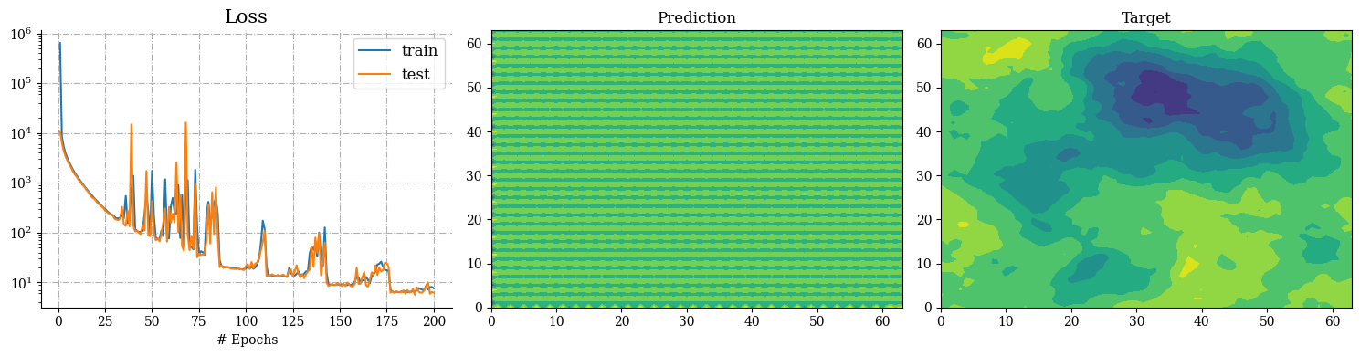

Slide 12
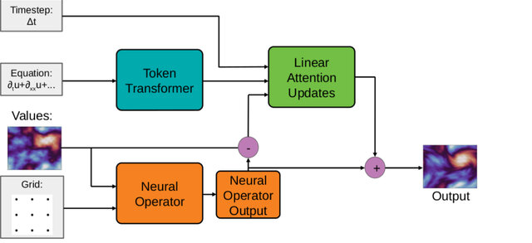
PITT (Physics-Informed Transformer)
Architecture:
Key features
Input Embedding: Conv2d maps 2 input channels (k, rhs) to d_model feature space.
Positional Encoding: Sinusoidal encoding for a 64x64 grid, added to embedded features.
Transformer Encoder: Processes sequences with num_layers layers and nhead attention heads.
Output Projection: Conv2d reduces d_model back to 1 output channel (u).
Physics Loss:
PDE Residual: ∇·(k∇u) – rhs
Boundary Loss: u = 0 at grid edges
Physics-Informed Loss: Incorporates PDE residuals and boundary conditions to align predictions with physical laws.
Transformer Encoder: Employs self-attention to model global dependencies across the grid.
PDE Token: A learnable token encodes PDE-specific information within the Transformer.Positional
Encoding: Adds spatial context to grid-based data using sinusoidal functions.
Key tuned hyperparameters:
Grid Size: 64
d_model: 128
nhead: 8
num_layers: 4
Dropout: 0.0
Learning Rate (lr): 1e-4
Epochs: 150
Batch Size: 8
Weight Decay: 1e-5
Result:
Training Loss: 0.15 (stabilized after 50 epochs)Test Loss: 0.25

Slide 13
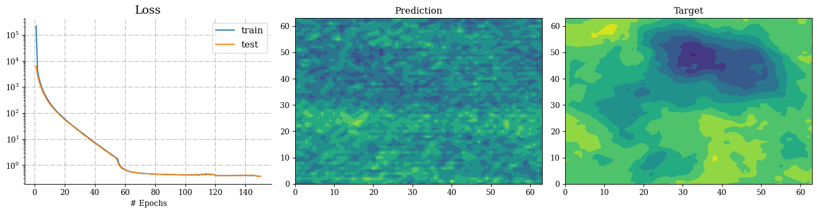
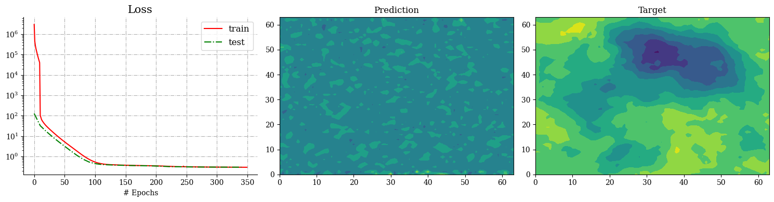
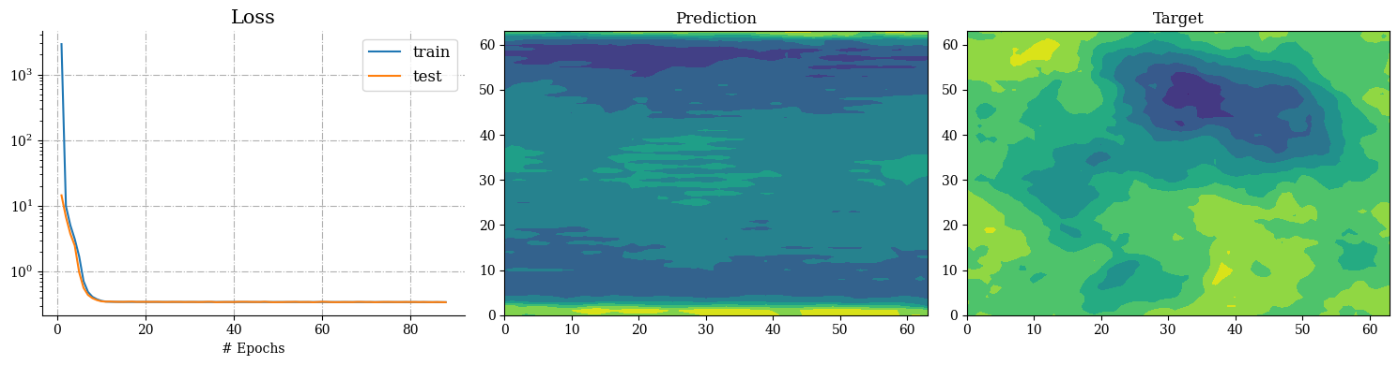

Slide 14
