Slide 1
Knowledge Management
Knowledge Graphs
Oļegs Krivko, Dace Pastore, Patrīcija Zālīte, Anete Siliņa

Slide 2
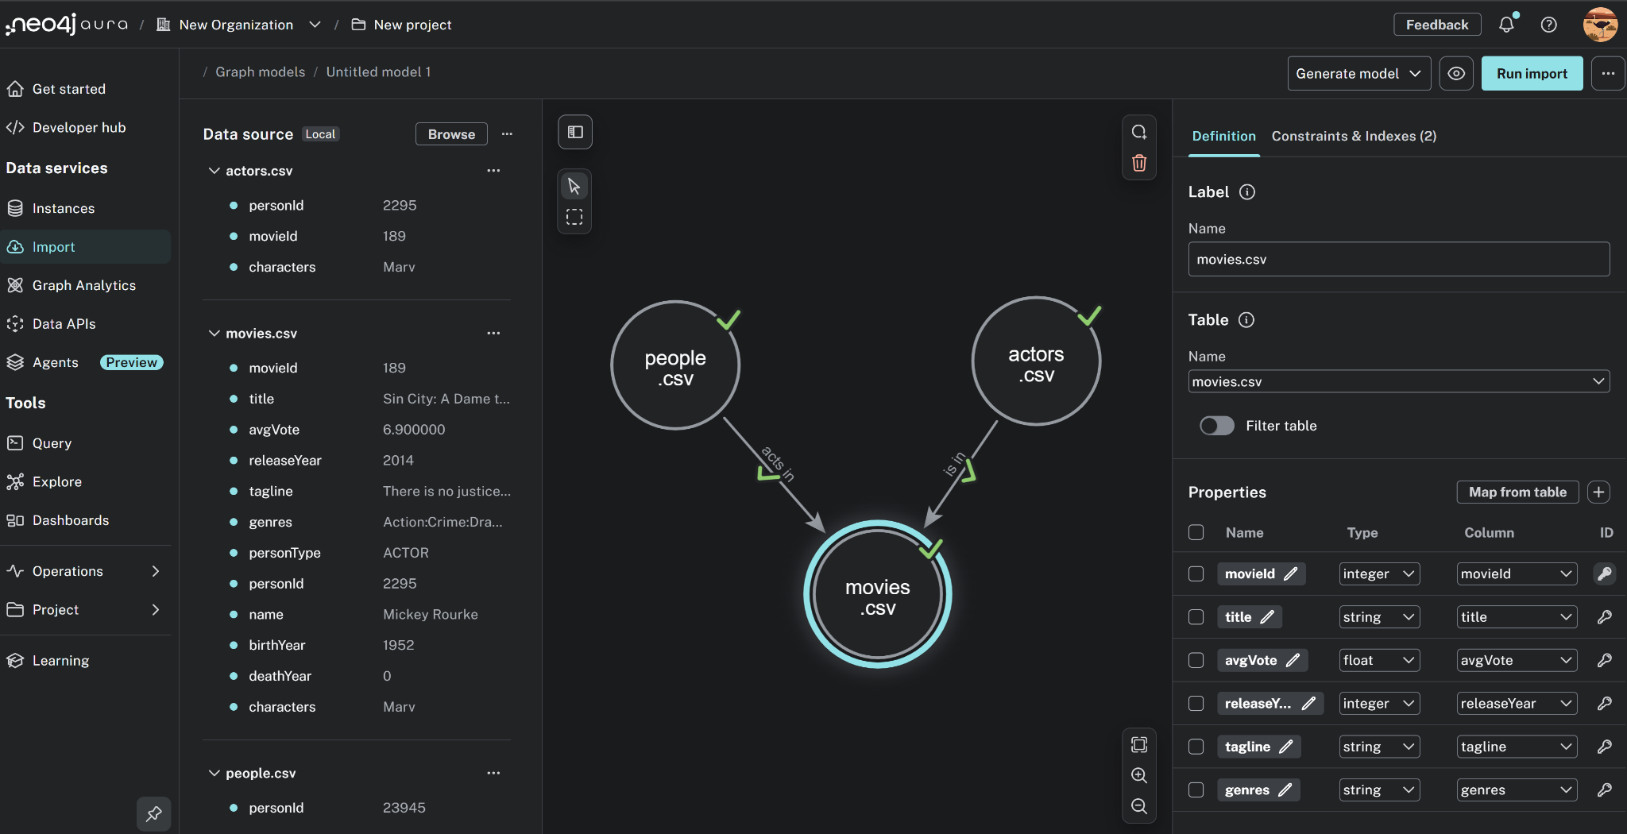

Slide 3

Max View

Slide 4
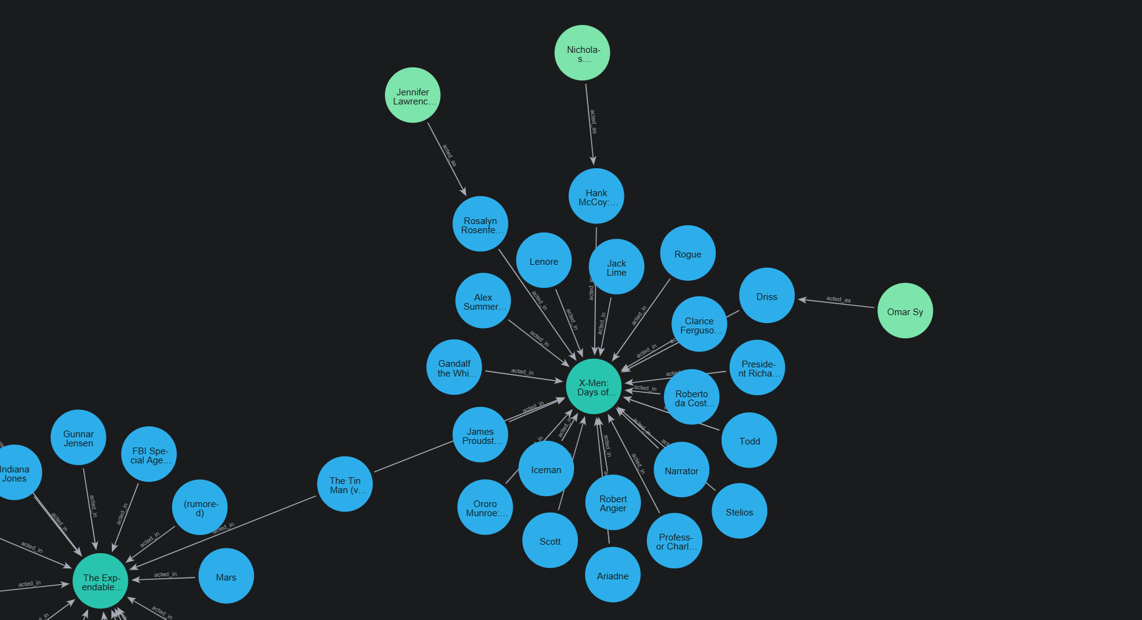
Movie Detail View

Slide 5
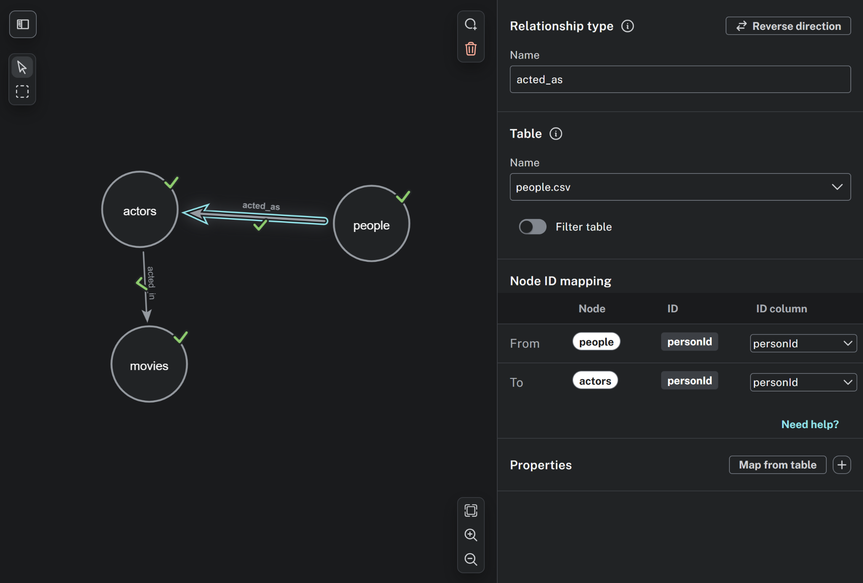
Relation - people -> acted_as -> actors

Slide 6
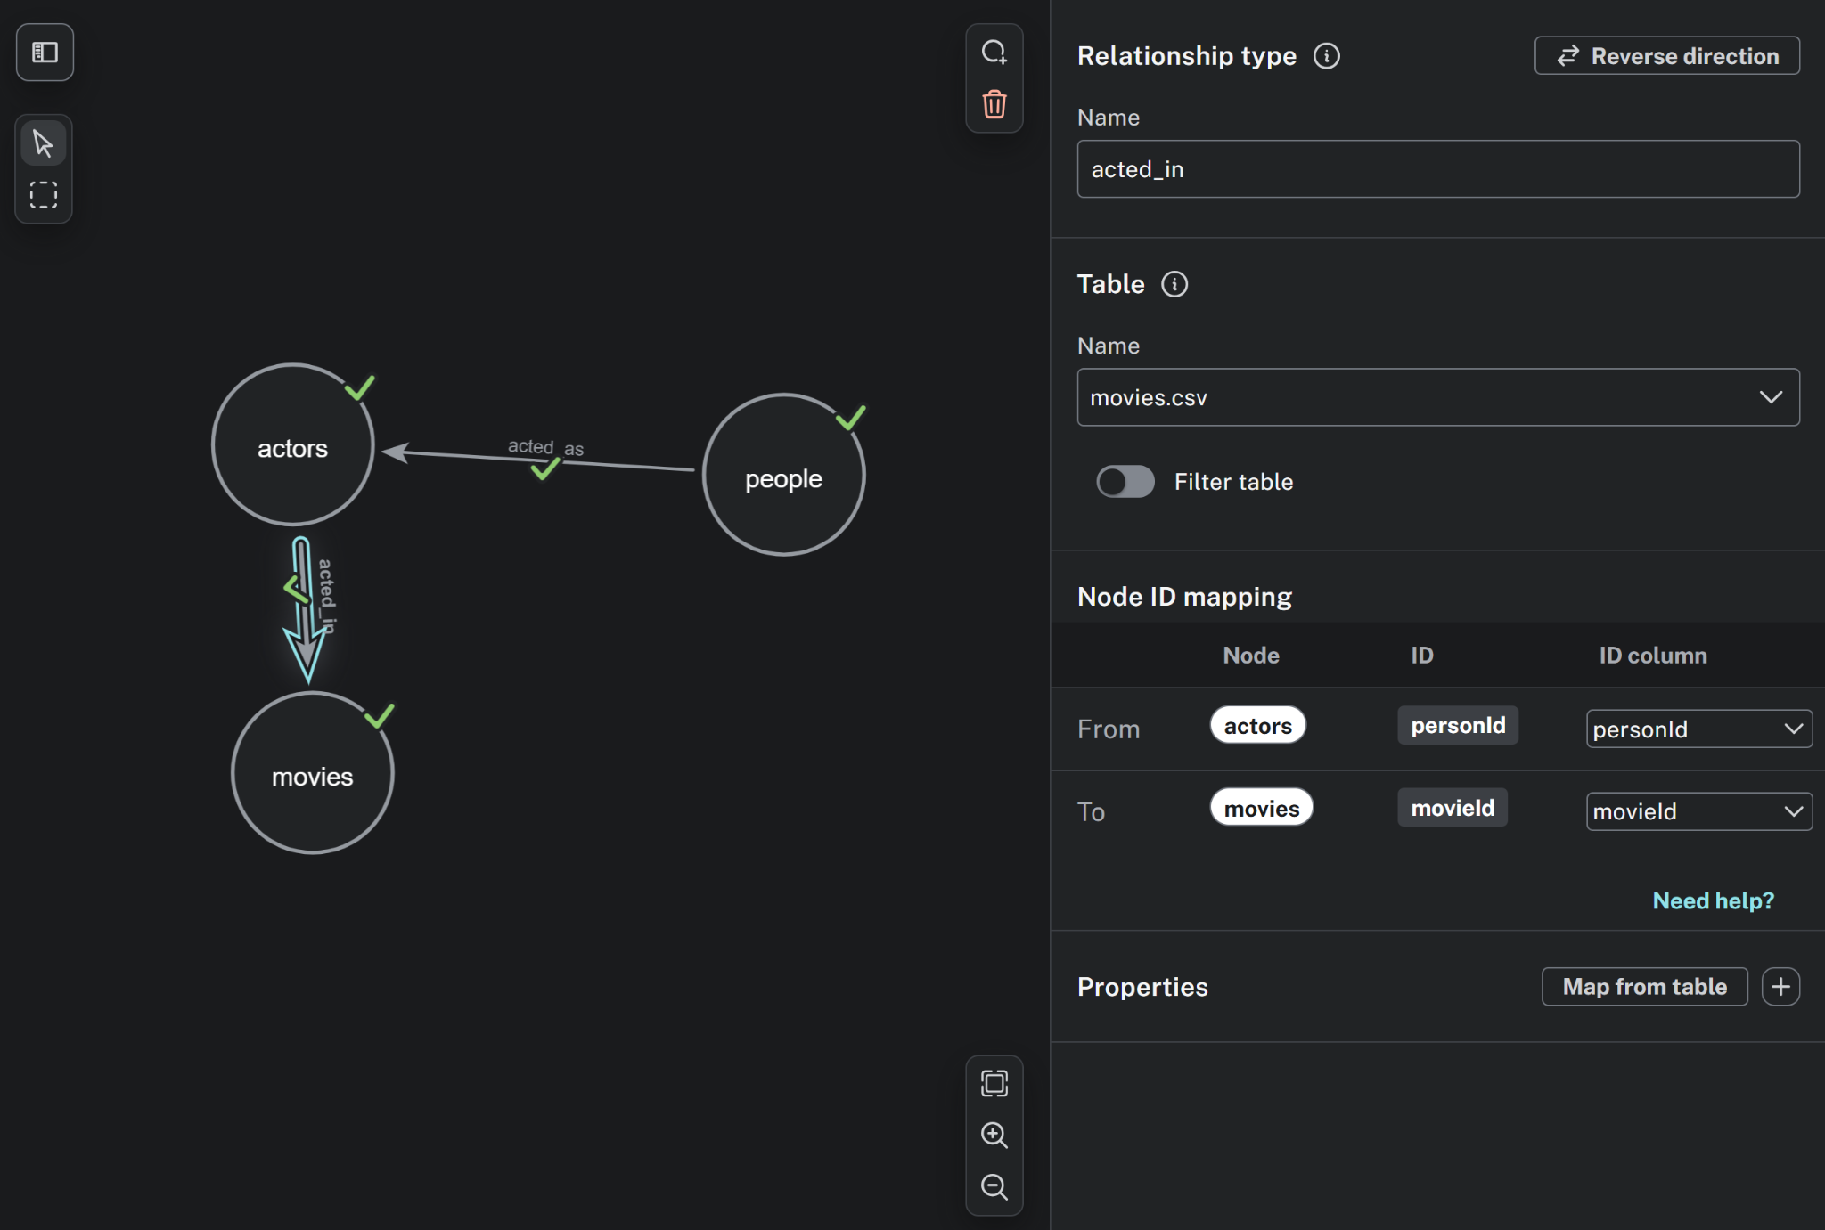
Relation - actors -> acted_in -> movies

Slide 7
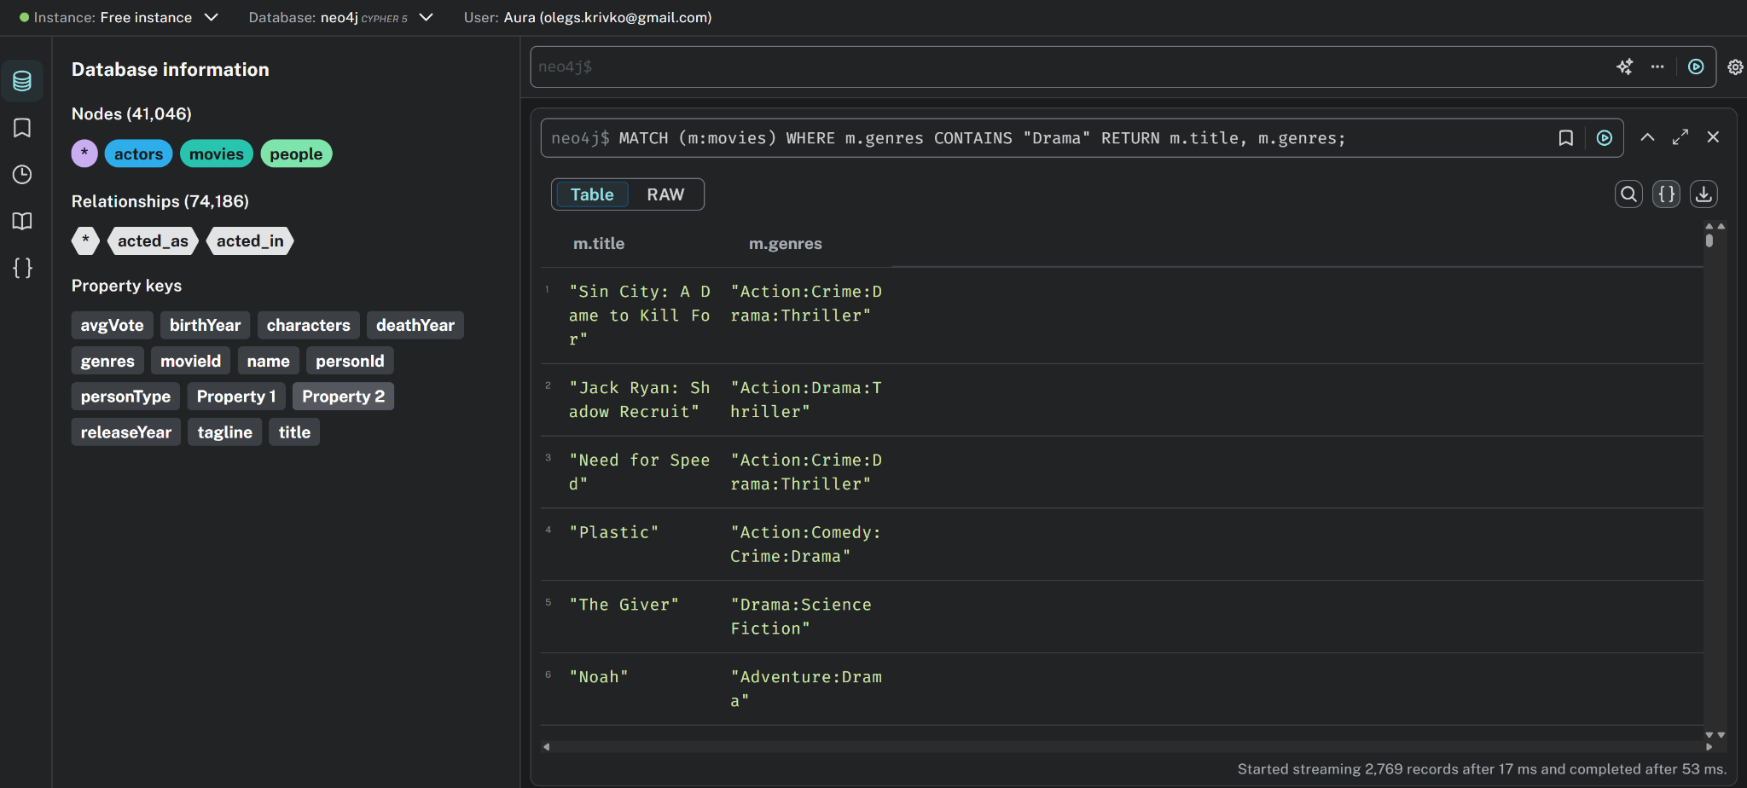
Queries
List all movies that include the genre "Drama"
MATCH (m:movies)
WHERE m.genres CONTAINS "Drama"
RETURN m.title, m.genres;

Slide 8
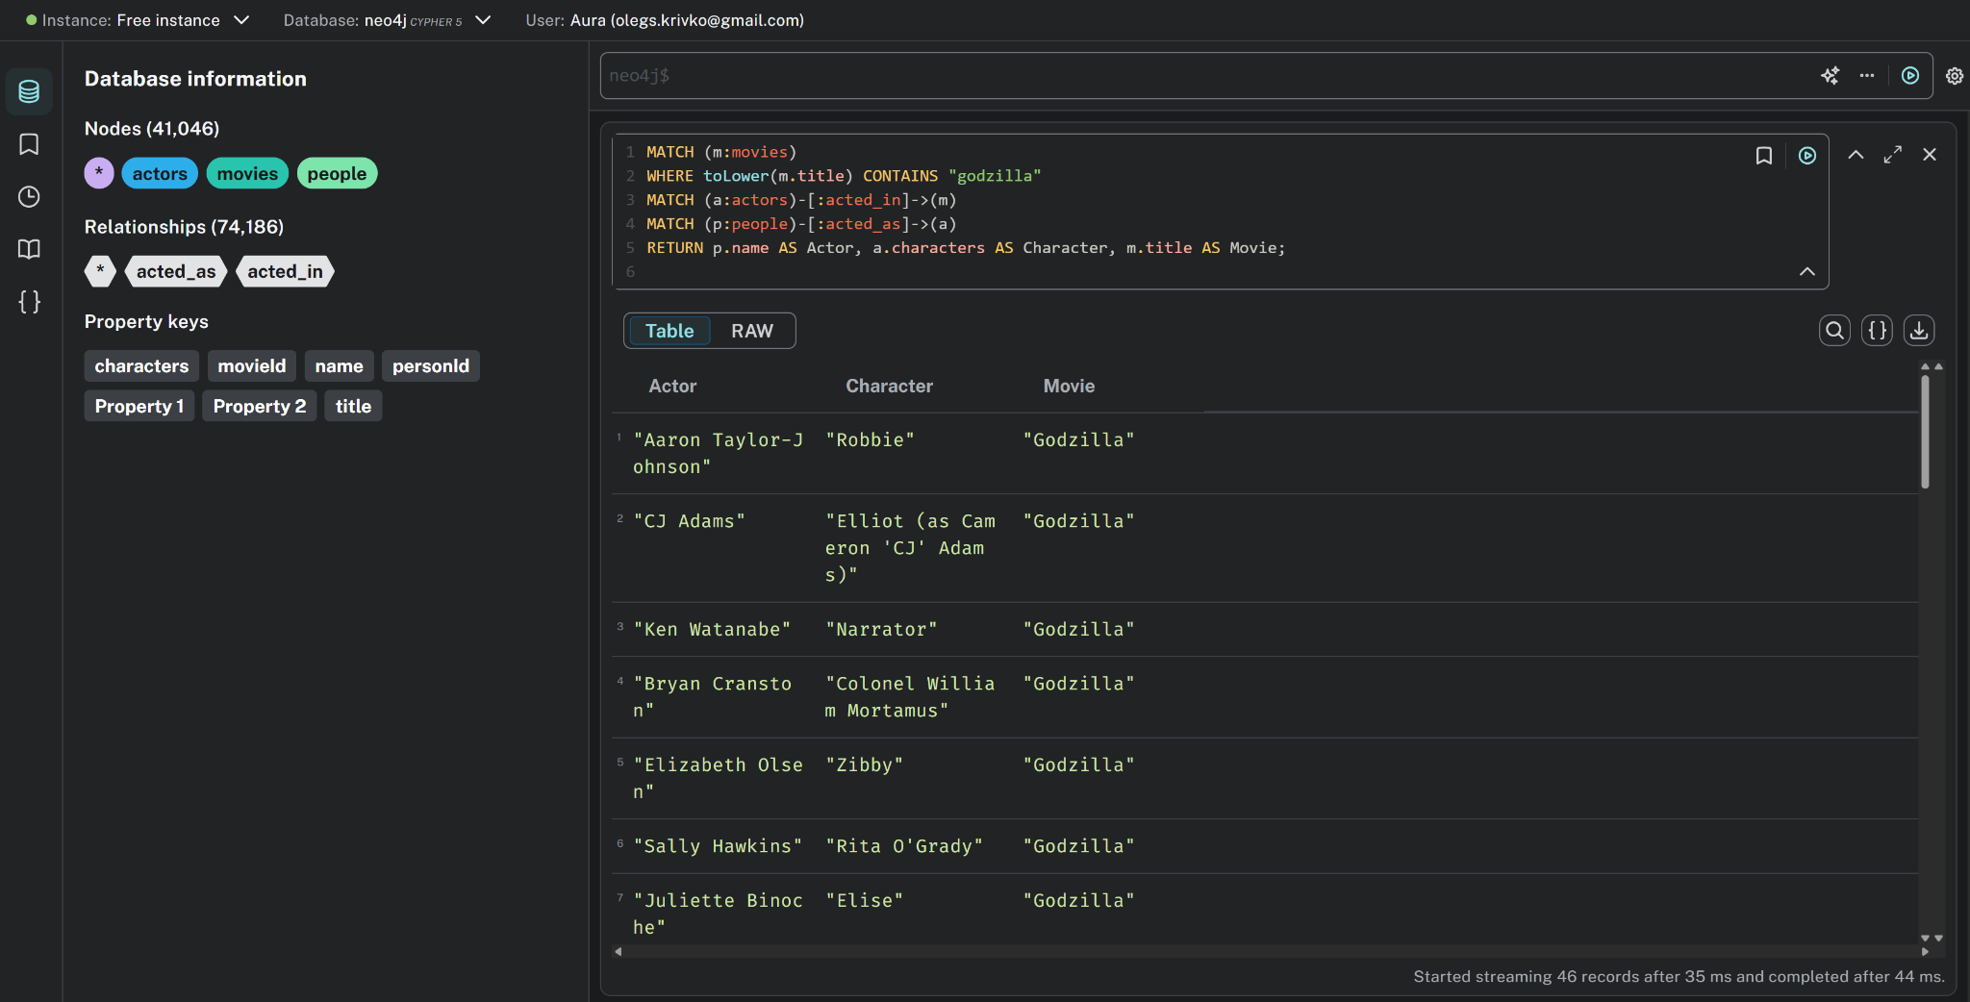
Queries
Find all actors who appeared in movies with "godzilla" in the title (case-insensitive)
MATCH (m:movies)
WHERE toLower(m.title) CONTAINS "godzilla"
MATCH (a:actors)-[:acted_in]->(m)
MATCH (p:people)-[:acted_as]->(a)
RETURN p.name AS Actor, a.characters AS Character, m.title AS Movie;

Slide 9
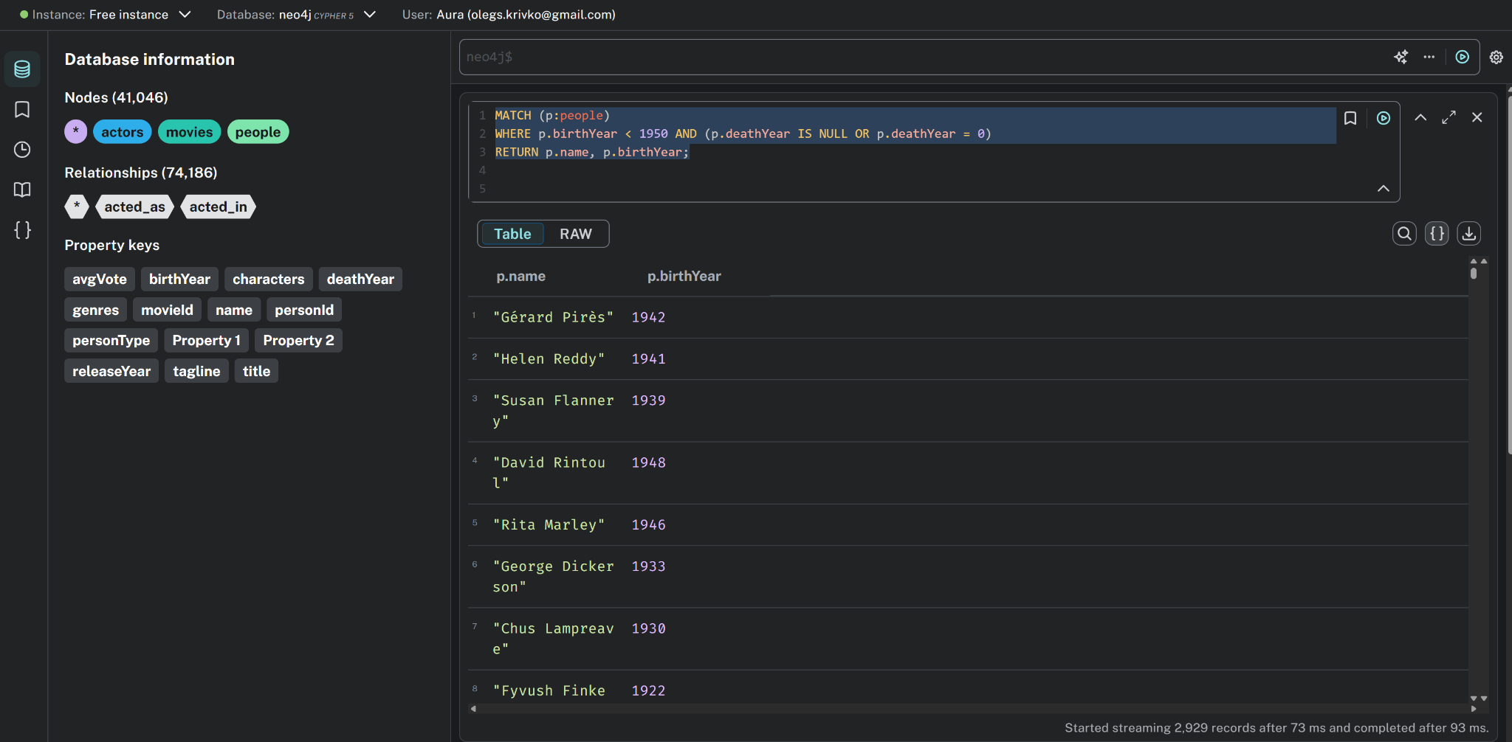
Queries
Find people born before 1950 who are still alive (deathYear is null or 0)
MATCH (p:people)
WHERE p.birthYear < 1950 AND (p.deathYear IS NULL OR p.deathYear = 0)
RETURN p.name, p.birthYear;

Slide 10
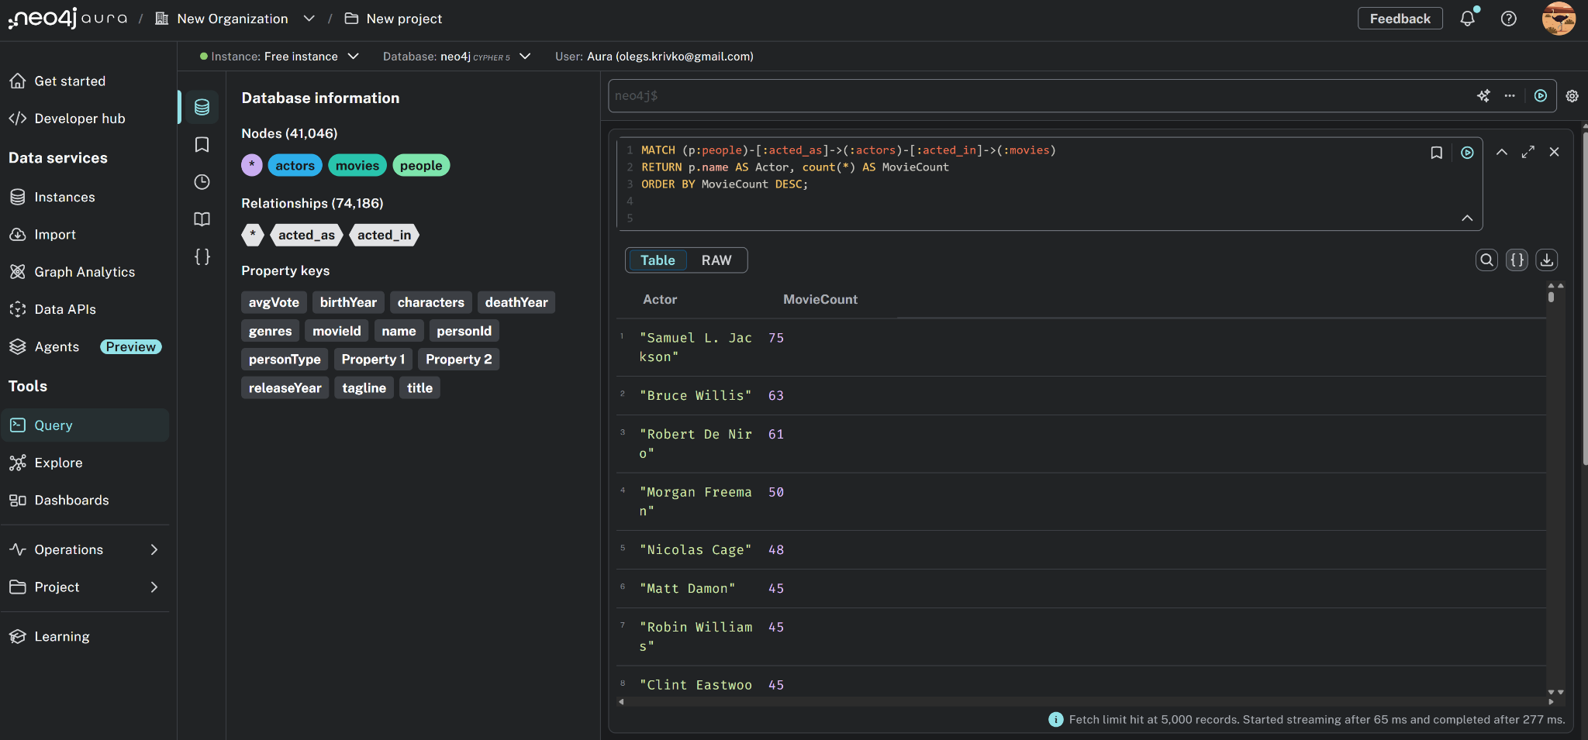
Queries
Count how many movies each person has acted in
MATCH (p:people)-[:acted_as]->(:actors)-[:acted_in]->(:movies)
RETURN p.name AS Actor, count(*) AS MovieCount
ORDER BY MovieCount DESC;

Slide 11
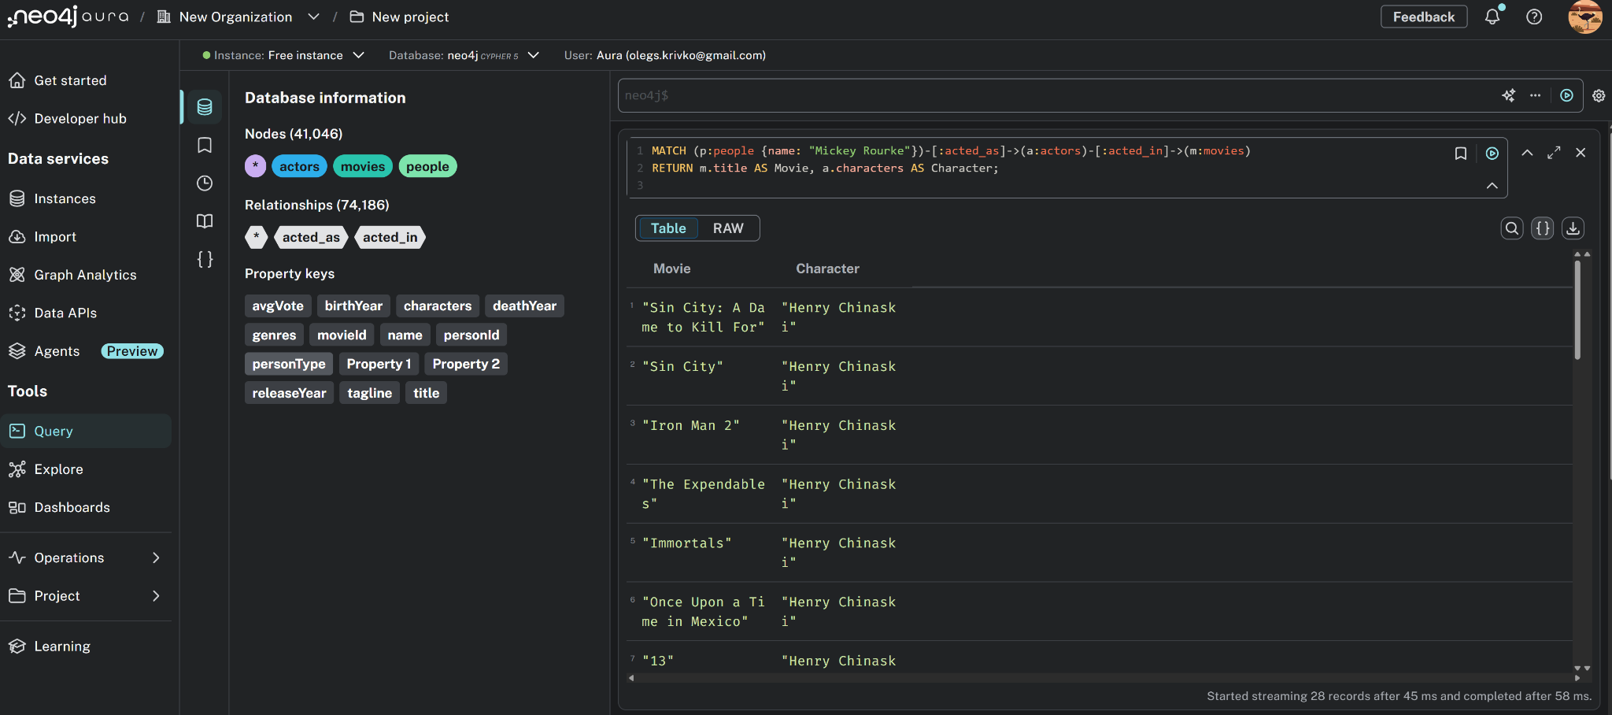
Queries
List all movies Mickey Rourke has acted in, along with the character(s) he played
MATCH (p:people {name: "Mickey Rourke"})-[:acted_as]->(a:actors)-[:acted_in]->(m:movies)
RETURN m.title AS Movie, a.characters AS Character;

Slide 12
Thank You!
Riga Technical University

