Slide 1
Typical network structure at some moment with some nodes in active state
Active
Active
Input nodes
Output nodes

Slide 2
Signal propagation
Executed
E
Result
R
Active
A

Slide 3
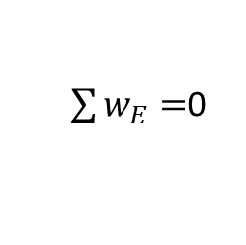
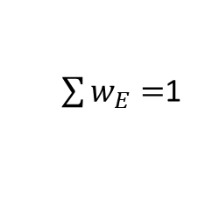
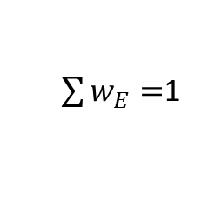
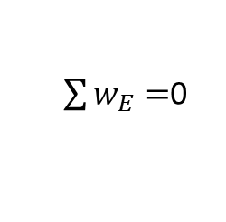
Example 2: ‘ab’ Input ‘a’: signal propagation
Network knowledge:
a → b
b → c
Input: a, b
E
W=1
W=1
A
R
a
b
a
b
c
$\sum{w_{E}}=$1
$\sum{w_{E}}=$0
$\sum{w_{E}}=$0
$\sum{w_{E}}=$1
Preferred output
Preferred output

Slide 4
Sample 1 Adjustment by correct output
Network knowledge:
a → b
b → c
Node becomes active because it was executed in previous iteration and leads to correct output
E
A
→ A
w=1
w=1
A
R
a
b
a
b
c
Correct output
Preferred output

Slide 5
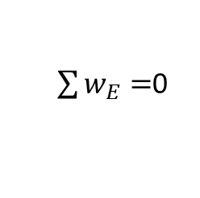
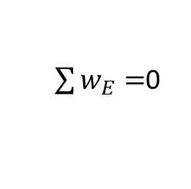
Example 2: ‘aab’ Input ‘a’: signal propagation
Network knowledge:
(a → a) →(a → b), or ‘aa’ →’b’
w=1
E
E
w=0
w=0
A
R
R
a
b
a
b
a
b
a
b
$\sum{w_{E}}=$0
$\sum{w_{E}}=$0
No preferred output

Slide 6
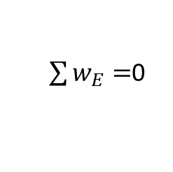
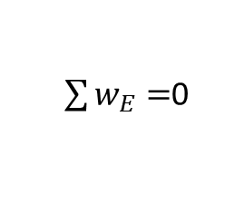
Example 2: ‘aab’ Adjustment by correct output
Network knowledge:
(a → a) →(a → b), or ‘aa’ →’b’
w=1
E
A
E
E → A
w=0
w=0
A
R
R
a
b
a
b
a
b
a
b
$\sum{w_{E}}=$0
$\sum{w_{E}}=$0
Correct output

Slide 7
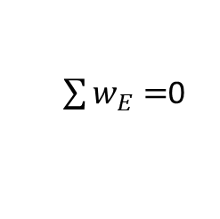
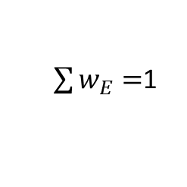
Example 2: ‘aab’ Input ‘a’: signal propagation
Network knowledge:
(a → a) →(a → b), or ‘aa’ →’b’
E
w=1
E
E, R
A, E
A
w=0
w=0
A
R
R
a
b
a
b
a
b
a
b
$\sum{w_{E}}=$0
$\sum{w_{E}}=$1
Preferred output

