Slide 1
Refactoring
by Maksym Zelenin

Slide 2
What is refactoring?
Code refactoring is the controlled process of restructuring existing code without changing its external behavior.

Slide 3
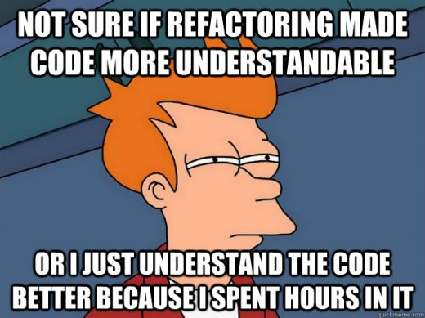
Why you should refactor?
Any fool can write code that a computer can understand. Good programmers write code that humans can understand.
Martin Fowler, 2008.

Slide 4
When to refactor?
Refactor when you add a function
Refactor when you fix a bug
Refactor as you do code review

Slide 5
When you should not refactor?
Easier to start from the beginning
Close to a deadline

Slide 6
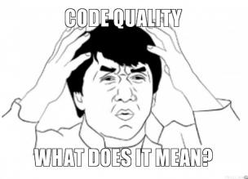
Clean code
is obvious for other programmers;
doesn't contain duplication;
contains a minimal number of classes and other moving parts;
passes all tests;
is easier and cheaper to maintain!

Slide 7
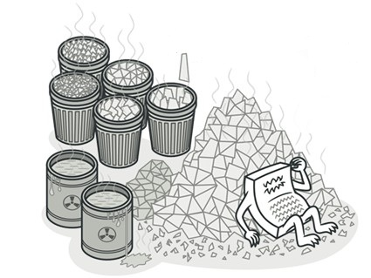
Code smells
– What? How can code "smell"??
– Well it doesn't have a nose... but it definitely can stink!

Slide 8

Code smells: bloaters
Bloaters are code, methods and classes that have increased to such gargantuan proportions that they are hard to work with.

Slide 9
Code smells: bloaters
Long method
Large class
Long parameter list
Data clumps

Slide 10
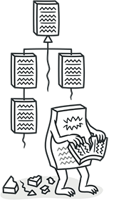
Code smells: Object-Orientation Abusers
All these smells are incomplete or incorrect application of object-oriented programming principles.

Slide 11
Code smells: Object-Orientation Abusers
Alternative Classes with Different Interfaces
Refused Bequest
Temporary Field
Switch Statements

Slide 12

Code smells: Change Preventers
These smells mean that if you need to change something in one place in your code, you have to make many changes in other places too.

Slide 13
Code smells: Change Preventers
Divergent Change
Parallel Inheritance Hierarchies
Shotgun Surgery

Slide 14
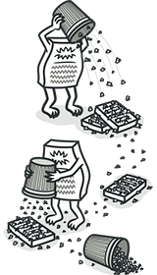
Code smells: Dispensables
A dispensable is something pointless and unneeded whose absence would make the code cleaner, more efficient and easier to understand.

Slide 15
Code smells: Dispensables
Comments
Duplicate Code
Data Class
Dead code

Slide 16
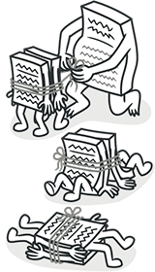
Code smells: Couplers
All the smells in this group contribute to excessive coupling between classes or show what happens if coupling is replaced by excessive delegation.

Slide 17
Code smells: Couplers
Feature Envy
Inappropriate Intimacy
Message chains (object.method_1().method_2().method_3())
Middle man (If a class performs only one action, delegating work to another class, why does it exist at all?)

Slide 18

Refactoring Techniques: Composing methods
The refactoring techniques in this group streamline methods, remove code duplication, and pave the way for future improvements.

Slide 19
Composing methods: Extract method
Problem
You have a code fragment, that
can be grouped together.
void printOwing() {
printBanner();
//print details
System.out.println("name: " + name);
System.out.println("amount: " + getOutstanding());
}
Solution
Move this code to a separate new
method (or function) and replace
the old code with a call to the
method.
void printOwing() {
printBanner(); printDetails(getOutstanding());
}
void printDetails(double outstanding) { System.out.println("name: " + name); System.out.println("amount: " + outstanding);
}

Slide 20
Composing methods: Inline method
Problem
When a method body is more
obvious than the method itself,
use this technique.
class PizzaDelivery {
//...
int getRating() {
return moreThanFiveLateDeliveries() ? 2 : 1;
}
boolean moreThanFiveLateDeliveries() {
return numberOfLateDeliveries > 5;
}}
Solution
Replace calls to the method with
the method's content and delete
the method itself.
class PizzaDelivery {
//...
int getRating() {
return numberOfLateDeliveries > 5 ? 2 : 1; }
}

Slide 21
Composing methods:
Split Temporary Variable
Problem
You have a local variable that is
used to store various
intermediate values inside a
method (except for cycle
variables).
double temp = 2 * (height + width);
System.out.println(temp); temp = height * width;
System.out.println(temp);
Solution
Use different variables for
different values. Each variable
should be responsible for only
one particular thing.
final double perimeter = 2 * (height + width);
System.out.println(perimeter);
final double area = height * width;
System.out.println(area);

Slide 22
Composing methods:
Remove Assignments to Parameters
Problem
Some value is assigned to a
parameter inside method's body.
int discount(int inputVal, int quantity) {
If (inputVal > 50) {
InputVal -= 2;
}
//...
}
Solution
Use a local variable instead of a
parameter.
int discount(int inputVal, int quantity) {
int result = inputVal;
if (inputVal > 50) {
result -= 2;
}
//...
}

Slide 23
Composing methods:
Replace Method with Method Object
Problem
You have a long method in which
the local variables are so
intertwined that you cannot apply
[Extract Method].
class Order {
//...
public double price() {
double primaryBasePrice;
double secondaryBasePrice;
double tertiaryBasePrice;
// long computation.
//...
}
}

Slide 24
Composing methods:
Replace Method with Method Object
Solution
Transform the method into a
separate class so that the local
variables become fields of the
class. Then you can split the
method into several methods
within the same class.
class Order {
//...
public double price() {
return new PriceCalculator(this).compute();
}
}
class PriceCalculator {
private double primaryBasePrice;
private double secondaryBasePrice;
private double tertiaryBasePrice;
public PriceCalculator(Order order) {
// copy relevant information from order object. //...
}
public double compute() {
// long computation.
//...
}
}

Slide 25
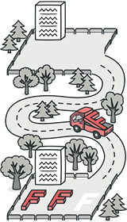
Refactoring Techniques: Moving Features between Objects
These refactoring techniques show how to safely move functionality between classes, create new classes, and hide implementation details from public access.

Slide 26
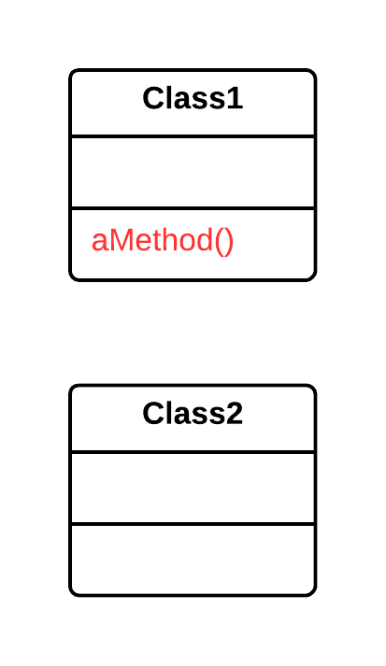
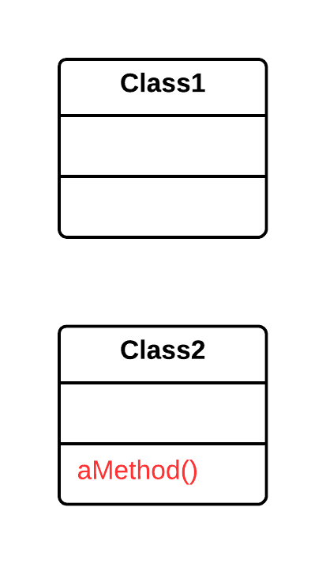
Moving features between objects: Move Method/Field
Problem
A method/field is used more in another class than in its own class.
Solution
Create a new method/field in the class that uses the method/field the most, then move code from the old method to there.

Slide 27
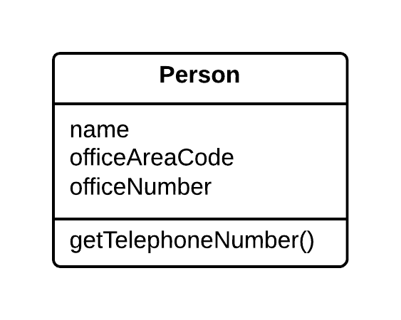
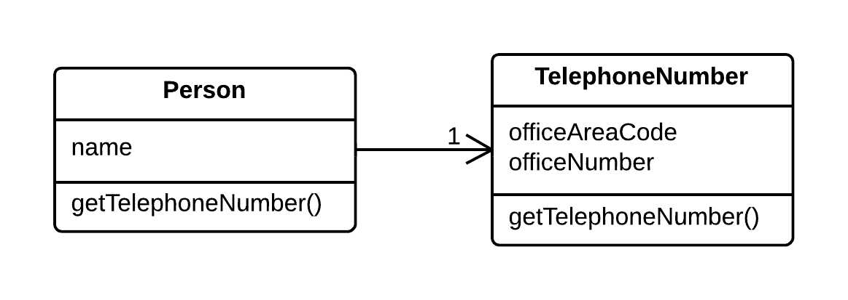
Moving features between objects: Extract class (opposite Inline Class)
Problem
When one class does the work of two, awkwardness results.
Solution
Instead, create a new class and place the fields and methods responsible for the relevant functionality in it.

Slide 28
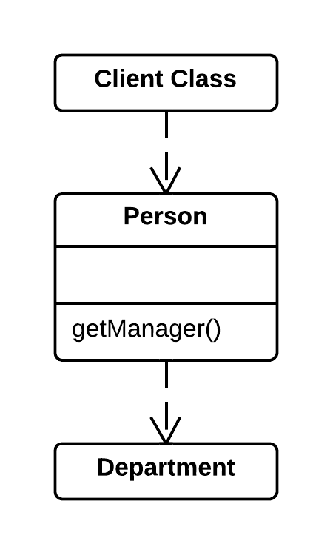
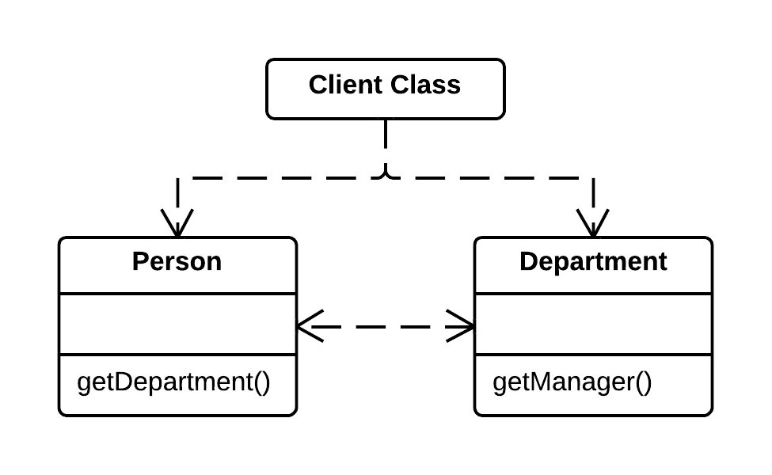
Moving features between objects: Hide Delegate(opposite Remove The Middle Man)
Problem
The client gets object B from a field or method of object А. Then the client calls a method of object B.
Solution
Create a new method in class A that delegates the call to object B. Now the client does not know about, or depend on, class B.

Slide 29
Moving features between objects: Introduce Foreign Method
Problem
A utility class does not contain
the method that you need and
you cannot add the method to
the class.
class Report {
//...
void sendReport() {
Date nextDay = new Date(previousEnd.getYear(), previousEnd.getMonth(), previousEnd.getDate() + 1);
//...
}
}
Solution
Add the method to a client class
and pass an object of the utility
class to it as an argument.
class Report {
//...
void sendReport() {
Date newStart = nextDay(previousEnd);
//...
}
private static Date nextDay(Date arg) {
return new Date(arg.getYear(), arg.getMonth(), arg.getDate() + 1);
}
}

Slide 30
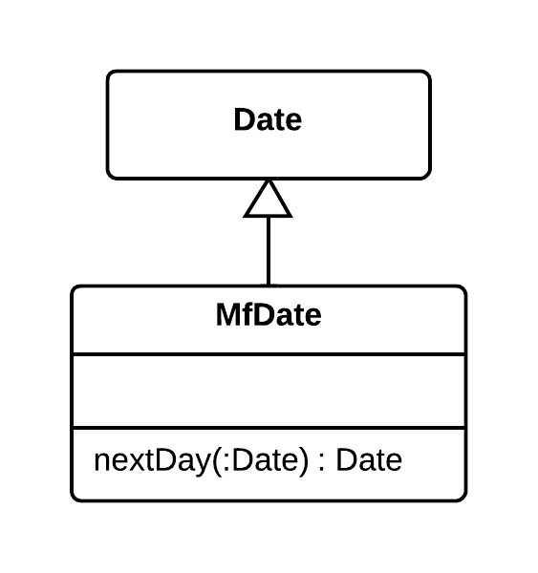
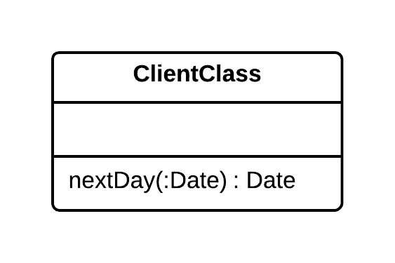
Moving features between objects: Introduce Local Extension
Problem
A utility class does not contain some methods that you need. But you cannot add these methods to the class.
Solution
Create a new class containing the methods and make it either the child or wrapper of the utility class.

Slide 31

Refactoring Techniques: Organizing Data
These refactoring techniques help with data handling, replacing primitives with rich class functionality. Another important result is untangling of class associations, which makes classes more portable and reusable.

Slide 32
Organizing Data: Self Encapsulate Field
Problem
You use direct access to private
fields inside a class.
class Range {
private int low, high;
boolean includes(int arg) {
return arg >= low && arg <= high;
}
}
Solution
Create a getter and setter for the
field, and use only them for
accessing the field.
class Range {
private int low, high;
boolean includes(int arg) {
return arg >= getLow() && arg <=getHigh();
}
int getLow() {
return low;
}
int getHigh() {
return high;
}
}

Slide 33
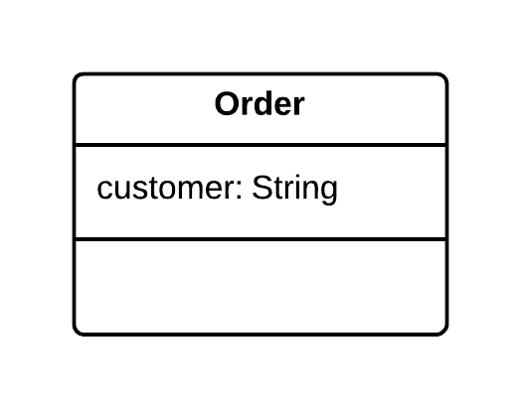
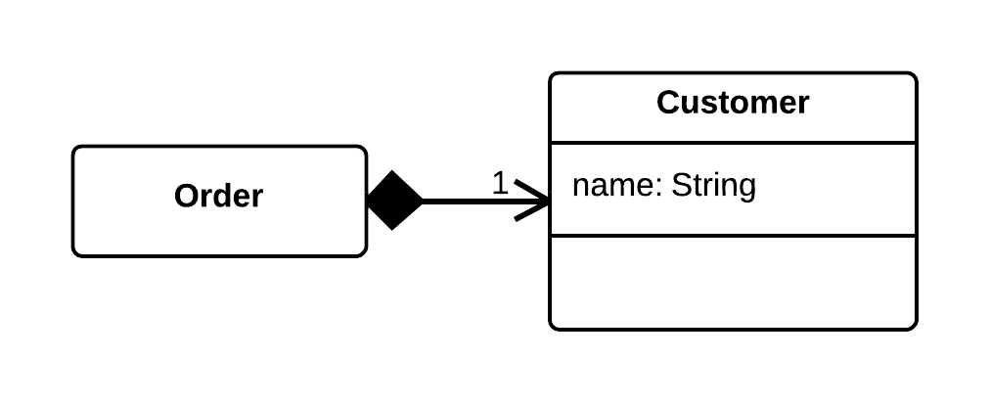
Organizing Data: Replace Data Value with Object
Problem
A class (or group of classes) contains a data field. The field has its own behavior and associated data.
Solution
Create a new class, place the old field and its behavior in the class, and store the object of the class in the original class.

Slide 34
Organizing Data: Replace Magic Number with Symbolic Constant
Problem
Your code uses a number that
has a certain meaning to it.
double potentialEnergy(double mass, double height) {
return mass * height * 9.81;
}
Solution
Replace this number with a
constant that has a human-
readable name explaining the
meaning of the number.
static final double GRAVITATIONAL_CONSTANT = 9.81;
double potentialEnergy(double mass, double height) {
return mass * height * GRAVITATIONAL_CONSTANT;
}

Slide 35
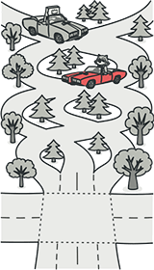
Refactoring Techniques: Simplifying Conditional Expressions
Conditionals tend to get more and more complicated in their logic over time, and there are yet more techniques to combat this as well.

Slide 36
Simplifying Conditional Expressions : Decompose Conditional
Problem
You have a complex conditional
(`if-then`/`else` or `switch`).
if (date.before(SUMMER_START) || date.after(SUMMER_END)) {
charge = quantity * winterRate +
winterServiceCharge;
} else {
charge = quantity * summerRate;
}
Solution
Decompose the complicated
parts of the conditional into
separate methods: the condition,
`then` and `else`.
if (notSummer(date)) {
charge = winterCharge(quantity);
} else {
charge = summerCharge(quantity);
}

Slide 37
Simplifying Conditional Expressions : Consolidate Conditional Expression
Problem
You have multiple conditionals
that lead to the same result or
action.
double disabilityAmount() {
  if (seniority < 2) {
  return 0;
  }
  if (monthsDisabled > 12) {
  return 0;
  }
  if (isPartTime) {
  return 0;
  }
  // compute the disability amount
  //...
}
Solution
Consolidate all these conditionals
in a single expression.
double disabilityAmount() {
if (isNotEligableForDisability()) {
return 0;
}
/ compute the disability amount
//...
}

Slide 38
Simplifying Conditional Expressions : Remove Control Flag
Problem
You have a boolean variable that acts as a control flag for
multiple boolean expressions.
Solution
Instead of the variable, use `break`, `continue` and `return`.
How to Refactor
Find the value assignment to the control flag that causes the exit from the loop or current iteration.
Replace it with break, if this is an exit from a loop; continue, if this is an exit from an iteration, or return, if you need to return this value from the function.
Remove the remaining code and checks associated with the control flag.

Slide 39
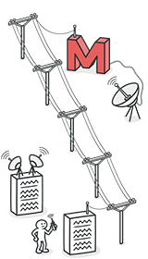
Refactoring Techniques: Simplifying Method Calls
These techniques make method calls simpler and easier to understand. This, in turn, simplifies the interfaces for interaction between classes.

Slide 40
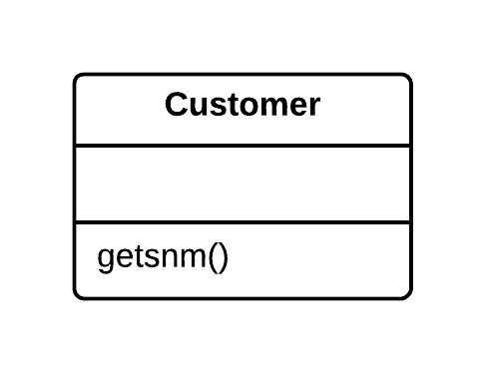
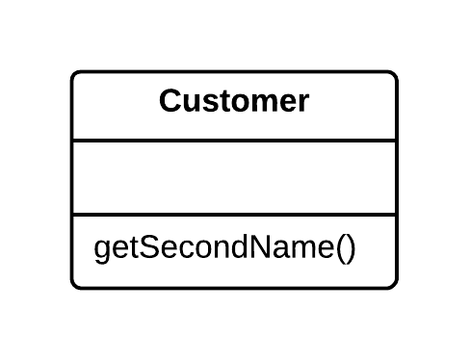
Simplifying Method Calls: Rename Method
Problem
The name of a method does not explain what the method does.
Solution
Rename the method.

Slide 41
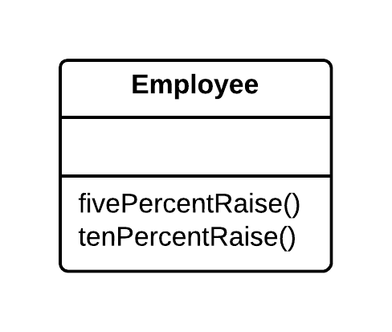
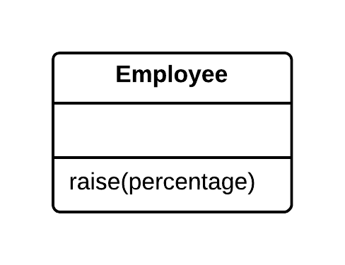
Simplifying Method Calls: Parametrize Method
Problem
Multiple methods perform similar actions that are different only in their internal values, numbers or operations.
Solution
Combine these methods by using a parameter that will pass the necessary special value.

Slide 42
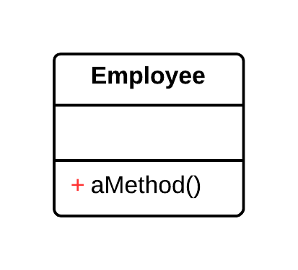
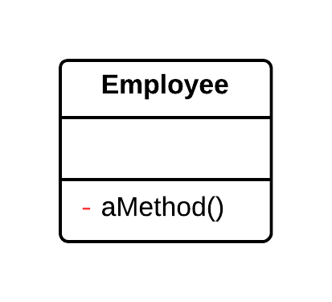
Simplifying Method Calls: Hide Method
Problem
A method is not used by other classes or is used only inside its own class hierarchy.
Solution
Make the method private or protected.

Slide 43
Simplifying Method Calls : Replace Error Code with Exception
Problem
A method returns a special value
that indicates an error?
int withdraw(int amount) {
if (amount > _balance) {
return -1;
} else {
balance -= amount;
return 0;
}
}
Solution
Throw an exception instead.
void withdraw(int amount) throws BalanceException {
if (amount > _balance) {
throw new BalanceException();
}
balance -= amount;
}

Slide 44
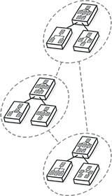
Refactoring techniques: Dealing with Generalization
Abstraction has its own group of refactoring techniques, primarily associated with moving functionality along the class inheritance hierarchy, creating new classes and interfaces, and replacing inheritance with delegation.

Slide 45
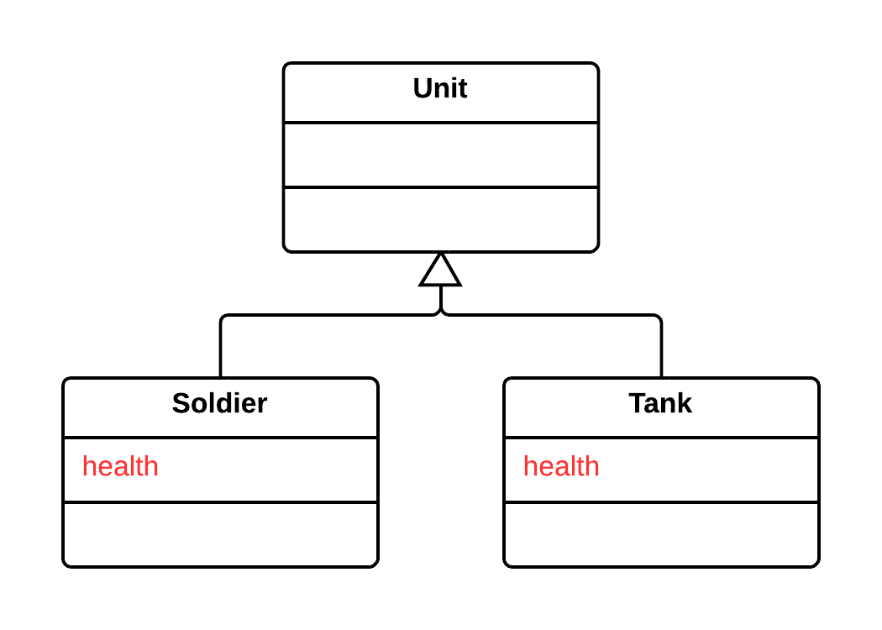
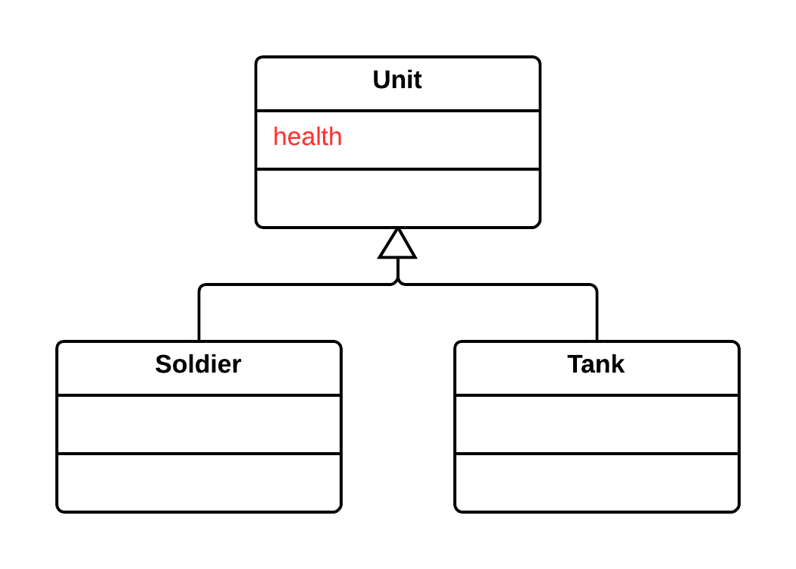
Dealing with Generalization : Pull Up Field/Method
Problem
Two classes have the same field/method.
Solution
Remove the field/mehtod from subclasses and move it to the superclass.

Slide 46
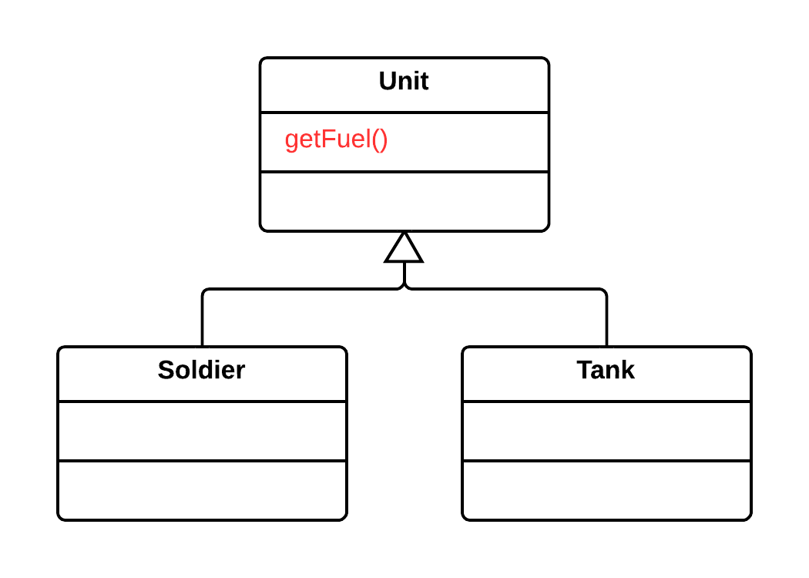
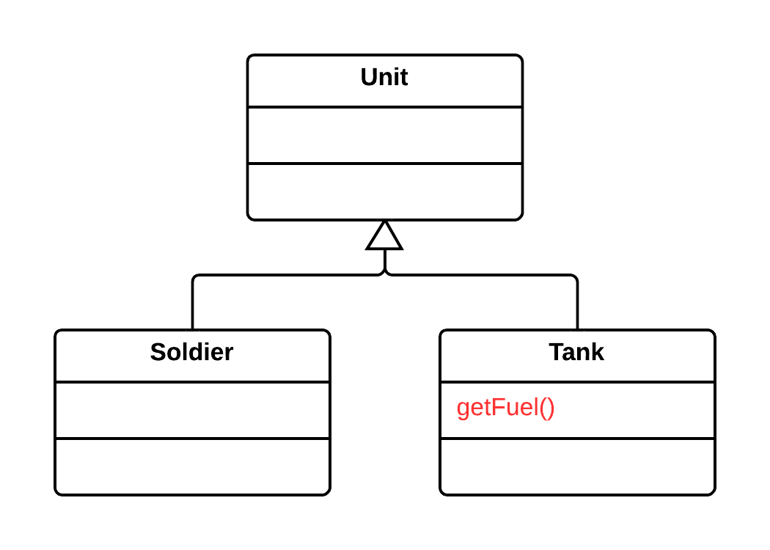
Dealing with Generalization : Push Down Method/Field
Problem
Is behavior implemented in a superclass used by only one (or a few) subclasses?
Solution
Move this behavior to the subclasses.

Slide 47
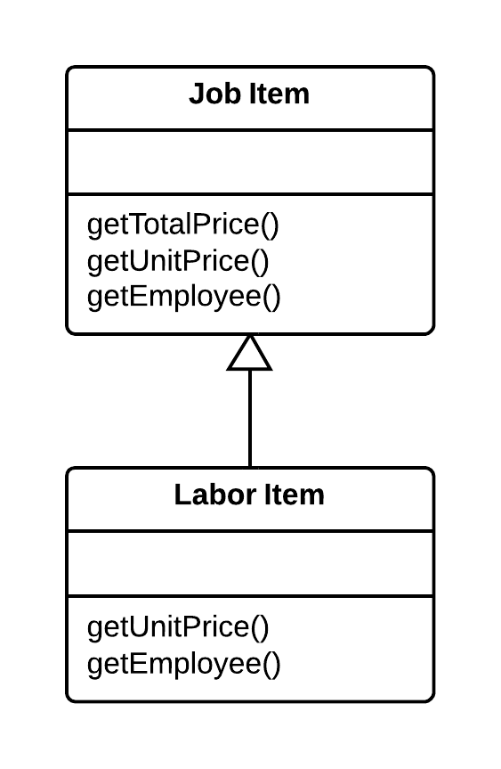
Dealing with Generalization : Extract Subclass
Problem
A class has features that are used only in certain cases.
Solution
Create a subclass and use it in these cases.

Slide 48
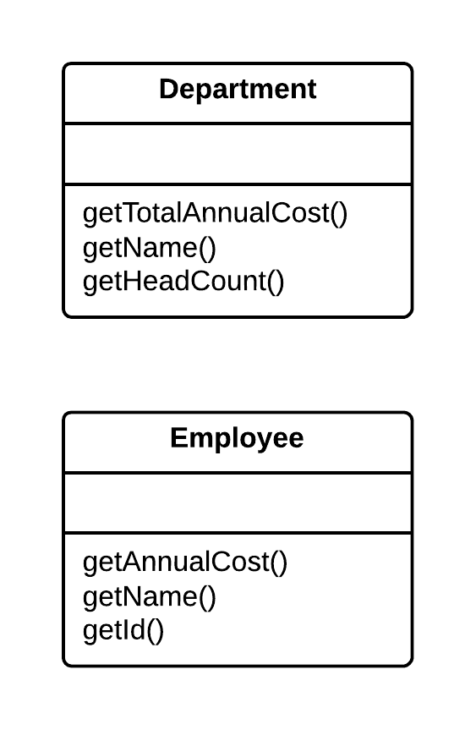
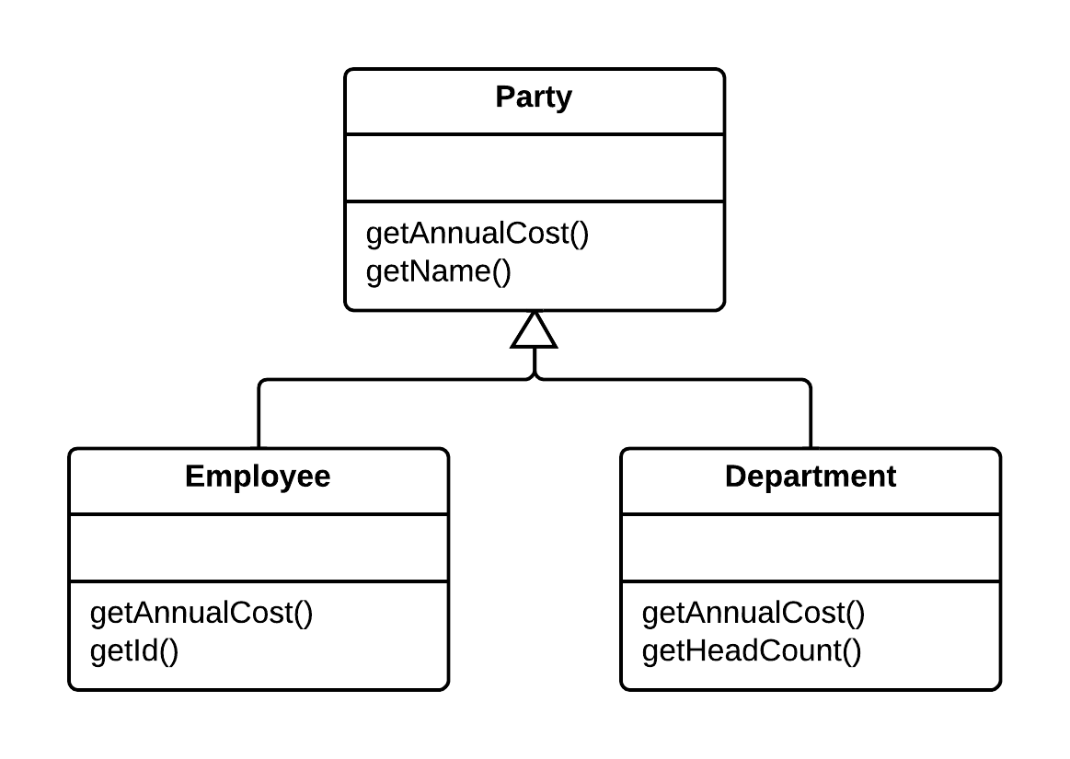
Dealing with Generalization : Extract Superclass
Problem
You have two classes with common fields and methods.
Solution
Create a shared superclass for them and move all the identical fields and methods to it.

Slide 49
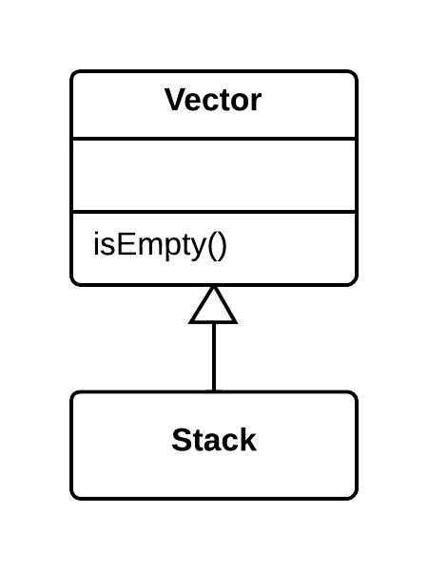
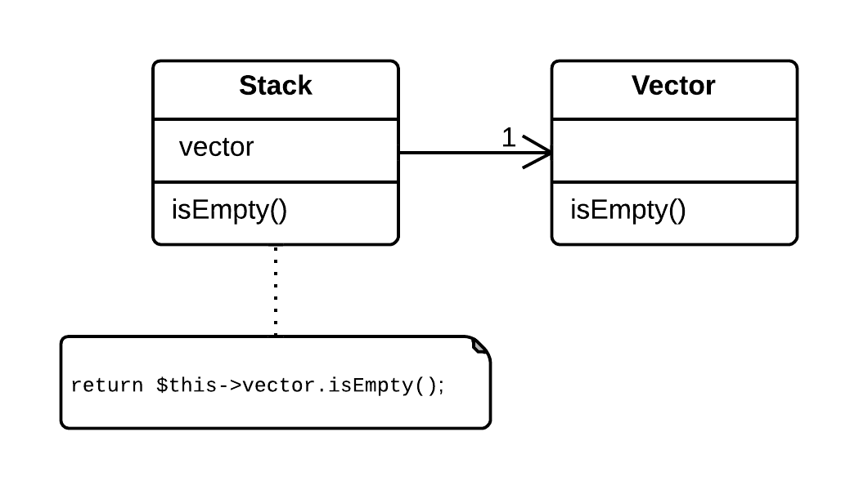
Dealing with Generalization : Replace Inheritance with Delegation
Problem
You have a subclass that uses only a portion of the methods of its superclass (or it's not possible to inherit superclass data).
Solution
You have a subclass that uses only a portion of the methods of its superclass (or it's not possible to inherit superclass data).

Slide 50
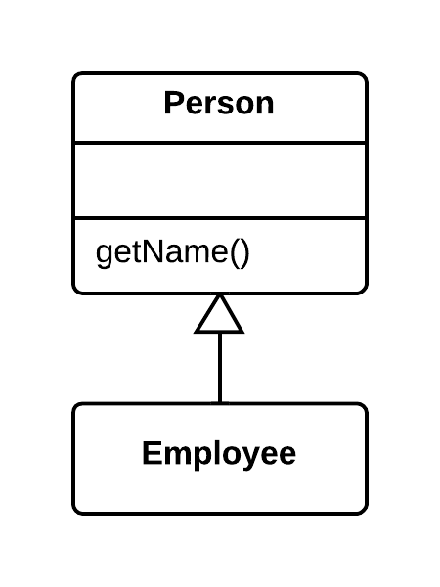

Dealing with Generalization : Replace Delegation with Inheritance
Problem
A class contains many simple methods that delegate to all methods of another class.
Solution
Make the class a delegate inheritor, which makes the delegating methods unnecessary.

Slide 51
References
www.refactoring.guru
Refactoring Improving the Design of Existing Code, Martin Fowler

