Slide 1
DPP Examination
Alexandre DA CUNHA--GUIBORAT (vdp873)
Oleksandr KRYSHTALOV (MDQ842)

Slide 2
RangeQuery2d

Slide 3
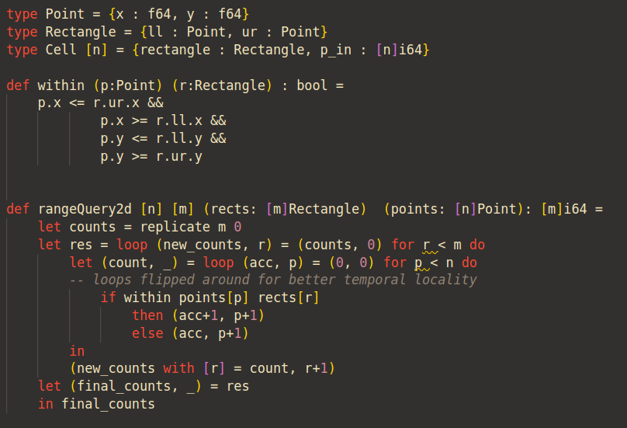
Naive Sequential Implementation

Slide 4
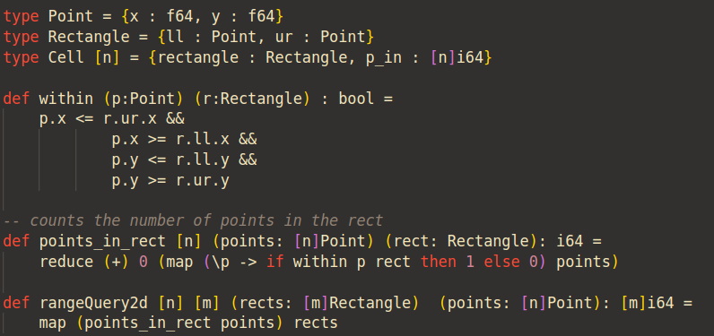
Naive Parallel Implementation

Slide 5
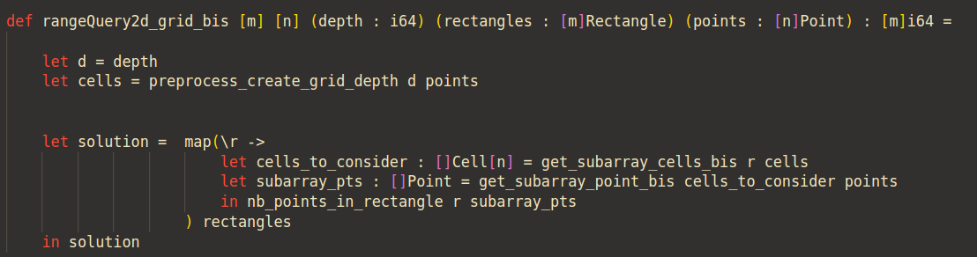
Grid Parallel Implementation

Slide 6
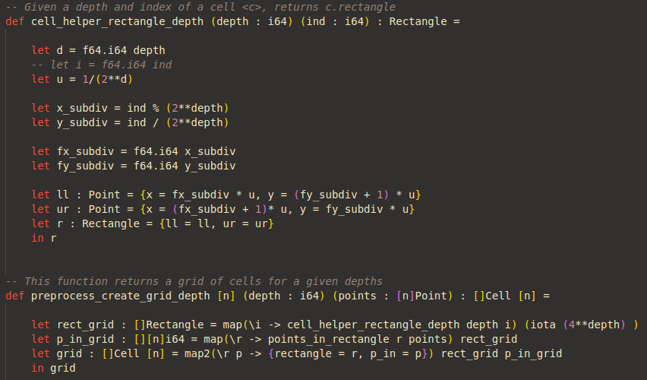
Preprocessing
0
1
2
3

Slide 7
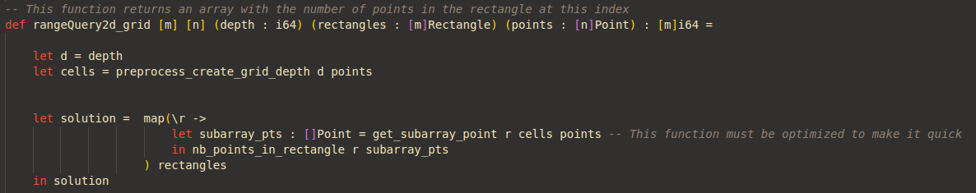
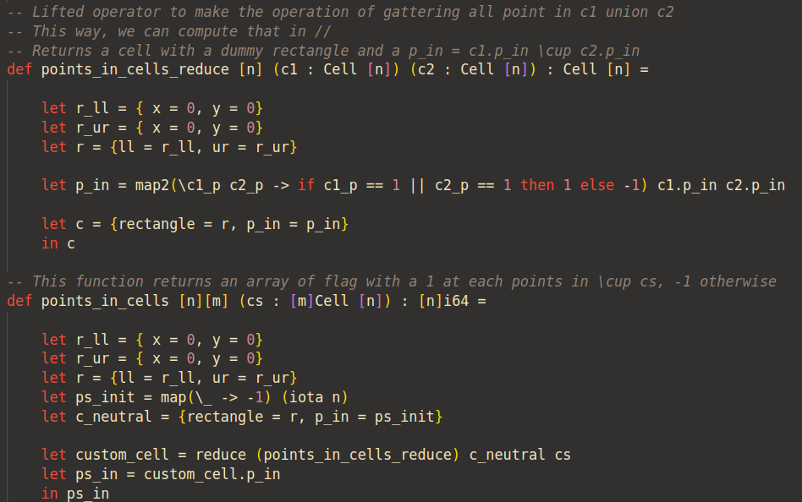
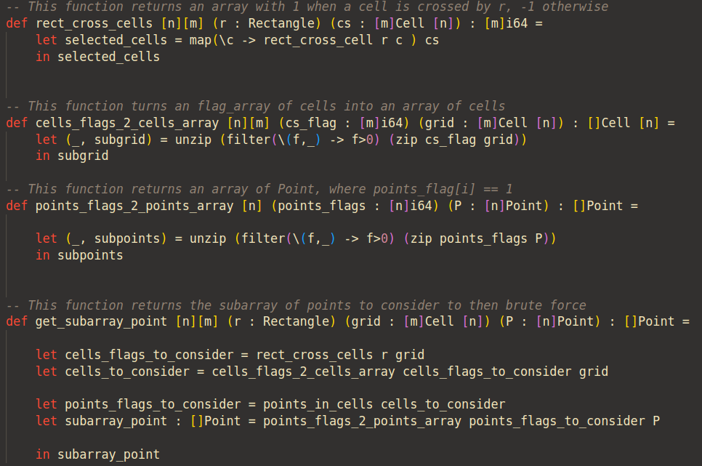
Optimisation

Slide 8
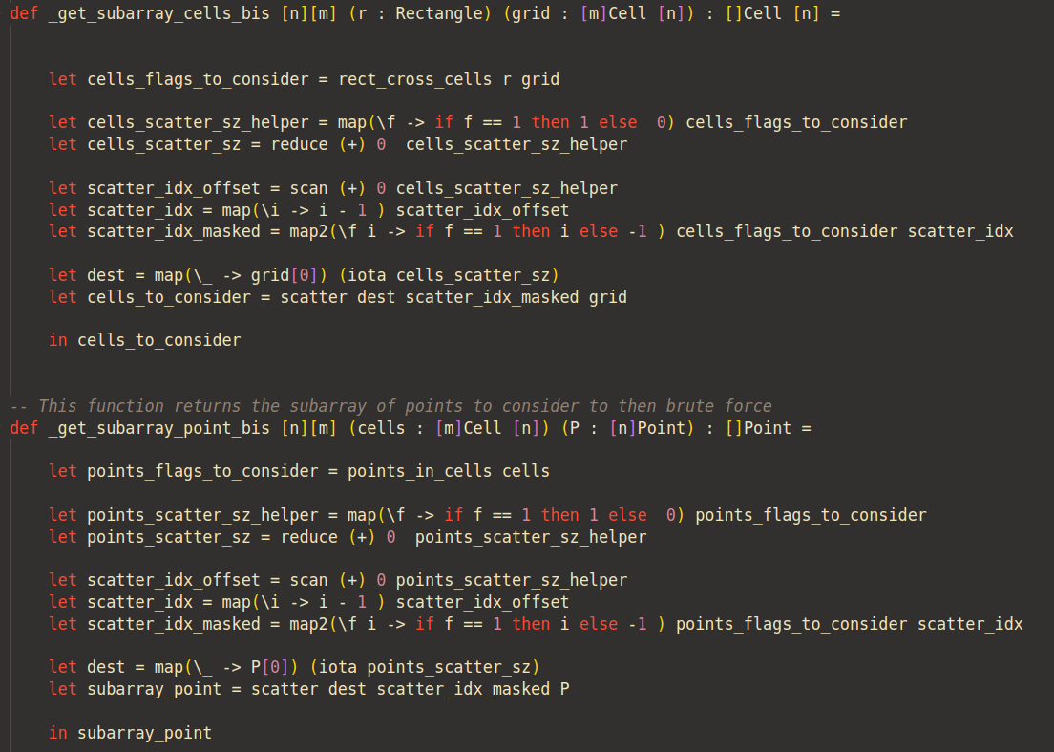
Optimisation (2)

Slide 9
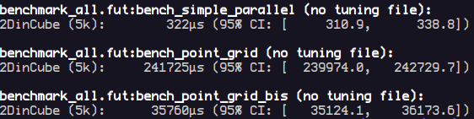

Performance
Memory allocation issue.
On smaller data :

Slide 10
Improvement
Cells may store array of different length -> Overhead
Change for a quadtree implementation -> Sequential / Massive usage of memory

Slide 11
Conclusion

