Slide 1



DataFrame
Stéphane Ducasse
Nick Papoylias
Serge Stinckwich
Yuriy Tymchuk
Oleksandr Zaytsev, BSc.
Ukrainian Catholic University
Faculty of Applied Sciences
oleks@ucu.edu.ua

Slide 2
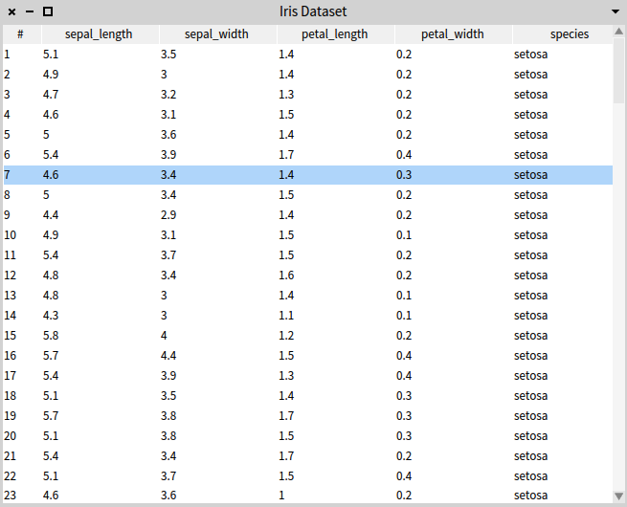

Slide 3
Hey, data! Give me the names of all students whose grade is below 50.

Slide 4
Hey, data! Give me the names of all students whose grade is below 50.

Slide 5
data give name whose grade is below 50.

Slide 6
data give name whose grade is below 50.

Slide 7
data select name where grade < 50.

Slide 8
data select name where grade < 50.

Slide 9
data select: #name where: [:grade | grade < 50].

Slide 10
data select: #name where:
[ :grade | grade < 50 ].

Slide 11
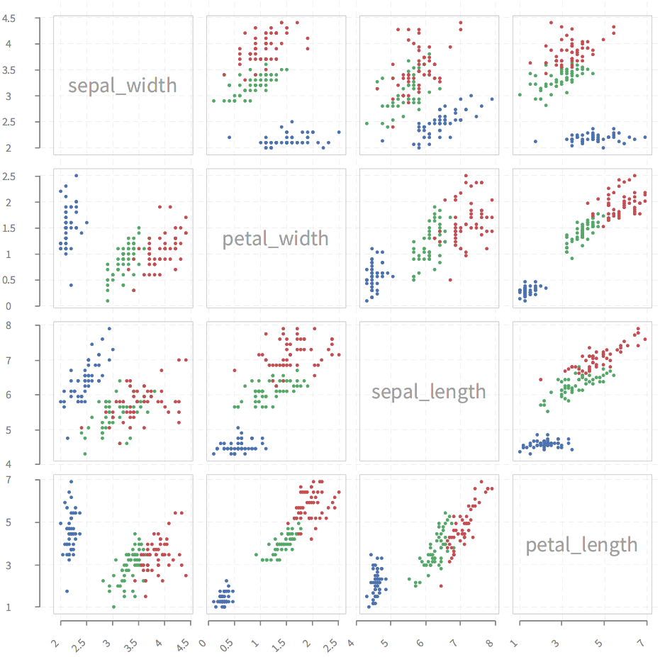

Slide 12
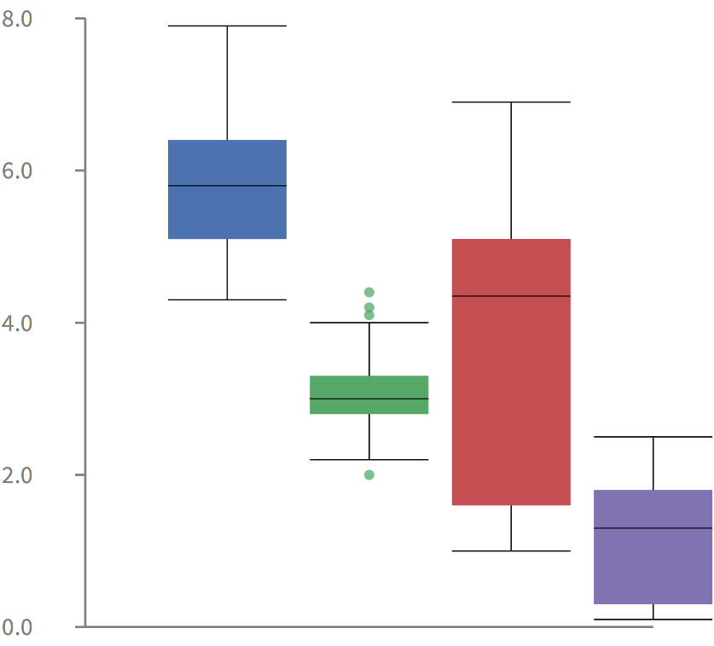

Slide 13
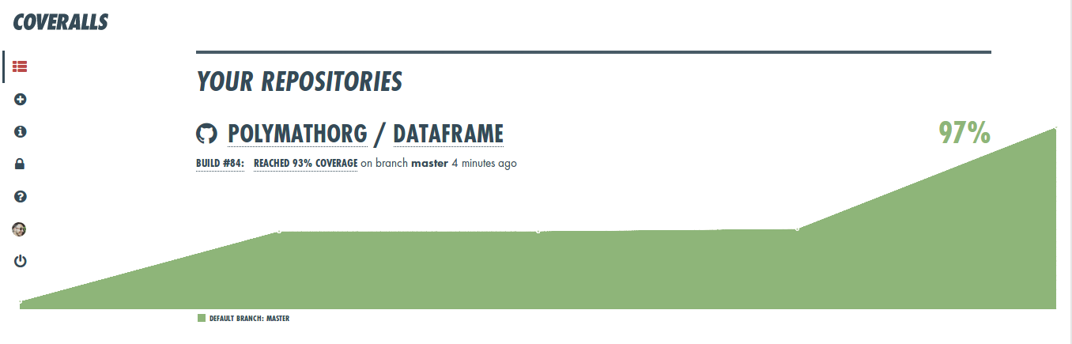

Slide 14
Future
Advanced inspection of data

