Slide 1
Wiz Technical Exercise
<Candidate Name>

Slide 2
Instructions - DELETE THIS SLIDE
This presentation is an optional template for inspiration.
You are free to use this template, or create your own presentation
The sections in here are suggestion for some minimum elements which you should present on or plan to include in your demo

Slide 3
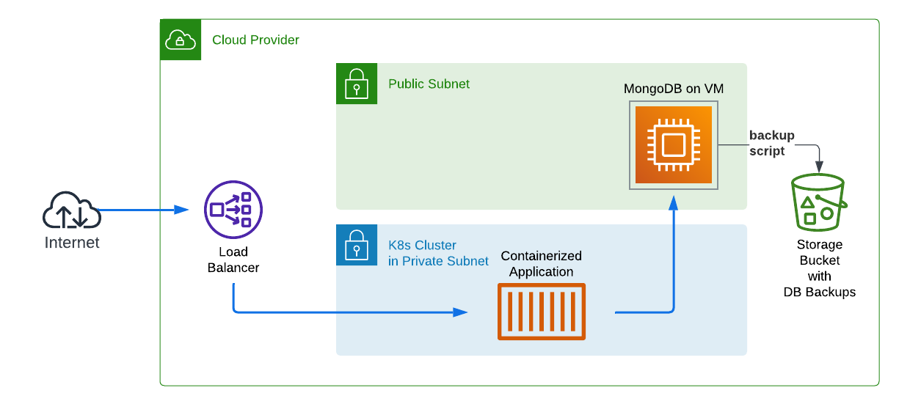
Sample Architecture: Replace with the reference architecture for the deployment for the CSP you chose.​
Overview
<tech assignment overview>

Slide 4
What you built
<architecture overview>

Slide 5
What are the business benefits and risks of this environment?
<discussion around value>

Slide 6
How you built it
<Overview of how you built this architecture and the tools you use to complete the task>​

Slide 7
The challenges you faced
<Challenges you experienced when building the technical assignment architecture>​

Slide 8
Architecture Security Outcomes
<What is the security outcome of building the technical assignment architecture?>
(optional for support roles)​

Slide 9
What Value will Wiz provide?
<What is the value Wiz would provide for this environment?>
(optional for support roles)​

Slide 10
What would you do different or extra?
<What would you change in what you built?>

Slide 11
Resources Used
<Referenced resources (docs, blogs, videos) used for the technical assignment >​

