Slide 1
KNATIVE OVERVIEW
Oleksii Khoriev
Critical Services

Slide 2
What is Knative
Knative extends Kubernetes to provide a set of middleware components that are essential to build modern, source-centric, and container-based applications that can run anywhere: on premises, in the cloud, or even in a third-party data center.
Knative adds three loosely-coupled components to provide a complete serverless platform: Build, Eventing, and Serving.
Build provides a pluggable model for building containers from source code.
Eventing allows apps/functions to publish to, and subscribe to, event streams such as external events, internal events, Google Cloud Pub/Sub, Apache Kafka and others.
Serving provides the ability to easily run applications/functions and scale them up or scale them down to zero.

Slide 3
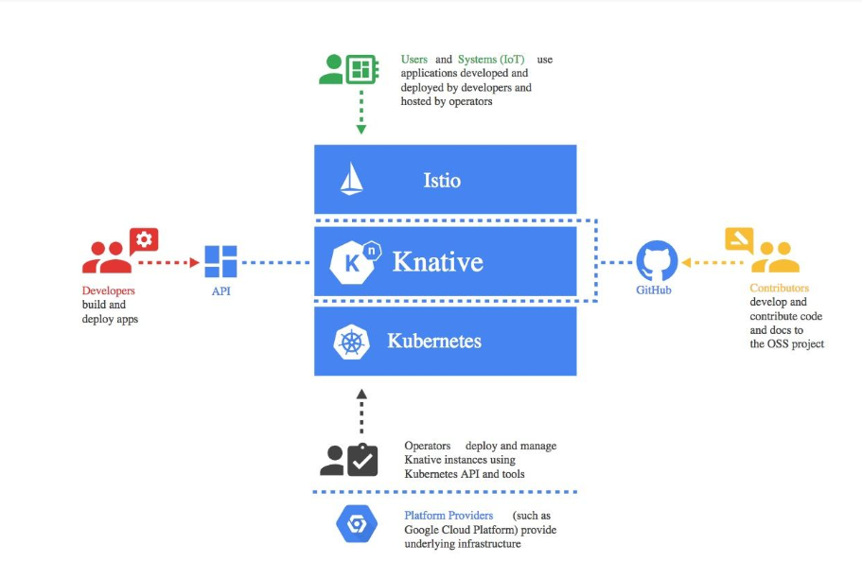
What is Knative
Knative based on Kubernetes, Istio and other components which created by Google, Pivotal, SAP, Red Hat, IBM, and many others contributors.

Slide 4
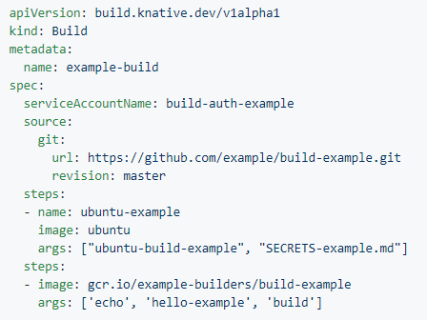
Knative Build
Knative Buld is a way to do an on-cluster build of container images from your source code i.e. source-to-image, the built container image can then be used in other Kubernetes resources like Knative serving service.
● Build pipelines can consist of multiple steps
● Each build step is a container image.
● Builds run inside the containers on the cluster

Slide 5
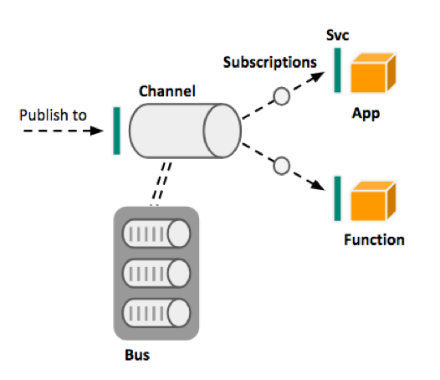
Knative Eventing
Knative Eventing allows apps/functions to publish to, and subscribe to, event streams such as external events, internal events, Google Cloud Pub/Sub, Apache Kafka and others.
● Channels - these are publish/subscribe destinations (topics) to which publishers send messages. Basically, channels are a catalog of places to get or put events.
● Bus - the backing provider for channels. This is the messaging platform for the events in the platform and can be Google Cloud PubSub, Apache Kafka, RabbitMQ, etc.
● Events are delivered to Services or forwarded to other channels (possibly of a different type) using Subscriptions

Slide 6
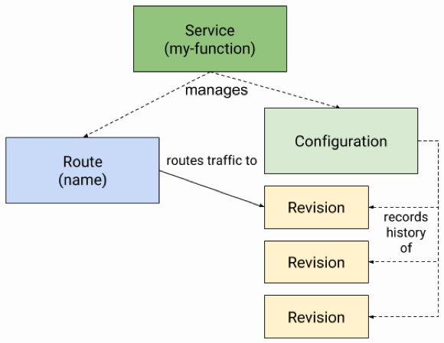
Knative Serving
Knative Serving provides the ability to easily run applications/functions and scale them up or scale them down to zero.
● Service – resource which automatically manages the whole lifecycle of your workload.
● Route - maps a network endpoint to a one or more revisions.
● Configuration - maintains the desired state for your deployment. It provides a clean separation between code and configuration and follows the Twelve-Factor App methodology. Modifying a configuration creates a new revision
● Revision - is a point-in-time snapshot of the code and configuration for each modification made to the workload. Revisions are immutable objects and can be retained for as long as useful.

Slide 7
Knative installation
Knative requires a Kubernetes cluster v1.11 or newer.
Community provide information for installing Knative on:
Google Kubernetes Engine;
IBM Cloud Kubernetes Service;
IBM Cloud Private;
Azure Kubernetes Service;
OpenShift Pivotal Container Service clusters;
on-premise Kubernetes.
Also you can deploy Knative at GKE as a service, but it need enabled “Serverless add-on for Google Kubernetes Engine early access”.

Slide 8
Knative finded issues
● Istio issues: not stable work of ingress, more services at istio = more iptables rules, and others;
● some samples don’t work correct;
● GKE Serverless add-on some time doesn’t work.

Slide 9
Knative demo

