Slide 1
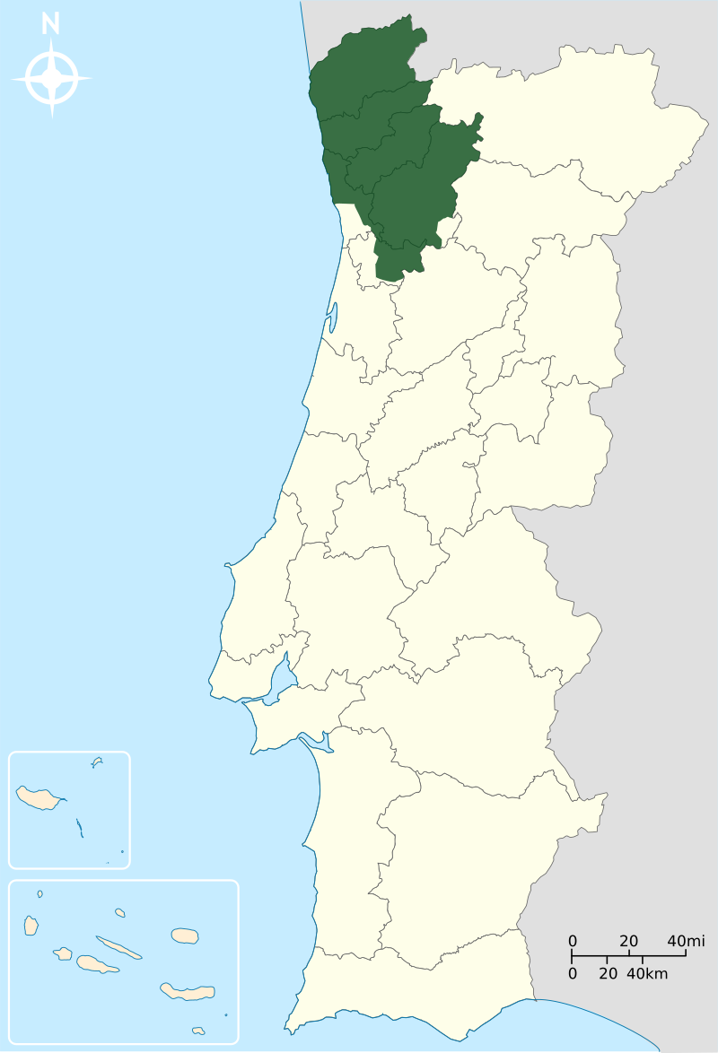
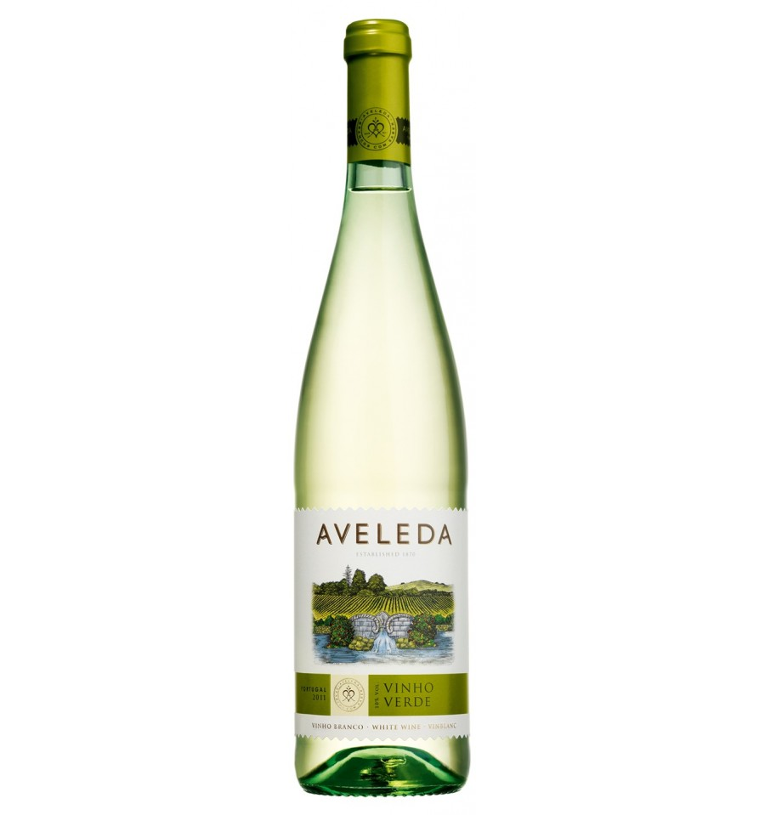
Clearing of the Vinho Verde Data Set
Duplicates
Legal Limits
Outliers
Resulting Correlations

Slide 2
Data Cleaning
The data set is very noisy
Naturally: wine and taste is very complex and interrelated
Shallow
Duplicates
Wines with exactly the same values
„Illegal“ Wines in EU
Total Sulfur Dioxide < 210 mg/l
Volatile Acidity < 1.1 g/l
Outliers Input Quantities
values outside 1.5*IQR
good wine
Remove the above wines from the data set because
Noisy and complex data set
At least work on the main features

Slide 3
Duplicates
937 of 4898 (19%) entries were dropped.
Do not make sense.
Effect: Duplicates shift correlation coefficients.

Slide 4
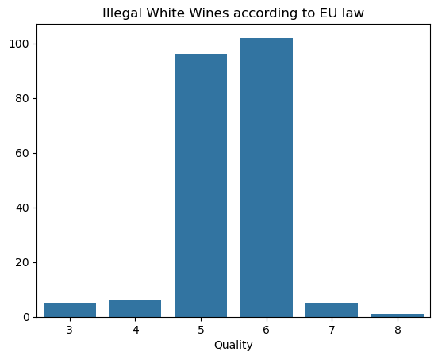
Illegal Stuff
Quantity | Limit | Count
Total Sulfur Dioxide | < 210mg/l | 215
Volatile Acidity | < 1.1g/l | 0
Remove if one of the legal limits is surpassed.
Irrelevant, because we cannot sell those wines!

Slide 5
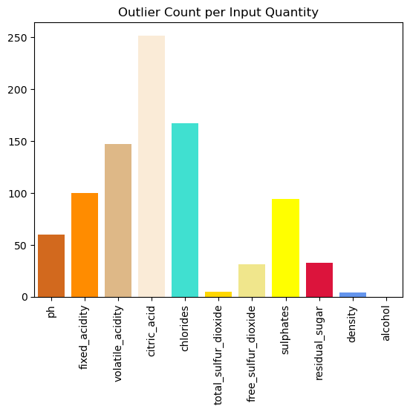
Outlier Wines
893 outliers in total
Acidity seems to be a wi(l)dely varying quantity in wines.
Chlorides (Terroir) varies strongly as well.
Sulfur Dioxide, Sulphates: The use of preservatives varies a lot.

Slide 6
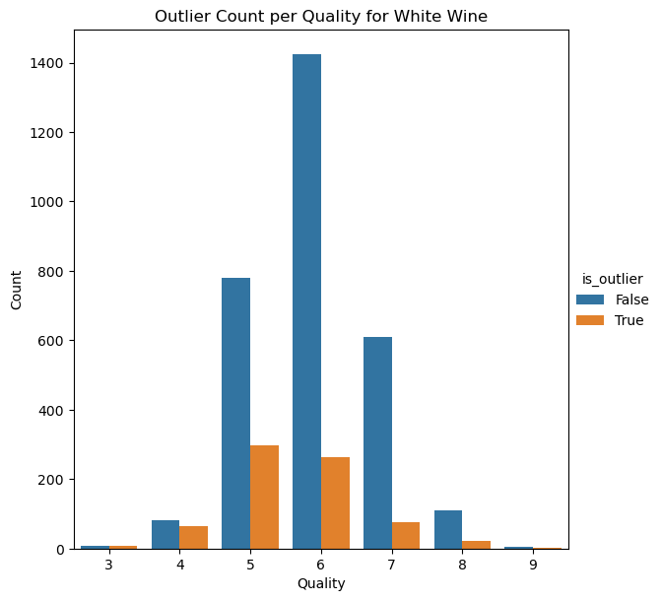
Outlier Wines
Outlier Wine is a wine with at least one outlier in the input values
Wine with
1 outlier: 729
2 outliers: 145
3 outliers: 13
First approach: Drop all outlier wines!
28%
16%
47%
20%
44%
11%
16%

Slide 7
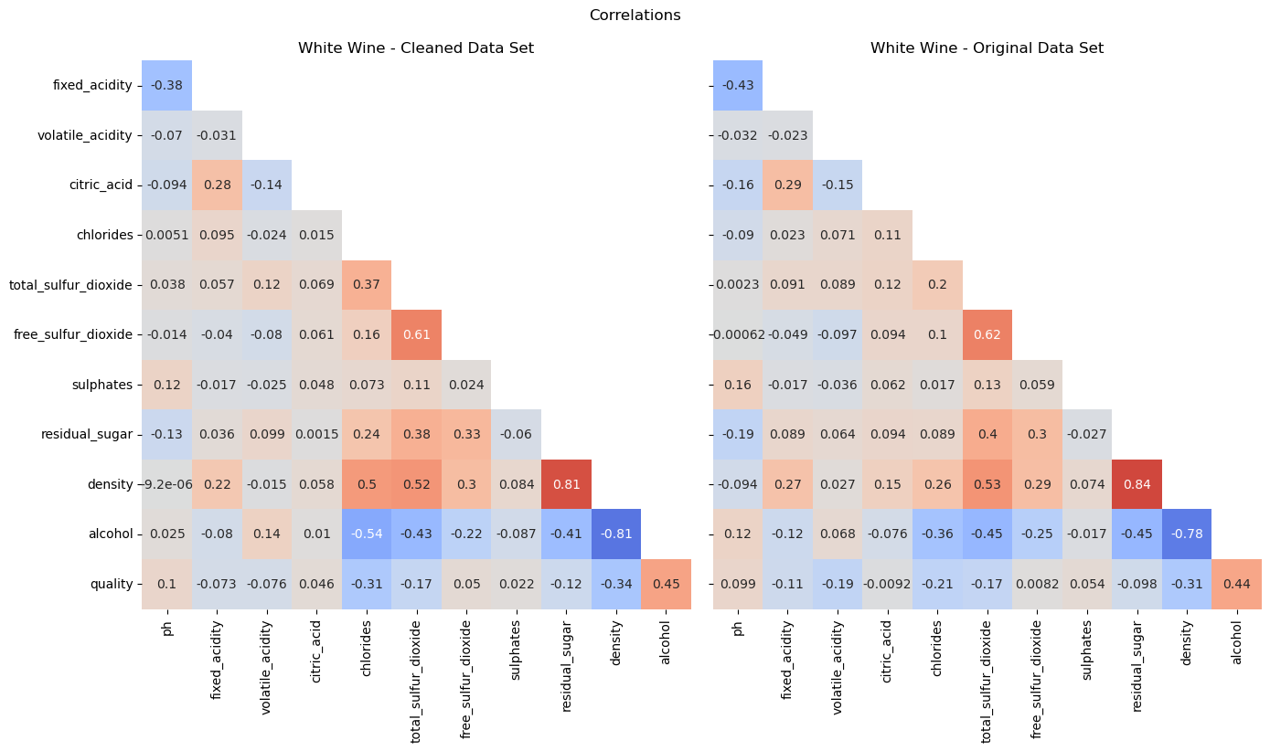
Result

Slide 8
Conclusions
Data set with reduced noise mainly in Acidity
Acidity of wine is a very complex quantity and is not fully available in the data set.
It‘s good to get rid of it in order to find the main features of a good wine.
Main features
Alcohol
Density
Chlorides
pH
Residual Sugar
Improvements
keep 5% of outliers per input quantity
keep the outliers in certain quantities, e.g. chloride
Select outliers more carefully (e.g.: take relation of sugar and density into account)
Use a different method to find outliers

