Slide 1
DNA Synthesis Screening
Under Device Proliferation
A regime-conditional analysis of governance architecture, 2026–2030
Olena Didenko · biosecurity fellowship · ERA / IBBIS
Notes:
Good morning. My thesis asks a single question: as DNA-synthesis screening becomes mandatory and moves onto the synthesis device itself, and as do-it-yourself and benchtop synthesis proliferate, where does control stay robust, where does it erode, and where must policy move to keep pace through 2030. I characterise the whole governance architecture as a function of the policy regime, and I back it with original forensic results. I'll walk through four workstreams: a technology-readiness index, cost trajectories, control robustness, and a forensic attribution framework.

Slide 2
Why now
Screening is going mandatory and on-device — exactly as DIY capability spreads.
200 → 50
§851
R0 → R1
nt screening window tightening (Oct 2026, paused)
BIOSECURE Act enacted, FY2026 NDAA (Dec 2025)
status quo to mandatory + on-device regime
Three US instruments define the moment: the OSTP Framework, Executive Order 14292, and Senate bill S. 3741.
DNA synthesis screening under device proliferation
1
Notes:
Three US policy instruments define this moment. The OSTP Framework for Nucleic Acid Synthesis Screening took first effect in April 2025 at a 200-nucleotide window; a second stage scheduled for October 2026 would tighten that to 50 nucleotides and add a functional sequence-of-concern definition. Executive Order 14292 then paused the Framework pending revision, so that milestone's survival is genuinely uncertain. And Senate bill S. 3741 would make screening statutory. The BIOSECURE Act became law in December 2025. So screening is being strengthened deliberately — the question is whether it reaches far enough as devices proliferate.

Slide 3
Two regimes, one question
The interesting object isn't whether screening works — it's what remains outside the perimeter.
R0 — status quo (Oct 2026)
R1 — projected (late 2026+)
Framework revision pending
IGSC protocol voluntary
No on-device mandate
Reagents unmonitored
Mandatory provider screening
On-device benchtop screening
50-nt window, functional SOC
Doubly conditional on enactment
DNA synthesis screening under device proliferation
2
Notes:
I anchor everything in two regimes. R0 is the status quo as of October 2026 — voluntary, no device mandate. R1 is the projected regime with mandatory provider and on-device screening at a 50-nucleotide window with functional detection. Crucially, R1 is a composite projection, doubly conditional on the Framework revision being issued and on S. 3741 being enacted. The analytically interesting object is not whether screening works — it's the residual DIY gap: the synthesis capability that remains outside the perimeter once commercial providers and benchtop manufacturers are covered. Everything is scored under both regimes and weighted toward that gap.

Slide 4
Four workstreams
One thread: move from threat-ranking to governance-architecture design.
1 · Readiness index
2 · Cost & accessibility
Seven synthesis routes scored across nine dimensions, weighted to DIY; detectability paired by regime.
Conditional, TRL-gated cost trajectories to 2030 — capital is the barrier, not per-base.
3 · Control robustness
4 · Forensic attribution
Which levers hold under R0 vs R1; jurisdictional reach and the reagent question.
Infer the synthesis route from the error phenotype — now measured, not just specified.
DNA synthesis screening under device proliferation
3
Notes:
The work has four parts. First, a regime-conditional technology-readiness index across the synthesis chemistries, weighted toward DIY. Second, cost and accessibility trajectories to 2030. Third, a control-robustness assessment — which levers stay durable and how far a US mandate actually reaches. And fourth, the forensic contribution: a method to attribute the synthesis route from error signatures in the sequenced product. The contribution overall is to move the conversation from ranking which sequences are dangerous toward designing the control architecture itself.

Slide 5
Workstream 1
Technology readiness (TRI)
Notes:
First, the readiness index — how accessible and how governable each synthesis route actually is.

Slide 6
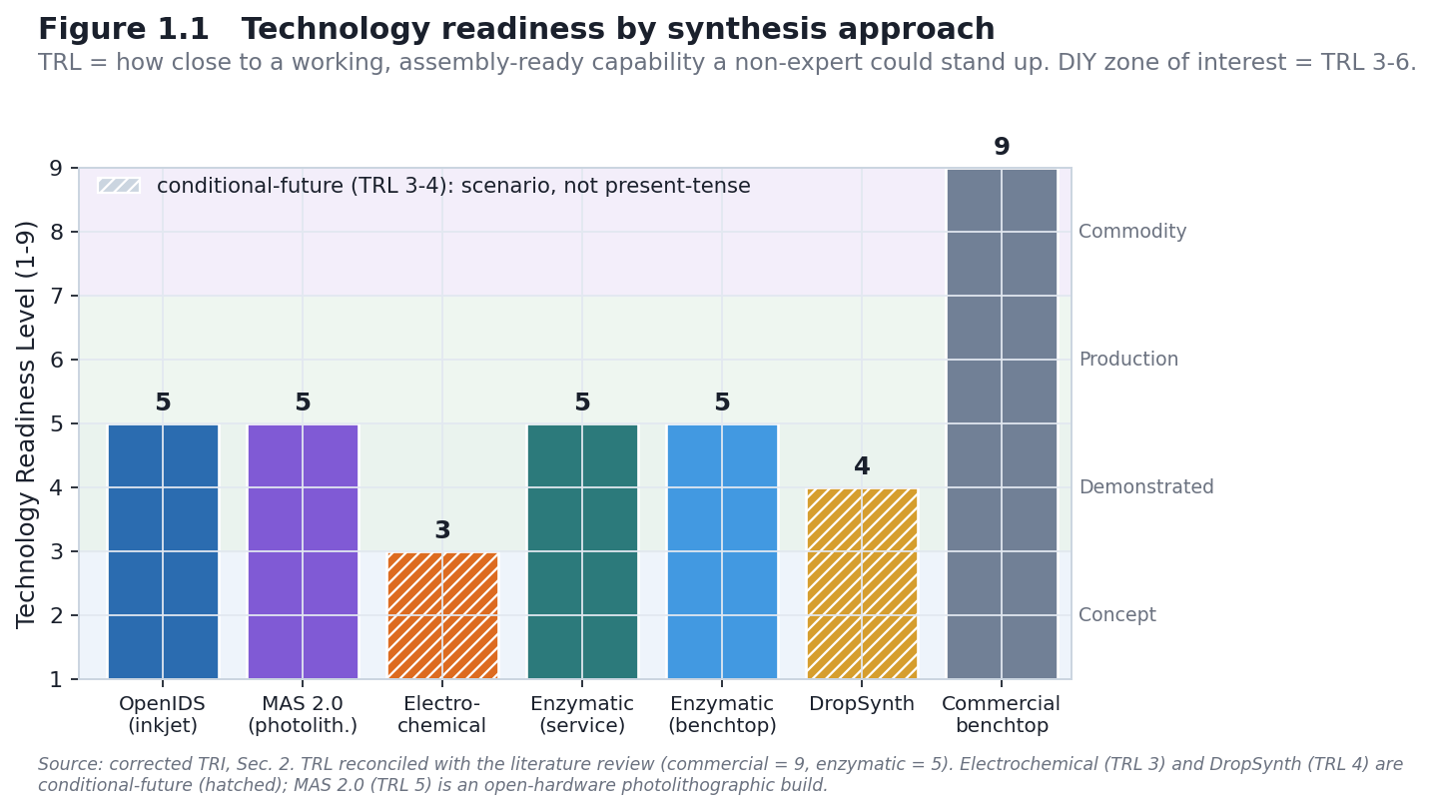
Seven approaches, scored by readiness
The zone of interest is TRL 3–6: mature enough to work, accessible enough to reproduce outside a provider.
OpenIDS & MAS 2.0 — open-source DIY builds (TRL 5)
DropSynth — DIY gene assembly (TRL 4)
Electrochemical — no DIY build yet (TRL 3)
Commercial — mature baseline (TRL 9), reached by purchase
DNA synthesis screening under device proliferation
4
Notes:
I score seven routes by technology-readiness level, which here means how close a route is to a working, assembly-ready capability a non-expert could stand up. The analytical weight sits in the TRL 3–6 band. OpenIDS and MAS 2.0 are the genuine open-source DIY builds at TRL 5. DropSynth is DIY gene assembly at TRL 4. Electrochemical is TRL 3 with no independent build. Commercial systems sit at 9 but are reached only by purchase — they're a baseline, not the object of concern.

Slide 7
Usable length, not advertised length
Capability is scored by what's demonstrated at fidelity — not the spec sheet.
~55%
~15–30 nt
>90%
OpenIDS full-length product at a 30-mer
usable length at fidelity (only a poly-dT demonstrated)
full-length that gene assembly actually needs
This discipline is what keeps the threat assessment honest — advertised maxima overstate DIY capability.
DNA synthesis screening under device proliferation
5
Notes:
A methodological point that keeps the assessment honest: I score capability by usable length at high fidelity, not advertised maximum. At 98% per-step coupling a 30-mer is full-length only about 55% of the time, and OpenIDS has only ever demonstrated a short poly-dT homopolymer. Gene assembly needs upwards of 90% full-length product. So the honest usable length for these DIY routes is tens of nucleotides — well short of a defined-sequence gene. Advertised numbers overstate the threat.

Slide 8
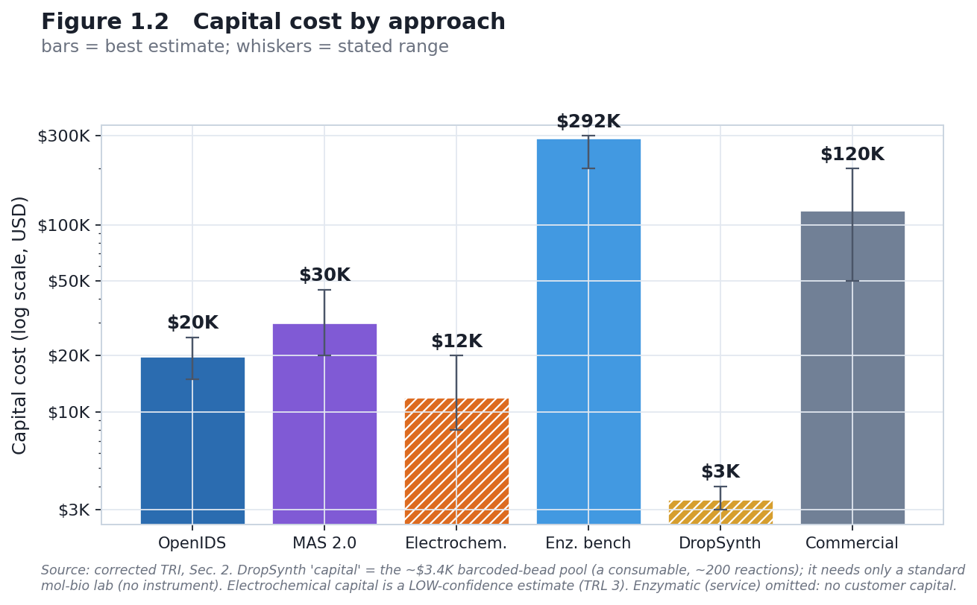
Capital cost by approach
DIY builds are cheap; the enzymatic benchtop is not — and DropSynth's low cost buys assembly, not unscreened synthesis.
OpenIDS ~$20K · MAS 2.0 ~$30K · DropSynth ~$3.4K bead pool · enzymatic SYNTAX ~$292K · commercial ~$60K
DNA synthesis screening under device proliferation
6
Notes:
On capital cost: OpenIDS is about twenty thousand dollars, MAS 2.0 tens of thousands, and DropSynth just a thirty-four-hundred-dollar bead pool. The enzymatic benchtop — DNA Script's SYNTAX — is around $292,000, verified against a vendor quote. The key nuance is DropSynth: its low cost buys you assembly of a commercial oligo pool, which is already screenable. Cheapness there doesn't translate into unscreened capability.

Slide 9
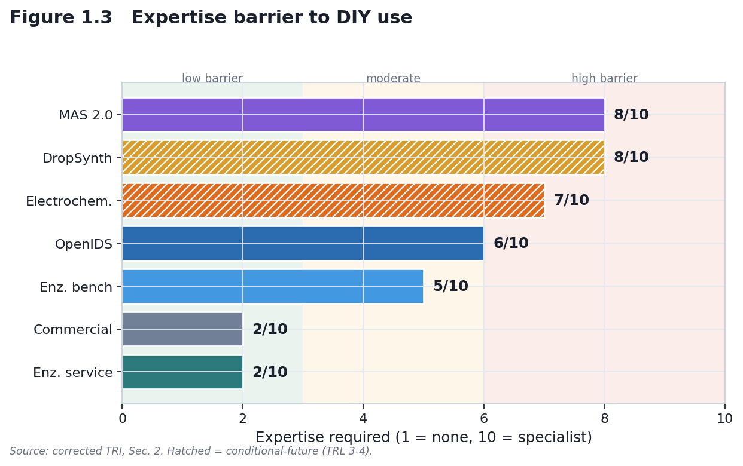
The real barrier is expertise
The accessible routes are the hardest to run; the easy routes are the ones you buy.
Expertise-to-first-use score (1 = push-button, 10 = specialist)
DNA synthesis screening under device proliferation
7
Notes:
When you plot the expertise required, the picture inverts the cost story. The cheap DIY routes — MAS 2.0, DropSynth, electrochemical — demand the most skill, scoring 7 to 8 out of 10 across multiple specialist domains. The easy, push-button options are the commercial ones you simply buy. So accessibility isn't really about price; it's gated by know-how.

Slide 10
Workstream 2
Cost & accessibility
Notes:
Second, where these costs are heading — and where the true barrier actually sits.

Slide 11
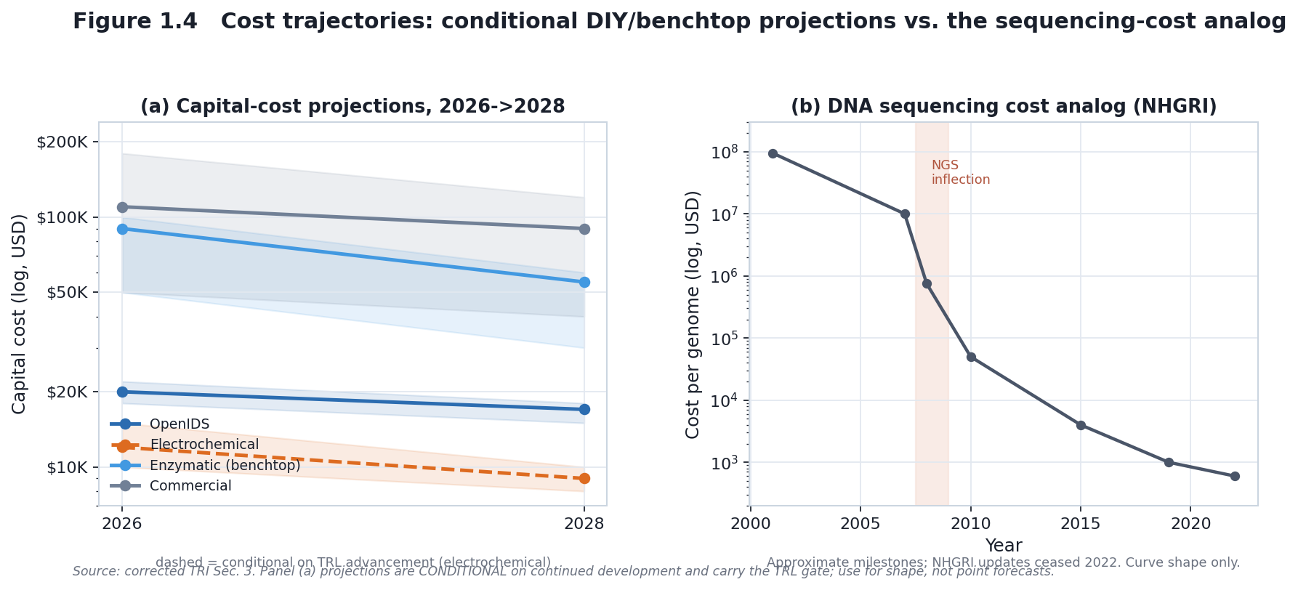
DIY cost trajectory to 2030
OpenIDS ~$19.9K → ~$12K base case — but the barrier is capital, not per-base cost.
Conditional annual-decline scenarios, anchored to the Kim 2024 build
DNA synthesis screening under device proliferation
8
Notes:
I model cost as conditional annual-decline scenarios with explicit TRL gating — not mechanical curve fits. OpenIDS, the only DIY route with a real anchor, projects from its nineteen-thousand-nine-hundred-dollar build to about twelve thousand by 2030 in the base case. But the load-bearing conclusion is that commercial cost-per-base has plateaued, so the DIY barrier is capital cost, not per-base cost — and even where OpenIDS undercuts a provider at volume, it yields raw short oligos, not a finished product.

Slide 12
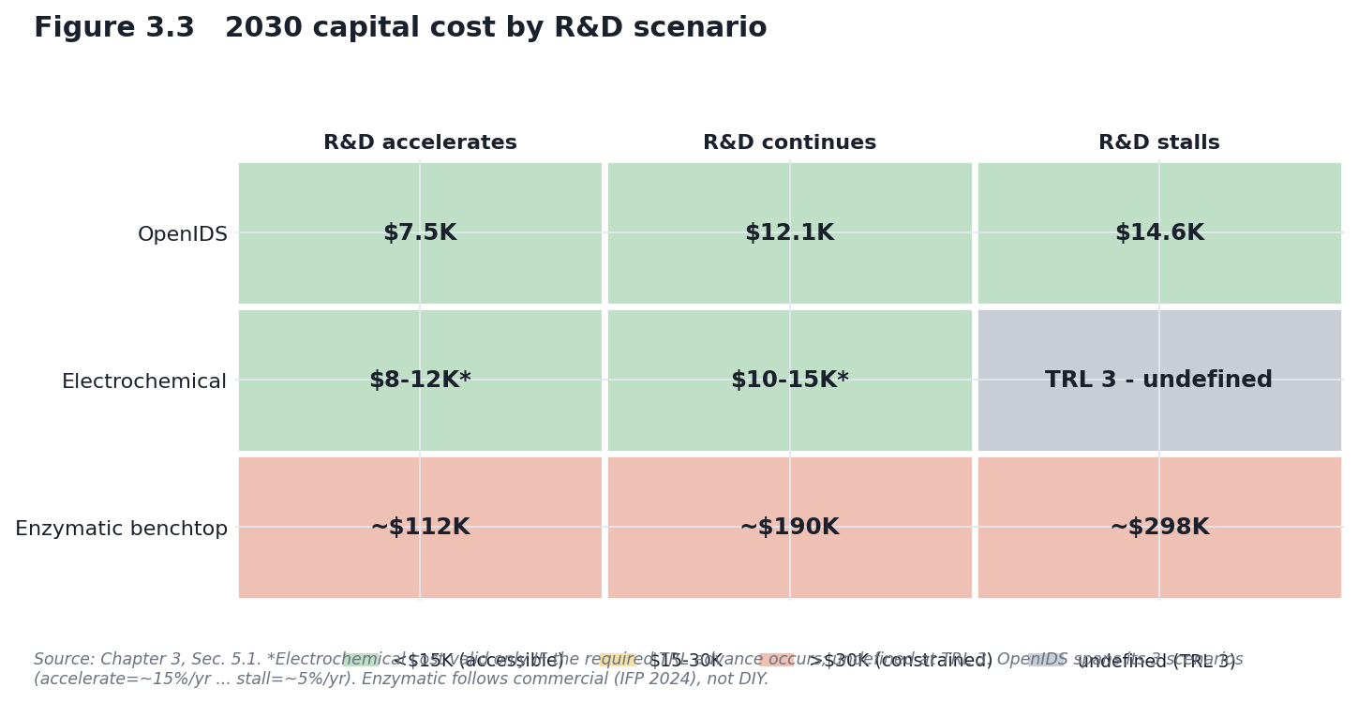
2030 capital cost by R&D scenario
Electrochemical is undefined until it works; enzymatic stays six-figure; only OpenIDS is genuinely low-cost.
Enzymatic scenarios track the Institute for Progress 2030 distribution ($112–298K)
DNA synthesis screening under device proliferation
9
Notes:
Across accelerate, continue, and stall scenarios, OpenIDS stays the only genuinely low-cost DIY route. Electrochemical cost is undefined at TRL 3 — I refuse to itemise parts for a system that doesn't exist. And the enzymatic benchtop stays six-figure, tracking the Institute for Progress 2030 forecast of roughly a hundred-and-twelve to two-hundred-and-ninety-eight thousand dollars.

Slide 13
The cheap part is the oligos
The markup to a correct, functional gene is entirely assembly + validation — and it's tacit-knowledge-gated.
~$1.5/kbp
~$125/kbp
~$6/kbp
commercial oligo pools (nearly free)
clonal, sequence-perfect DNA
assembly + validation done in-lab (Gandall)
The ~80× markup is know-how, not a hard cost floor — which reframes the residual gap as expertise-gated.
DNA synthesis screening under device proliferation
10
Notes:
A practitioner benchmark sharpens the whole argument. Commercial oligo pools cost about a dollar-fifty per kilobase — nearly free. Clonal, sequence-perfect DNA from the same provider is about a hundred and twenty-five. That eighty-fold markup is entirely assembly and sequence validation — which Keoni Gandall has shown can be done for about six dollars per kilobase with enough know-how. So the barrier isn't a hard cost floor; it's tacit knowledge — two years of specialisation. That reframes the residual DIY gap as expertise-gated, downstream of synthesis.

Slide 14
Workstream 3
Control robustness
Notes:
Third, which control levers actually hold as the regime changes.

Slide 15
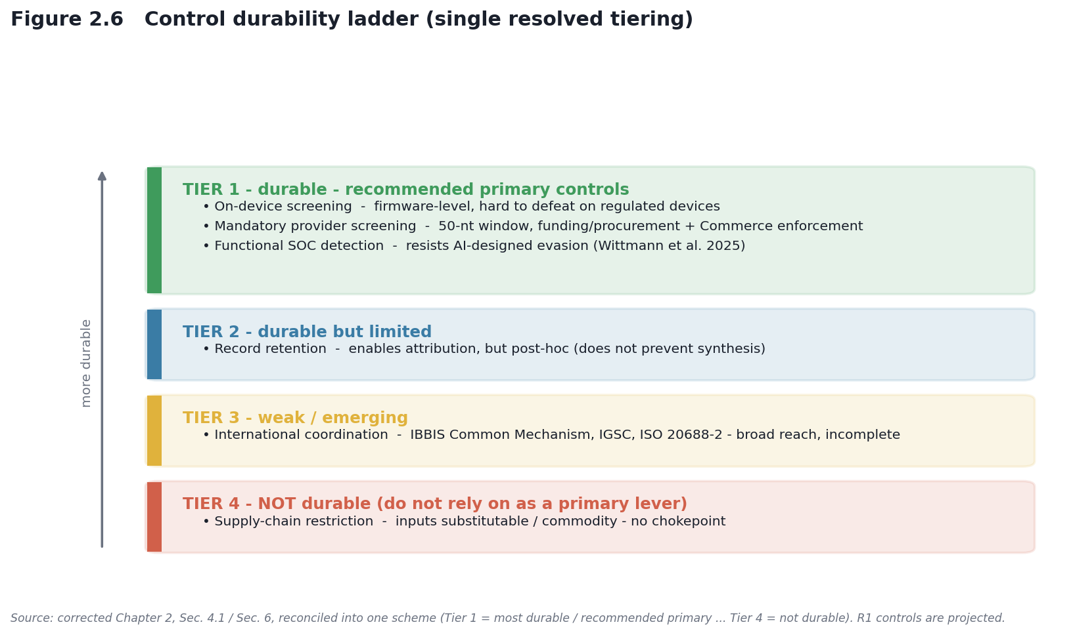
What holds, and what doesn't
R0 is fragile across every lever; R1 is durable — but only for regulated commercial devices.
Control durability, reconciled into one tiering
DNA synthesis screening under device proliferation
11
Notes:
Under R0, every lever is fragile — voluntary screening, and reagent or component restrictions that are trivially routed around. Under R1, mandatory provider and on-device screening plus functional detection and retention are substantially more durable — but only for regulated commercial devices. Open firmware makes on-device screening weak for DIY systems, and legacy and secondhand devices escape it entirely. So the durable tier is real, but it has holes exactly where the DIY gap lives.

Slide 16
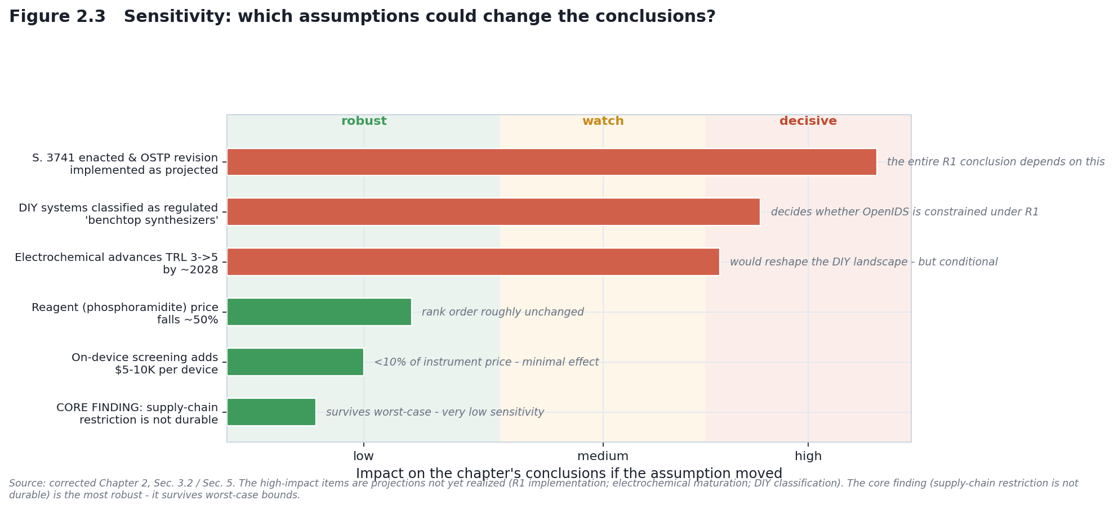
Supply-chain restriction is not durable
Inputs are commodity or substitutable — a HIGH-confidence finding that survives worst-case.
Which assumptions could change the conclusions
DNA synthesis screening under device proliferation
12
Notes:
My highest-confidence, worst-case-surviving finding is that supply-chain restriction is not a durable control point under either regime. The inputs are commodity or substitutable — propylene carbonate, a food additive, replaces the regulated solvent; phosphoramidites are made on demand from stable precursors. Control belongs at the device and the provider, not the input.

Slide 17
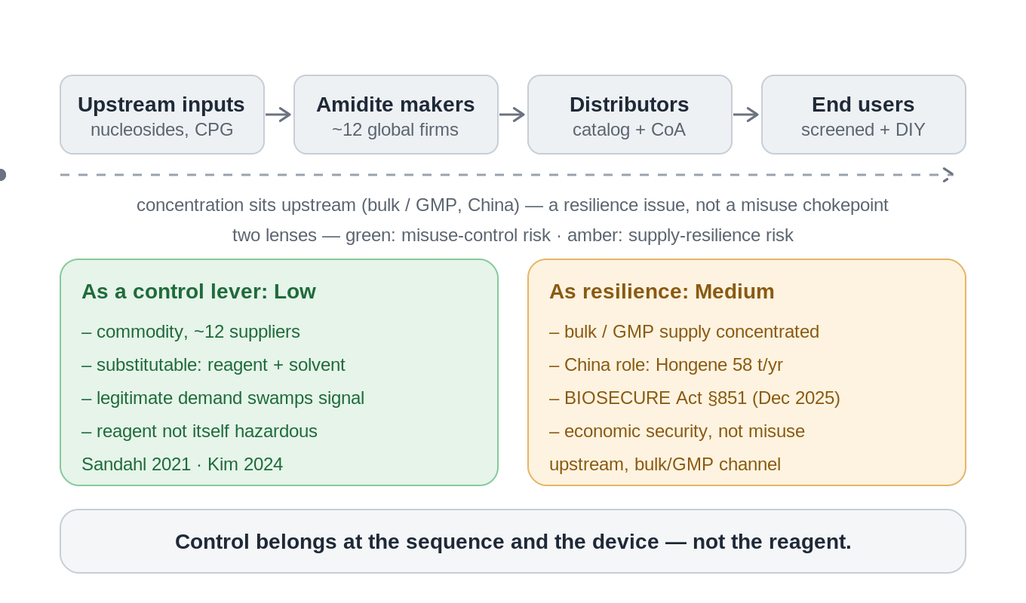
Reagents are the wrong control point
Phosphoramidites: commodity, substitutable, swamped by legitimate demand — control belongs at sequence + device.
Two lenses: low as a misuse lever, medium only as a supply-resilience issue
DNA synthesis screening under device proliferation
13
Notes:
I make this concrete with the phosphoramidite supply chain. As a misuse-control lever the risk is low — a dozen suppliers, no purchase controls, chemically substitutable, and a billion-dollar legitimate market that swamps any signal. There is a real concentration upstream, in bulk and GMP grade, with a growing Chinese role — but that's an economic and drug-security issue, addressed by the BIOSECURE Act, not a misuse chokepoint. The one-line takeaway: control belongs at the sequence and the device, not the reagent.

Slide 18
A US mandate reaches under a quarter
The newest, most capable capacity is concentrating exactly where a US rule cannot reach.
8 / 34
14
5 / 9
benchtop manufacturers US-bound by a mandate
outside US and allied reach
firms founded since 2019 that sit outside reach
International harmonisation is therefore load-bearing — not an optional add-on.
DNA synthesis screening under device proliferation
14
Notes:
The single most consequential result is about reach, not manufacturing. Of thirty-four benchtop manufacturers inventoried, only eight are US-headquartered and directly bound by a mandate; fourteen sit outside US and allied reach; and five of the nine firms founded since 2019 are outside reach, including the highest-throughput array class. So a US mandate directly reaches under a quarter of known makers, and the frontier is drifting away from it. International harmonisation isn't optional — it's load-bearing.

Slide 19
Workstream 4
Forensic attribution
Notes:
Fourth — and this is the original scientific core — when prevention leaks, can we attribute after the fact.

Slide 20
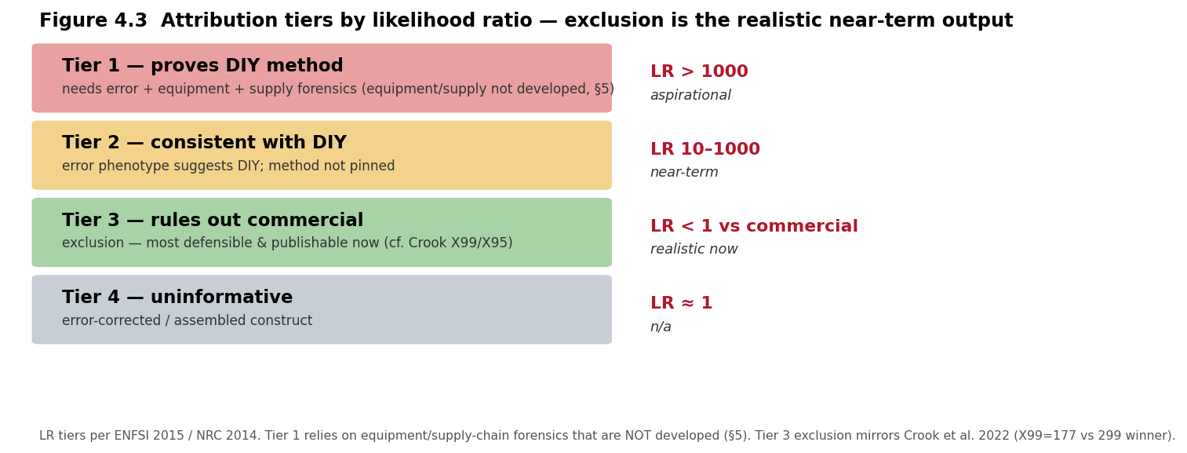
Delay, detect, defend
When prevention leaks, attribute the synthesis route from the error phenotype of the product.
Class-level attribution, not device-level
Exclusion is the strongest, most defensible output
Grounded in the GEA literature (Alley, Crook)
Consumes product-sequence data only — no synthesis
DNA synthesis screening under device proliferation
15
Notes:
Prevention is imperfect by design, so a mature architecture pairs it with post-hoc detection and attribution — Esvelt's delay, detect, defend. My contribution is the detect leg: infer the synthesis route from characteristic error signatures in the sequenced product, using reads alone. The scope is honest — this is class-level attribution, not a serial number — and following the genetic-engineering-attribution literature, exclusion is the primary value: ruling out a commercial origin redirects an investigation from subpoenaing order records toward searching for equipment.

Slide 21
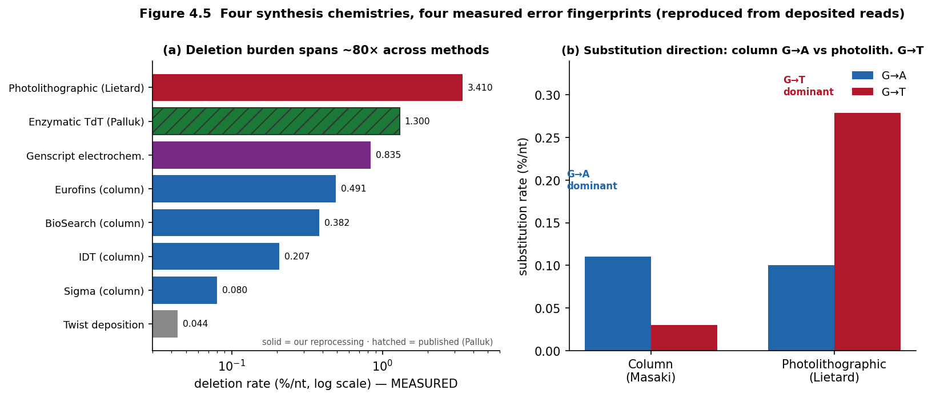
Four chemistries, four fingerprints
Reproduced independently from deposited reads, each within ~±20% of the published signature.
Column · photolithographic · electrochemical · material-deposition
DNA synthesis screening under device proliferation
16
Notes:
The premise is no longer just cited — I reprocessed four deposited datasets from raw reads and reproduced each method's published error signature to within about twenty percent. Column phosphoramidite is deletion-dominated with a G-to-A substitution bias; photolithographic is deletion-dominated with a G-to-T bias. The substitution direction is the fine discriminator. Deletion burden alone spans about eighty-fold across methods.

Slide 22
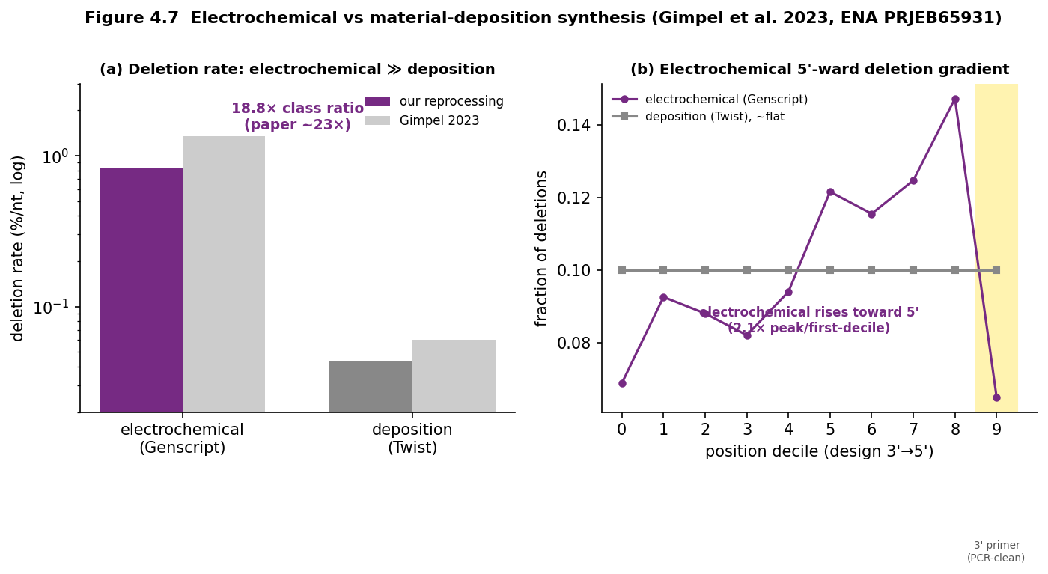
Electrochemical vs deposition
18.8× higher deletion and a 5′-ward gradient — a clean class-level signature.
Reproduced from ENA PRJEB65931 (Gimpel et al. 2023)
DNA synthesis screening under device proliferation
17
Notes:
From the Gimpel data I reproduced the electrochemical-versus-deposition distinction: the electrochemical pool shows roughly nineteen times the deletion rate of material deposition, plus a distinctive five-prime-ward gradient, while deposition is essentially error-free. That's exactly the kind of order-of-magnitude, class-level signature my classifier relies on.

Slide 23
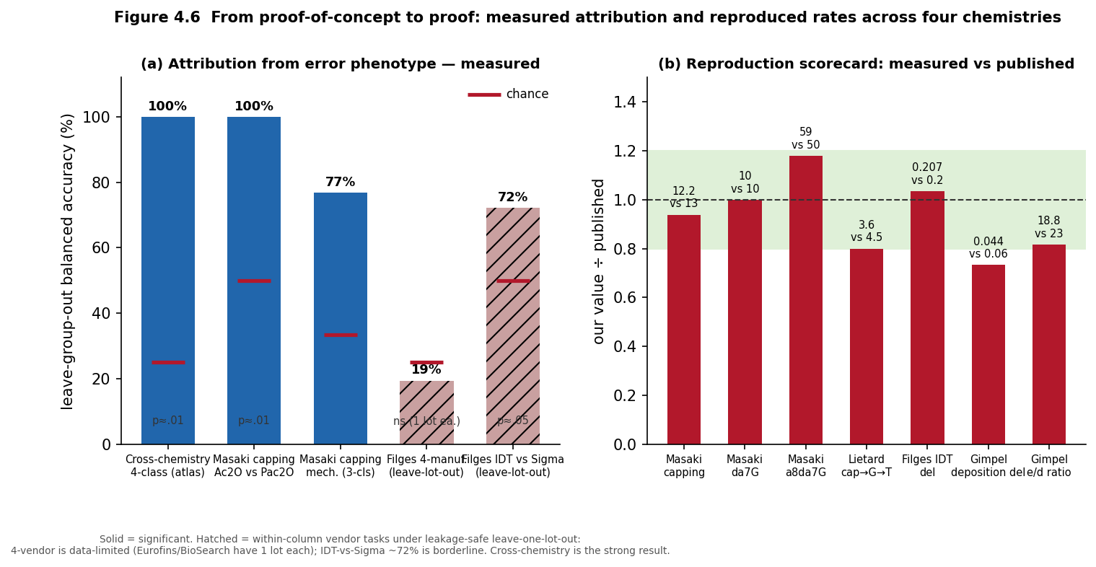
From proof-of-concept to proof
Cross-chemistry attribution: 100%. Within-vendor: hard. Built on a co-processed atlas of 65 runs.
Leave-one-run-out (chemistry) and leave-one-lot-out (vendor), label-shuffle controlled
DNA synthesis screening under device proliferation
18
Notes:
And I built the binding-constraint artifact: a single co-processed reference atlas — all four datasets through one pipeline, sixty-five runs. On it, cross-chemistry attribution is essentially perfect: a hundred percent balanced accuracy, permutation p around point-oh-one. Within-chemistry vendor attribution, by contrast, is hard: under leakage-safe validation the four-vendor task isn't supported and near-neighbour vendors reach only about seventy-two percent. That's an honest, rigor-improving result — it corrected an earlier number that had been inflated by replicate leakage.

Slide 24
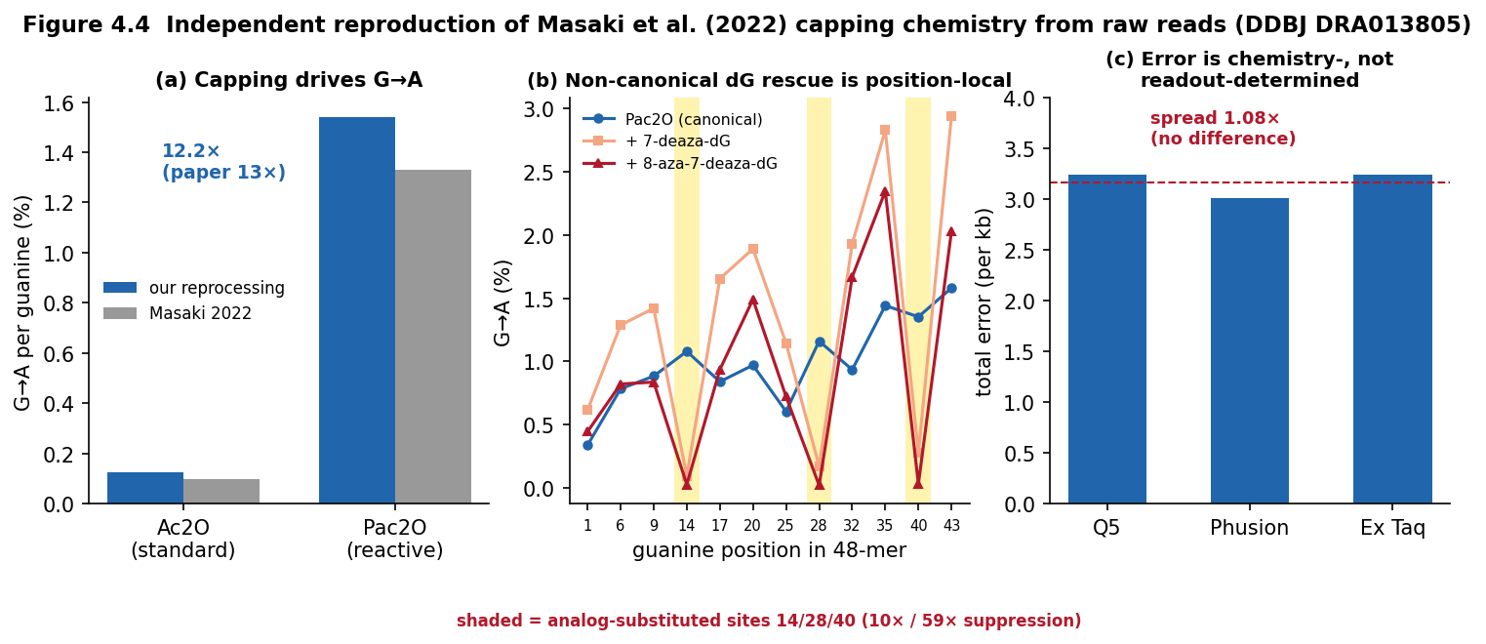
A testable DIY-vs-commercial tell
OpenIDS omits the capping step — so its product should carry a distinguishable phenotype.
Capping drives the G→A signature (reproduced 12.2×)
No capping → suppressed G→A
No capping → elevated n−1 deletions
Awaits collaborator OpenIDS reads (IBBIS-reviewed)
DNA synthesis screening under device proliferation
19
Notes:
Finally, a concrete, mechanistically-anchored prediction. OpenIDS uses standard column chemistry but omits the capping step. I reproduced that the G-to-A signature is capping-driven — a twelve-point-two-fold shift. So OpenIDS product should show a suppressed G-to-A signature and elevated single-base internal deletions — a distinguishable DIY-versus-commercial phenotype. It's a hypothesis, not yet a measurement, because Kim deposited no sequencing data; testing it needs collaborator OpenIDS reads, infohazard-reviewed through IBBIS. That's the single highest-value next step.

Slide 25
Durable vs illusory control
The frontier problem is function-based screening, not sequence similarity alone.
Durable (conditional on R1)
Illusory
On-device screening
Mandatory provider compliance
Functional-SOC detection
International coordination
Forensic attribution (the backstop)
Reagent restriction
Solvent restriction
Printhead / component controls
Single point-of-sale screening
DNA synthesis screening under device proliferation
20
Notes:
Pulling it together: the durable levers, conditional on R1, are on-device screening, mandatory provider compliance, functional detection, international coordination, and forensic attribution as the backstop. The illusory ones are supply-chain restrictions of every kind. And the live frontier problem is function-based screening: the Paraphrase Project showed that even after coordinated patching, about three percent of AI-designed functional protein variants still escape similarity-based screening — which is exactly what the October 2026 functional-sequence-of-concern provision is meant to close.

Slide 26
The contribution
From threat-ranking to governance-architecture design — with a working forensic backstop.
Screening must be mandatory, on-device, international, and backstopped by attribution.
Notes:
So, to conclude. Screening is being strengthened for good reason, but a single point-of-sale control is insufficient. My work maps which levers hold, shows that supply-chain restriction is not one of them, quantifies how far a US mandate reaches — under a quarter of makers — and delivers a forensic backstop that is now demonstrated, not just proposed: four reproduced chemistries and a real, one-hundred-percent cross-chemistry classifier. The problem shifts from preventing DIY synthesis to governing a proliferating-device world with a layered, mandatory, regime-conditional architecture — backstopped by attribution for the devices and residual routes it cannot reach. Thank you.

