Slide 1
Player 1
C
D
7
10
C
7
0
Player 2
0
3
D
10
3

Slide 2
Player 1
C
D
“C” = cooperate or open science
“D” = defect or closed science
E.g., If both players cooperate, each gets 7 points reward.
If both players defect, each gets 3 points reward.
If one defects, other doesn’t, defector gets 10, cooperator gets 0
See github/olendorf/
gametheoryopenscience
7
10
C
7
0
Player 2
0
3
D
10
3

Slide 3
Graph of payoff vs strategy frequency

Slide 4
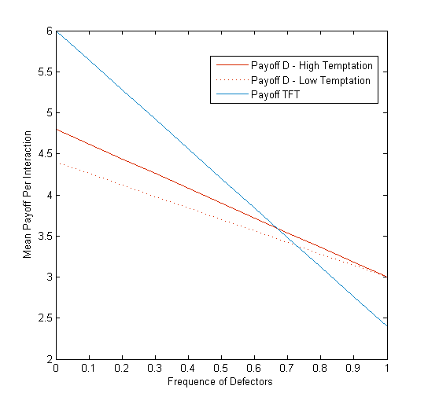
If frequency of cooperators is
Low (high freq. defect.)
then defectors (D) wins
If frequency of cooperators is high enough (low freq. defect.)
then cooperation (TFT) wins
Moving the crossing point to the right is good for open science. Can do this by increasing payoff for open science, reducing temptation to D, or many other things.

Slide 5
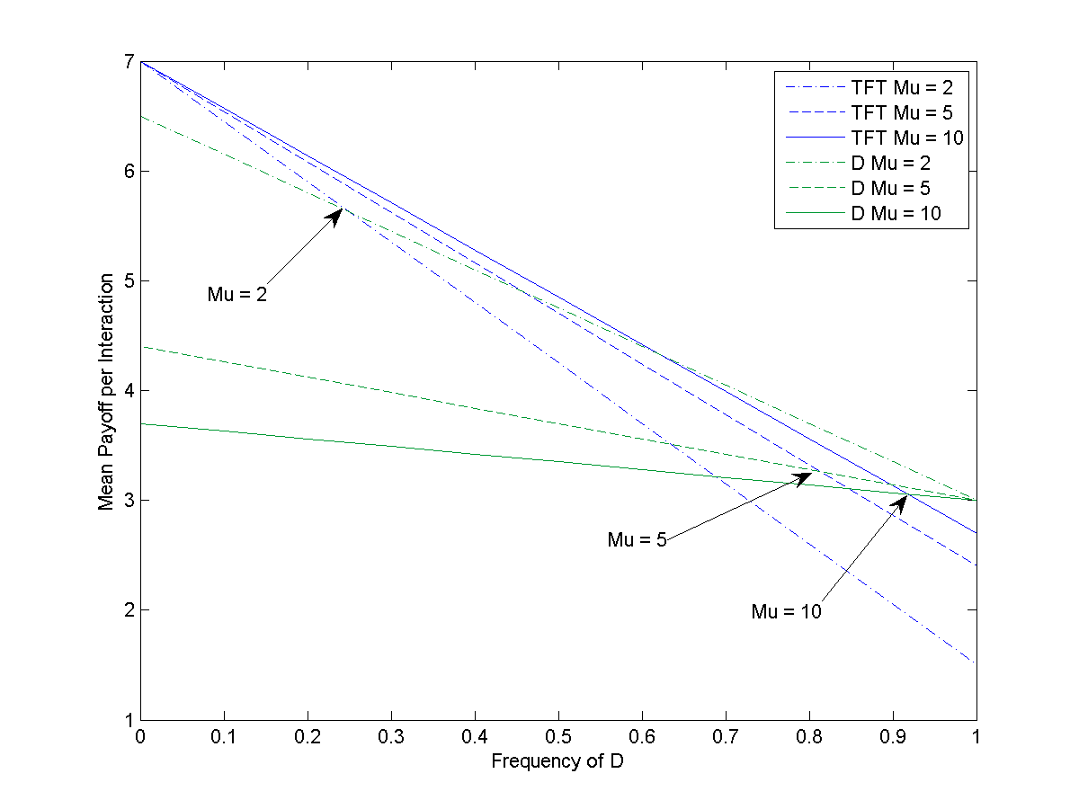
As the length of interactions increases
the critical point moves in favor of TFT.

Slide 6
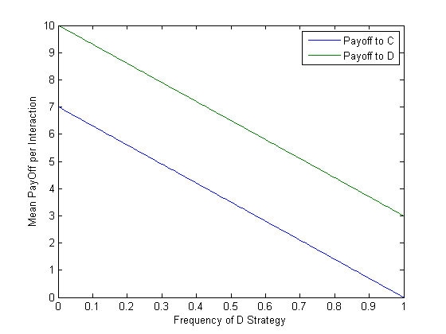

Slide 7
(D) wins
(TFT) wins

