Slide 1
Player 1
C
D
7
10
C
7
0
Player 2
0
3
D
10
3

Slide 2
Player 1
C
D
“C” = cooperate or open science
“D” = defect or closed science
E.g., If both players cooperate, each gets 7 points reward.
If both players defect, each gets 3 points reward.
If one defects, other doesn’t, defector gets 10, cooperator gets 0
See github/olendorf/
gametheoryopenscience
7
10
C
7
0
Player 2
0
3
D
10
3

Slide 3
Graph of payoff vs strategy frequency

Slide 4
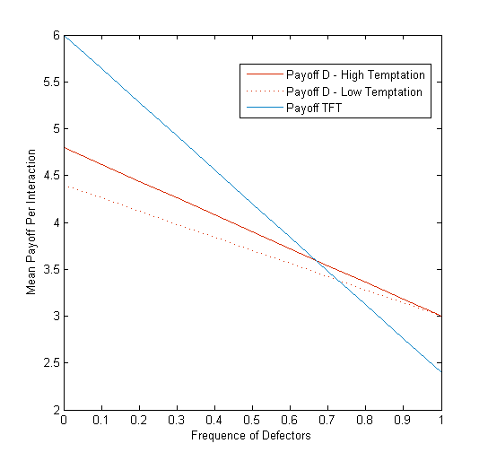
Strategies:
(1) D = defection,
closed science
(2) TFT = tit for tat, open science until burned by defector
(SJK: I can’t remember what temptation refers
to)
One take home message Even with TFT, open
science reaches tipping point with enough participation
Figures by Rob Olendorf see github/olendorf/
gametheoryopenscience
If frequency of open science cooperators low
(high freq. defect.)
then closed science (D) wins
If frequency of open science cooperators high enough
(low freq. defect.)
then Open Science (TFT) pays off
Moving the crossing point to the right is good for open science. Can do this by increasing payoff for open science, reducing temptation to D, or many other things.

Slide 5
