Slide 1
9_31_20
Q9 The following group of statements relates to your views on the use of data across your research field. Tell us how much you agree with each using the following scale: agree strongly, agree somewhat, neither agree nor disagree, disagree somewhat, disagree strongly
9_31_20
Q9_1 Lack of access to data generated by other researchers or institutions is a major impediment to progress in science.
Q9_2 Lack of access to data generated by other researchers or institutions has restricted my ability to answer scientific questions.
Q9_3 Data may be misinterpreted due to complexity of the data.
Q9_4 Data may be misinterpreted due to poor quality of the data.
Q9_5 Data may be used in other ways than intended.

Slide 2
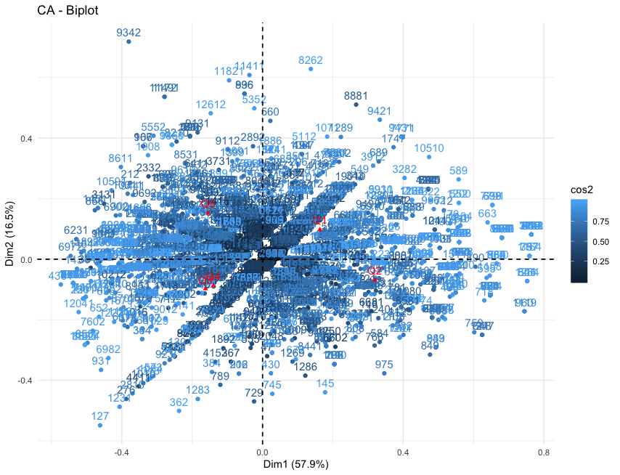
9_31_20

Slide 3
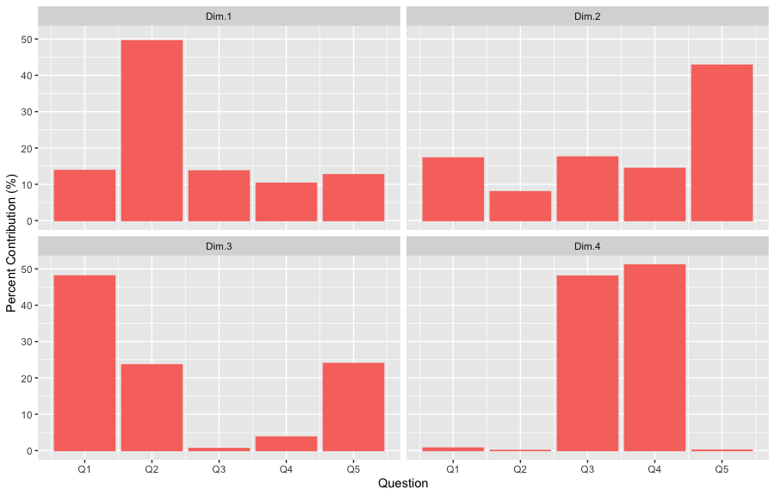
9_31_20
 | Dim.1 | Dim.2 | Dim.3 | Dim.4
Q1 | 13.8 | 17.3 | 48.1 | 0.7
Q2 | 49.5 | 8.0 | 23.6 | 0.1
Q3 | 13.7 | 17.5 | 0.6 | 48.0
Q4 | 10.3 | 14.4 | 3.7 | 51.1
Q5 | 12.7 | 42.8 | 24.0 | 0.1

Slide 4
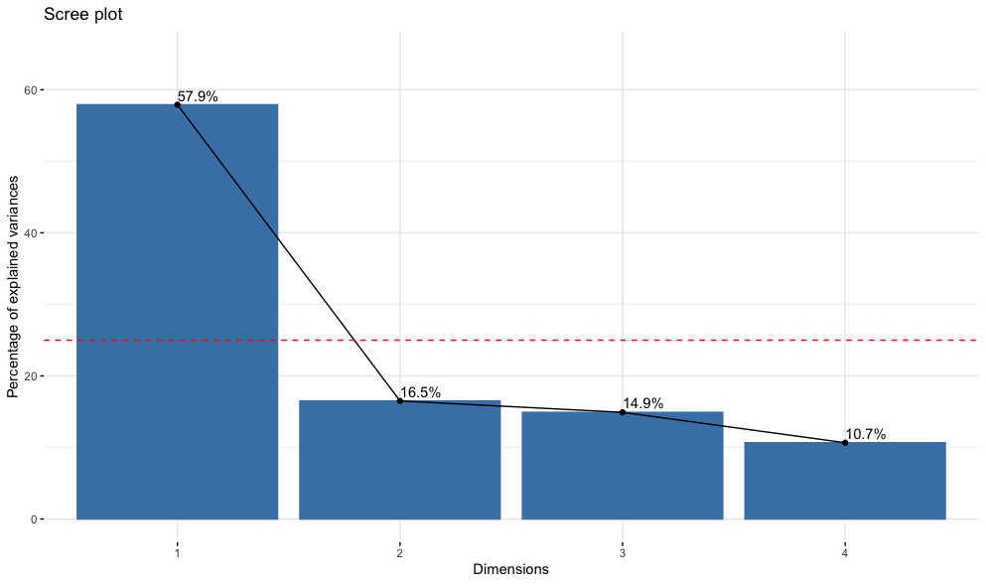
9_31_20

Slide 5
10_32_19
Q19 The following statements relate to sharing scientific data. Tell us how much you agree with each statement. 1 = Disagree strongly, 2 = Disagree somewhat, 3 = Neither agree nor disagree, 4 = Agree somewhat, 5 = Agree strongly, 6 = Not Sure
10_32_19
Q19_1 I would use other researchers' datasets if their datasets were easily accessible.
Q19_2 I would be willing to place at least some of my data into a central data repository with no restrictions.
Q19_3 I would be willing to place all of my data into a central data repository with no restrictions
Q19_4 I would be more likely to make my data available if I could place conditions on access.
Q19_5 I am satisfied with my ability to integrate data from disparate sources to address research questions.
Q19_6 I would be willing to share data across a broad group of researchers.
Q19_7 It is important that my data are cited when used by other researchers.

Slide 6
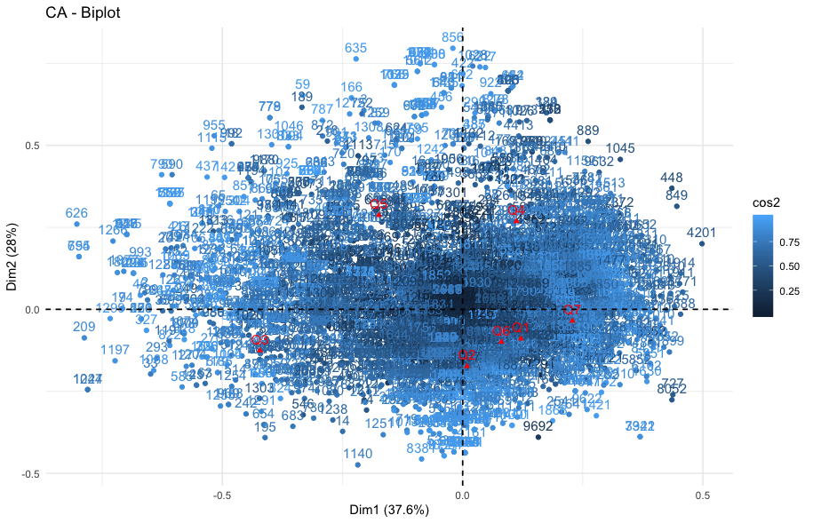
10_32_19

Slide 7
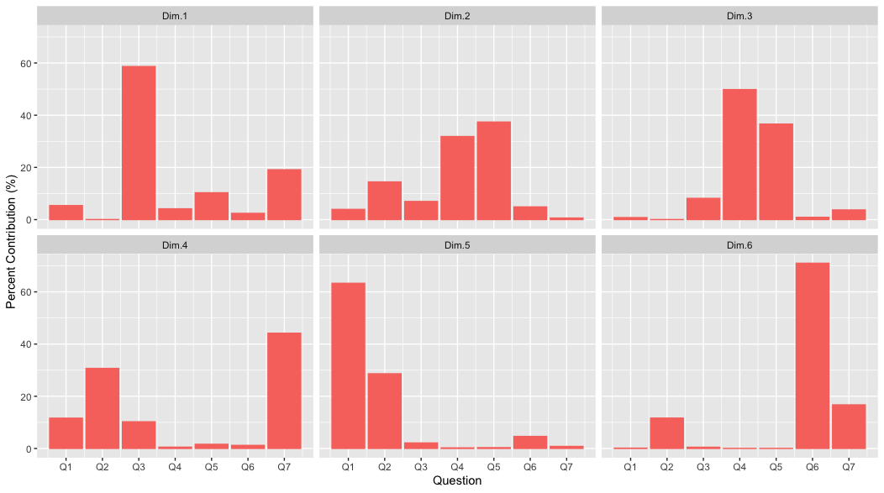
10_32_19

Slide 8
10_32_19
 | Dim.1 | Dim.2 | Dim.3 | Dim.4 | Dim.5 | Dim.6
Q1 | 5.4 | 3.9 | 0.8 | 11.6 | 63.3 | 0.1
Q2 | 0.0 | 14.4 | 0.0 | 30.7 | 28.6 | 11.6
Q3 | 58.6 | 7.0 | 8.1 | 10.2 | 2.1 | 0.5
Q4 | 4.1 | 31.8 | 49.8 | 0.5 | 0.2 | 0.0
Q5 | 10.3 | 37.4 | 36.6 | 1.6 | 0.3 | 0.0
Q6 | 2.4 | 4.9 | 0.9 | 1.2 | 4.6 | 71.0
Q7 | 19.1 | 0.6 | 3.7 | 44.2 | 0.8 | 16.7

Slide 9
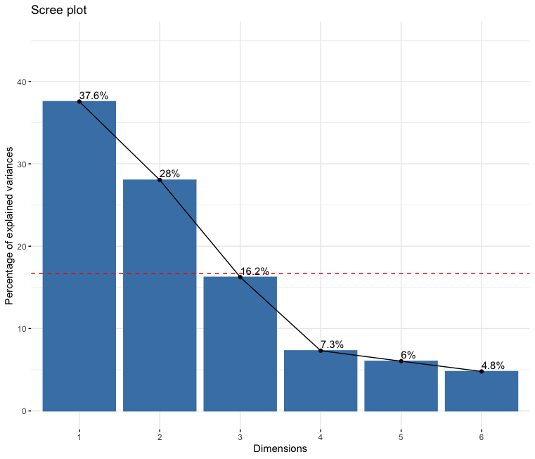
10_32_19

Slide 10
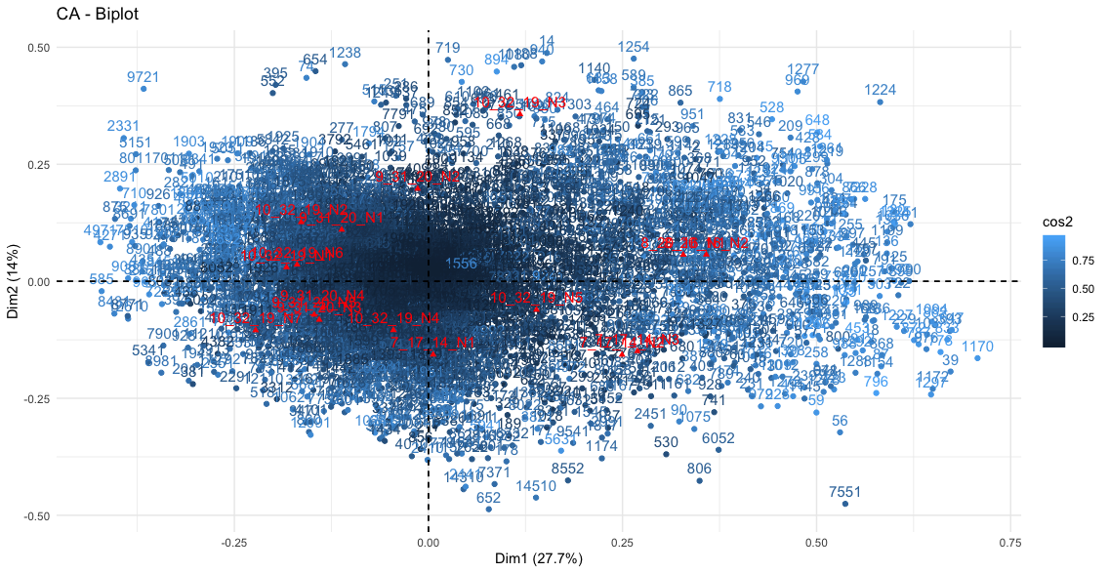
7_17_14, 8_20_16, 9_31_20, 10_32_10

Slide 11
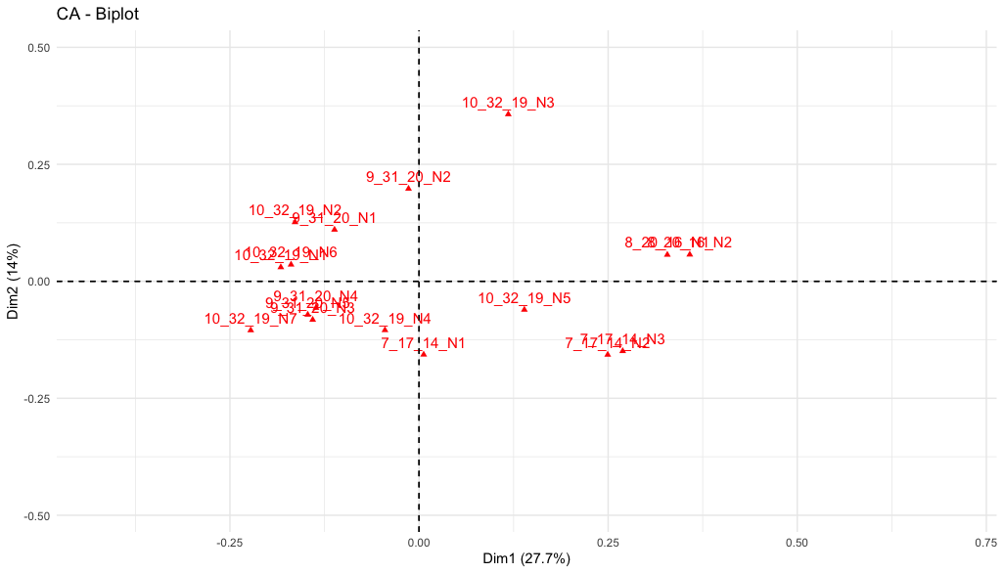
7_17_14, 8_20_16, 9_31_20, 10_32_10

Slide 12
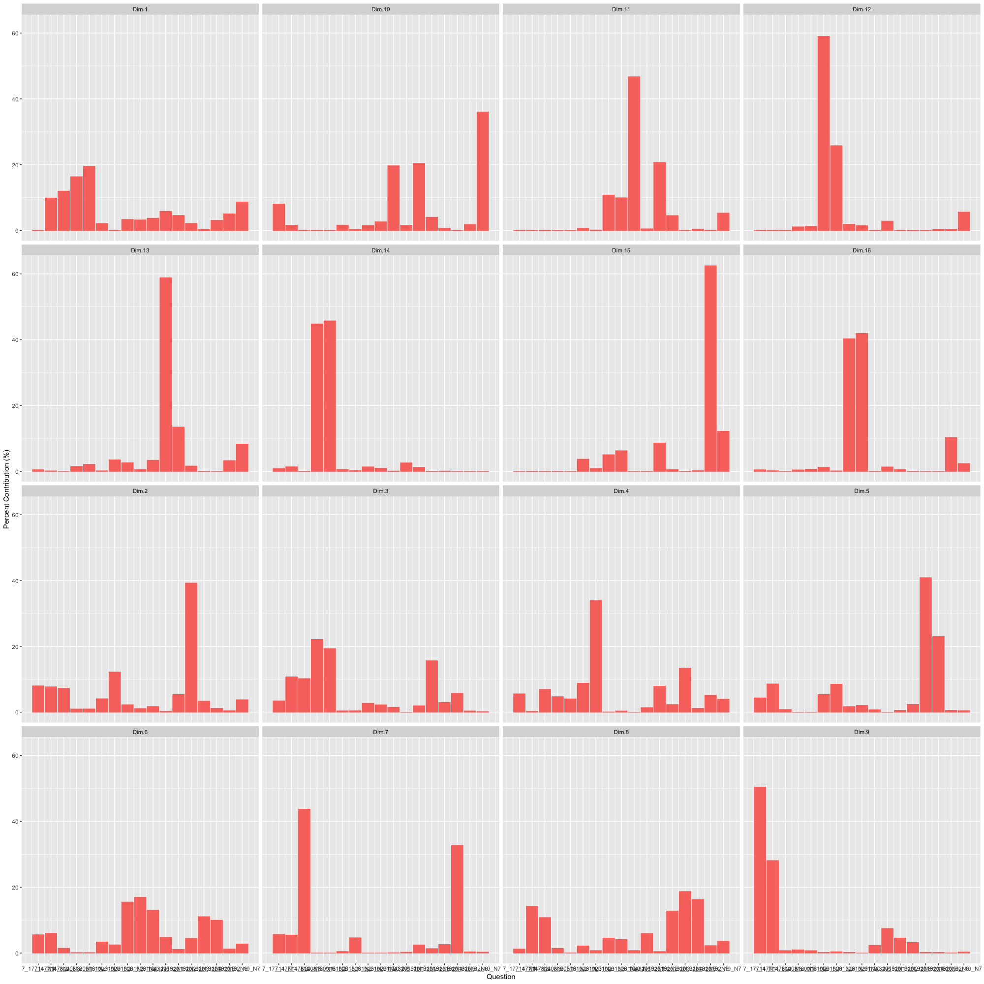

7_17_14
8_20_16
9_31_20
10_32_10

Slide 13
7_17_14
8_20_16
9_31_20
10_32_10
 | Dim.1 | Dim.2 | Dim.3 | Dim.4
7_17_14_N1 | 0.0 | 8.0 | 3.5 | 5.6
7_17_14_N2 | 9.9 | 7.7 | 10.7 | 0.3
7_17_14_N3 | 12.0 | 7.3 | 10.2 | 7.0
8_20_16_N1 | 16.3 | 1.0 | 22.1 | 4.7
8_20_16_N2 | 19.5 | 1.0 | 19.3 | 4.1
9_31_20_N1 | 2.1 | 4.1 | 0.4 | 8.8
9_31_20_N2 | 0.0 | 12.2 | 0.4 | 33.9
9_31_20_N3 | 3.4 | 2.3 | 2.7 | 0.1
9_31_20_N4 | 3.2 | 1.1 | 2.2 | 0.4
9_31_20_N5 | 3.8 | 1.7 | 1.5 | 0.0
10_32_19_N1 | 5.8 | 0.3 | 0.0 | 1.4
10_32_19_N2 | 4.6 | 5.4 | 1.9 | 7.9
10_32_19_N3 | 2.2 | 39.2 | 15.6 | 2.3
10_32_19_N4 | 0.3 | 3.4 | 3.0 | 13.4
10_32_19_N5 | 3.1 | 1.2 | 5.8 | 1.2
10_32_19_N6 | 5.1 | 0.4 | 0.4 | 5.1
10_32_19_N7 | 8.7 | 3.8 | 0.2 | 4.0

Slide 14
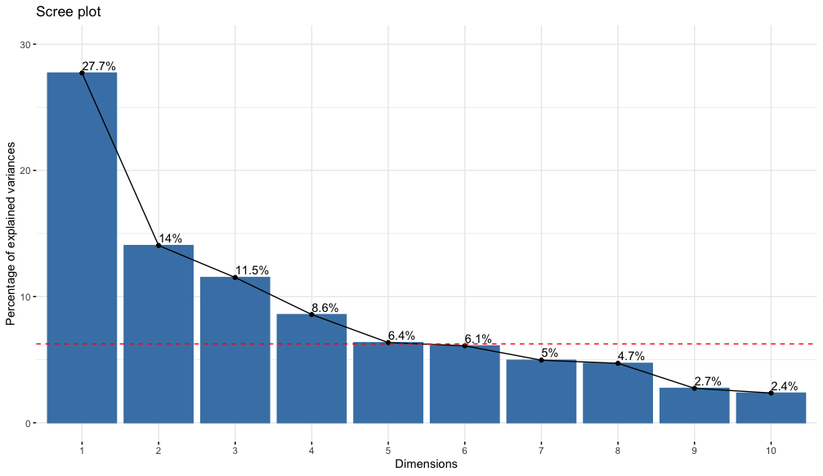
7_17_14
8_20_16
9_31_20
10_32_10

Slide 15
7_17_14, 8_20_16, 9_31_20, 10_32_10
7_17_14_N1 Q7_4… I am satisfied with the process for storing my data during the life of the project (short-term)
7_17_14_N2 Q7_5… I am satisfied with the process for storing my data beyond the life of the project (long-term)
7_17_14_N3 Q7_9… I am satisfied with the tools for preparing metadata.
8_20_16_N1 Q8_1 My organization or project has a formal established process for managing data during the life of the project (short-term).
8_20_16_N2 Q8_2 My organization or project has a formal established process for storing data beyond the life of the project (long-term).
9_31_20_N1 Q9_1 Lack of access to data generated by other researchers or institutions is a major impediment to progress in science.
9_31_20_N2 Q9_2 Lack of access to data generated by other researchers or institutions has restricted my ability to answer scientific questions.
9_31_20_N3 Q9_3 Data may be misinterpreted due to complexity of the data.
9_31_20_N4 Q9_4 Data may be misinterpreted due to poor quality of the data.
9_31_20_N5 Q9_5 Data may be used in other ways than intended.
10_32_19_N1 Q10_1 I would use other researchers' datasets if their datasets were easily accessible.
10_32_19_N2 Q10_2 I would be willing to place at least some of my data into a central data repository with no restrictions.
10_32_19_N3 Q10_3 I would be willing to place all of my data into a central data repository with no restrictions.
10_32_19_N4 Q10_4 I would be more likely to make my data available if I could place conditions on access.
10_32_19_N5 Q10_5 I am satisfied with my ability to integrate data from disparate sources to address research questions.
10_32_19_N6 Q10_6 I would be willing to share data across a broad group of researchers who use data in different ways.
10_32_19_N7 Q10_7 It is important that my data are cited when used by other researchers.

