Slide 1
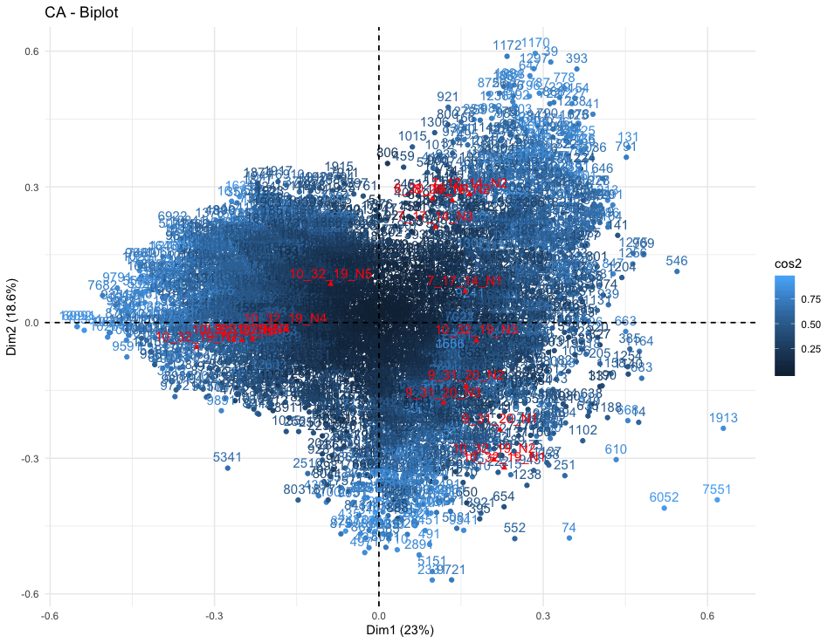
7_17_14, 8_20_16, 9_31_20, 10_32_10

Slide 2
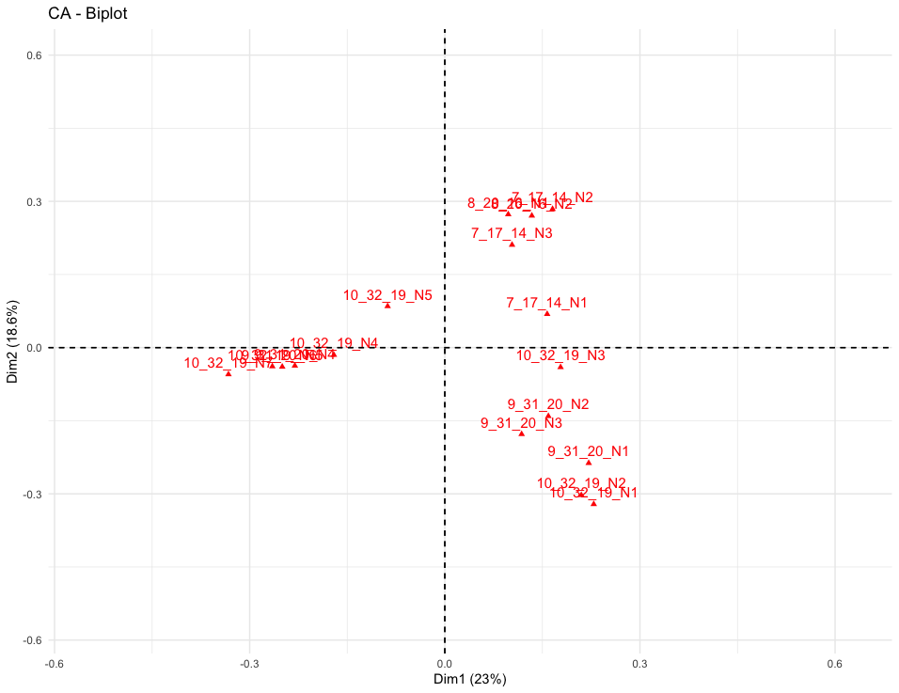
7_17_14, 8_20_16, 9_31_20, 10_32_10

Slide 3
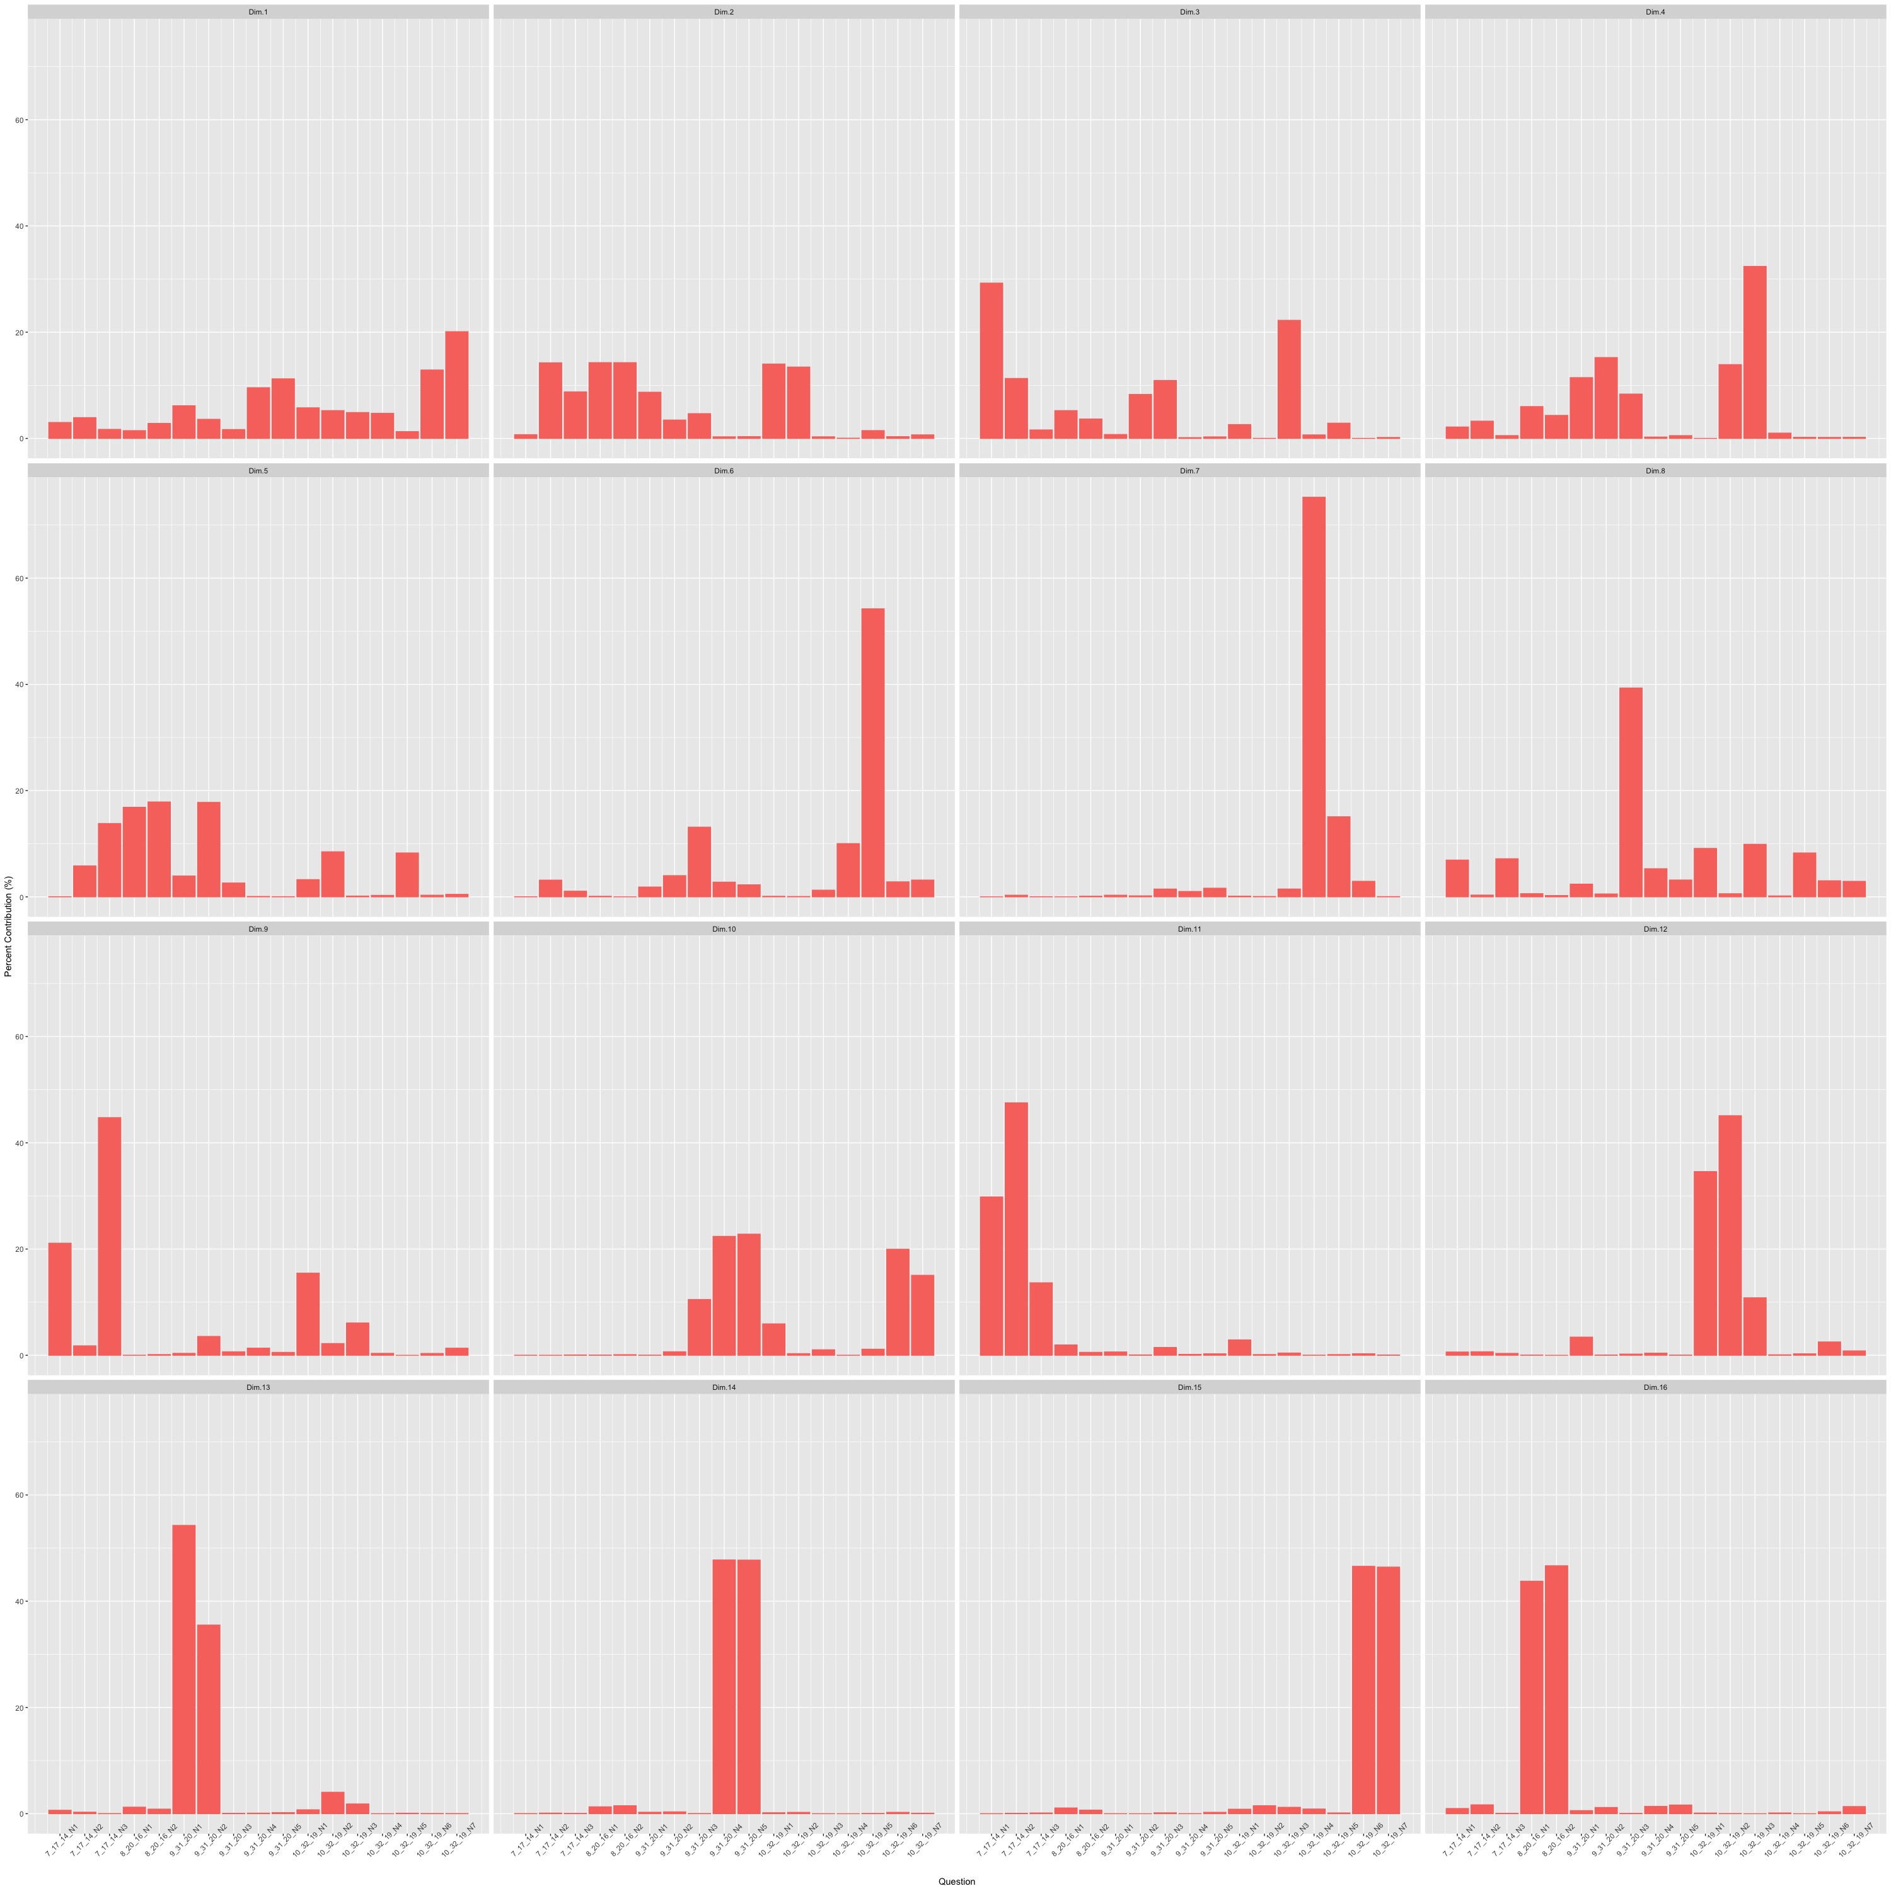
7_17_14
8_20_16
9_31_20
10_32_10

Slide 4
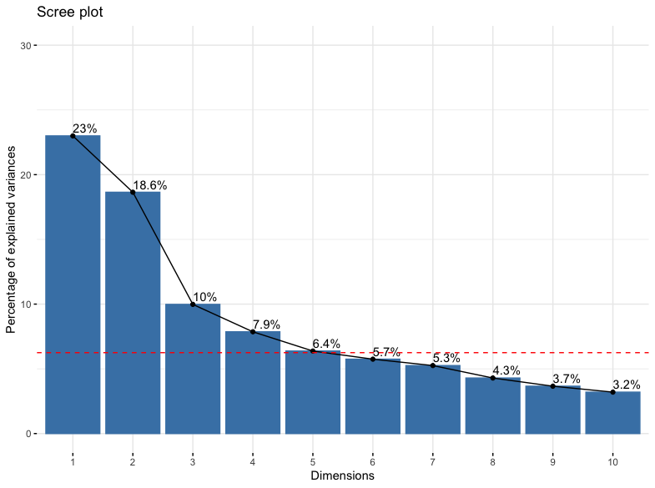
7_17_14
8_20_16
9_31_20
10_32_10

Slide 5
7_17_14, 8_20_16, 9_31_20, 10_32_10
7_17_14_N1 Q7_4… I am satisfied with the process for storing my data during the life of the project (short-term)
7_17_14_N2 Q7_5… I am satisfied with the process for storing my data beyond the life of the project (long-term)
7_17_14_N3 Q7_9… I am satisfied with the tools for preparing metadata.
8_20_16_N1 Q8_1 My organization or project has a formal established process for managing data during the life of the project (short-term).
8_20_16_N2 Q8_2 My organization or project has a formal established process for storing data beyond the life of the project (long-term).
9_31_20_N1 Q9_1 Lack of access to data generated by other researchers or institutions is a major impediment to progress in science.
9_31_20_N2 Q9_2 Lack of access to data generated by other researchers or institutions has restricted my ability to answer scientific questions.
9_31_20_N3 Q9_3 Data may be misinterpreted due to complexity of the data.
9_31_20_N4 Q9_4 Data may be misinterpreted due to poor quality of the data.
9_31_20_N5 Q9_5 Data may be used in other ways than intended.
10_32_19_N1 Q10_1 I would use other researchers' datasets if their datasets were easily accessible.
10_32_19_N2 Q10_2 I would be willing to place at least some of my data into a central data repository with no restrictions.
10_32_19_N3 Q10_3 I would be willing to place all of my data into a central data repository with no restrictions.
10_32_19_N4 Q10_4 I would be more likely to make my data available if I could place conditions on access.
10_32_19_N5 Q10_5 I am satisfied with my ability to integrate data from disparate sources to address research questions.
10_32_19_N6 Q10_6 I would be willing to share data across a broad group of researchers who use data in different ways.
10_32_19_N7 Q10_7 It is important that my data are cited when used by other researchers.

