Slide 1
Legitimacy, Justice and Justification of Intergroup Violence between the Police and Protestors in Chile
Monica Gerber, Universidad Diego Portales
Ana Figueiredo, Universidad de O’Higgins
Luciano Sáez, Universidad de Buenos Aires
Macarena Orchard, Universidad Diego Portales
33rd Meeting of the German Peace Psychology Forum
2022

Slide 2
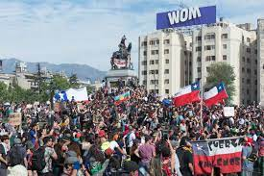
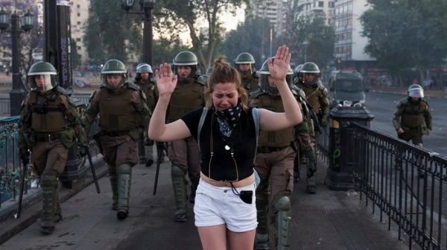
Context
Violent protest and police repression all over the world (Flom, 2022)
Social outbreak of October 2019 in Chile – Human rights violations
Grave loss of police legitimacy (Dammert, 2020)
But… why is the loss of police legitimacy so relevant?

Slide 3
Legitimacy, procedural justice and violence
Legitimacy is key to promote law compliance (Jackson & Bradford, 2019) and cooperation with authorities (Jackson et al, 2012)
The most relevant predictor of police legitimacy is perceived police procedural justice
Low procedural justice and low police legitimacy radicalizes protest and support for violent means to achieve social change among indigenous groups (Gerber et al., 2018)
Vicious circle: intergroup conflict and violence
Procedural justice
Legitimacy
Support for violence

Slide 4
Legitimacy, procedural justice and violence
Gerber, M. M., González, R., Carvacho, H., Jiménez-Moya, G., Moya, C., & Jackson, J. (2018). On the justification of intergroup violence: The roles of procedural justice, police legitimacy, and group identity in attitudes toward violence among indigenous people. Psychology of Violence, 8(3), 379–389.

Slide 5
Research objectives
Explore the effects of perceived police procedural justice and police legitimacy on support for intergroup violence
Moderating role of identification with protestors: procedural justice is a more relevant predictor among people who identify with the group who received the treatment (Gerber et al., 2018.
Justification of police violence
Perceived procedural injustice against protestors
Perceived police legitimacy
Identification with protestors
Justification of protestor violence

Slide 6
Method
Online survey on legitimacy and police violence
January 2021
n = 2.594
Quota sampling: gender, age and socio-economic status
First wave of a 3-wave study
Analyses
Confirmatory factor analysis of all four measures
Path analysis to test moderated mediation

Slide 7
Method
Measures
Procedural justice: e.g. “To what extent do the police treat protestors with dignity and respect”
Legitimacy: e.g., “You must support the police’s decisions even if you don’t agree”
Support for police violence: e.g., “To what extent is it justified for the police to use teargas”
Support for protestor violence: e.g., “Block streets even if prohibited by the police”

Slide 8
Results
59,7%
-0,07*
Justification of police violence
89,3%
Perceived procedural injustice against protestors
+0,59**
Perceived police legitimacy
-0,76**
73,4%
-0,47**
Justification of protestor violence
+0,15**

Slide 9
Results
59,7%
-0,07*
Justification of police violence
89,3%
Perceived procedural injustice against protestors
+0,59**
Perceived police legitimacy
-0,76**
73,4%
-0,47**
Justification of protestor violence
+0,15**
Indirect effects
Police violence: β = -0,45**

Slide 10
Results
59,7%
-0,07*
Justification of police violence
89,3%
Perceived procedural injustice against protestors
+0,59**
Perceived police legitimacy
-0,76**
73,4%
-0,47**
Justification of protestor violence
+0,15**
Total effect
Police violence: β = -0,53**

Slide 11
Results
59,7%
-0,07*
Justification of police violence
89,3%
Perceived procedural injustice against protestors
+0,59**
Perceived police legitimacy
-0,76**
73,4%
-0,47**
Justification of protestor violence
+0,15**
Indirect effects
Protestor violence: β = +0,36**

Slide 12
Results
59,7%
-0,07*
Justification of police violence
89,3%
Perceived procedural injustice against protestors
+0,59**
Perceived police legitimacy
-0,76**
73,4%
-0,47**
Justification of protestor violence
+0,15**
Total effect
Protestor violence: β = -0,52**

Slide 13
Results
59,7%
-0,07*
Justification of police violence
89,3%
Perceived procedural injustice against protestors
+0,60**
Perceived police legitimacy
-0,76**
73,6%
-0,47**
Justification of protestor violence
+0,15**
-0,02*
+0,03*
Directly experienced violence
+0,04**
Vicariously experienced violence

Slide 14
Results
59,7%
-0,07*
Justification of police violence
89,3%
Perceived procedural injustice against protestors
+0,60**
Perceived police legitimacy
-0,76**
73,6%
-0,47**
Justification of protestor violence
+0,15**
+0,05**
-0,02*
+0,17**
+0,03*
Directly experienced violence
+0,04**
Indirect effects
Police violence: β = -0,02**
Protestor violence: β = 0,019**
Vicariously experienced violence
Indirect effects
Police violence: β = -0,08**
Protestor violence: β = 0,06**

Slide 15
Conclusions
Vicious circle: experienced violence and perceived procedural injustice increase support for protestor violence
Police violence can be perceived as procedurally unfair if it does not follow protocols
Relevance of reducing police violence to reduce protestor violence
Secondary identification (with protestors) did not moderate the role of procedural justice on police legitimacy
Limitations: non-representative data; one-time measurement

Slide 16
Thank you! Contact: Monica Gerber (monica.gerber@udp.cl)

