Slide 1

Understanding the Modern Developer Community
Olesia Mironenko
June 24, 2026

Slide 2

OUTLINE
Executive Summary
Introduction
Methodology
Results
Visualization – Charts
Dashboard
Discussion
Findings & Implications
Conclusion
Appendix

Slide 3

EXECUTIVE SUMMARY
Project Objective: Analyze developer technology trends and demographics
Data Sources:
Technology survey data
Demographic survey data
Analysis Areas:
Current Technology Usage
Future Technology Trends
Developer Demographics
Key Deliverable: Developed interactive dashboards and visualizations
Business Value: Provides insights into technology adoption, emerging trends, and the characteristics of the developer community

Slide 4

INTRODUCTION
Report Purpose: Analyze developer survey data to understand technology usage, future technology preferences, and demographic characteristics.
Intended Audience: Technology professionals, students, and decision-makers.
Data Scope: Developer survey data on technology usage and preferences.
Key Benefits:
Understand current and emerging technology trends.
Gain insights into the developer community.

Slide 5

METHODOLOGY
Data Sources:
Technology survey dataset
Demographics survey dataset
Data Collection:
Survey responses collected from participants in the technology community
Data Preparation:
Filtered and aggregated survey data for analysis
Analysis & Visualization:
Identified technology and demographic trends
Created visualizations and dashboards in Looker Studio

Slide 6
RESULTS
Developed 3 interactive dashboards using Looker Studio.
Created 12 visualizations covering technology usage, future trends, and demographics.
Identified patterns in programming languages, databases, platforms, web frameworks, and respondent characteristics.
Generated insights to support technology planning and data-driven decision-making.

Slide 7
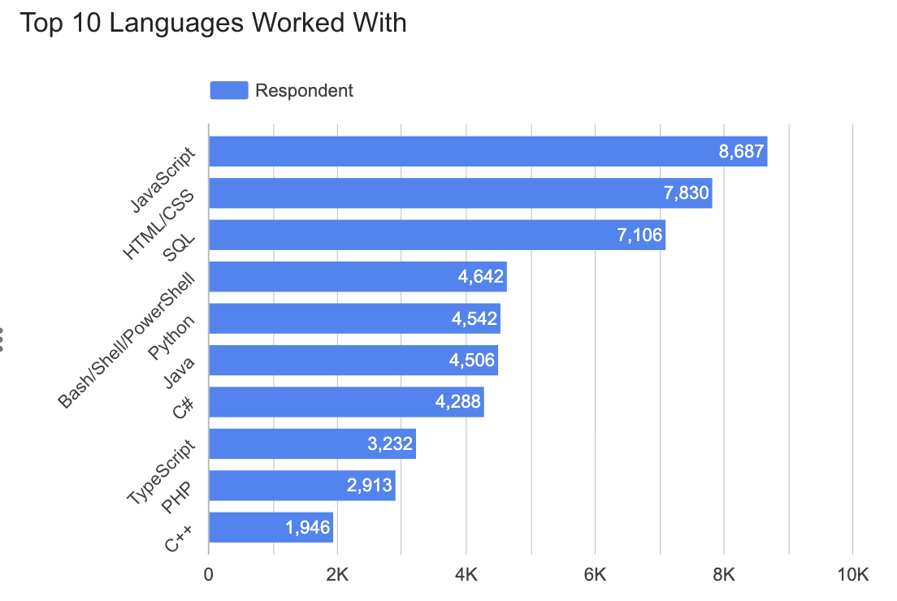
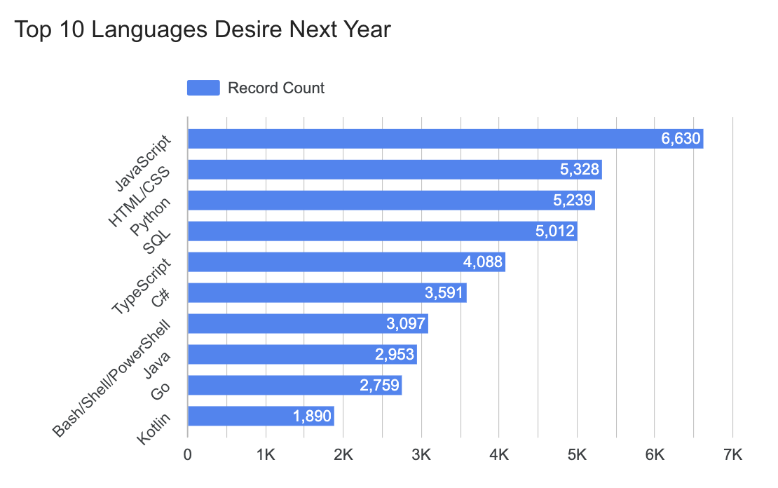
PROGRAMMING LANGUAGE TRENDS
Current Year
Next Year
<Bar chart of top 10 programming languages for the current year goes here.>
< Bar chart of top 10 programming languages for the next year goes here.>

Slide 8
PROGRAMMING LANGUAGE TRENDS - FINDINGS & IMPLICATIONS
Findings
JavaScript remains the most widely used and most desired programming language among respondents.
Python and TypeScript show strong growth in future preference rankings, indicating increasing interest in these technologies.
SQL, HTML/CSS, and Java continue to maintain significant relevance across the technology landscape.
Kotlin appears among the top desired languages despite not being among the most widely used currently.
Some established languages, such as C++, show lower future interest compared to emerging alternatives.
Implications
Demand for web development skills is expected to remain strong, particularly in the JavaScript ecosystem.
Professionals seeking career growth may benefit from developing Python and TypeScript expertise.
Organizations should monitor emerging technologies and evolving developer preferences when planning training and hiring strategies.
Continuous learning and skill development are essential to remain competitive in a rapidly changing technology environment.
Technology adoption trends suggest a growing focus on modern, scalable, and data-driven development practices.

Slide 9
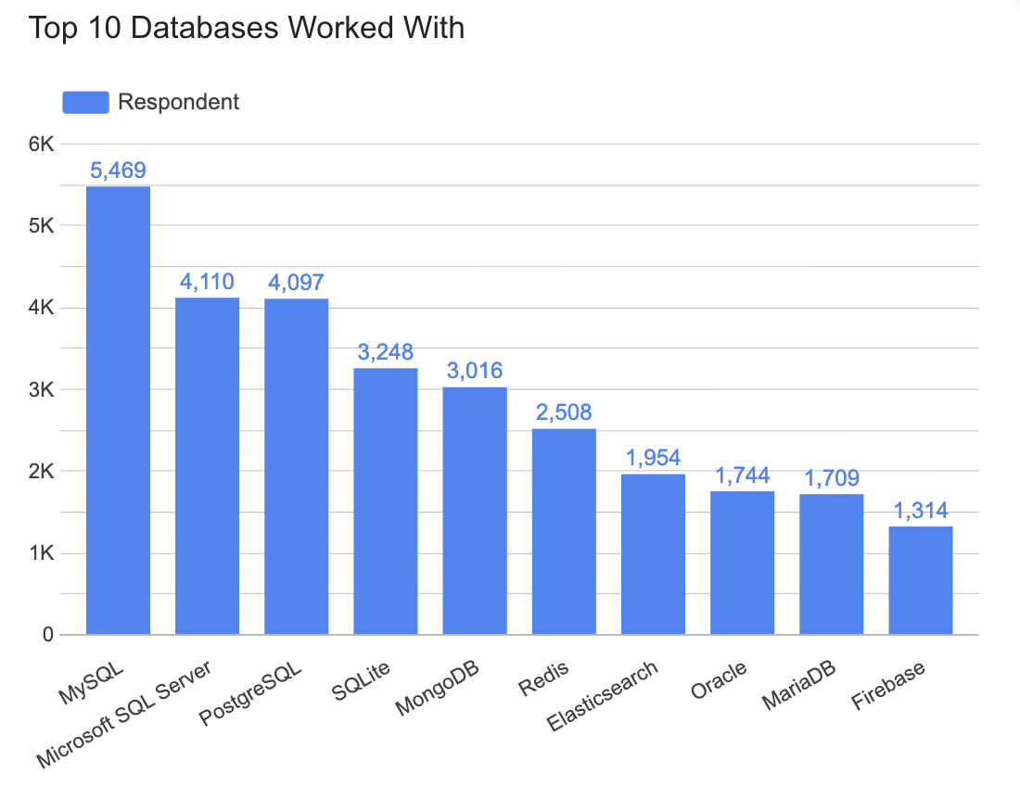
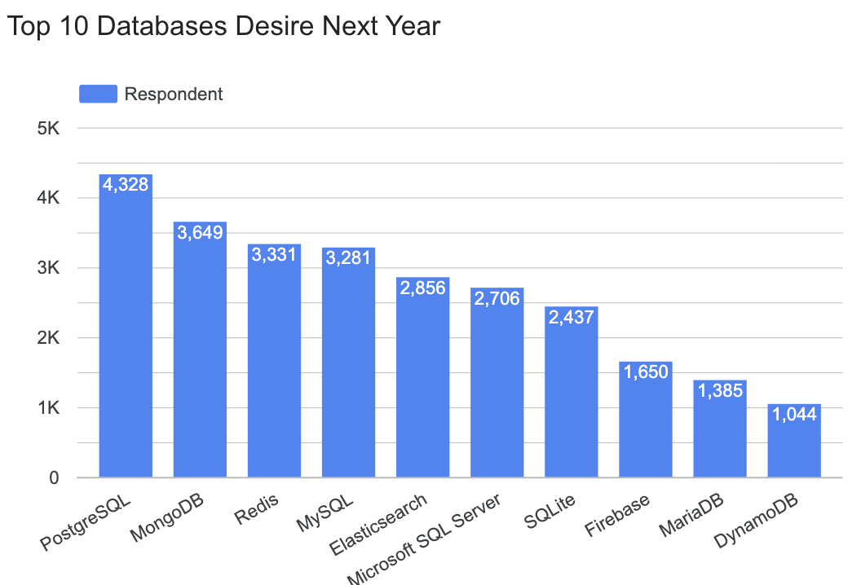
DATABASE TRENDS
Current Year
Next Year
< Bar chart of top 10 databases for the current year goes here >
< Bar chart of top 10 databases for the next year goes here.>

Slide 10
DATABASE TRENDS - FINDINGS & IMPLICATIONS
Findings
MySQL is currently the most widely used database, but PostgreSQL becomes the most desired database for next year.
PostgreSQL, MongoDB, Redis, and Elasticsearch all move up in future preference rankings, indicating growing interest in these technologies.
Traditional relational databases such as MySQL and Microsoft SQL Server remain highly relevant but show relatively lower future preference compared to current usage.
Firebase declines in current usage rankings but remains a desired option for future adoption, suggesting continued interest in cloud-native development.
DynamoDB enters the future top 10 despite not appearing among the most-used databases currently.
Implications
Organizations may see increased adoption of PostgreSQL due to its flexibility, open-source ecosystem, and broad support for modern applications.
Demand for NoSQL and distributed data technologies such as MongoDB, Redis, and DynamoDB is likely to continue growing.
Database professionals should consider expanding skills beyond traditional relational databases to include cloud and NoSQL platforms.
Training and hiring strategies should account for increasing interest in scalable, high-performance, and cloud-native database solutions.
The database landscape is becoming more diverse, requiring organizations to support multiple data storage technologies for different business needs.

Slide 11

DASHBOARD
Dashboard on Google Data Studio / former Looker Studio (alternative to Cognos dashboard):
https://datastudio.google.com/reporting/fa207be8-e459-4e46-afaa-547c3817393e

Slide 12
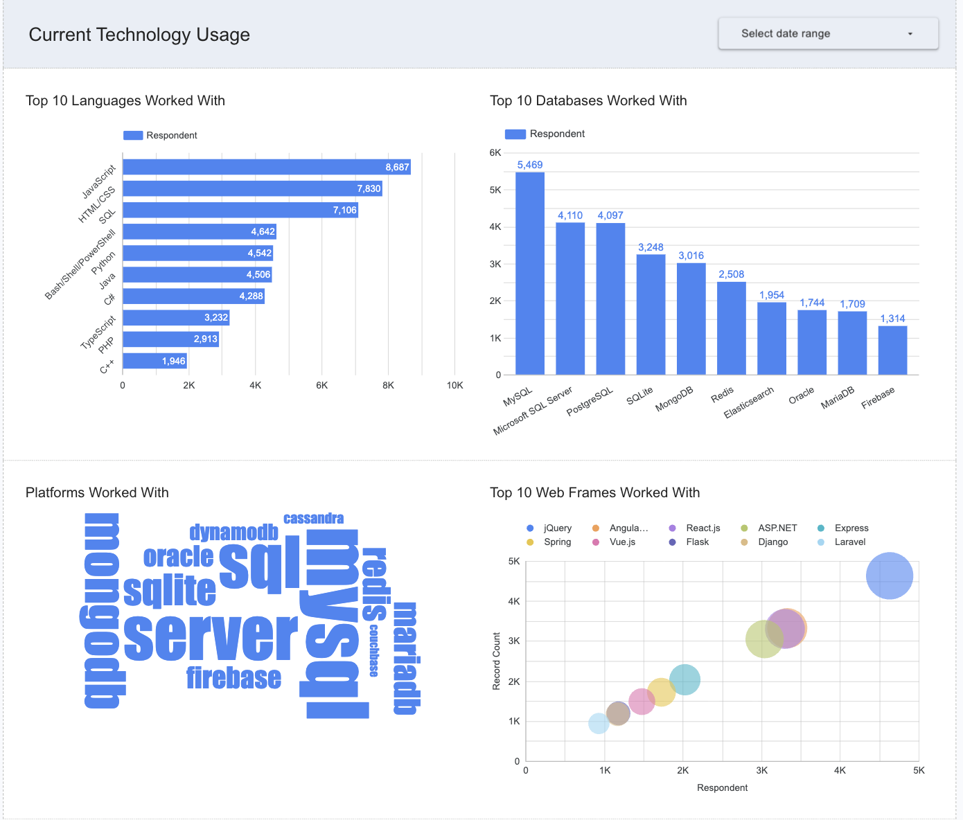
DASHBOARD TAB 1

Slide 13
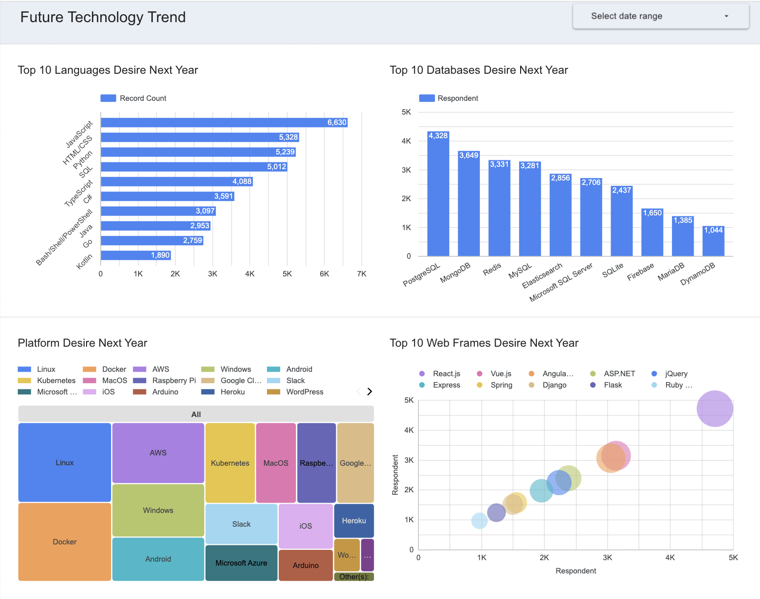
DASHBOARD TAB 2

Slide 14
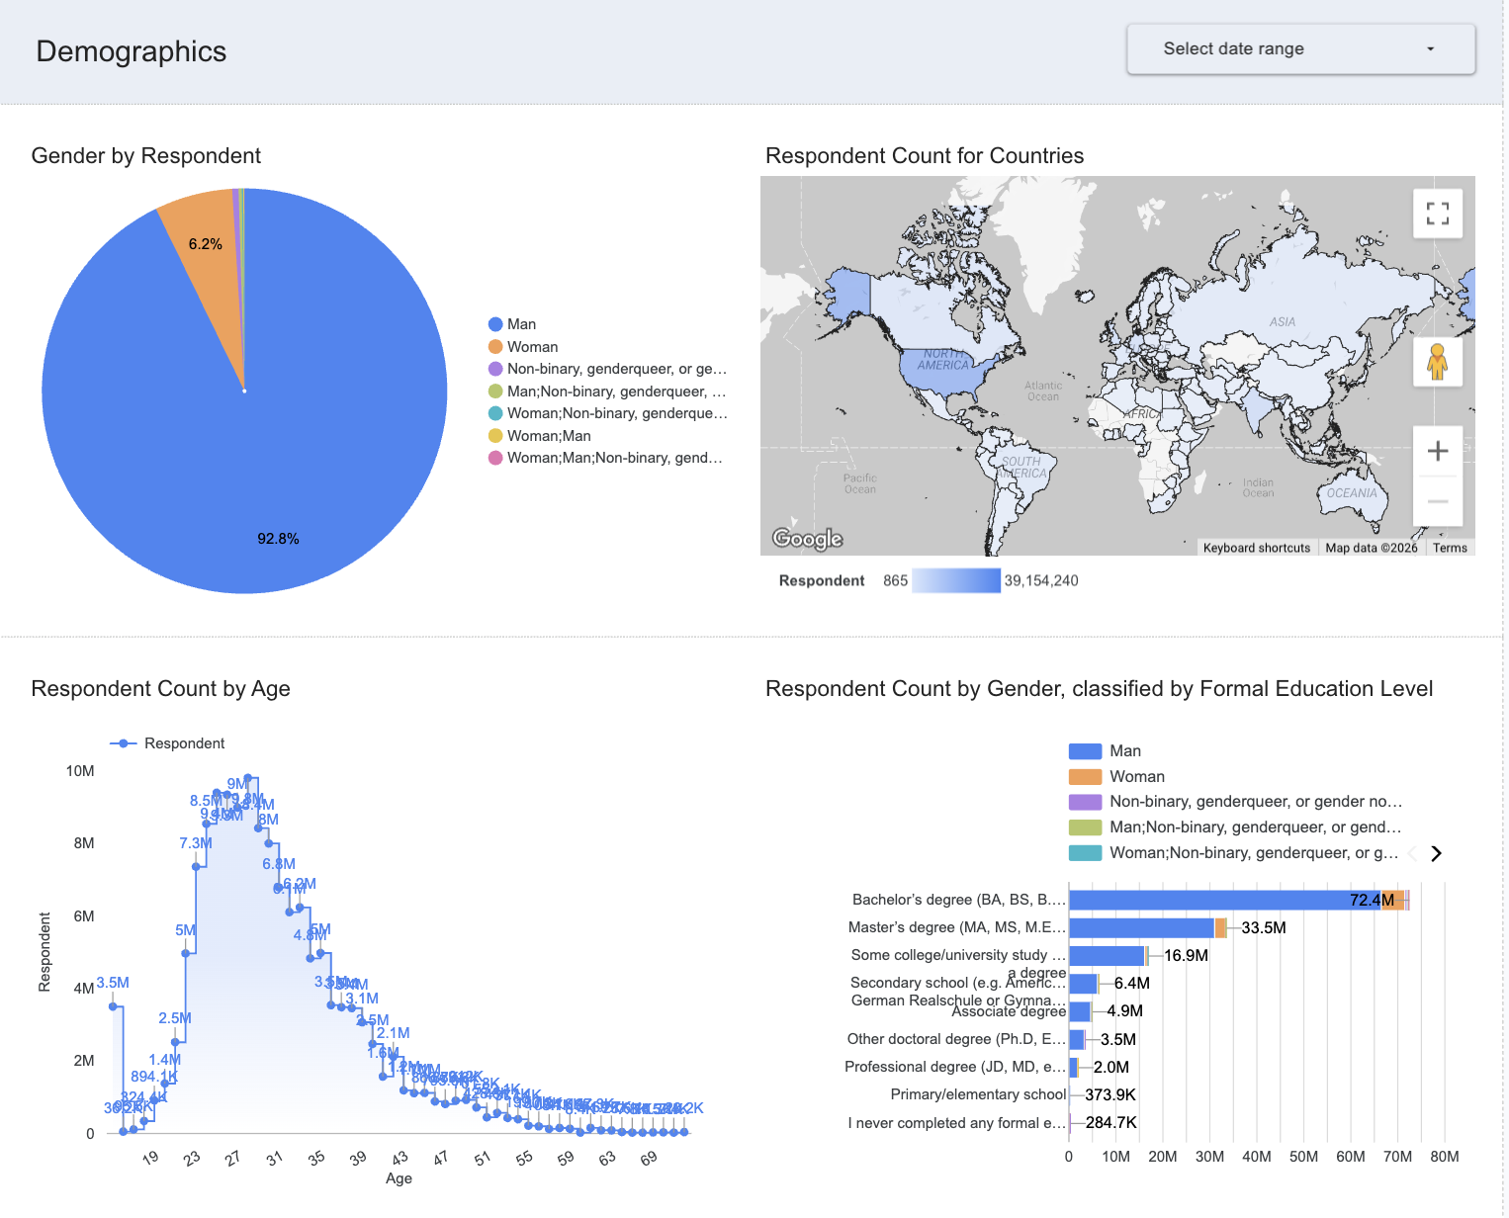
DASHBOARD TAB 3

Slide 15
DISCUSSION
Current technology usage reflects the continued importance of established tools.
Future preferences, on the other hand, point toward greater adoption of modern, cloud-based, and data-focused technologies.
Understanding these trends supports informed decisions in technology investment, hiring, and professional development.

Slide 16
OVERALL FINDINGS & IMPLICATIONS
Findings
The analysis highlights clear patterns in technology adoption and future preferences.
Demographic data enhances understanding of the technology landscape.
Interactive dashboards provide an effective way to explore complex survey results.
Implications
Data-driven insights support informed decision-making.
Regular trend analysis helps anticipate changes in the technology ecosystem.
Visual analytics makes large survey datasets more accessible and actionable.

Slide 17

CONCLUSION
Survey data reveals both stable technology adoption patterns and emerging technology trends.
Interactive dashboards effectively transform complex survey data into clear, actionable insights.
Combining technology and demographic analysis provides a more comprehensive understanding of the technology landscape.
The findings can support informed decisions in technology planning, workforce development, and professional learning.

Slide 18

APPENDIX
Include any relevant additional charts, or tables that you may have created during the analysis phase.

Slide 19
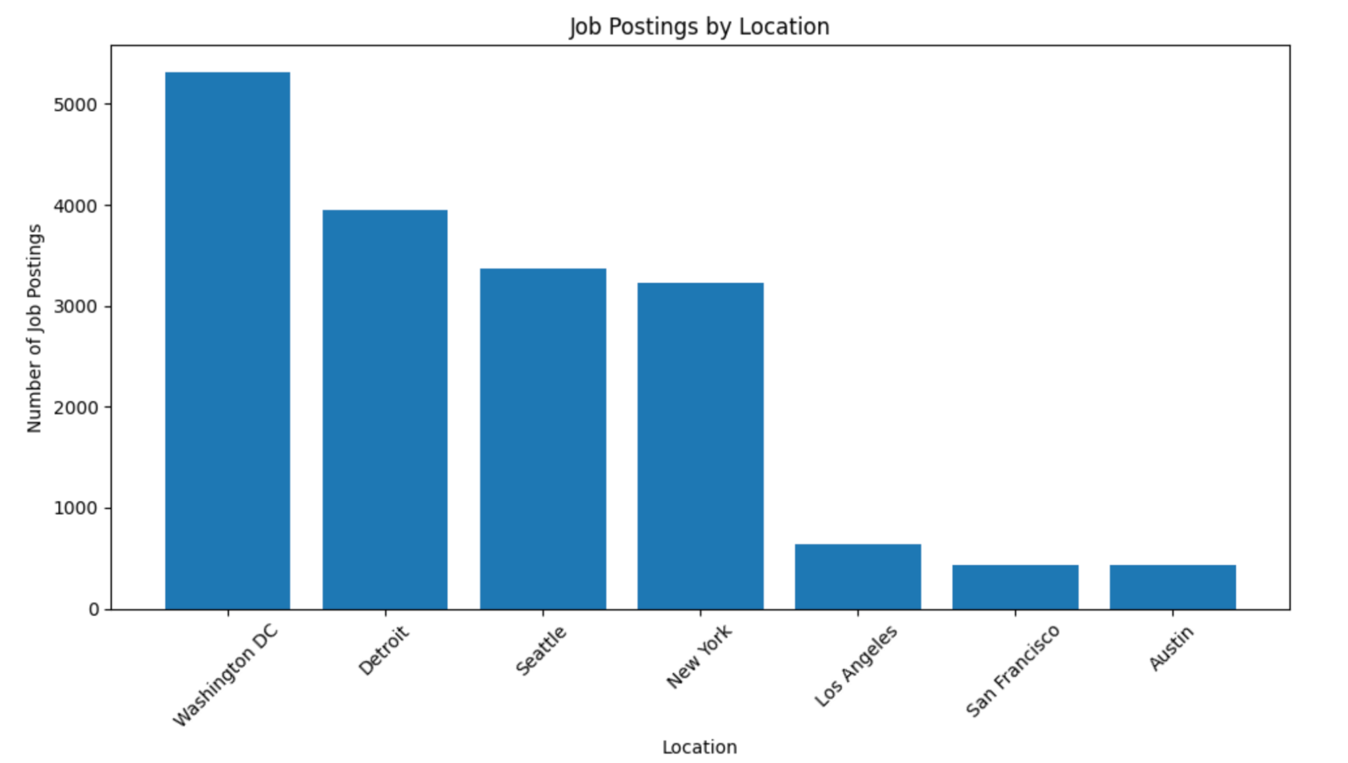
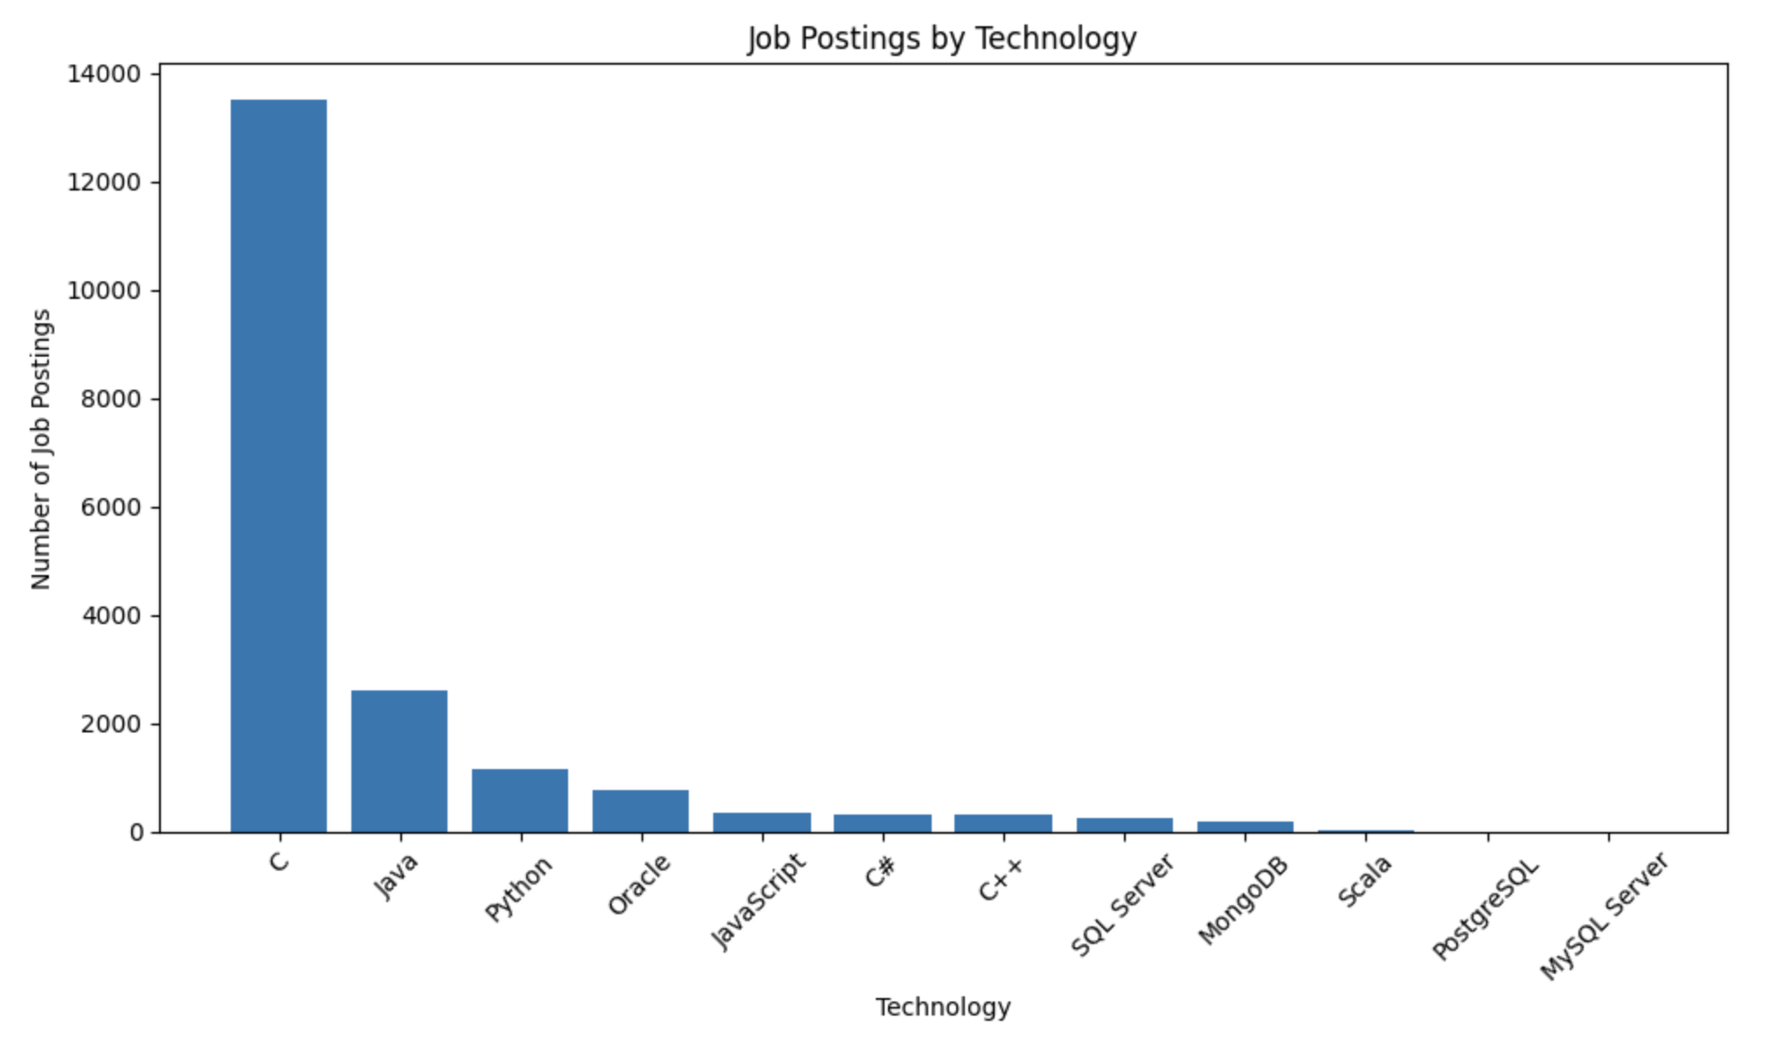
JOB POSTINGS

Slide 20
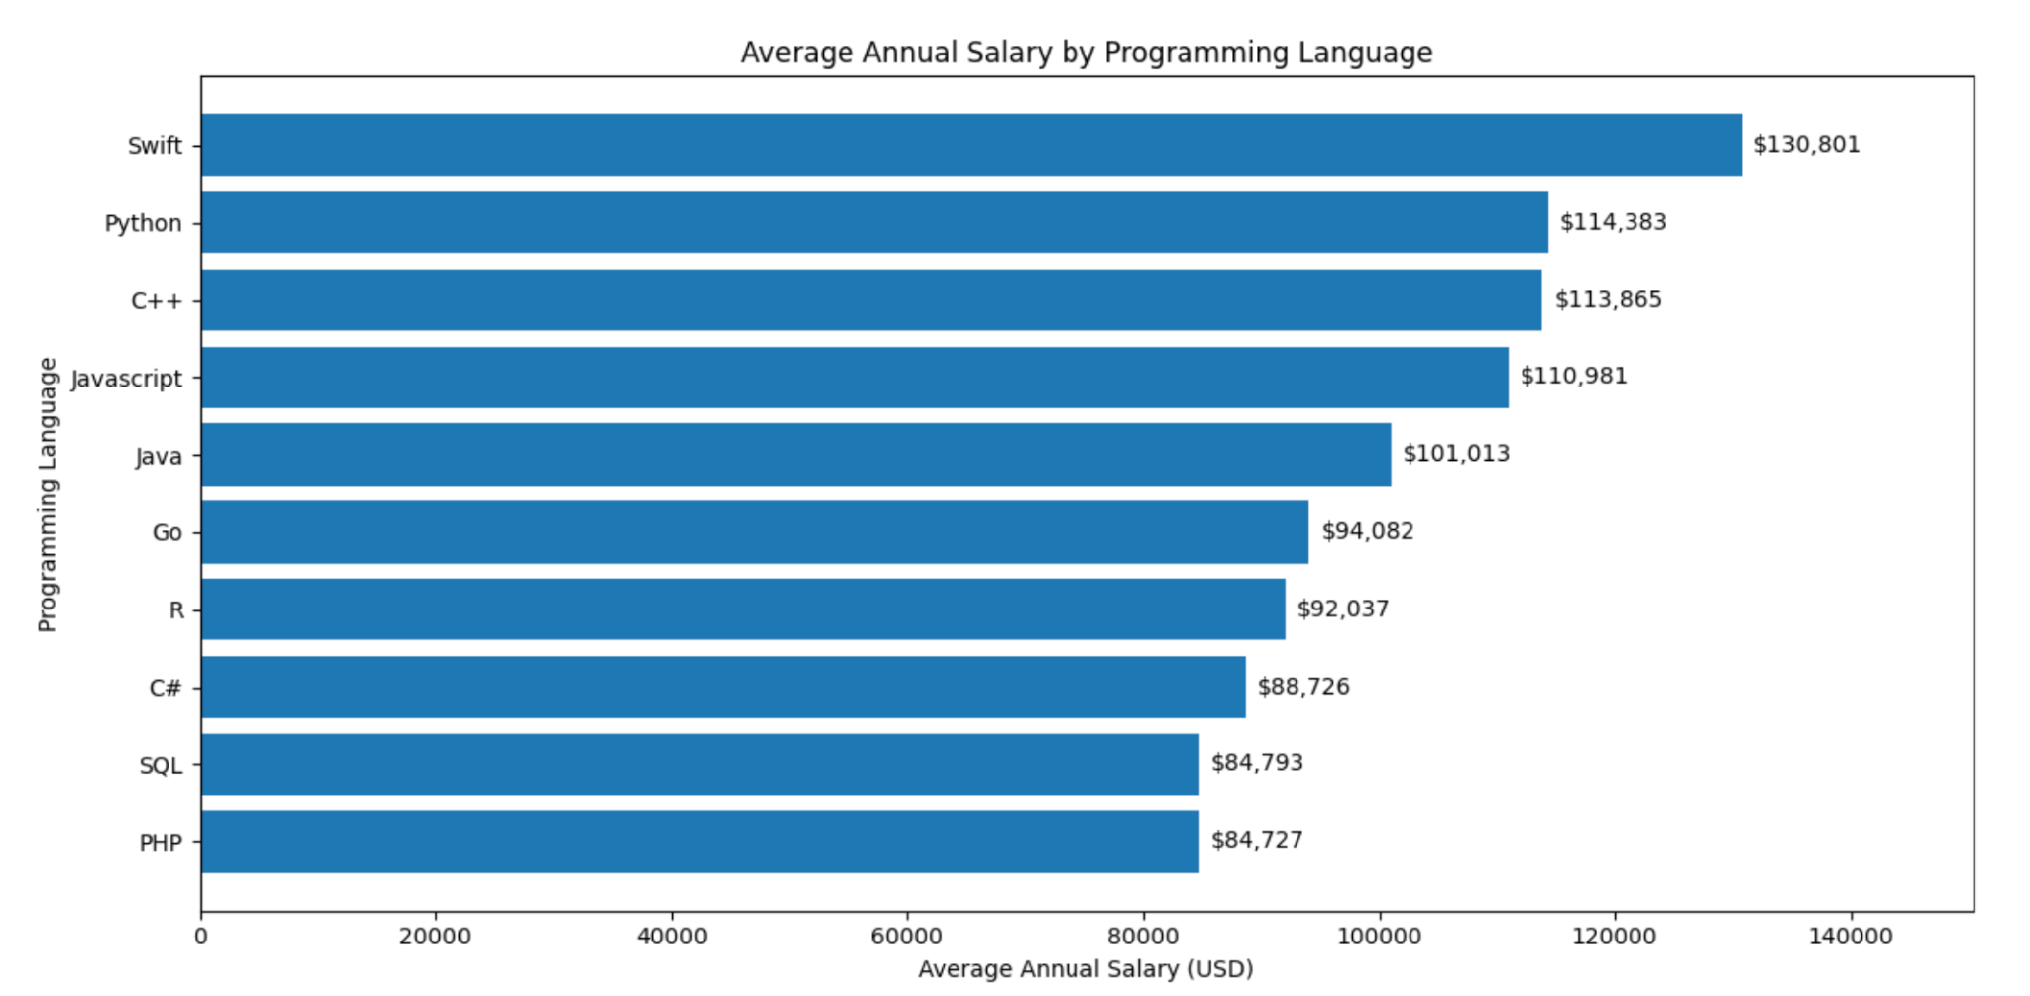
POPULAR LANGUAGES

