Slide 1
LSTM neural networks
Ole Schulz-Trieglaff
Hochreiter & Schmidhuber (1991)
London Data Science Journal Club
2015/10/22

Slide 2
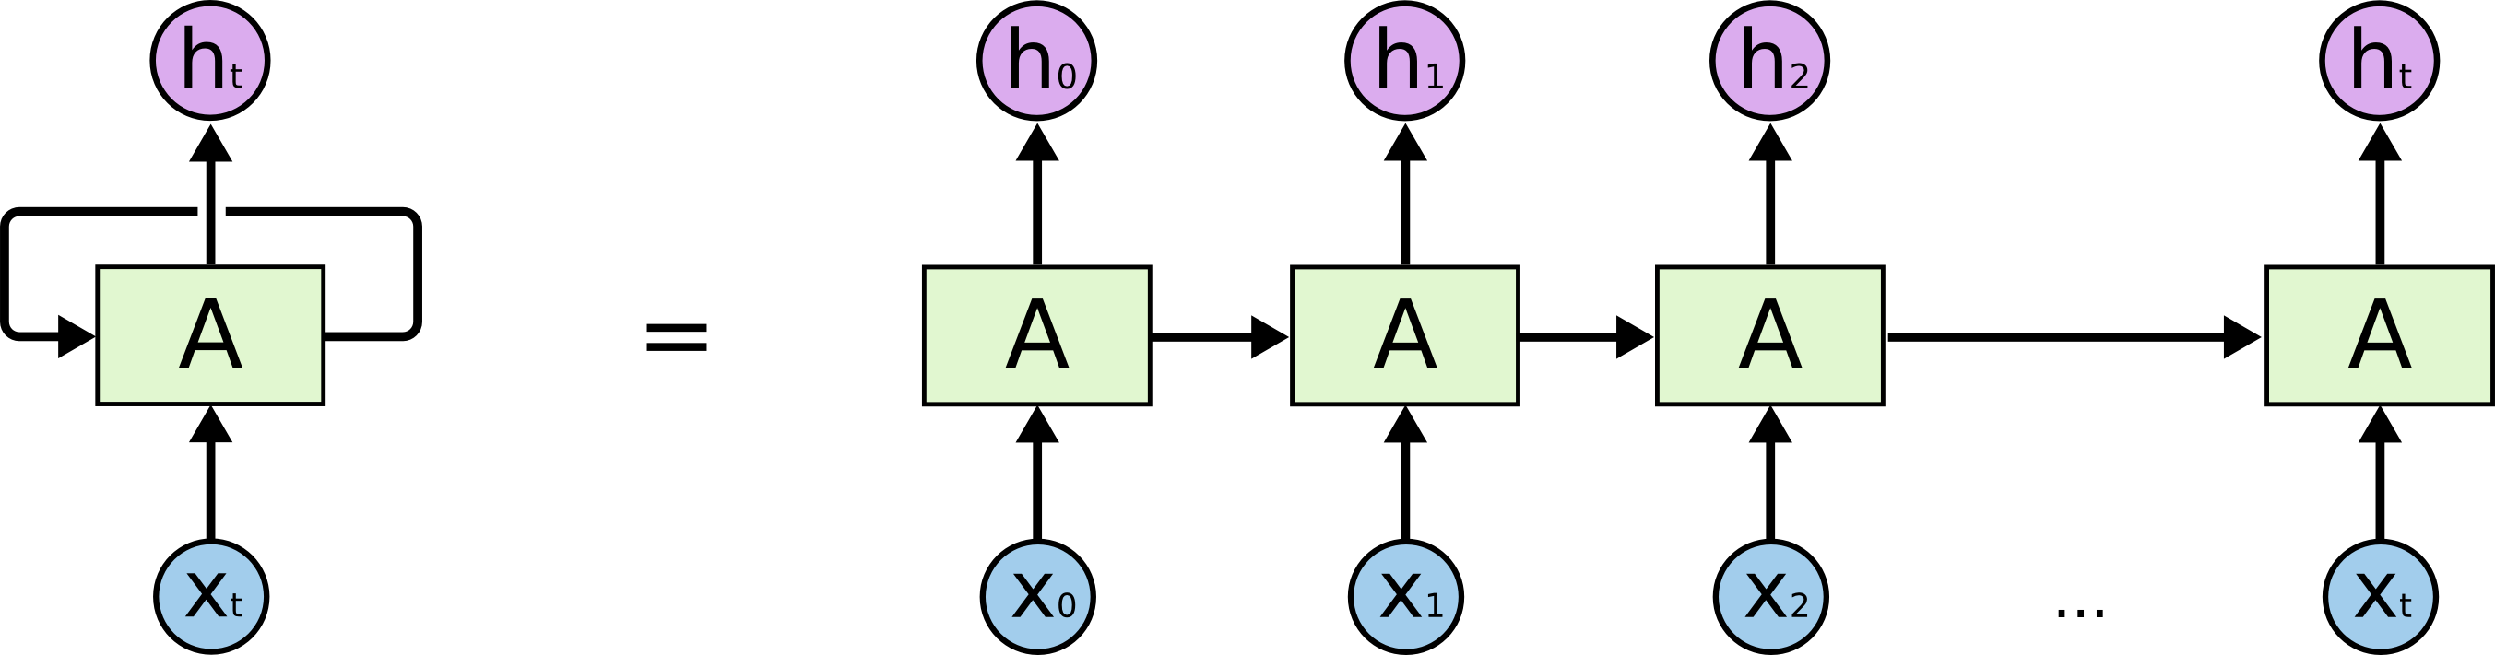
Recurrent Neural Network
Useful to learn sequences and correlations over time (speech, text, time series)
Unrolling a recurrent neural network
http://colah.github.io/posts/2015-08-Understanding-LSTMs/

Slide 3
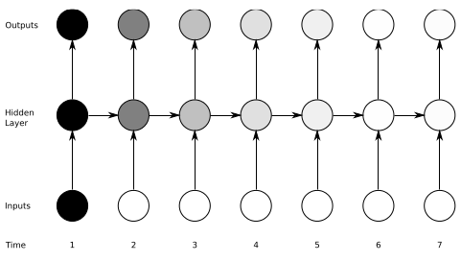
Vanishing gradient problem
From A.Graves
“Supervised
Sequence Labelling
with Recurrent
Neural Networks”
Intuitively: Back-propagating the error made in time step 1 to later step involves
multiplying lots of small numbers during backpropagation. The errors become very small,
“vanish” and are overridden by input at later time steps.
Can happen in any deep neural network, not only recurrent ones.

Slide 4
Constant error carrousel (CEC)
How to avoid a vanishing error signal?
Simple solution: single unit with circular connection
Weight of the circular connection is constant, activation function is the identity => ensures constant error flow over time and no vanishing gradient.
Problem: learning with a constant weight is problematic, want units which can model more complex functions.

Slide 5
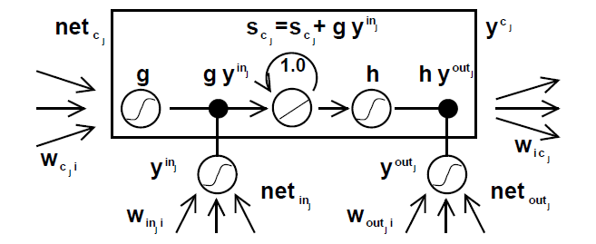
LSTM
Recurrent unit with constant weight in the middle, input gate to the left and output
gate to the right.

Slide 6
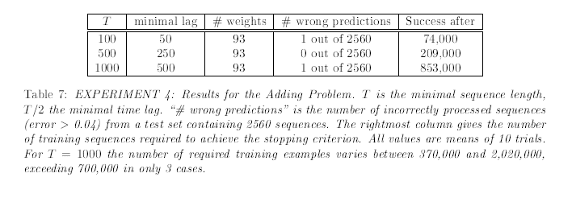
Experimentss
Input is series of tuples (x,y) where x = real number in [-1,+1] and
y is a “marker”, Either 0,-1,+1
Task is to compute the sum between tuples marked as +1.
Markers are set deliberately at long time lags

Slide 7
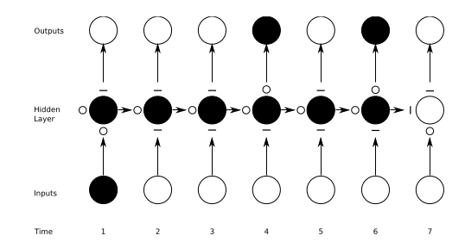
Error propagation using LSTM
From A.Graves
“Supervised
Sequence Labelling
with Recurrent
Neural Networks”
Still using gradient clipping to prevent “exploding errors” outside the LSTM

Slide 8
Variants of LSTM
“Peepholes” : cell state C feeds into gates
Gated recurrent unit (GRU) : combine forget and update gate
LSTM with “attention” => Deepmind paper

Slide 9
Summary
Take-aways from the Hochreiter & Schmidhuber paper:
Analysis of “vanishing/exploding” error during backpropagation learning in Neural Networks
Not limited to Recurrent Networks, affects any deep neural network
Propose some easy solutions
Constant error carousel (CEC, recurrent unit with constant weights)
But CEC is too simple for all but academic problems.
LSTM = CEC with in- and output gate which allow to switch the unit “on- and off”
Powerful mechanism, now standard. But adds complexity to the net (additional weights)
Guessing the right weights works surprisingly well for simple problems

Slide 10
Sources
Hochreiter and Schmidhuber 1997 “Long short-term memory” Neural computation
A. Graves “LSTM Networks for Handwriting Recognition” Phd thesis
A Pascanu “On the difficulty of training recurrent neural networks” LCMS 2013
http://blog.terminal.com/demistifying-long-short-term-memory-lstm-recurrent-neural-networks/
http://colah.github.io/posts/2015-08-Understanding-LSTMs/
http://karpathy.github.io/2015/05/21/rnn-effectiveness/

