Slide 1

DA_LON14
TEAM: Scatter brains
20 November 2025
Data Analytics Group Project
Presented by
Kristina Schogoleva , Nataliia Biliuk, Olesya Drozhzhina, Oksana Karpenko

Slide 2
Introduction
20 November 2025
We are a group of data analytics students working with the AdventureWorks 2022 dataset.
Our Goal
Apply SQL, Python, and analytics skills to answer real business questions using a complex demo database.
TEAM: Scatter brains
01

Slide 3
The Problem
Investigate six business-critical analytical questions
01.
The AdventureWorks 2022 dataset covers several business domains such sales performance, human resources, and retail operations.
Extract meaningful insights from synthetic but realistic data
02.
02
Communicate clear, data-driven conclusions in a professional presentation
03.
Our challenge was to:

Slide 4
Our Solution
Data Extraction & Transformation
Team Collaboration
Responsibilities were divided among team members to focus on specific analytical questions.
Used SQL to extract, join, and transform the data.
Data Analysis & Visualisation
Value Delivered
Used Python (Pandas, Matplotlib, NumPy) for cleaning, analysis, visualisation, and statistical checks.
Our analysis provides actionable insights from the dataset while showcasing our skills in SQL, Python, data analytics, project management, and teamwork.
03

Slide 5
DA_LON14
TEAM: Scatter brains
20 November 2025
What We Deliver (Results)
04
-
-

Slide 6
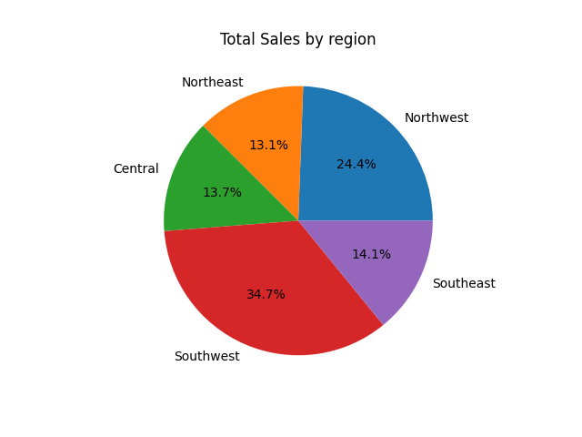
DA_LON14
Regional sales in the best performing country
20 November 2025
The US has remained the leader in sales for 2 years in a row.
South West has been the reqion with most sales for the last 2 years.
-
-

Slide 7
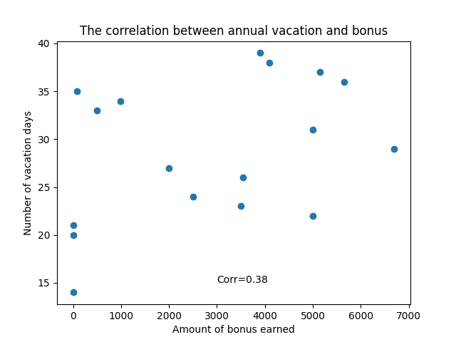
Relationship between annual leave and bonus
DA_LON14
20 November 2025
No correlation between
the annual leave taken and bonus earned
3 out of 4 people
with the shortest time of annual leave
have not earned any bonus
Conclusion:
not taking the annual leave
does not mean good performance
-
-

Slide 8
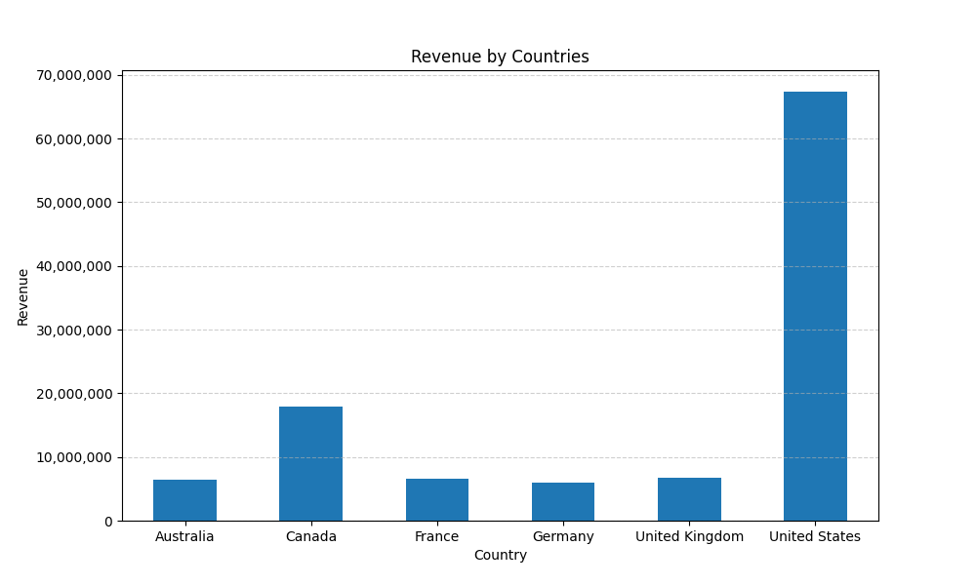
DA_LON14
Relationship between Country and Revenue
20 November 2025
  The bar chart displays the total revenue by country, clearly showing the United States as the dominant market with revenue exceeding $65,000,000.
  Canada is the second-largest contributor, while the remaining countries generate significantly lower and comparable revenue amounts.
-
-

Slide 9
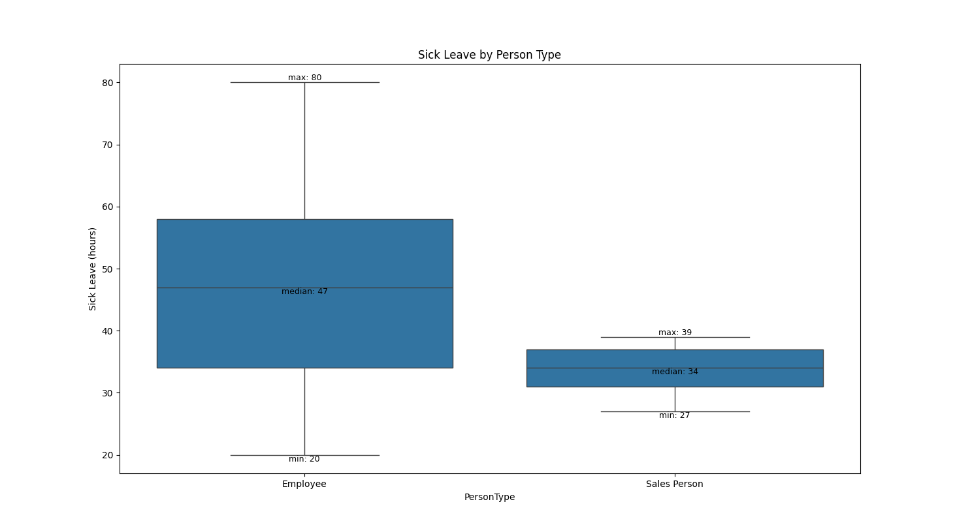
DA_LON14
Relationship between Sick Leave and Job Title (PersonType)
20 November 2025
  Only 2 types of person
  Sales Persons tend to take less sick leave hours then Employees
-
-

Slide 10
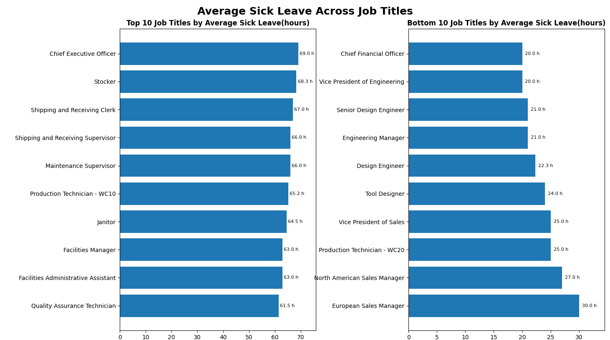
DA_LON14
Relationship between Sick Leave and Job Title (PersonType)
20 November 2025
  Operational and physical labor roles (e.g., Stocker, Janitor) use the most sick leave.
  Technical and senior management roles use the least sick leave
-
-

Slide 11
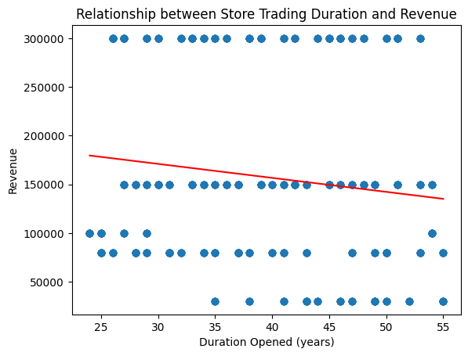
DA_LON14
Store trading duration and revenue
20 November 2025
Overall correlation is very low (-0.13) → no clear relationship.
Overall correlation is very low (-0.13) → no clear relationship.
-
-

Slide 12
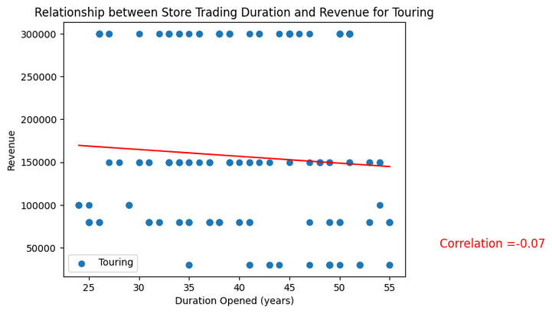
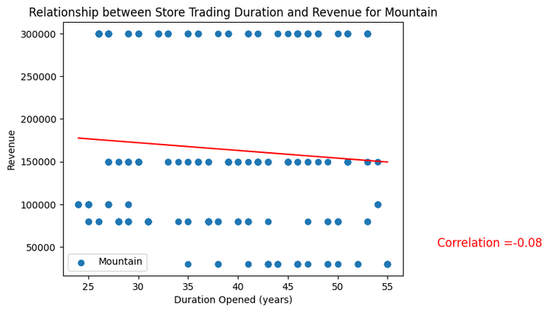
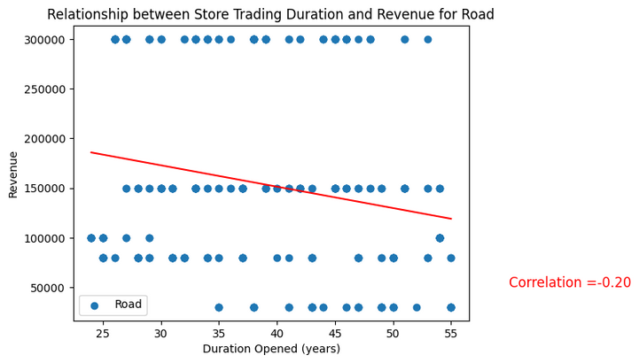
DA_LON14
Store trading duration and revenue
20 November 2025
Grouping by store specialty (Touring, Mountain, Road) also shows no significant correlation.
-
-

Slide 13
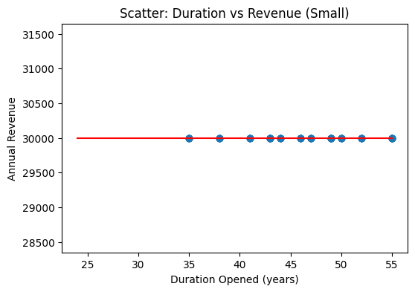
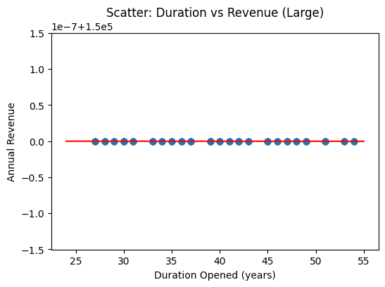
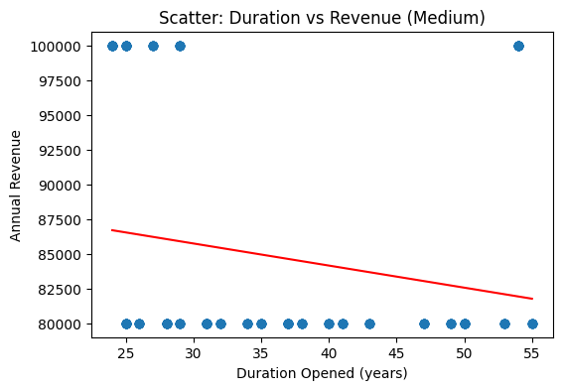
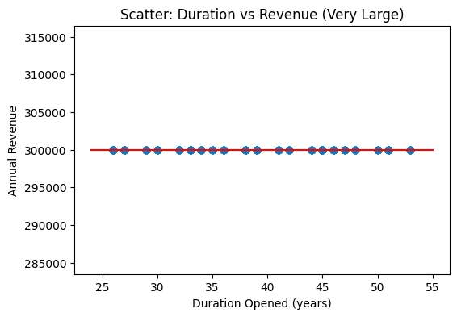
DA_LON14
Store trading duration and revenue
20 November 2025
Grouping by store size (Small, Medium, Large, Very Large) also shows no significant correlation between store age and revenue.
All size categories have constant revenue due to synthetic data, so correlation cannot be calculated.
Conclusion: Store age does not meaningfully affect revenue in this dataset.
-
-

Slide 14
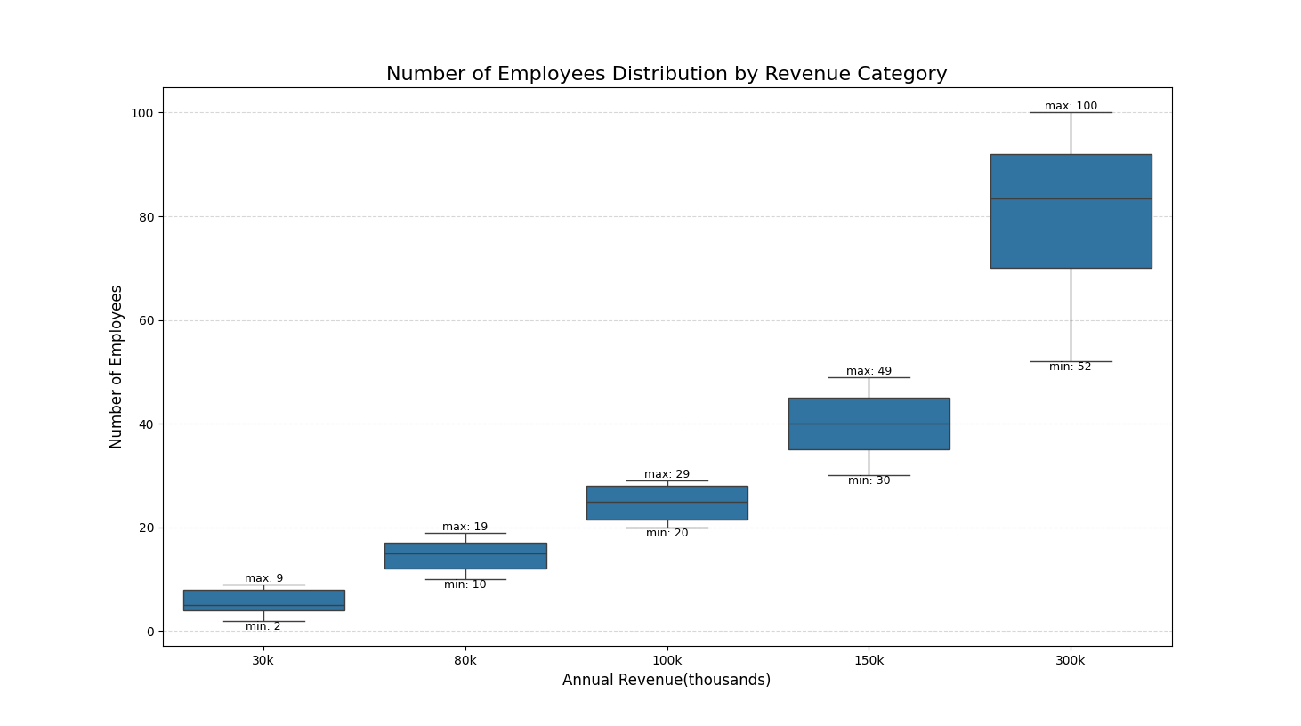
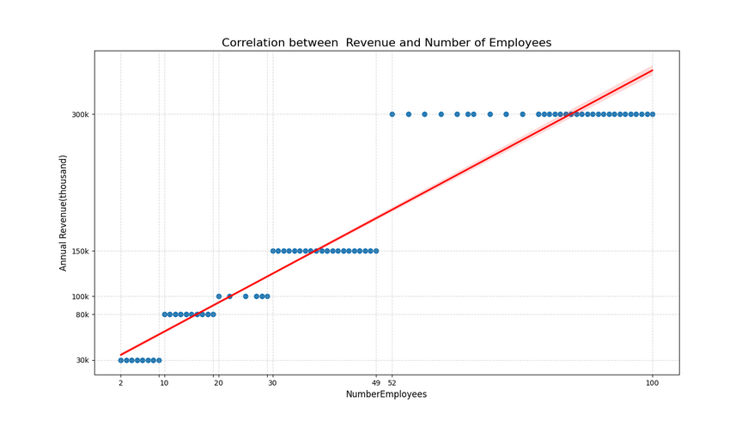
DA_LON14
Store size, employees and revenue
20 November 2025
  strong positive linear correlation
  stores with more employees generate higher revenue
-
-

Slide 15
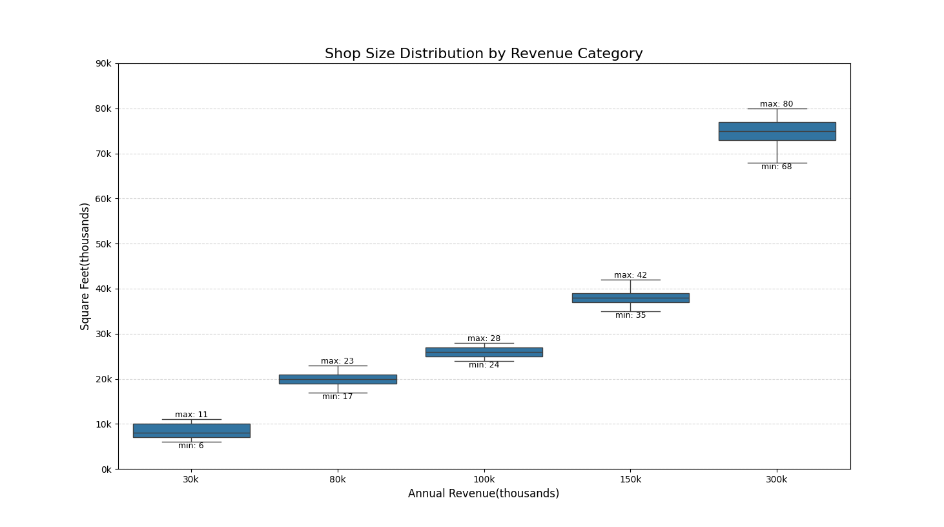
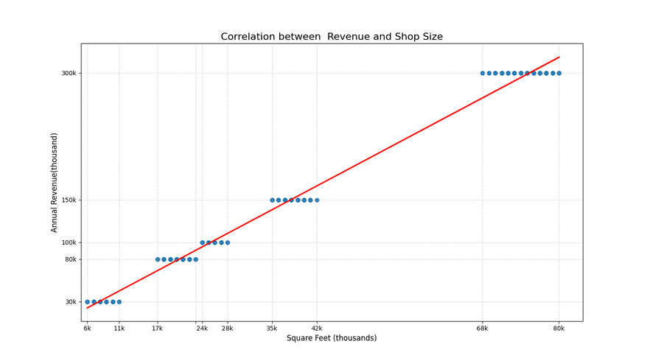
DA_LON14
Store size, employees and revenue
20 November 2025
  strong positive linear correlation
  larger stores tend to generate higher revenue

Slide 16
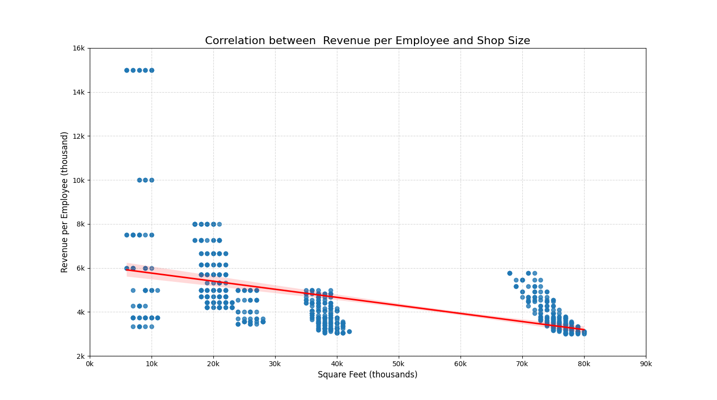
DA_LON14
Store size, employees and revenue
20 November 2025
  introduced new metric Revenue Per Employee
  smaller shops are slightly more efficient

Slide 17
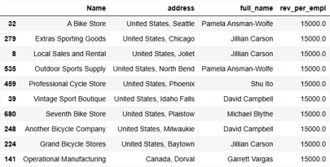
DA_LON14
Store size, employees and revenue
20 November 2025
  identified the top 10 most efficient and least efficient stores
  additional information helps to identify geographical patterns and personnel responsible for the best- and worst-performing stores

Slide 18
Timeline
17 Nov — Setup & Exploration
  Task review, dataset familiarisation
  Task allocation, SQL extraction, initial Python EDA
18 Nov — Analysis
  Team sync, task adjustments
  Python EDA and visualisations
19 Nov — Preparation
  Presentation deck creation
  Report preparation
20 Nov — Final Presentation
  Deliver project results
06

Slide 19
Thynk Unlimited
-
Project
-
Presentation 2024
DA_LON14
TEAM: Scatter brains
20 November 2025
Thank You
Questions and feedback are welcome.
Project repository:https://github.com/KristinaScgen/Group-Task_2

