Slide 1
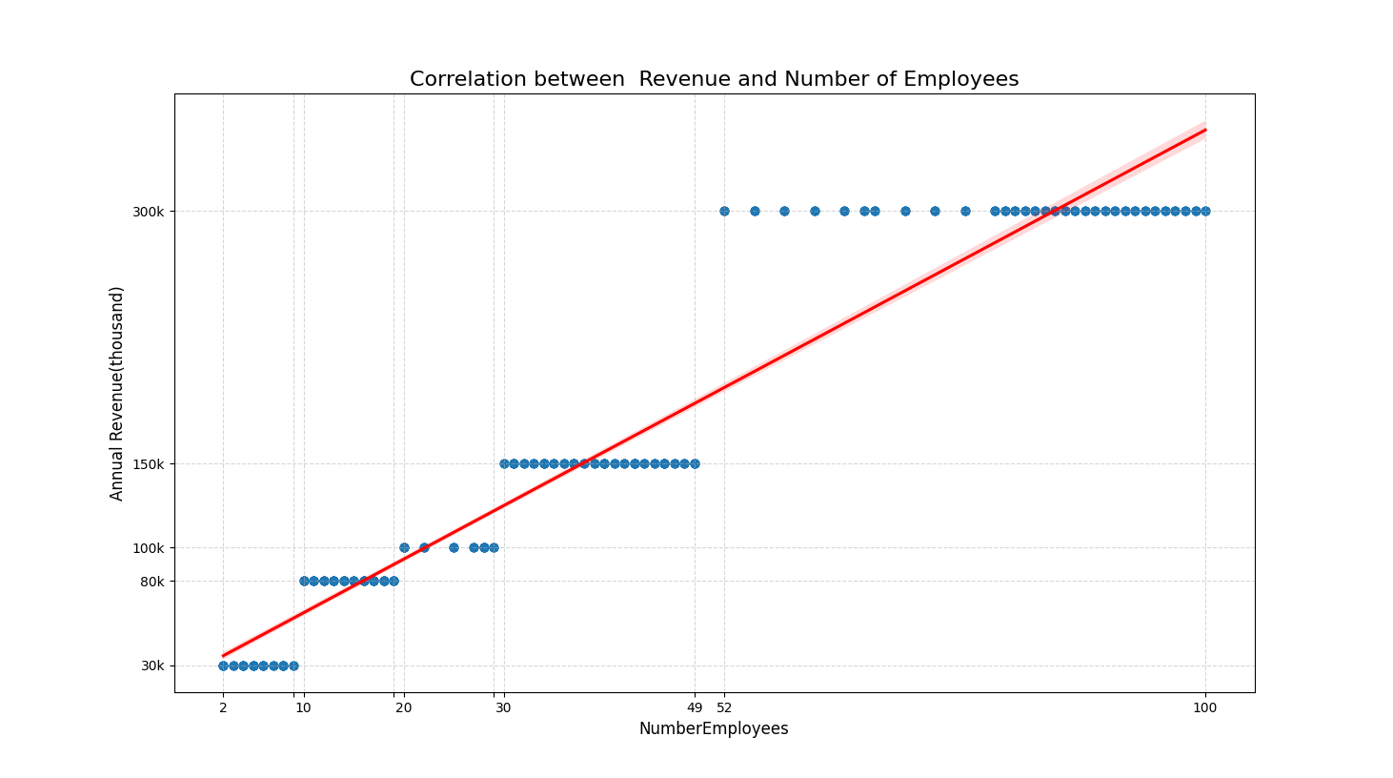
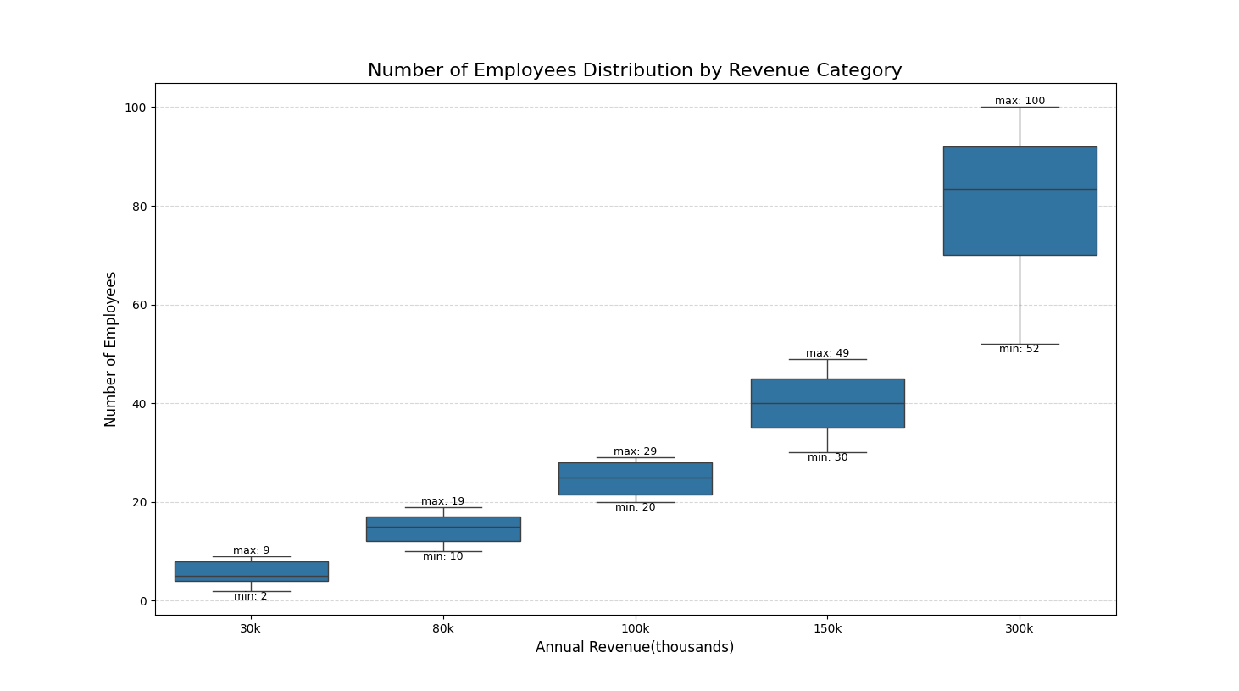
strong positive correlation between revenue and number of employees
clear separation in employee count - small shops have fewer than ~10 employees, while the highest revenue group reaches ~100
linear correlation - revenue growth is mostly achieved by scaling headcount, not efficiency improvements

Slide 2
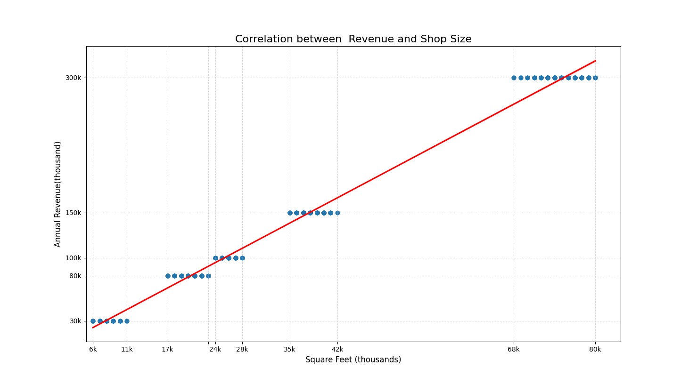
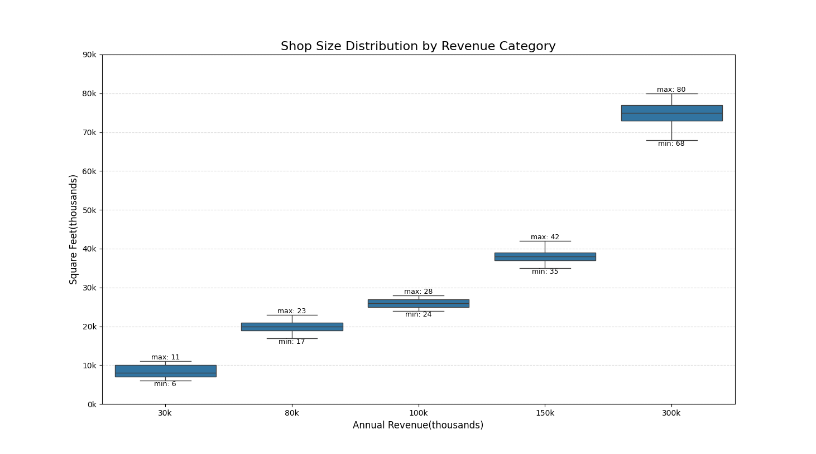
strong positive correlation between revenue and shop size
Revenue groups differ noticeably in shop size ranges (e.g., 30k shops are 6k–11k sq ft; 300k shops reach 70k–80k sq ft)
The pattern shows that physical size is a major driver of revenue potential

Slide 3
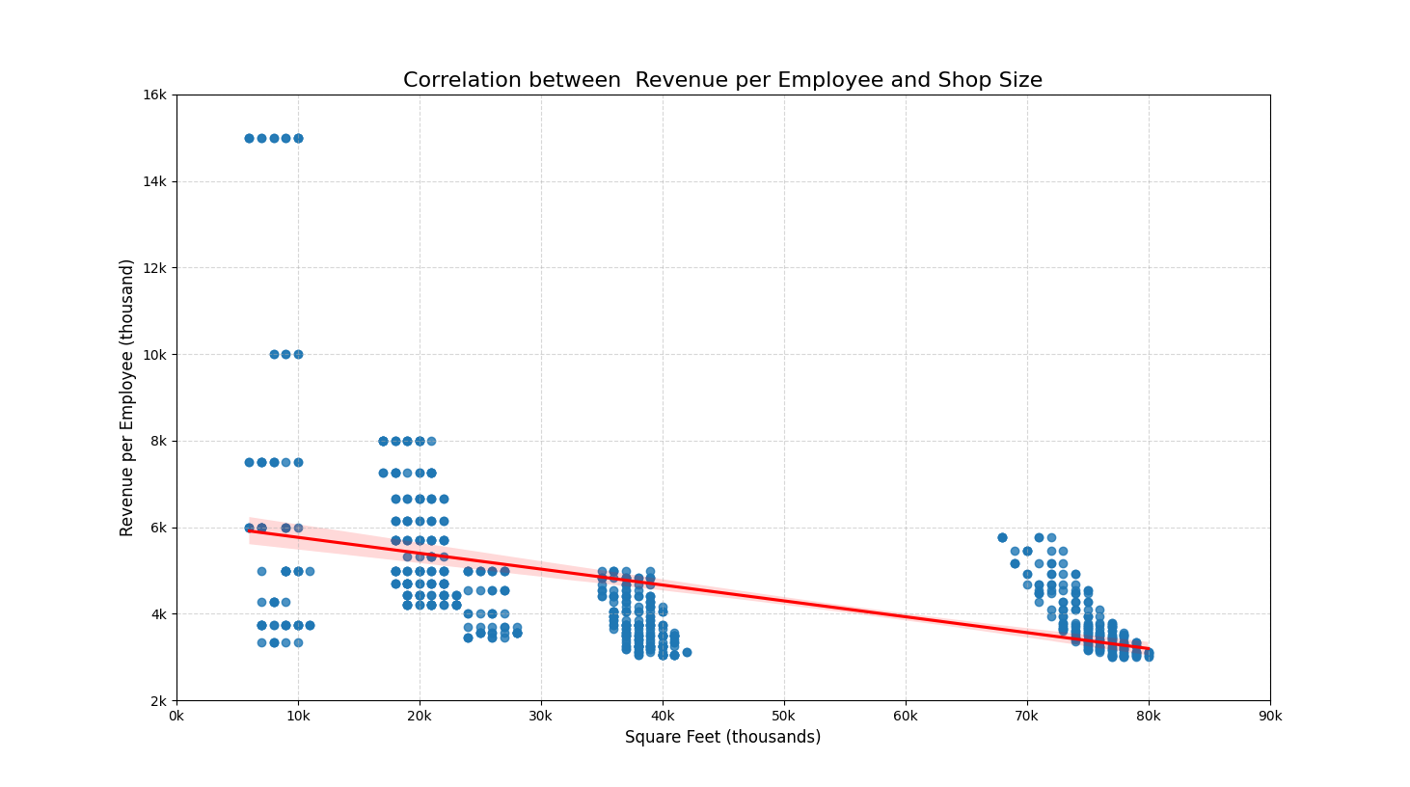
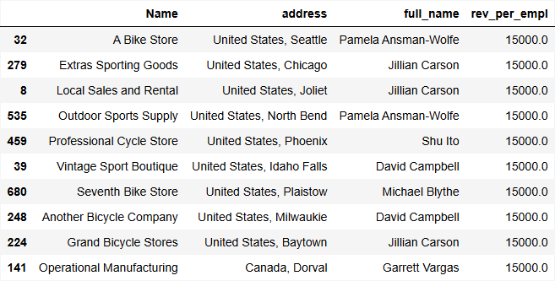
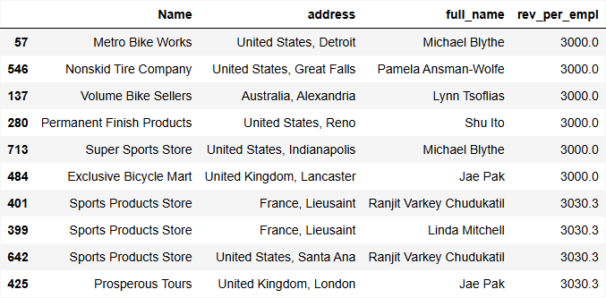
Smaller shops often have higher productivity per employee, reaching up to 15k per employee
Best-performing shops are mostly located in the United States and often belong to a few consistently strong sales representatives.
Worst-performing shops are scattered around the world with no particular geographic or pattern.

