Slide 1
name : Oleti hemanth Sateesh kumar Project name : EBAY
UNDER GUIDANCE OF MRS.VAISHALI SONAWANE MAM.

Slide 2
INTRODUCTION
eBay is a global e-commerce platform that allows users to buy and sell a wide range of products through online auctions and direct sales. The project focuses on testing the core functionalities of the eBay website such as user login, product search, add to cart, checkout, and account management.
The objective is to ensure that all modules work smoothly, provide a seamless shopping experience, and meet customer expectations.

Slide 3
OVERVIEW
WHAT IS EBAY?
eBay is a leading global e-commerce marketplace where individuals and businesses can buy and sell products online.
The eBay project focuses on testing the main functionalities of the website to ensure smooth user experience.

Slide 4
MODULES OF THE PROJECT
MODULE 1: Login & Registration
Checked all the functionalities on Sign in page which included personal info as email
address, password.
MODULE 2: Product Search & Filters
Verified search box, category selection, price filters, and sorting options.
MODULE 3: Product Details
Checked product description, images, specifications, reviews, and add to cart button.
MODULE 4: Shopping Cart
Validated add/remove items, update quantities, and total price calculation.

Slide 5
MODULES OF THE PROJECT
MODULE 5: Checkout & Payment
Verified address entry, shipping options, and secure payment gateways.
MODULE 6: Wishlist & Watchlist
Checked adding/removing products and saving for later.
MODULE 7: Order History
Verified past order details, invoices, and tracking info.
MODULE 8: Navigation (Header & Footer)
Validated quick links, categories, policies, and contact options.

Slide 6
DEFECTS
While running a testcase at certain point some fields are not working as it is expected which is nothing but a defect, so I have created a Defect report on those defects.

Slide 7
DEFECT IDENTIFIER :- B_001
Defect summary :- when you enter special characters in search box it is showing some results instead of no elements found.
Ø Test Id :- TC_020
Ø Test case name :-
Ø Module name :- Product search
Ø Reproducible :-
Ø Severity :- medium
Ø Priority :- high
Ø Raised by :- Team lead
Ø Assigned to :- developer Team lead
Ø Date of assignment :-
Ø Status :- pending
Ø Snap shots :-
Ø Fixed by :- developer
Ø Date of fixing :-

Slide 8
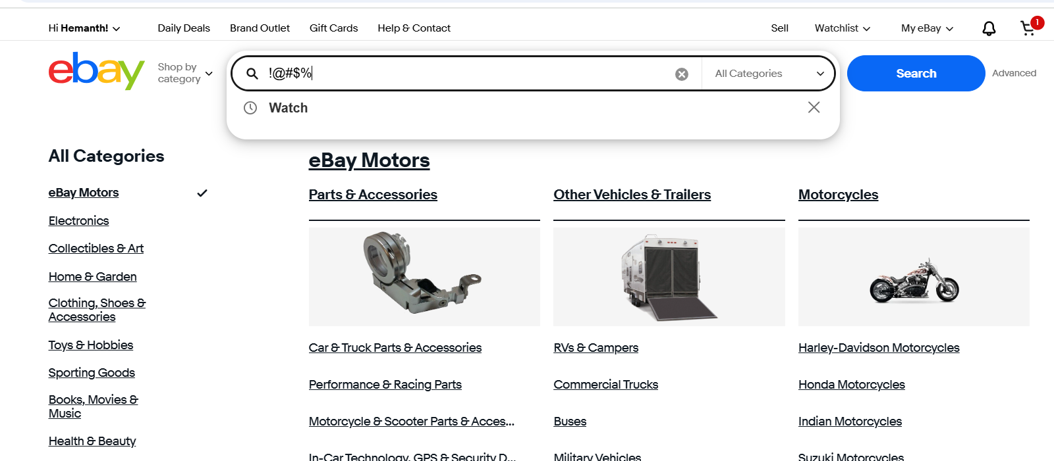
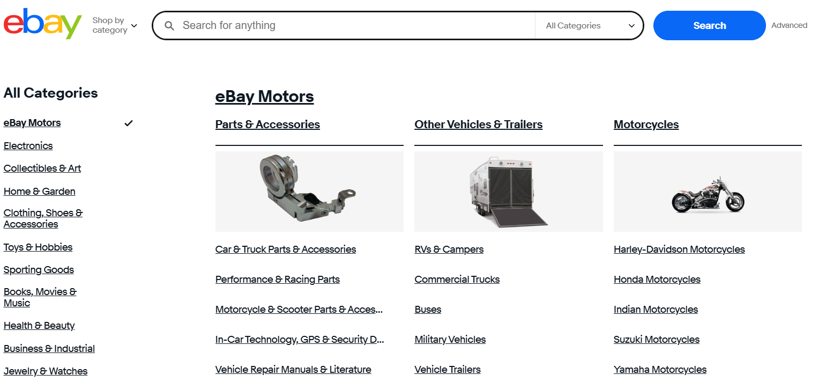

Slide 9
DEFECT IDENTIFIER :- b_002
Defect summary :- enter shoes from low price in search option the result will be in sorted order and the actual output is showing in unsorted order.
Ø Test Id :- TC_010
Ø Test case name :-
Ø Module name :- product search and filters
Ø Reproducible :-
Ø Severity :- high
Ø Priority :- medium
Ø Raised by :- Team lead
Ø Assigned to :- developer Team lead
Ø Date of assignment :-
Ø Status :- pending
Ø Snap shots :-
Ø Fixed by :- developer
Ø Date of fixing :-

Slide 10
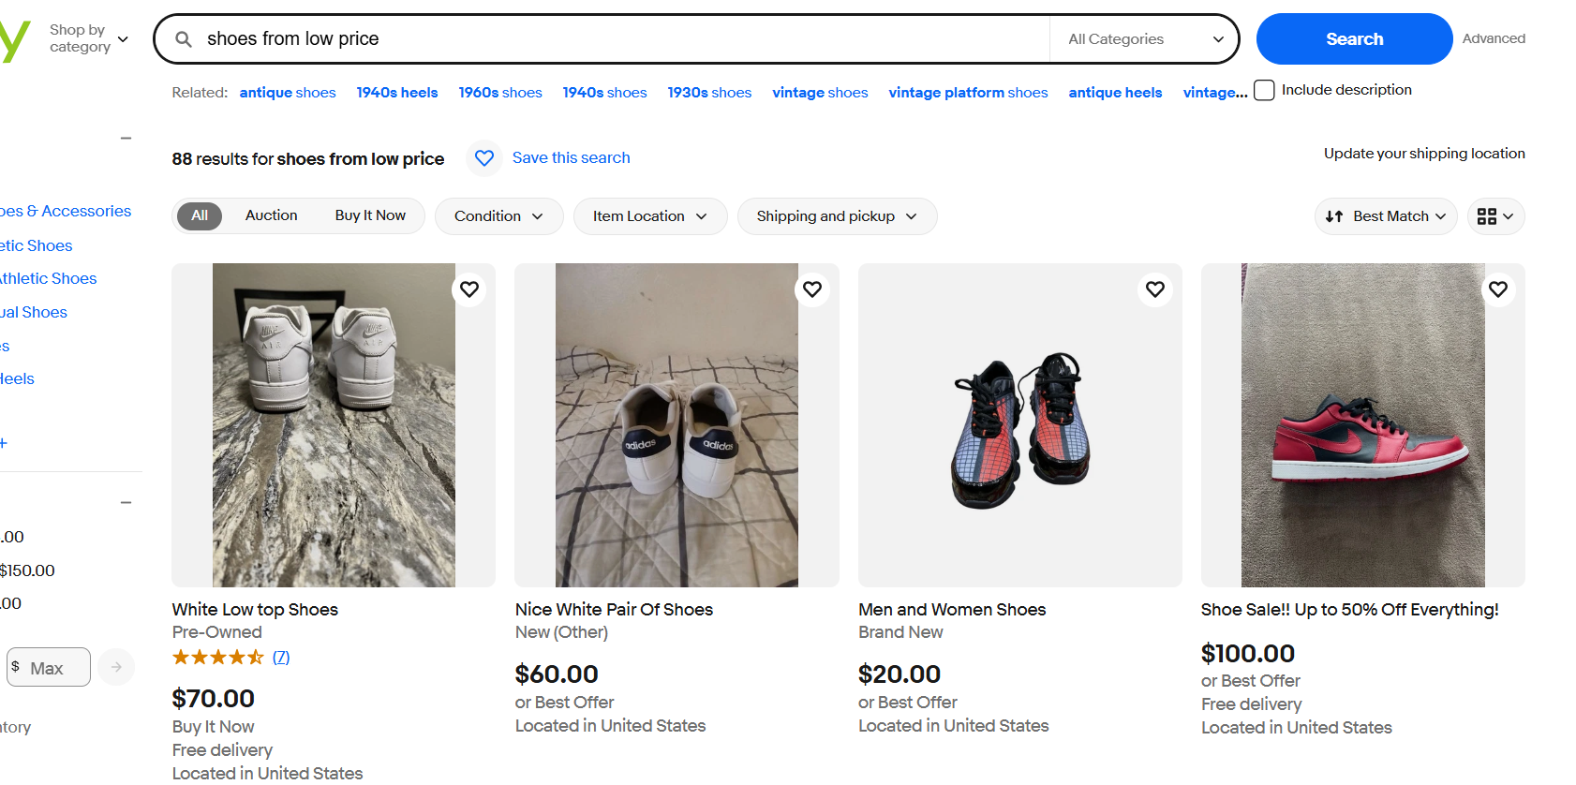

Slide 11
CHALLENGES
While testing big website which contains huge data i faced some challenges about:
Faced difficulties in setting up Selenium, TestNG, browser drivers, and handling synchronization issues without immediate team support.
Ensuring all modules (Login, Search, Cart, Checkout, etc.) were covered by test cases was challenging without dividing work among multiple testers.
Identifying root causes of failed test cases and updating scripts for dynamic web elements was time-consuming when managed by a single person.

Slide 12
EXPERIENCE
Gained hands-on experience in automating functional test cases using Selenium with TestNG.
Improved skills in handling dependencies, data-driven testing, and parallel execution.
Learned to manage complete testing lifecycle alone, from test planning to defect reporting.
Enhanced problem-solving and debugging skills while working independently on real-time e-commerce modules.

Slide 13
THANK YOU…!.!.!
Vaishali Mam For Guiding Me through out the Project.

