Slide 1
revplay
Seamless audio, dynamic user experience, and secure music management.
under guidance by : remya g mam
The revplay team:
O.hemanth Sateesh kumar – team lead & security, profiles
D.devi prasad – audio engine & search
G.sai kiran – artist dashboard & uploads
K.Rekha – playlists & favorites
D.ahmad ali – albums & history

Slide 2
Project overview
Revplay : A full-stack music streaming web application that allows users to listen to music, manage playlists, and enables artists to upload and manage their own tracks.
The Goal : To build a platform that doesn't just play music, but provides a persistent, modern, "no-refresh" experience.
Key Features :
Role-based access (Listeners vs. Artists).
Persistent, global audio player.
Real-time UI updates without page refreshes.
Custom playlist and favorites management.

Slide 3
Our technology stack
Frontend (The User Interface) :
Angular : Component-based UI.
RxJS : For reactive state management (managing the global audio state).
HTML5/CSS3 : For a responsive, modern dark-mode aesthetic.

Slide 4
Our technology stack
Backend (The Brain & Security):
Spring Boot 3.4 : Core backend framework.
Spring Security & JWT : For stateless, secure authentication.
Springdoc OpenAPI (Swagger) : For dynamic API documentation.
Database :
MySQL & Spring Data JPA : For relational data mapping.

Slide 5
Our technology stack
JUnit : Utilizing JUnit to automatically test individual pieces of backend logic.
Guaranteeing that when we add a brand new feature, our existing code remains unbroken and fully functional.
Log4j :A real-time recording system that tracks exactly what the Spring Boot backend is doing at any given millisecond.
Capturing hidden errors, warnings, and system health metrics so developers can fix issues before users even report them.

Slide 6
Database architecture(er diagram)
Robust relational structure handling Users, Songs, Albums, Playlists, and History.
Many-to-Many relationships for Playlists and Favorites.
Foreign key constraints to ensure data integrity (e.g., deleting a song cascades appropriately).

Slide 7
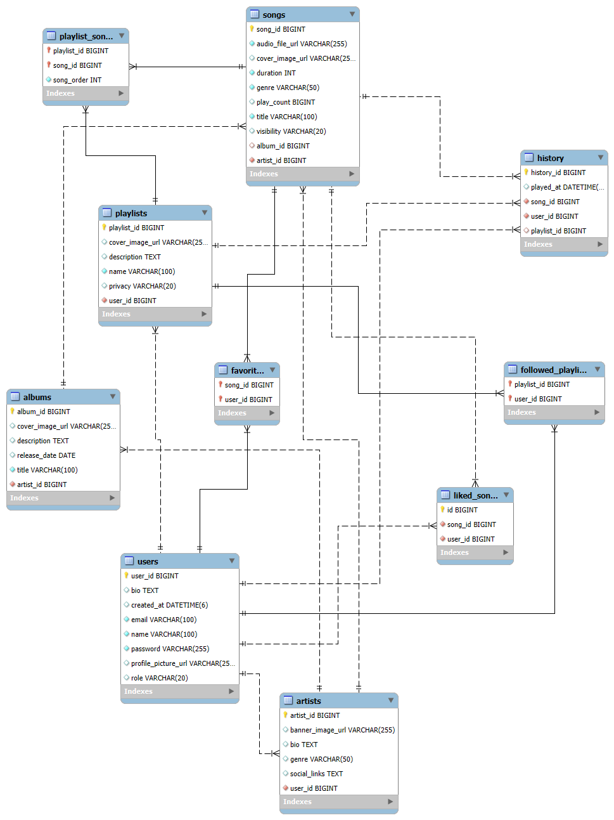

Slide 8
Security and Identity -Role based access & authentication
Stateless Security: We implemented Spring Security with JWT (JSON Web Tokens) to ensure user sessions are fast, scalable, and secure.
Role-Based Access Control (RBAC): We built strict boundaries. Standard USER accounts can only listen and create playlists. Only accounts with the ARTIST role can access the "My Uploads" dashboard and upload .mp3 files.
Endpoint Protection: Configured SecurityConfig to leave audio streaming (/api/songs/play/**) public so the HTML player works smoothly, while locking down every other database action.

Slide 9
listener roles & capabilities
The Listener (Standard User) :
Discover & Stream: Search for songs, filter by genre, and enjoy uninterrupted playback via the Global Audio Player.
Curate Playlists: Create, edit, and manage custom playlists (Public or Private).
Favorites: 'Like' tracks to instantly add them to a dedicated Favorites library.
Listening History: Automatically track and view recently played songs.

Slide 10
Artist roles & capabilities
The Artist (Content Creator) :
Includes ALL Listener features, plus:
Creator Dashboard: Access exclusive "My Uploads" and "My Albums" portals dynamically rendered by Angular.
Content Uploads: Securely upload .mp3 audio files alongside custom cover art to the Spring Boot backend.
Portfolio Management: Edit song metadata (title, genre, visibility) on the fly.

Slide 11
The songs module (Content ingestion)
Multipart File Handling: Securely processing .mp3 audio, .jpg cover art, and JSON metadata in a single network request.
Complete CRUD Control: Artists can Create, Read, Update (change visibility/genre), and Delete their tracks.
Instant UI Rendering: Angular updates the dashboard in real-time as soon as a song is uploaded or modified.

Slide 12
The analytics module (data insights)
Automated Tracking: Backend APIs automatically increment play counters every time a track is streamed by a user.
Real-Time Feedback: Artists can instantly see which of their songs are performing best.
Unified Ecosystem: Artists inherit all standard listener features, seamlessly blending content creation with music discovery.

Slide 13
Song discovery & Browsing (The core engine)
Dynamic Discovery: Fetching and rendering a global feed of all public songs uploaded by artists.
Genre Filtering: Allowing users to instantly sort the database (e.g., Pop, Classical, Rock) without page reloads.
Visual Presentation: Fetching secure image URLs to display custom cover art alongside the track metadata.

Slide 14
The Global Audio Player (Uninterrupted Listening)
Persistent Architecture: Component sits completely outside the main Angular Router, meaning music never stops when navigating between pages.
Reactive State Management: Powered by an RxJS BehaviorSubject to keep the UI perfectly synced with the backend audio data.
Native Integration: Custom UI controls (Play, Pause, Skip, Volume, Mute, Seek) wired directly into the browser's native HTML5 <audio> element.
Smart Queueing: Automatically tracks the current playlist, remembers the user's history, and auto-plays the next track.

Slide 15
Custom playlist curation
Personalized Curation: Users can create, edit, and populate custom playlists seamlessly.
Privacy Controls: Implemented visibility toggles to allow users to keep playlists Private or share them Publicly.
Many-to-Many Architecture: Engineered a complex PLAYLIST_SONGS join table in MySQL so one song can exist in infinite playlists.

Slide 16
Personalization (favorites)
Instant Engagement: One-click "Like/Unlike" toggle that provides immediate visual feedback to the user.
Complex Data Mapping: Powered by a LIKED_SONGS Many-to-Many join table in the MySQL database (linking Users to Songs).
Reactive UI Updates: Unliking a song from the Favorites page instantly removes it from the screen without requiring a page refresh.
Personalized Dashboard: Aggregates all loved tracks into a single, easily accessible user library.

Slide 17
The album module
Relational Data Mapping: Utilizing Spring Data JPA to create strong One-to-Many relationships (One Album -> Many Songs).
Organized Portfolios: Giving artists a professional way to group singles into cohesive projects.
Cascading Updates: Ensuring that if an album is updated or deleted, the associated songs are handled correctly in the database.

Slide 18
Automated listening history
Silent Tracking: The backend securely logs every song a user streams.
Timestamp Management: Database records the exact played_at datetime to organize history chronologically.
Personalized Dashboard: Users are greeted with a dynamically generated "Recently Played" queue upon logging in.

Slide 19
Current achievements
Present (What We Have Built)
Fully Functional Streaming Engine: A persistent, global audio player built with Angular and RxJS that allows uninterrupted listening.
Secure Creator Ecosystem: Artists can securely upload .mp3 files and cover art via multipart Spring Boot APIs.
Interactive User Library: Listeners can seamlessly manage custom Playlists, Favorites, and automated Listening History.
Role-Based Security: Strict JWT authentication ensuring data privacy and correct access levels.

Slide 20
Future scope
AI-Powered Recommendations: Implementing machine learning algorithms to analyze a user's listening history and auto-generate personalized "Discover Weekly" playlists.
Collaborative Playlists: Building real-time WebSocket connections so multiple friends can add, reorder, and listen to tracks in a shared playlist simultaneously.
Recommend songs based on :Listening historyFavorite genresMost played songsSimilar artists

Slide 21
conclusion
Delivered a premium, modern streaming environment where the music never stops while users explore the app.
Successfully bridged the gap between listeners discovering new tracks and artists managing their portfolios.
Empowered users to curate their own music experience through custom playlists, instant favorites, and automated history tracking.
Collaborated to design, build, and secure a complete, real-world application from the ground up.

Slide 22
Thank you

