Slide 1
Security Experiments The FNI Experiment
Fabio Massacci, Aurora Papotti

Slide 2
Purpose of this Material
The purpose of this document is to provide
Explanation of the FNI Experiment
How to move from the experimental data to the actual report

Slide 3
What Happened During the Experiment

Slide 4
What Happened
Read a brief description of the task
Accepted the possibility of using data
If you didn’t accept your data will not be shared, so can’t be there
Answered some general questions on the background
Inspected four different code files
For each source code fragments answered a number of questions
Identified the vulnerable lines
Write the motivation for choosing the vulnerable lines
The source code fragments files were randomly assigned

Slide 5
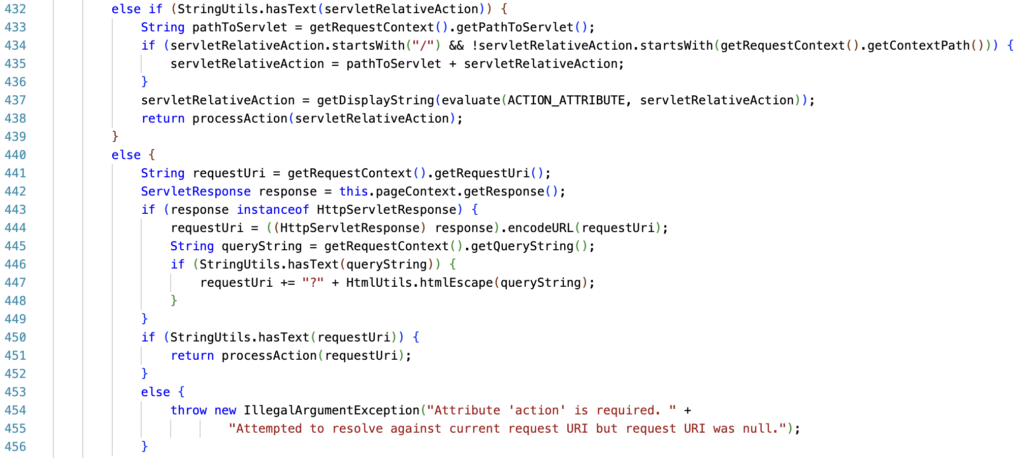
Example of a source code fragments

Slide 6
Understanding the experiment

Slide 7
What happened – II
Each scenario has different manipulations/intervention
The type of vulnerability
Path Traversal, User Injection, XSS, DoS
Type of source code fragments
Original file vs slice of file

Slide 8
What is the intervention?
Depend on what is interesting for you
Inspecting a slice of source code fragment helps to identify more vulnerabilities
It is easier to identify one type of vulnerability respect another one
What we expect:
There should be a difference between in the intervention levels
Difference, if we expect to check equivalence this is possible but more complicated.
Example
When inspecting a slice of source code fragment more vulnerabilities are found
It is easier to identify the vulnerable lines for vulnerability X rather than vulnerability Y

Slide 9
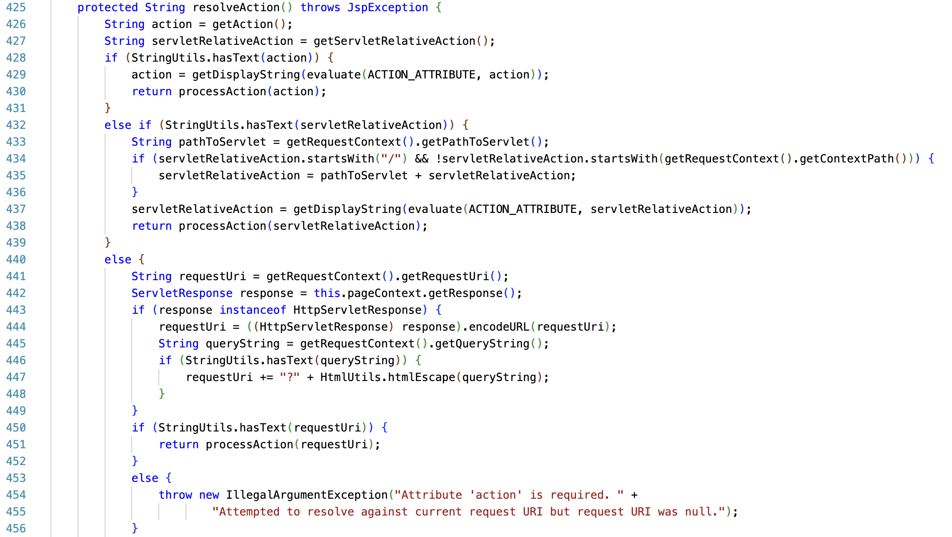
Function containing the vulnerable lines – Original file

Slide 10
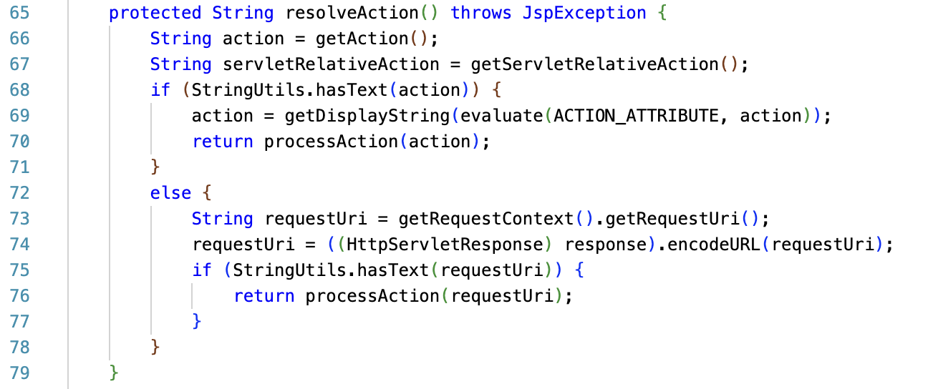
Function containing the vulnerable lines – Slice file
The vulnerable lines are preserved, but the irrelevant lines of the function are removed in the slice file

Slide 11
Different interventions are shown to different people – Original vs Slice
The type of vulnerability is the same
The vulnerable lines are the same
What changes is the number of lines preserved in the slice file. The lines that are considered irrelevant are removed from the slicing algorithm

Slide 12
So what we can conclude? Original vs Slice
It is easier to identify the vulnerability when inspecting the original file
It is easier to identify the vulnerability when inspecting the slice file

Slide 13
Measuring the intervention

Slide 14
The questions are possible measures
Actual Effectiveness
Number of correct questions (for a given time)
What is a correct answer here?
By using the notions of TP, FP, FN, what is a TP in this context? Do we consider correct only the lines perfectly matched or also the one around?
Actual Efficiency
Time to answer the questions (for the same number of correct questions)
Perceived Effectiveness/Usability
Do you think <intervention> helped you to find the correct questions
Gave wrong question is the same, you just revert.
Perceived Ease of Use
Do you think that <intervention> was easy to use

Slide 15
More questions are on background
Do you have professional experience as a coder (somebody paid you to develop code for at least a month Full-Time-Equivalent)
Do you have any experience working with Java (in any context, uni or outside uni)?
Do you have any experience finding software vulnerabilities in source code (in any context, uni or outside uni)?
You could also use to partition the dataset
E.g. people who has more experience in finding vulnerabilities identifies more vulnerability
Or conclude that the answer cannot be fully generalized
Or to discard data points
E.g. people who do not have experience with Java

Slide 16
Measures in the FNI Case
You were sufficiently familiar with Java as a programming language to execute the task.
Strongly disagree (1) → Strongly Agree (5)
You were sufficiently familiar with the concept of software vulnerabilities to execute the task
Strongly disagree (1) → Strongly Agree (5)
Rate the difficulty of marking the correct applicable lines of code.
Very easy (1) → Very hard (5)
Rate your confidence that your solution is correct (you selected the correct lines of code)

Slide 17
More measures in the FNI case
You had a clear understanding of what the task asked you to do.
You were given sufficient time to read the material and complete the task.
The training prepared you sufficiently to carry out the task.
Any optional comments or remarks to improve the experiment experience

Slide 18
Ideal experiment

Slide 19
So what we should do…
Randomly assign each participant to a configuration of
L – Levels
Original file
Slice file
K - Factors
Path Traversal
User Injection
XSS
DoS
S – Scenarios (say 6)
Different configurations of pair (vulnerability-type of code)
Ask the participants the questions
Analyze the data
Select one possible intervention
Say Original vs Slice
Is it easier to identify one type of vulnerability respect another one when inspecting a slice or original file?
Select all possible scenarios
Collect the data in a file and compare it with statistics

Slide 20
We should get a dataset such as
SID | Group | Treatment | Vulnerability |  | Metric 1 | Metric 2
A1 | 1 | Full | XSS |  | 0 | 4
A2 | 5 | Full | DoS |  | 0 | 3
A3 | 4 | Full | Path |  | 1 | 2
A4 | 4 | Slice | XSS |  | 1 | 1
A5 | 3 | Full | DoS |  | 1 | 4
A6 | 6 | Full | User |  | 1 | 3
A132 | 2 | Slice | XSS |  | 0 | 4
A133 | 2 | Slice | Path |  | 1 | 3
A134 | 1 | Full | Path |  | 1 | 2
A135 | 3 | Full | XSS |  | 0 | 5
A136 | 5 | Slice | User |  | 1 | 5
A137 | 6 | Full | User |  | 1 | 5

Slide 21
And then…
Use the Python code provided by the teachers
Generate plots
Test the statistical significance of the material
Or any other code of your choice
Conceptually what it does is just re-arranging and comparing
SID | Group | Treatment | Vulnerability |  | M1 | M2 |  |  | SID | Full | Slice
A10 | 1 | Full | XSS |  | 0 | 4 |  |  | A10 | 0
A11 | 5 | Full | DoS |  | 0 | 3 |  |  | A11 | 0
A12 | 4 | Slice | Path |  | 1 | 2 |  |  | A15 | 1
A13 | 4 | Slice | XSS |  | 1 | 1 |  |  | A111 | 1
A14 | 3 | Slice | DoS |  | 1 | 4 |  |  | A112 | 1
A15 | 6 | Full | User |  | 1 | 3 |  |  | A115 | 1
A110 | 2 | Slice | XSS |  | 1 | 4 |  |  | A12 |  | 1
A111 | 2 | Full | Path |  | 1 | 3 |  |  | A13 |  | 1
A112 | 1 | Full | Path |  | 1 | 2 |  |  | A14 |  | 1
A113 | 3 | Slice | XSS |  | 0 | 5 |  |  | A110 |  | 1
A114 | 5 | Slice | User |  | 1 | 5 |  |  | A113 |  | 0
A115 | 6 | Full | User |  | 1 | 5 |  |  | A114 |  | 1
Number of 1s of Slice is more than 1s for Full

Slide 22
And then… (contd)
More re-arranging and comparing
SID | Group | Treatment | Vulnerability |  | M1 | M2 |  |  | SID | Full | Slice
A10 | 1 | Full | XSS |  | 0 | 4 |  |  | A10 | 0
A11 | 5 | Full | DoS |  | 0 | 3 |  |  | A11 | 0
A12 | 4 | Slice | Path |  | 1 | 2 |  |  | A15 | 1
A13 | 4 | Slice | XSS |  | 1 | 1 |  |  | A111 | 1
A14 | 3 | Slice | DoS |  | 1 | 4 |  |  | A112 | 1
A15 | 6 | Full | User |  | 1 | 3 |  |  | A115 | 1
A110 | 2 | Slice | XSS |  | 1 | 4 |  |  | A12 |  | 1
A111 | 2 | Full | Path |  | 1 | 3 |  |  | A13 |  | 1
A112 | 1 | Full | Path |  | 1 | 2 |  |  | A14 |  | 1
A113 | 3 | Slice | XSS |  | 0 | 5 |  |  | A110 |  | 1
A114 | 5 | Slice | User |  | 1 | 5 |  |  | A113 |  | 0
A115 | 6 | Full | User |  | 1 | 5 |  |  | A114 |  | 1
What is the probability of getting the table below by chance if we had
6 analysts to Full
6 analysts to Slice
9 analysts found the vuln
3 analysts not found the vuln
 | Found Vul | Not Found Vul
Full | 4 | 2
Slice | 5 | 1

Slide 23
Real experiment

Slide 24
But we often don’t have enough participants
Randomly assign each participant to each configuration of
K - Factors
Path Traversal, User Injection, XSS, DoS
L – Levels
Full vs Slice
Not always feasible
L^{k} (=2⁴ = 16) configurations
for each large number of participants n >= 16 (rule of thumb, but ideally n>25)
This means 1000 people before being able to conclude anything → doesn’t look usable in any practical case

Slide 25
So what we should do…
Ask each participant to repeatedly do the assessment for a sequence of different scenarios
S – Scenarios (say 4)
Different types of pair type of vulnerabilituy
Where each scenario is assigned to a different configuration of
K - Factors (each with
Original vs Slice
Each participant is randomly assigned to a different sequence
The sequence is designed using a special design called Taguchi design
You can find more details and an even an excel file in this paper
Massacci, F., Papotti, A., & Paramitha, R. (2024). Addressing combinatorial experiments and scarcity of subjects by provably orthogonal and crossover experimental designs. Journal of Systems and Software, 211, 111990
https://doi.org/10.1016/j.jss.2024.111990
For the report just use the ground truth design that is provided to you

Slide 26
What we start as raw data…
SID | Group A | Group B |  | Group K |  | M2 | M2 |  | M2
A123 | 0 | 1 |  | 0 |  | 4 | 3 |  | 5
A124 | 1 | 0 |  | 0 |  | 3 | 2 |  | 3
A125 | 0 | 0 |  | 0 |  | 2 | 1 |  | 2
A126 | 0 | 0 |  | 1 |  | 1 | 3 |  | 3
A127 | 0 | 0 |  | 0 |  | 4 | 5 |  | 4
A128 | 0 | 1 |  | 0 |  | 3 | 5 |  | 1
The Participants
The Design Group which is NOT the intervention group
Answer to scenario 1, … scenario 4

Slide 27
Taguchi Design of the Ground Truth Table
 | Path | User | XSS | DoS
Group 1 | [368,383,384,385,386,388, 432, 846, 853, 854, 859, 860, 864] | [59, 61, 62, 87, 90] | [441, 444, 450, 451] | [48,50,51]
Group 2 | [76, 78, 79, 80, 81, 83, 95, 108, 113, 114, 119, 120, 123] | [144, 147, 151, 287, 290] | [73, 74, 75, 76] | [459, 462, 463]
Group 3 | [76, 78, 79, 80, 81, 83, 95, 108, 113, 114, 119, 120, 123] | [59, 61, 62, 87, 90] | [441, 444, 450, 451] | [459, 462, 463]
Group 4 | [368,383,384,385,386,388, 432, 846, 853, 854, 859, 860, 864] | [144, 147, 151, 287, 290] | [73, 74, 75, 76] | [48,50,51]
Group 5 | [368,383,384,385,386,388, 432, 846, 853, 854, 859, 860, 864] | [59, 61, 62, 87, 90] | [73, 74, 75, 76] | [459, 462, 463]
Group 6 | [76, 78, 79, 80, 81, 83, 95, 108, 113, 114, 119, 120, 123] | [144, 147, 151, 287, 290] | [441, 444, 450, 451] | [48,50,51]

Slide 28
We must re-arrange the data
In the ideal design experiment → one line per participant
N participants / K groups
In the Taguchi design experiment → one line per participant-scenario
With N participants randomly assigned to each of the K Groups each doing S scenarios → N /K x S rows in the final file
Restructuring
The AI intervention is now done by
Participant X in Group B doing XSS
Participant Y in Group K doing Path Traversal
Participant Y in Group K doing User Injection
Etc.
We just create a table for remapping

Slide 29
Lookup Table
Design Group | Scenario | Interv
1 | Path | Full
1 | XSS | Full
1 | User | Slice
2 | Path | Slice
2 | XSS | Slice
2 | DoS | Full
K | User | Slice
K | XSS | Full
K | DoS | Full
This is the Intervention Group we really care

Slide 30
What we start as raw data…
SID | Group A | Group B |  | Group K |  | M2 | M2 |  | M2
A123 | 0 | 1 |  | 0 |  | 4 | 3 |  | 5
A124 | 1 | 0 |  | 0 |  | 3 | 2 |  | 3
A125 | 0 | 0 |  | 0 |  | 2 | 1 |  | 2
A126 | 0 | 0 |  | 1 |  | 1 | 3 |  | 3
A127 | 0 | 0 |  | 0 |  | 4 | 5 |  | 4
A128 | 0 | 1 |  | 0 |  | 3 | 5 |  | 1
Copy this entire block below for all Scenarios
Move below in correspondence to scenario 2
Add a column for the Scenario Number here
Move this below in correspondence to the S-th scenario

Slide 31
So we get…
SID | Scenario | Group 1 | Group 2 |  | Group K |  | M2
A123 | Path | 0 | 1 |  | 0 |  | 4
A124 | NCSC-2023-0428 | 1 | 0 |  | 0 |  | 3
A125 | NCSC-2023-0428 | 0 | 0 |  | 0 |  | 2
A126 | NCSC-2023-0428 | 0 | 0 |  | 1 |  | 1
A127 | Path | 0 | 0 |  | 0 |  | 4
A128 | Path | 0 | 1 |  | 0 |  | 3
A123 | User | 0 | 1 |  | 0 |  | 3
A124 | User | 1 | 0 |  | 0 |  | 2
A125 | NCSC-2023-0277 | 0 | 0 |  | 0 |  | 1
A126 | NCSC-2023-0277 | 0 | 0 |  | 1 |  | 3
A127 | User | 0 | 0 |  | 0 |  | 5
A128 | User | 0 | 1 |  | 0 |  | 5
A123 | XSS | 0 | 1 |  | 0 |  | 5
A124 | XSS | 1 | 0 |  | 0 |  | 3
A125 | NCSC-2023-0346 | 0 | 0 |  | 0 |  | 2
A126 | NCSC-2023-0346 | 0 | 0 |  | 1 |  | 3
A127 | XSS | 0 | 0 |  | 0 |  | 4
A128 | XSS | 0 | 1 |  | 0 |  | 1
ID of Scenario 1
Values for
Scenario 1
Repeated
block
Values for
Scenario 2
ID of Scenario 2
Values for
Scenario …
ID of Scenario …

Slide 32
The final table for the analysis
SID | Group | Scenario | Group 1 | Group 2 |  | Group K | M2
A123 | Full | Path | 0 | 1 |  | 0 | 4
A124 | Full | Path | 1 | 0 |  | 0 | 3
A125 | Full | Path | 0 | 0 |  | 0 | 2
A126 | Slice | Path | 0 | 0 |  | 1 | 1
A127 | Full | Path | 0 | 0 |  | 0 | 4
A128 | Full | Path | 0 | 1 |  | 0 | 3
A123 | Slice | NCSC-2023-0277 | 0 | 1 |  | 0 | 3
A124 | Full | User | 1 | 0 |  | 0 | 2
A125 | Full | User | 0 | 0 |  | 0 | 1
A126 | Full | User | 0 | 0 |  | 1 | 3
A127 | Full | User | 0 | 0 |  | 0 | 5
A128 | Slice | User | 0 | 1 |  | 0 | 5
A123 | Full | XSS | 0 | 1 |  | 0 | 5
A124 | Full | XSS | 1 | 0 |  | 0 | 3
A125 | Full | XSS | 0 | 0 |  | 0 | 2
A126 | Slice | XSS | 0 | 0 |  | 1 | 3
A127 | Full | XSS | 0 | 0 |  | 0 | 4
A128 | Full | XSS | 0 | 1 |  | 0 | 1
We use this part with the scenarios to create the final group we really want and then we can delete it

Slide 33
Some Caveat
We have “recycled” the participants
This cannot be done in medicine as the participant is typically “radically changed” after the intervention → vaccine, used antibiotics, surgery vs chemistry for cancer etc.
Here depends → a single vulnerability assessment is not going to change you much
In some case you don’t know (e.g. pen-tested planes not used for flights)
This is called a cross-over design since the same participant crosses over from an intervention to another
What can happen?
If the scenario is sufficiently different it should not be a problem
If the scenario is too similar then there could be a learning effect and it must be mitigated
the second time is better just because I have done it twice.. The eight is better because …
So there must be also some balance in the order in which interventions are presented → Some sequence starts with X, and others starts with Y etc.
Check the paper for more formal details.

Slide 34
Long Story Short…
If you are using Groups 1, 2, …, K in your report then the report is wrong
you are not actually testing any intervention, just the Taguchi design group
Could make sense as an advanced control but not at this point
Process just shown can be done for any of preferred intervention and any preferred metric

