Slide 1



IT-avdelingen
Ole W. Saastad, Dr. Scient (Kjemi)
IT-Avdelingen, Beregningstjenester

Slide 2


From your Grandmother’s Fortran to the future.
Part 1
History, FORmula TRANslation
Why still in use? after 72 years ?
Prime numeric scientific language

Slide 3

Files and presentation at github
https://github.com/olewsaa/Introduction-to-Fortran

Slide 4

Presentation
https://docs.google.com/presentation/d/13bGwaeO1sbTbeEYX1XXye9j6fLXHsLpjEz2F_bwdYwE
Presentation is also included
in the git repo.

Slide 5
Source codes available
All the source codes are in the directory called 2026
However, the 2023 directory contain some mode codes.
This training were given in 2023 and not all material did fit into the allotted time.
Some mode demo codes including codes that demonstrate object oriented code.
Fortran support objects and pointer chains and trees can be constructed.
There are also some more examples which explore more about different new things like assumes rank parameters and more polymorphism. Going through this require more
than a one day introduction.
All the example codes (almost) are written for this training.

Slide 6
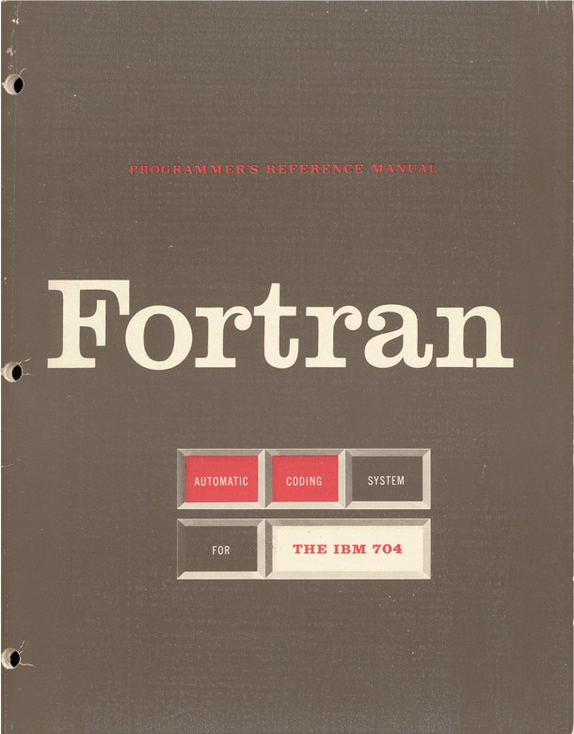
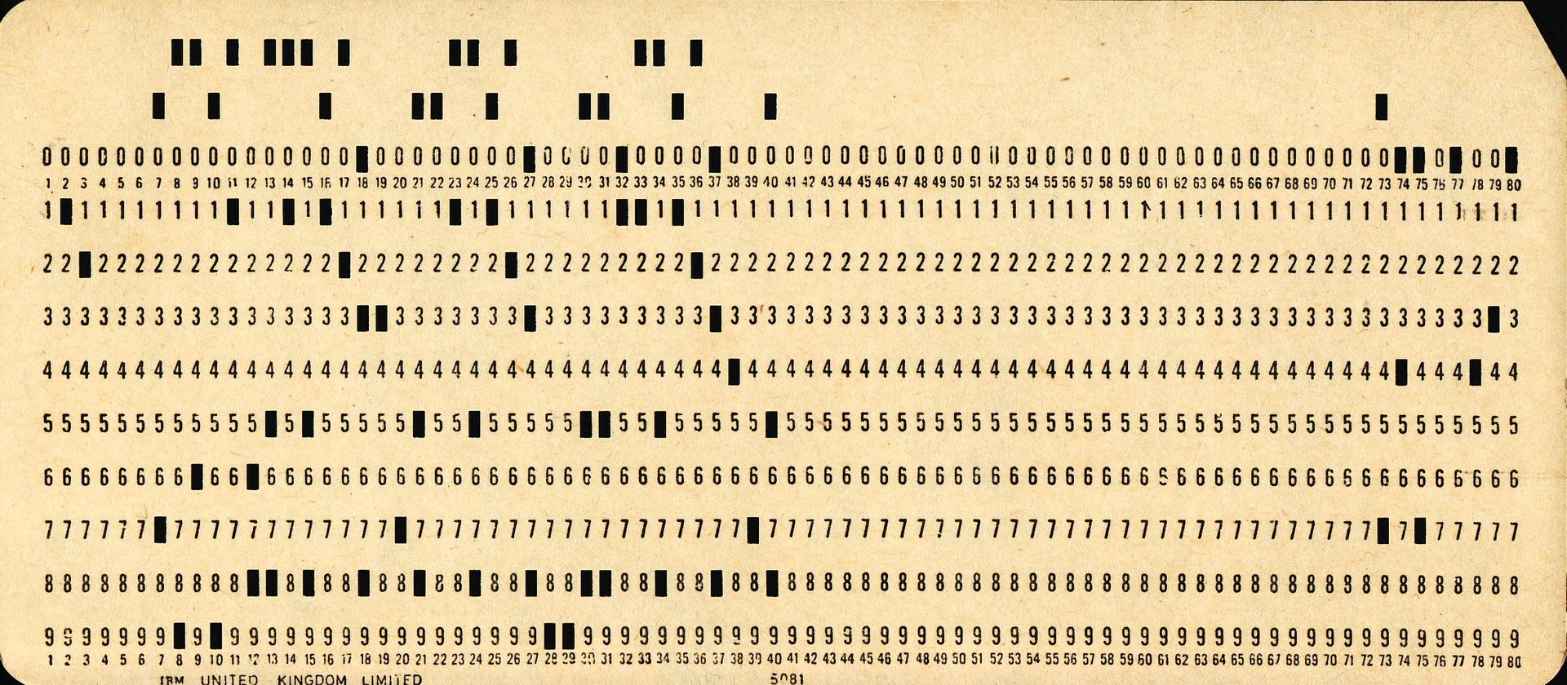
In the beginning, there was FORTRAN – FORmula TRANslator for the IBM 704 (1954).
C AREA OF A TRIANGLE - HERON'S FORMULA
C INPUT - CARD READER UNIT 5, INTEGER INPUT
C OUTPUT -
C INTEGER VARIABLES START WITH I,J,K,L,M OR N
READ(5,501) IA,IB,IC
501 FORMAT(3I5)
IF (IA) 701, 777, 701
701 IF (IB) 702, 777, 702
702 IF (IC) 703, 777, 703
777 STOP 1
703 S = (IA + IB + IC) / 2.0
AREA = SQRT( S * (S - IA) * (S - IB) * (S - IC) )
WRITE(6,801) IA,IB,IC,AREA
801 FORMAT(4H A= ,I5,5H B= ,I5,5H C= ,I5,8H AREA= ,F10.2,
$13H SQUARE UNITS)
STOP
END
Fortran : 1954 to present
unit 5 for stdin (cards)
unit 6 for stdout (cards/printer)
C : 1972 to present
unit 0 for stdin
unit 1 for stdout
unit 2 for stderr

Slide 7
Introduction to modern fortran
This training is an introduction to FORTRAN from old legacy code to more modern Fortran.
The rationale was that many students and scientists are meeting old legacy (dusty decks) FORTRAN codes to maintain and develop.
It’s expected programming experience and knowledge of numerical programming.
As the F66 standard was introduced generations ago, knowledge of the totally renewed language is a good idea. Since early 90s and forward many new concepts are introduced.
This not a parallel programming course, hence co-arrays & «do concurrent» are not covered.
Modern fortran is object oriented like all modern programming languages.
With the new 2023 standard just accepted we’re good at least for the next few decades.
There are good reasons that this mature language is still with us today.

Slide 8
Why Fortran in 2026 ? easy : PERFORMANCE !
Matrix matrix multiplication as an example, the major operation since Konrad Zuse (1941) up to today’s machine learning.
Two major languages Python and Fortran (F77 code from 1989)
N=2000 , two 2000 x 2000 matrices multiplied together.
Python : 22067.96 secs (10000x10000 : estimated ~51 days)
Fortran : 0.6897 secs (10000x10000 : 139.895 secs)
Fortran+lib : 0.3707 secs (10000x10000 : 43.9182 secs)
Python code :
for j in range(n):
for l in range(n):
for i in range(n):
z[i,j] = z[i,j] + x[i,l]*y[l,j]
Fortran code :
z = matmul(x,y)

Slide 9
Why Fortran in 2026 ? -
Simple syntax - fewer pitfalls
Tailored for numerical work
Simple syntax, prevent you from many C / C++ pitfalls
Powerful syntax for numerics saving you from many pitfalls
Strongly typed

Slide 10
Why Fortran in 2026 ? -
Simple vector syntax - less loops
a = sqrt(b) ; call random(b)
z = matmul(x,y) ; c = matmul(b(1:3,1:3), b(1:3,1:3))
y = sum(x(1:2,1:6:2)) ; y = product(x(1,:), 1, x(1,:)<15 )
where (x>=0)
x=sqrt(x) pack(v1, v1(1:) <= v1(1) )
elsewhere
x=sqrt(-x) qsort_reals(pack(data(2:), data(2:) > data(1)) )
end where

Slide 11
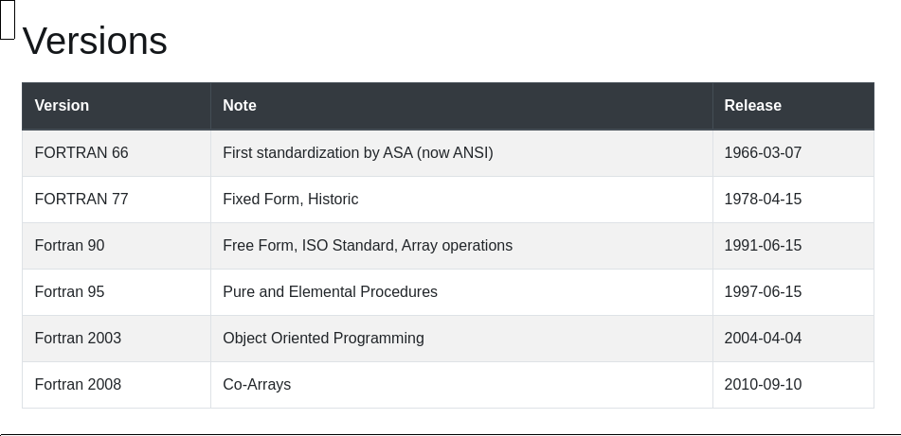
In the beginning, there was FORTRAN – FORmula TRANslator for the IBM 704 (1954).

Slide 12
Syntax, fixed format, free format came in f90
Fixed format (old legacy code you might come across):
Column 1 through 5 are for labels
A ‘C’ in the 1st column signify a comment
Any character in column 6 signify a continuation of the previous line
Columns 7-72 are for statements read by the compiler
Columns from 73 to 80 are not significant, not read by the compiler.
Comments after column 72, often used to number cards
Blanks are insignificant hence ‘DO 15 I’ is a legal variable named ‘DO15I’

Slide 13
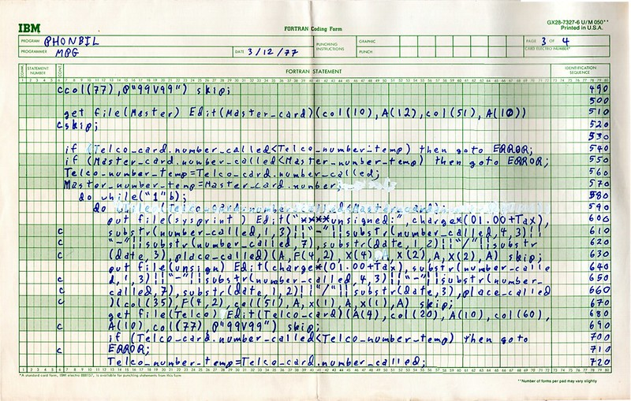

Slide 14
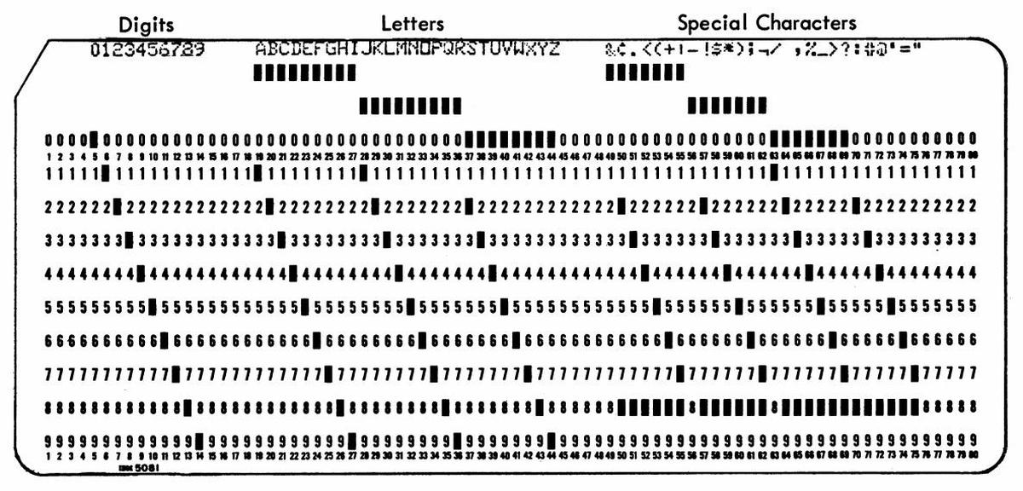

Slide 15
Syntax, fixed format, free format came in f90
123456789012345670123456789012345678901234567890123456789012345678901234567890
PROGRAM SYNTAX CARD 1
DO 10 I=1, 10, 2 CARD 2
PRINT *,I CARD 3
10 CONTINUE CARD 4
PRINT *,’DONE’ CARD 5
END CARD 6
comments after column 72, often used to number cards
Blanks are insignificant hence DO15I is a legal variable.
The newer standards have superior flow control.

Slide 16
Variables - naming could be important
Names starting with I,J,K,L,M,N declared as integers, all other real.
Implicit real a-z was commonly used
Implicit none - introduced in fortran90, before one could use implicit logical a-z
implicit none - is ubiquitous today, gfortran support : -fimplicit-none
5 types of standard variables integer, real, complex, character and logical
Plus any number of derived types.

Slide 17
Hello world in fortran 90
This hello-world is the first program in your new favorite language.
example-1/hello.f90
Demo - try to compile and run it. Fortran syntax is easy to learn, it’s verbose, in some way self explanatory. We’ll go through the compile and link process using the command line.
gfortran hello.f90 This yield an executable called a.out , try adding -o hello

Slide 18

Control flow - labels - old style and bad programming
Labels have been with us since the beginning of Fortran in 1954.
Labels are numericals located in column 1 through 5.
They are fixed points at which execution can be directed to.
Some standards existed like two digits for loops, 3 digits for formats.
This all up to the programmer.
DO NOT USE LABELS IN 2026 (or in any other year after 1990 )
Labels are outdated and regarded as bad practice.

Slide 19
Control flow - labels - 1970s do loop style
123456789012345670123456789012345678901234567890123456789012345678901234567890
PROGRAM SYNTAX CARD 1
DO 10 I=1, 10, 2 CARD 2
PRINT *,I CARD 3
10 CONTINUE CARD 4
PRINT *,’DONE’ CARD 5
END CARD 6

Slide 20
Control flow - jumps using GOTO and labels
Jumps to a certain label to alter control flow was common before. Assembly (machine code instructions have only jumps).
It turned out to be a very bad practice with unreadable code.
GOTO STATEMENTS SHOULD BE PROHIBITED ! - no joke.
Older code uses these statements.
If possible try to clean such statements.

Slide 21
Control flow - machine code has only jumps - Fortran is high level !
MOV AX, 00 ; Initializing AX to 0
MOV BX, 00 ; Initializing BX to 0
MOV CX, 01 ; Initializing CX to 1
L20:
ADD AX, 01 ; Increment AX
ADD BX, AX ; Add AX to BX
SHL CX, 1 ; Shift left CX, this in turn doubles the CX value
JMP L20 ; Repeats the statements

Slide 22
Modern x86-64 assembly/machine code
hello in machine code, close to how it was back in 1954.
example-1/hello.asm (or .nasm)
Demo - it should compile on most machines using x86-64 processors.
Maybe the only time in your life you’ll see an assembly program 😁
This is what the processor actually process, just very simple instructions

Slide 23
Control flow - GOTO and labels - arithmetic GOTO
123456789012345670123456789012345678901234567890123456789012345678901234567890
PROGRAM BADSYNTAX CARD 1
IF (I) 60,70,80 CARD 2
60 PRINT *,'NEGATIVE',I CARD 3
GOTO 91 CARD 4
70 PRINT *,'NULL',I CARD 5
GOTO 91 CARD 6
80 PRINT *,'POSITIVE',I CARD 7
91 END CARD 8

Slide 24
Control flow - GOTO and labels - computed GOTO
123456789012345670123456789012345678901234567890123456789012345678901234567890
PROGRAM BADSYNTAX CARD 1
100 FORMAT(/'GIVE AN INTEGER'/) CARD 2
WRITE(*,100) CARD 3
READ(*,*) I CARD 4
GOTO (30,40,50) I CARD 5
PRINT *,'ONLY 1, 2 OR 3' CARD 6
GOTO 90 CARD 7
30 PRINT *,'ONE' CARD 8
GOTO 90 CARD 9
40 PRINT *,'TWO' CARD 10
GOTO 90 CARD 11
50 PRINT *,'THREE' CARD 12
90 END

Slide 25
One of the classics of computer science is Edsger Dijkstra's "Go To Statement Considered Harmful", written in 1968. This missive argued that the GOTO statement (present in several languages at the time, including Fortran) was too primitive for high-level programming languages, and should be avoided.
https://degenerateconic.com/goto-still-considered-harmful.html
https://craftofcoding.wordpress.com/2020/02/07/is-goto-evil/

Slide 26
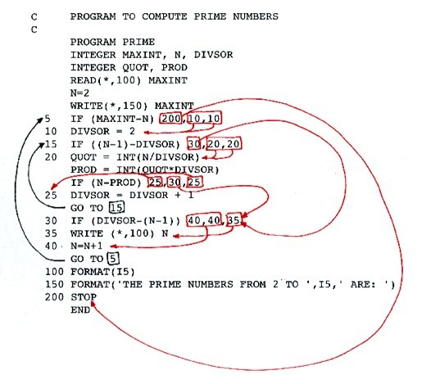
Such code is often called Spaghetti code
Would you like to review and maintain a million lines of such code ?

Slide 27
Spaghetti code - how bad can it be ?
Bad code should in most cases not be shown when teaching.
example-1/gotos.f
Demo - would you like to work with such code ?

Slide 28
Variables - not so simple…
integer, real, complex, character and logical
Fortran standard makes no assumptions of hardware logic nor sizes, it care about science not computers.

Slide 29
Variables - not so simple…
integer, real, complex, character and logical
Fortran standard makes no assumptions of hardware logic nor sizes, it care about science not computers.
You, the scientist know what you need - review your task before starting to program !
Fortran is and have always been a science language.
Need to specify explicit (default are available)
(human or machine approach)
Note that all integers are signed, this is science not computer architecture/science.

Slide 30
Variables - Human or machine approach ?
Human:
Integer range (lowest to highest, number of digits)
Real/Complex (lowest to highest exponent and number of decimal places)
Machine:
Integer 8, 16, 32, 64 or 128 bit size (whatever range that is?)
Real/Complex 32 or 64 bits components (complex 64 and 128) what range (exponent) and number of decimal places is this ?
Both approaches are available and widely used.

Slide 31
Variables - Human or machine approach ?
Humans need some help:
print *, "maxint i4 ",huge(ii4)
print *, "Precision and range r4 ",precision(rr4), range(rr4)
(i4 is a 32 bit integer and r4 is a 32 bit/float/single precision variable)

Slide 32
Variables - human approach
What do you need ? (the human approach, range, precision/decimals and exponent range) :
Review your code and data needs, what variables do I need to hold my data ?
What is the outcome of any calculation ? What’s kind of variable is needed ?
While Fortran only uses signed variables you still should review if negative answers
from symmetrical solutions are valid or not. Same for complex solutions, are they
valid for your calculation ? Make a plan for data management before beginning to write code.

Slide 33
Variables - human approach - paper & pencil exercise
What do you need ? (the human approach, range, precision/decimals and exponent range) :
integer, parameter :: i4 = selected_int_kind(r=9) - at least 9 digits
integer, parameter :: i8 = selected_int_kind(17) - at least 17 digits
integer, parameter :: r4 = selected_real_kind(p=6,r=20) - at least 6 decimal places, ± 20 exp
integer, parameter :: r8 = selected_real_kind(p=15,r=307) - at least 15 dec. places, ± 307 exp
The value of i4, i8, r4 and r8 are undefined by the standard, it’s compiler specific !
Do not rely on the actual number, another compiler might have a totally different numbering.

Slide 34
Variables - human approach
integer(i8) :: long_int actually integer(kind=i8), we drop ‘kind=’
real(r8) :: long_real No need to use i8, longint is also used,
complex(r8) :: long_complex int is a function so int cannot be used.
logical(i1) :: short_logical
constants : 2.0_r8 , 1.0_r4 , 1_i2 , 2_i4 , 1_i8
The usage of i8 and r4 / r8 is suggest sizes in bytes. Could very well have been longint or float or double ?
Size in bytes are less important than the number of digits and precision and range.

Slide 35
Variables - hardware approach
Use standard environment ,
use iso_fortran_env
integer(int64) :: long_int
real(real64) :: long_real
complex(real64) :: long_complex
logical(int8) :: short_logical
How many digits do an integer16 have ?
How many decimals do a real32 have ?
What is the range of the exponent for a real64?
The hardware approach expects the user to have these numbers at hand for each individual system then use.
For most machines these numbers are standardised.
IEEE 754 standard explain in detail.

Slide 36
Variables - not as simple as before -hardware approach
The machine approach, size in bits, who knows what precision and exponent range are? (VAX 11 had two 64 bit formats D_float: 16 decimals ± 38 exp, while G_float: 15 decimals ±308 exp).
Standards: IEEE 754-2019 and ISO/IEC 60559:2020 define it today
integer(kind=int64) :: long_int
2.0_real64 or 2_int64
integer*4 is portable in the sense it always means 4 bytes. But on the other hand it is not portable because it has never been part of any standard. Programs using this notation are not valid Fortran 77, 90 or any other Fortran. Avoid any usage of <datatype>*N !! - rewrite !!

Slide 37
Declaration of variables
This file contain an example of declaring variables and shows
sizes, ranges etc.
example-1/variables_iso.f08
fortran standard 2008 code.
Demo

Slide 38
Derived types - declaration of variables user specified type
With the fortran 90 standard came user defined derived types.
Simple example:
type :: t_location
real :: lat, lon
end type t_location
The new type is t_location, just like integer, real, logical etc.

Slide 39
Derived types - demo
With the fortran 90 standard came user defined derived types.
example-1/location.f90
The new type is t_location, just like integer, real, logical etc.

Slide 40
«Poor programming kills people»
stated at a Supercomputing tutorial on better programming
https://arstechnica.com/civis/threads/mariner-1-fortran-bug.862715/
program do10i
do 10 i = 1.10
print *,do 10 i
end

Slide 41
Mariner fault 1962 - simple mistake
Spot the error
example-1/mariner.f
Demo - try to run it, it’s all about the details.

Slide 42

The importance of keeping control over data types and their ranges cannot
be stressed more than pointing to two disasters :
Ariane-5 failure : Ariane flight V88 - Wikipedia

Slide 43

An even worse example, killing people, the Therac-25 incident Therac-25 - Wikipedia
The examples are just variable overflow examples…..

Slide 44
Overflow - what is 127 + 1
This exercise is showing examples of overflow
example-1/overflow.f90
Demo - do you have control over the range and precision of your variables ?
Are you sure that you don’t make an out of range mistake ?
Fun facts: MPI uses 4 byte integers for counting number or elements in the transfer. Max value of a 4 byte integer is 2.147.483.648 or 2 Giga numbers, only af GB of data. There is
an example of this to test it yourself.

Slide 46
Decision - test - flow control
if then else construction
if (test) statement
if (test) then
statement
else
statement
end if

Slide 47
Decision - test
logical :: p=.true.
if (p) then print *,’true’
if (a==b) write(*,'(a)') 'They are equal'
if (a>0) then
x=1/a
else
a=0
end if
There is no ‘elif’.
‘else if’ can be used, nested tests.

Slide 48
Decisions - if-then-else
This exercise is showing how to make decisions.
example-1/if.f90
Demo

Slide 49
Loops - do loop - the backbone of fortran
Syntax of do loop:
do variable = start, end, step ; where all must be integers.
Simple do loop :
do i = j, n, k
print *,i
end do

Slide 50
Loops - do loop - cycle and exit
Syntax of do loop:
do
print *,i
i=i+1
if (i>3) exit
end do
The statement exit finish execution of the loop.

Slide 51
Loops - do loop - cycle and exit
Syntax of do loop:
do
i=i+1
if (i<5) cycle
if (i>9) exit
print *, i
end do
Print only the last elements using cycle and exit.

Slide 52
Loops - do while loop
Syntax of do while loop:
do while (test)
print *, ‘here’
test = .false.
end do
Test can be a test like (a>0) or a logical. Cycle and exit as before.

Slide 53
Loops , fixed loops if decision loops
This exercise is showing how loops works in Fortran
example-1/loops.f90 , example-1/loop2.f90 , example-1/control-flow.f90
Demo - loops and different control flows.

Slide 54
Decision - case
Syntax of the case construct.
do i=1, 10
select case (j) ! j must be integer, character or logical
case(1) ! Case must be a constant, or a parameter variable.
print *, "One"
case(2)
print *, "Two"
case default
if (j > 4) exit ! Exit the do loop, not the case.
print *, "Many"
end select
end do

Slide 55
Decision - case
Syntax of the case construct.
character :: c
select case(c)
case ('0':'9') ! A range is allowed, integers and characters.
print *, 'Numbers !'
end select

Slide 56
Case - select from multiple of cases
This exercise is showing how to select from multiple options.
example-1/case.f90
Demo - select from a range of options with different control flows.

Slide 58
Formatting output
The most common format code letters are:
A - text string
D - double precision numbers, exponent notation
E - real numbers, exponent notation
F - real numbers, fixed point format
I - integer
X - horizontal skip (space)
/ - vertical skip (newline)
The format code F (and similarly D, E) has the general form Fw.d where w is an integer constant denoting the field width and d is an integer constant denoting the number of decimal digits.

Slide 59
Formatting output
The most common format code letters are:
(A) - A is for text, character string
(I3) - I is for integer, here I3 with up to 3 digits, i6.4 yield leading zeros.
(F10.3) - F is for reals, in this case width of total 10 characters and 3 decimal places.
(E12.8) - Scientific notation decimals and exponent, width 12 with 8 decimals.
(en10.2) - Engineering notation decimals and exponent, width 10 with 2 decimal places,.
(es8.1) - Scientific notation, decimals and exponent, width 8 with 2 decimal places.
(3I4) - Three integers, each with a width of up to four digits.
(5(a,f3.0)) - 5 tuples of text and float/real with 3 places, and zero decimals, 2 digits and decimal.
(G12.3) - Scientific format decimal number of exponent format depending on value, humal format.
(L) - Logical

Slide 60
Input / Output - format
print ‘(a)’, ‘hello world’
unit=6 for terminal <= Old style
unit=OUTPUT_UNIT <= New standard, highly portable
format = ‘(a)’
write(unit,fmt=format) ‘Hello world‘

Slide 61
Input / Output - terminal
print *, ‘hello world’
print ‘(a)’, ‘hello world’
write(*,’(A)’) ‘Hello world‘
form=’(i3,x,a,x,f5.2)’
write(*,form) 127,’is int’,3.14
Variables supplied MUST match the format,
no compile error, run time error.

Slide 62
Formatting output
The most common special codes are:
(x) - Emit a space
(/) - Emit a linefeed
(sp) - Numeric, print ‘+’ for positive numbers
(dc) - Decimal symbol, can be comma ‘,’ or period ‘.’

Slide 63
Format string
Format statements can be kept in a string.
form='(a)' ! One character or a string
form='(a,2x,i3,i3,f4.2)' ! One string, two spaces, one integer, one integer, one real.
form='(a, "," i3 "," i3 "," f4.2 "," e8.2 "," g10.3)' ! string, comma, one integer, comma,
one integer, comma, one real, comma, one real, comma, one real
form='(10(ai3))’ ! Ten tupples of string + integer
print format, <variables>
write(*,format) <variables>

Slide 64
Format string - internal file (actually a buffer)
Format statements can be kept in a string variable or buffer, this is called internal file.
A string can be written to :
write(string,’(a)’) ‘Hello world’
string will now contain the text, formats can also be written to format strings.

Slide 65
Demos on formatting
This demo explore formatting.
examples-2/format.f90
examples-2/format2.f90
examples-2/format3.f90
Introduction to implied do loop, (i, i=1,10) a powerful tool.
implied-do-loop.f90

Slide 67
Working with stored files - Input / Output
Important concepts :
Unit numbers 5 and 6 for keyboard and terminal, old fashion.
Modern concept is using the predefined variables: INPUT_UNIT, OUTPUT_UNIT, ERROR_UNIT
Files can be assigned to a unit, keyword newunit assign an unsed number.
No need to actually know what the unit number is.
open(newunit=myunit,file=’myfile.txt’)
read(myunit,*) a

Slide 68
Working with stored files - Input / Output
Important concepts :
Unit numbers 5 and 6 for keyboard and terminal, old legacy numbers.
Modern concept is using the predefined variables: INPUT_UNIT, OUTPUT_UNIT, ERROR_UNIT
write(ERROR_UNIT,*) “Error message”
write(OUTPUT_UNIT,*) “Warning, no error”
read(INPUT_UNIT,*) a

Slide 69
Working with stored files - Input / Output
Binary output, data structures can be written.
real(real64), dimension(100,100) :: x
open(myunit,file=’myfile.txt’, form=’unformatted’) ! Binary ‘raw’, written as stored.
write(myunit) x

Slide 70
Demos on input/output - I/O
This demo explore file I/O files in examples-2
formatted, ascii text format:
fileio_w.f90 and fileio_r.f90
Binary file format:
fileio2_w.f90 and fileio2_r.f90

Slide 72
Vector syntax - declaration of variables
With the fortran 90 standard came vector syntax and more strict declarations of indexed variables of often referred to as vectors (of multidimensions).
The keyword is dimension
dimension(n1,n2,n3,...,n15) up to 15 dimensions (2008 std).
The 2023 standard introduce the keyword “rank” which open up for multidimensional vectors of at start in not fixed and can be set at run time.

Slide 73
Vector syntax - declaration of variables
Declare vectors of different dimensions :
integer(int8), dimension(100) :: k
logical(int8), dimension(5) :: ok
real(real64), dimension(10,10) :: x
real(real32), dimension(10,10,10) :: y
complex(real64), dimension(10,10,10) : z
complex(real32), dimension(5,5,5,5) :: w = (1.4_real32, 1.5_real32)
In the 2023 standard (rank not known at compile time):
integer, rank(r) :: a

Slide 74
Vector syntax - no do loops
We can operate on vectors, matrices and higher dimensional (up to 15) arrays as if they were scalars. This is element by element by element operations.
A = 0 ! all elements in A is set to zero
A = B + C ! All elements in A are assigned to the sum of B + C
B = B*10 ! Elements of B are multiplied by ten
C = C**2 ! Elements of C are squared
C = 1/C ! Elements of C are inverted

Slide 75
Vector syntax -no do loops
This is element by element by element operations. Important - remember.
Assume A,B & C are arrays - then C = A+B is equivalent to
do j=1,n As you need one do loop per dimension, operations on
C(j)=A(j)+B(j) 3d or higher dimensions become easier and easier.
While C=A+B is vector syntax.
A*B is different from matrix-matrix multiplication, element by element.

Slide 76
Vector syntax - no do loops anymore (almost)
Vectors of any dimension
assigning A=1.0
extracting A(1:2)
slicing A(1:2:2)
shaping A(1:4)
reshaping A(1:4) => A(2,2)
masking L = A<0

Slide 77
Demos on vector syntax
This demo explore vectors, files in example-3:
vectors1.f90 , vectors2.f90, vectors3.f90, vectors4.f90
Advanced usage, functions this is homework and exercise
slicing.f90 , pack.f90
A challenge for homework is the qsort.F90 code, a simple quicksort using vector syntax.

Slide 78
vector / array operations
We can operate on vectors, matrices and higher dimensional structures.
packing
unpacking
masking
shifting
rotating
locate (locate a value in a vector)
modern fortran:
mask = v1 /= 0
F77 style (n must be known):
do j=1,n
if (v1(j) .ne. 0) then
mask(j)=.true.
else
mask(j)=.false.
end

Slide 79
Vector / array operations
We can operate on vectors, matrices and higher dimensional structures.
shape
reshape
pack
Change shape of vectors of any dimension.
Change a N*N*N long 1-d vector to a 3-d N x N x N cube,
or to a 2-d N*N x N matrix.
or pack, mask and reshape together.

Slide 81
Functions and routines
Functions and subroutines.
Functions are well known, they return a value.
Subroutines are called, exchange data via parameters
In fortran everything is by reference. Any variable is an address (e.g. like a pointer to a chunk of memory).

Slide 82
Functions
Functions return something,
a = func(x) where a gets assigned to the result of the function
Like s = sqrt(2.0) , t = exp(1.0) etc. (s & t can be scalars or multidimensional)
The input parameter should not change, not be updated, or any other values should be changed. These are called side effects and can cause issues and errors. However Fortran have constructs to prevent this!

Slide 83
Intrinsic routines
Built in routines, functions and subroutines:
https://gcc.gnu.org/onlinedocs/gfortran/Intrinsic-Procedures.html
A large selection of useful routines.
Be careful with the GNU extensions.
.

Slide 84
Pure functions
Pure functions have no side effects !
Any assignments of parameters, allocation or I/O are not allowed.
allocation could cause the system to run out of memory
I/O could in principle fill up the storage.
Or other effects the compiler will flag as impure.

Slide 85
Subroutines
Subroutines are called, no return value.
Subroutines exchange data via parameters
In fortran everything is by reference. Any variable is an address (e.g. like a pointer to a chunk of memory). Fortran have mechanisms to prevent updating of input only parameters.

Slide 86
Subroutines
call name(a,b,c)
Calling subroutine with 3 parameters, which can be:
in
out
inout
It also possible to have optional parameters.

Slide 87
Pure subroutines
Pure subroutines have no side effects !
Any assignments of input parameters, allocation or I/O are not allowed.
allocation could cause the system to run out of memory
I/O could in principle fill up the storage
Or other effects the compiler will flag as impure.

Slide 88
Interface to functions and subroutines
The compiler need to know how to call a routine.
Without the interface there is no way the compiler can make sure the calling of a routine is correct. You might send a long integer (64 bit) to an unsuspecting receiver (routine) who expect a long real (64 bit).
Or an index to an array which might be far off and cause a segment violation and abort.
If possible use an interface, it’s there to guide and provide safer programs.

Slide 89
Interface to functions and subroutines
The compiler need to know how to call a routine.
Number, size and type of parameters. An example of just the routine’s interface:
interface
pure subroutine multwo(a,b,c)
use iso_fortran_env
implicit none
integer(int8), intent(in) :: a,b
integer(int8), intent(out) :: c
end subroutine multwo
end interface

Slide 90
Demos functions and subroutines
This demo show how fortran call by reference, and how pure works, and introduce the concept of interface. Files found in example-4:
functions1.f90 through functions4.f9 , subroutines1.f90 and subroutines2.f90
Contiguous layout : subroutines3.f90

Slide 91
Functions calling themselves
Functions can call itself, this is called recursive functions.
In Fortran the default is not to allocate new memory when a function is called the second time. Old values will keep their value.
The keyword recursive must be used.
Typical example is the Fibonacci number generator :
fib(n) = fib(n-1) + fib(n-2)

Slide 92
Demos functions and subroutines
This demo show recursive functions.
example-4/functions5.f90
Simple Fibonacci number sequence generator.
Fun fact: the ratio of two Fibonacci numbers is close to the golden ratio.

Slide 93
Elemental Functions
Elemental functions operate on element by element.
It can take input of various length and ranks.
Operation is done element by element on the arrays given.
Example, a sum : s=a(1,1)+b(1,1) + a(2,1)+b(2,1) etc etc.
arguments can have any higher ranks.
like example addint([1,2,3], [4,5,6]) would yield 1+4, 2+5, 3+6
Take any ranks and dimension!

Slide 94
Demos functions and subroutines
This demo show elemental functions.
example-4/functions6.f90

Slide 96
Dynamic memory allocation
Dynamic memory allocation allows programs to be more flexible and adaptable. It allows the allocation and deallocation of memory as needed during runtime, enabling the program to handle varying amounts of data.
Efficient memory management: Dynamic memory allocation provides more efficient memory management compared to static memory allocation. With dynamic allocation, memory can be allocated and deallocated on-demand, reducing wasted memory space.
Review your program and assess what kind of memory management you need.

Slide 97
Dynamic memory allocation
Performance is comparable when using static or dynamic allocation.
Performance is not a big issue when deciding on static or dynamic allocation.

Slide 98
Dynamic memory allocation
However,
Allocation takes time, same for static or dynamic, Linux is lazy so static memory is allocated by the OS as it’s written to (init or written).
if you allocate a large chunk, then deallocate and allocate again it will impact performance.
If your structure is static during a run you might keep the variables allocated for the duration of the run (static or dynamic)
.

Slide 99
Dynamic memory allocation
Static memory allocation :
Stores static variables
Static Memory Allocation is done before program execution.
In Static Memory Allocation, there is no memory re-usability
In this allocated memory remains from start to end of the program.
Dynamic Memory allocation :
Stores dynamic variables
Dynamic Memory Allocation is done during program execution.
In Dynamic Memory Allocation, there is memory re-usability and memory can be freed when not required
In this allocated memory can be released at any time during the program.

Slide 100
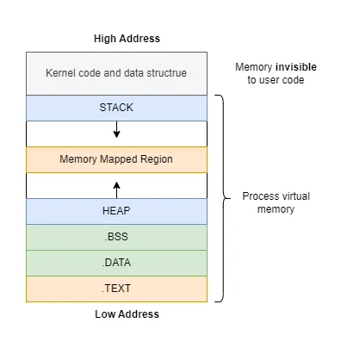
Human point of view:
Your memory space start at 0 and extend linearly to N.
Behind the scenes the OS and memory management system fragment and place it at various places (even write it out to storage).
https://www.linux.com/training-tutorials/stack-vs-heap-whats-difference-and-why-should-i-care/

Slide 101
Dynamic memory allocation
Practical issues, too small stack size, run time error abort program
solution (some times) : ulimit -s unlimited
Check if already set : ulimit -a
This is Linux stuff, not Fortran language.

Slide 102
Dynamic memory allocation
Important statements, dimension is unknown, rank must be known :
real(real64), allocatable, dimension(:) :: x
allocate(x(size))
Only difference is that x is allocated, use as before, no change.

Slide 103
Dynamic memory allocation
Important statements, dimension is unknown, rank must be known :
real(real64), allocatable, target, dimension (:) :: x
real(real64), pointer, dimension(:) :: pt
allocate(x(size)) or allocate(pt(size))
The pointer can now point to vector x. Only difference with x is that’s a possible target for a pointer.

Slide 104
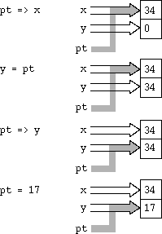
Pointers
pointers are strongly typed
Data type
Rank of array
real(real64), pointer, dimension(:) :: pt

Slide 105
Demos on dynamic memory allocation
This demo show dynamic allocation and pointer.
example-5/alloc1.f90 through alloc8.F90

Slide 106
Dynamic memory allocation
Important statements, dimension is unknown, rank must be known :
allocate(z, source=x)
allocate(z, mold=pt)
allocate(z(vectorsize), source=3.14_real64)
Source make a new vector identical to source with content of source.
Mold make a new vector identical to source without any copy of data.

Slide 107
Demos on dynamic memory allocation
These demos show dynamic allocation and some associated syntax tricks.
example-5/alloc4.f90 through alloc8.F90

Slide 108
draft of the fortran 2018 standard are available at :
std-2018-007r1.pdf
Useful links include :
Fortran Wiki
Fortran-lang.org
Fortran Tutorial
The GNU Fortran Compiler
https://wg5-fortran.org/N2201-N2250/N2212.pdf (whats’n new in 2023 standard)

