Slide 1
Supervised & unsupervised learning
Supervised learning algorithms are those used in classification and prediction
We must have data available in which the value of the outcome of interest (e.g., purchase or no purchase) is known
e.g. segmentation, rule based grouping
Unsupervised learning algorithms are those used where there is no outcome variable to predict or classify
E.g. Association rules, data reduction methods, and clustering

Slide 2
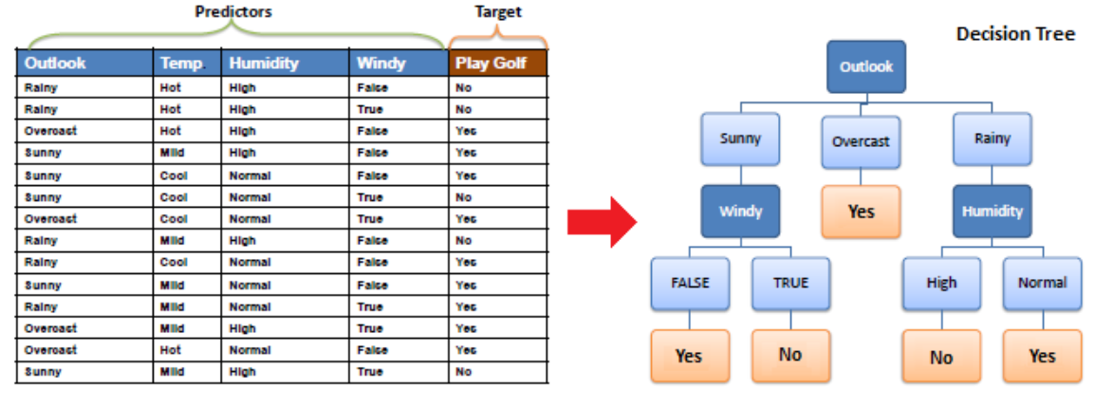
Example : Decision Tree

Slide 3
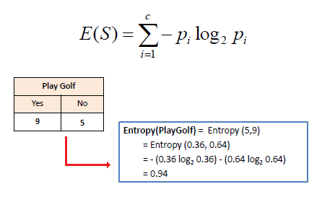
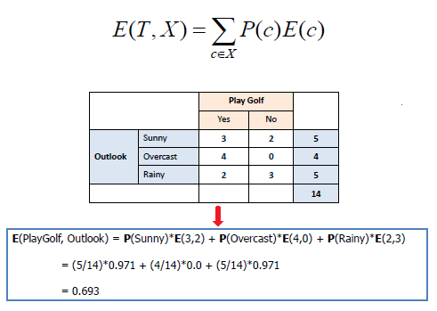
Algorithms for decision trees
There are many specific decision-tree algorithms. Notable ones include:
CART (Classification And Regression Tree)
Algorithms uses entropy to calculate the homogeneity of a sample.
If the sample is completely homogeneous the entropy is zero and if the sample is an equally divided it has entropy of one
We aim to decrease the entropy of the dataset until we reach leaf nodes at which point the subset that we are left with is pure, or has zero entropy and represents instances all of one class

Slide 4
Building decision trees using R
rpart()
CART algorithm is implemented by the rpart() function in package rpart
rpart(formula, data=, method=,control=) where
formula : outcome ~ predictor1 + predictor2 + predictor3 + …
data= specifies the data frame
Notes:
ctree()
ctree(formula, data=)
uses Conditional Inference Tree
The tree generated by party package doesn’t need to be pruned because the tree growth is based on statistical stopping rules

Slide 5
Entropy

Slide 6

Quality indicators
TP – True Positive : Correctly assigned observations to the positive class
TN – True Negative : Correctly assigned observations to the negative class
FP – False Positive : Wrongly assigned observations to the positive class. (Which actually belong to the negative class)
FN – False Negative : Wrongly assigned observations to the negative class (Which actually belong to the positive class)

Slide 7
Quality indicators
TPR - True Positive Rate : TPR = TP / (TP + FN) …Ability to detect members of the positive class
TNR - True Negative Rate : TNR = TN / (TN + FP) …Ability to detect members of the negative class
FPR - False Positive Rate: FPR = FP / (FP + TN) ...Frequency of mistakes to classify the false observation as true class
FNR - False Negative Rate: FNR = FN / (FN + TP) …Frequency of mistakes to classify the true observation as false class
Total Accuracy = (TP+TN) / (TP+TN+FN+FP)

