Slide 1
Phylogenetics
• The study of evolutionary relationships.
• Conversion of DNA or protein sequence data into a branching diagram (“tree”) that shows the relationships between the sequences.

Slide 2
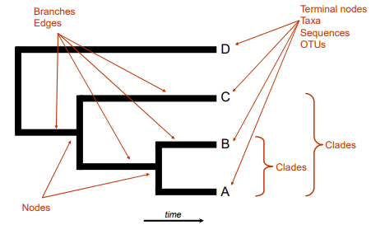
Phylogenetics
The anatomy of a phylogenetic tree

Slide 3
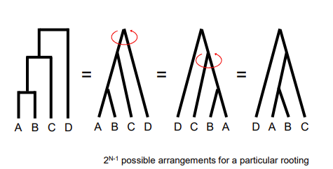
Phylogenetics the many shapes of trees

Slide 4
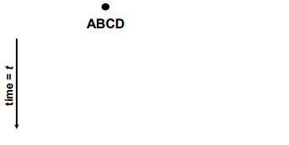
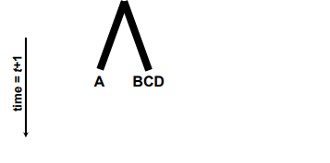
Tree growth(1)

Slide 5
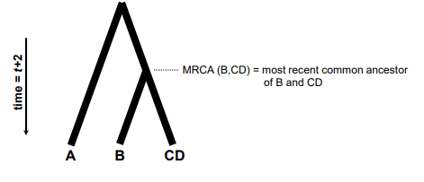
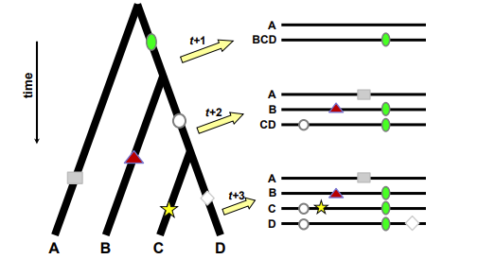
Tree growth(2)

Slide 6
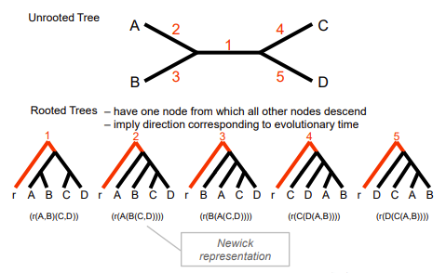
Rooting trees

Slide 7
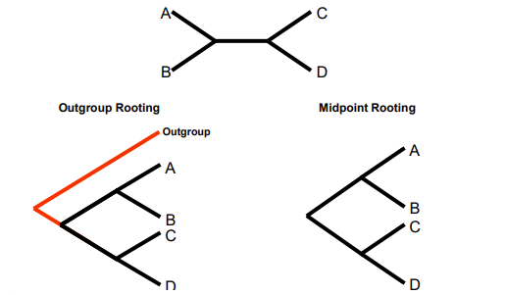
Rooting trees

Slide 8
Phylogenetics - terminology
Ancestral State
a.k.a. plesiomorphy
Derived State
a.k.a. apomorphy
o Autapomorphy = unique derived state
o Synapomorphy = shared derived state
Homoplasy
Similarity due to parallel evolution, convergent evolution or secondary loss
Homology
Similarity due to common ancestry

Slide 9
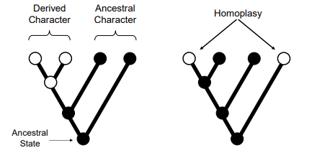
Phylogenetics - terminology

Slide 10
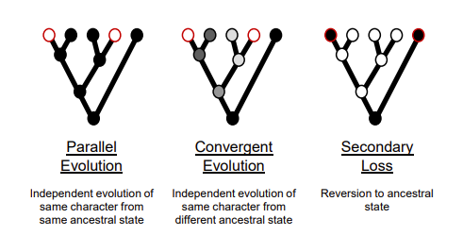
Homoplasy(1)

Slide 11
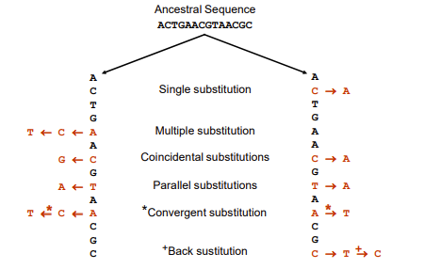
Homoplasy(2)

Slide 12
Basic elements
Taxa
Sampling
Loci
Homology
Variation
Independence
Analysis
Data
Sequence Alignments
Phylogenetic methods
Statistical support

Slide 13
Tree building methods
Distance methods
UPGMA (Unweighted Pair Group Method with Arithmetic mean )
Neighbour-joining
Character-based (discrete) methods
Maximum parsimony
Maximum likelihood
Phylogenetics and Recombination – how would recombination affect interpretation of a tree?

Slide 14
Neighbor Joining
Calculate pairwise distances
Create distance matrix
Determine net divergence for each terminal node
Create rate-corrected distance matrix
Identify taxa with minimum rate-corrected distance
Connect taxa with minimum rate-corrected distance via a new node, and determine their distance from this new node
Determine the distance of new node from rest of taxa or nodes
Regenerate distance matrix
Return to step 2 N

Slide 15
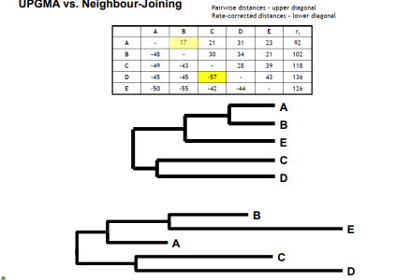
UPMG Vs. Neighbor Joining

Slide 16
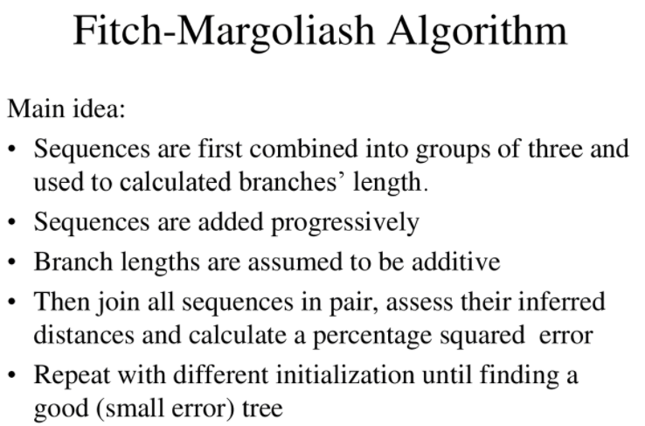
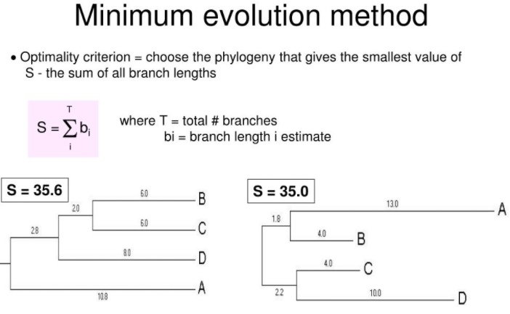
Optimality based distance methods

Slide 17
Maximum likelihood
Attempts to answer question:
What is the probability of observing the data, given a particular model of evolution and evolutionary history?
o data = MSA
o model = transition probabilities, base frequencies, rate heterogeneity...
o evolutionary history = phylogenetic tree
Evaluates the likelihood of every substitution of every possible tree.
All possible trees are considered, and the number of substitutions that must have occurred are calculated.
The tree with the highest likelihood is assumed to be the correct tree.

Slide 18
Likelihood – coin example
Likelihood (L) = Probability (data_{observed} | model)
Data : HHTHTH
Model 1 : fair coin Prob(H) = 0.5, Prob(T) = 0.5
Model 2 : 2-head coin Prob(H) = 1.0, Prob(T) = 0.0
Model 3 : 2-tail coin Prob(H) = 0.0, Prob(T) = 1.0
L (Data|Model1)
= Prob(H|Model1) * Prob(H|Model1) * Prob(T|Model1) * Prob(H|Model1) * Prob(T|Model1) * Prob(H|Model1)
= 0.5 * 0.5 * 0.5 * 0.5 * 0.5 * 0.5 = 0.0156
L (Data|Model2) = 1.0 * 1.0 * 0.0 * 1.0 * 0.0 * 1.0 = 0.0
L (Data|Model3) = 0.0 * 0.0 * 1.0 * 0.0 * 1.0 * 0.0 = 0.0

Slide 19
Maximum Likelihood
Find the model that maximizes the likelihood of the observed data
Data : GGACGCCTGACGCCGCTCGG
Model 1: equal base composition - 0.25, 0.25, 0.25, 0.25 – A, C, G, T, respectively
Model 2: G+C bias - 0.1, 0.4, 0.4, 0.1 – A, C, G, T, respectively
Model 3: A+T bias - 0.4, 0.1, 0.1, 0.4 – A, C, G, T, respectively
L (Data|Model1)
= Prob(G|Model1)*Prob(G|Model1)*Prob(A|Model1)*...* Prob(G|Model1) = 0.2520 = 9.1x10-13
L (Data|Model2) = 0.416 * 0.14 = 4.3x10-11 - maximum likelihood
L (Data|Model3) = 0.116 * 0.44 = 2.6x10-18

Slide 20
Maximum Likelihood
Advantages of ML methods:
Based on explicit evolutionary models.
Permits statistical evaluation of the likelihood of specific tree topologies.
Often returns many equally likely trees.
Usually outperforms other methods.
Disadvantages:
Computationally very intensive.
Often returns many equally likely trees.

Slide 21
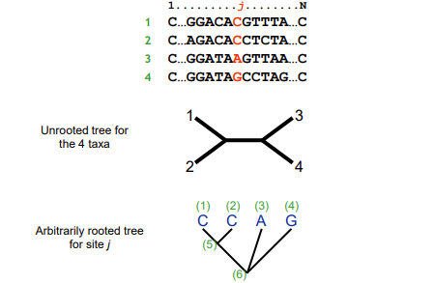
Maximum Likelihood(1)

Slide 22
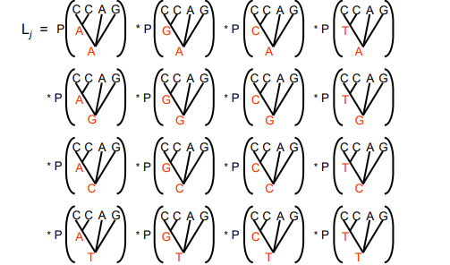
Maximum Likelihood(2)

Slide 23
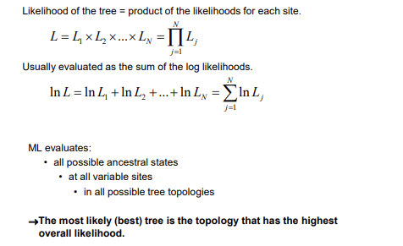
Maximum Likelihood(3)

Slide 24
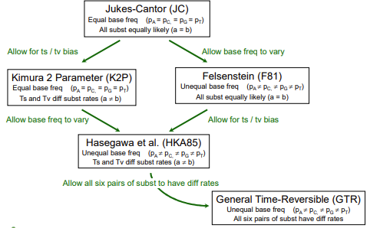
Models of sequence evolution

Slide 25
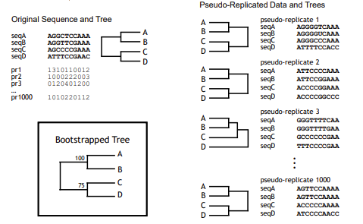
Phylogenic confidence - bootstrapping

Slide 26
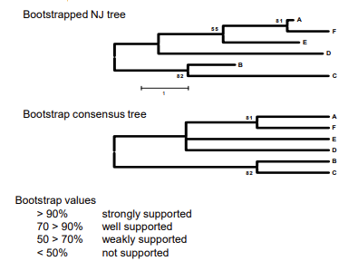
Phylogenic confidence - bootstrapping

Slide 27
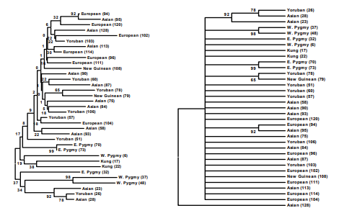
Phylogenic confidence - bootstrapping

