Slide 1
Spring and Java EE Side by Side
Reza Rahman
Java EE/GlassFish Evangelist
Reza.Rahman@Oracle.com
@reza_rahman

Slide 2
Program Agenda
Spring and Java EE
Side-by-Side
Ecosystems

Slide 3
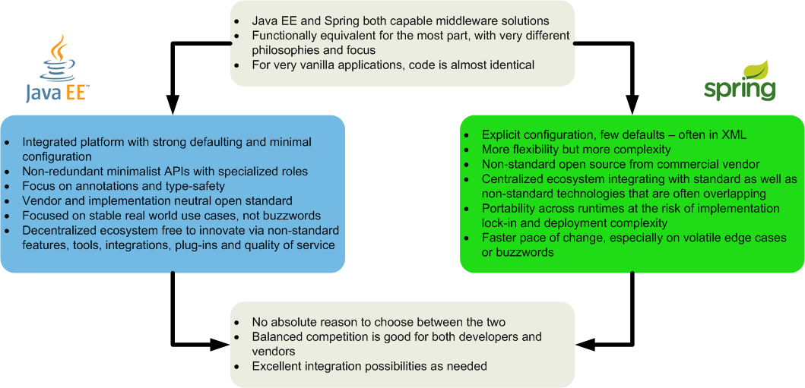
A Bird’s Eye View

Slide 4
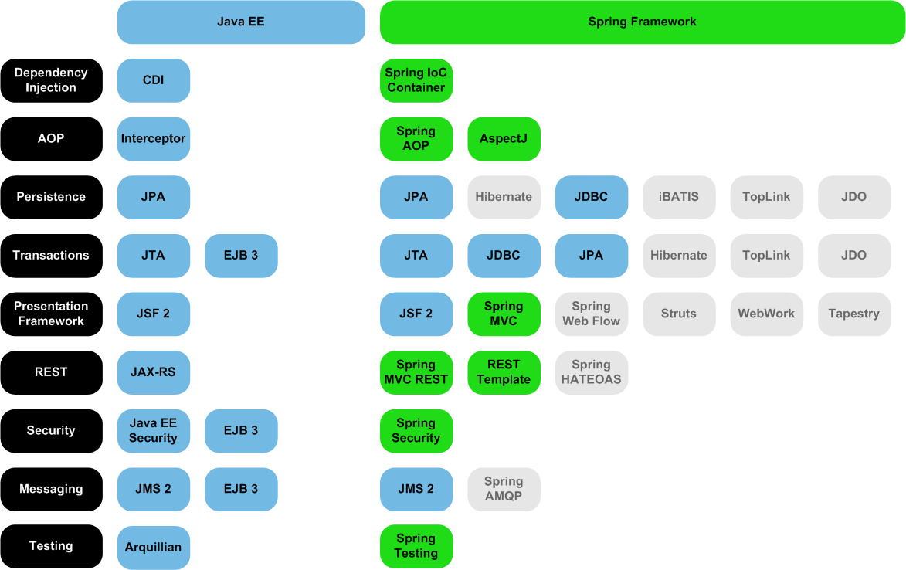
Main Features/APIs
Similar patterns for validation, WebSocket, JSON, XML, SOAP, remoting, scheduling, caching, etc
Spring also integrates with EJB 3, but not CDI

Slide 5
Java EE and Spring Component
@Stateless
public class BidService {
@PersistenceContext
private EntityManager entityManager;
public void addBid(Bid bid) {
entityManager.persist(bid);
}
}
@Component
public class BidService {
@PersistenceContext
private EntityManager entityManager;
@Transactional
public void addBid(Bid bid) {
entityManager.persist(bid);
}
}

Slide 6
Spring Bootstrap (XML)
<beans xmlns="http://www.springframework.org/schema/beans"
xmlns:xsi="http://www.w3.org/2001/XMLSchema-instance"
xmlns:context="http://www.springframework.org/schema/context"
xmlns:aop="http://www.springframework.org/schema/aop"
xmlns:tx="http://www.springframework.org/schema/tx"
xsi:schemaLocation="http://www.springframework.org/schema/beans
http://www.springframework.org/schema/beans/spring-beans.xsd
http://www.springframework.org/schema/context
http://www.springframework.org/schema/context/spring-context.xsd
http://www.springframework.org/schema/aop
http://www.springframework.org/schema/aop/spring-aop.xsd
http://www.springframework.org/schema/tx
http://www.springframework.org/schema/tx/spring-tx.xsd">
<context:component-scan base-package="com.actionbazaar"/>
<tx:annotation-driven/>
...
<bean id="transactionManager"
class="org.springframework.jdbc.datasource.DataSourceTransactionManager">
<property name="dataSource" ref="dataSource"/>
</bean>
<bean id="entityManagerFactory"
class="org.springframework.orm.jpa.LocalContainerEntityManagerFactoryBean">
<property name="dataSource" ref="dataSource"/>
<property name="loadTimeWeaver">
<bean
class="org.springframework.instrument.classloading.InstrumentationLoadTimeWeaver"/>
</property>
</bean>
</beans>

Slide 7
Defining the Data Source
<bean id="dataSource" class="org.apache.commons.dbcp.BasicDataSource"
destroy-method="close">
<property name="driverClassName"
value="oracle.jdbc.driver.OracleDriver"/>
<property name="url"
value="jdbc:oracle:thin:@localhost:1521:actionbazaar"/>
<property name="user" value="scott"/>
<property name="password" value="tiger"/>
</bean>
<data-source>
<name>java:global/jdbc/myDataSource</name>
<class-name>oracle.jdbc.driver.OracleDriver</class-name>
<port-number>1521</port-number>
<server-name>localhost</server-name>
<database-name>actionbazaar</database-name>
<user>scott</user>
<password>tiger</password>
<property>
<name>createDatabase</name>
<value>create</value>
</property>
</data-source>

Slide 8
Spring Bootstrap (Java)
@Configuration
@ComponentScan(basePackages="com.actionbazaar")
@EnableTransactionManagement
public class DataConfiguration {
@Bean(destroyMethod="close")
public DataSource dataSource(){
BasicDataSource ds = new BasicDataSource();
ds.setDriverClassName("oracle.jdbc.driver.OracleDriver");
ds.setUrl("jdbc:oracle:thin:@localhost:1521:actionbazaar");
ds.setUser("scott");
ds.setPassword("tiger");
return ds;
}
@Bean
public PlatformTransactionManager transactionManager(){
return new DataSourceTransactionManager(dataSource());
}
@Bean
public LocalContainerEntityManagerFactoryBean entityManagerFactory(){
LocalContainerEntityManagerFactoryBean factory = LocalContainerEntityManagerFactoryBean();
factory.setDataSource(dataSource());
factory.setLoadTimeWeaver(new InstrumentationLoadTimeWeaver());
return factory;
}
}

Slide 9
Servlet Bootstrap
<web-app>
<context-param>
<param-name>contextConfigLocation</param-name>
<param-value>
classpath*:**/applicationContext*.xml
</param-value>
</context-param>
<listener>
<listener-class>
org.springframework.web.context.ContextLoaderListener
</listener-class>
</listener>
...
</web-app>

Slide 10
Simple JSF Page
<html xmlns="http://www.w3.org/1999/xhtml"
xmlns:ui="http://java.sun.com/jsf/facelets"
xmlns:h="http://java.sun.com/jsf/html"
xmlns:f="http://java.sun.com/jsf/core">
<ui:composition template="/WEB-INF/template.xhtml">
<ui:define name="title">Add Bid</ui:define>
<ui:define name="content">
<h3>Add Bid</h3>
<h:form>
<p>Item: <h:outputText value="#{item.name}"/></p>
<p>Current bid:
<h:outputText value="#{item.highestBid.amount}"/></p>
<p>Amount: <h:inputText id="amount" value="#{bid.amount}"/></p>
<p><h:commandButton value="Add bid"
action="#{addBid.onClick}"/></p>
</h:form>
</ui:define>
</ui:composition>
</html>

Slide 11
CDI/JPA Components
CDI Backing Bean
JPA Entity
@Named @ViewScoped
public class AddBid {
@Inject private BidService bidService;
@Inject @LoggedIn private User user;
@Inject @SelectedItem private Item item;
@Produces @Named
private Bid bid = new Bid();
public String onClick() {
bid.setBidder(user);
bid.setItem(item);
bidService.addBid(bid);
return “bid_confirm.xhtml”;
}
}
@Entity @Table(name="BIDS")
public class Bid {
@Id @GeneratedValue
private long id;
@ManyToOne(optional=false)
private User bidder;
@ManyToOne(optional=false)
private Item item;
DecimalMin("0.0")
private double amount;
...
}

Slide 12
Servlet Bootstrap
<web-app>
<servlet>
<servlet-name>Faces Servlet</servlet-name>
<servlet-class>javax.faces.webapp.FacesServlet</servlet-class>
<load-on-startup>1</load-on-startup>
</servlet>
<servlet-mapping>
<servlet-name>Faces Servlet</servlet-name>
<url-pattern>*.xhtml</url-pattern>
</servlet-mapping>
<welcome-file-list>
<welcome-file>index.xhtml</welcome-file>
</welcome-file-list>
</web-app>

Slide 13
Spring MVC JSP Page
<%@ taglib prefix="tiles“
uri="http://tiles.apache.org/tags-tiles" %>
<%@ taglib prefix="form"
uri="http://www.springframework.org/tags/form" %>
<tiles:insertDefinition name="defaultTemplate">
<tiles:putAttribute name=“title">Add Bid</tiles:putAttribute>
<tiles:putAttribute name=“content">
<h3>Add Bid</h3>
<form:form modelAttribute="bid" method="post">
<p>Item: <form:errors path="item" cssClass="error"/>
${item.name}</p>
<p>Current bid: ${item.highestBid.amount}</p>
<p>Amount: <form:errors path="amount" cssClass="error"/>
<form:input path="amount"/></p>
<p><input type="submit" value="Add Bid">
</form:form>
</tiles:putAttribute>
</tiles:insertDefinition>

Slide 14
Spring MVC Controller
@RequestMapping("/add_bid.do") @SessionAttributes({"item", "bid"})
public class BidController {
@Autowired private ItemService itemService;
@Autowired private BidService bidService;
@RequestMapping(method=RequestMethod.GET)
public String setupForm(@RequestParam("itemId") int itemId, ModelMap model) {
Item item = itemService.getItem(itemId);
model.addAttribute("item", item);
Bid bid = new Bid();
model.addAttribute("bid", bid);
return "add_bid";
}
@RequestMapping(method=RequestMethod.POST)
public String addBid(@ModelAttribute("item") Item item, @Valid @ModelAttribute("bid") Bid bid,
HttpSession session, BindingResult result, SessionStatus status) {
bid.setBidder((User)session.getAttribute("user"));
bid.setItem(item);
if (result.hasErrors()) {
return "add_bid";
} else {
bidService.addBid(bid);
status.setComplete();
return "redirect:confirm_bid.do?itemId=" + item.getItemId();
}
}
}

Slide 15
Spring MVC Bootstrap
<beans xmlns="http://www.springframework.org/schema/beans"
xmlns:xsi="http://www.w3.org/2001/XMLSchema-instance"
xmlns:mvc="http://www.springframework.org/schema/mvc"
xmlns:context="http://www.springframework.org/schema/context"
xsi:schemaLocation="http://www.springframework.org/schema/beans
http://www.springframework.org/schema/beans/spring-beans.xsd
http://www.springframework.org/schema/mvc
http://www.springframework.org/schema/mvc/spring-mvc.xsd
http://www.springframework.org/schema/context
http://www.springframework.org/schema/context/spring-context.xsd">
<mvc:annotation-driven/>
<context:component-scan base-package="com.actionbazaar"/>
<bean id="viewResolver"
class="org.springframework.web.servlet.view.InternalResourceViewResolver">
<property name="viewClass"
value="org.springframework.web.servlet.view.JstlView"/>
<property name="prefix" value="/jsp/"/>
<property name="suffix" value=".jsp"/>
</bean>
<bean id="tilesConfigurer"
class="org.springframework.web.servlet.view.tiles3.TilesConfigurer">
<property name="definitions">
<list>
<value>/WEB-INF/tiles/tiles-definitions.xml</value>
</list>
</property>
</bean>
</beans>

Slide 16
Servlet Bootstrap
<web-app>
<context-param>
<param-name>contextConfigLocation</param-name>
<param-value>
classpath*:**/applicationContext*.xml
</param-value>
</context-param>
<listener>
<listener-class>
org.springframework.web.context.ContextLoaderListener
</listener-class>
</listener>
<servlet>
<servlet-name>actionbazaar</servlet-name>
<servlet-class>
org.springframework.web.servlet.DispatcherServlet
</servlet-class>
<load-on-startup>1</load-on-startup>
</servlet>
<servlet-mapping>
<servlet-name>actionbazaar</servlet-name>
<url-pattern>*.do</url-pattern>
</servlet-mapping>
<welcome-file-list>
<welcome-file>jsp/index.jsp</welcome-file>
</welcome-file-list>
</web-app>

Slide 17
CDI Interceptor
@Stateless
public class BidService {
@Inject private BidRepository bidRepository;
...
@Audited
public void addBid(Bid bid) {
...
bidRepository.saveBid(bid);
}
}
@Interceptor @Audited
public class AuditInterceptor {
@AroundInvoke
public Object audit(InvocationContext context) {
logger.log(Level.INFO, "Executing: {0}",
context.getMethod().getName());
return context.proceed();
}
}
@InterceptorBindingType
@Target({TYPE, METHOD}) @Retention(RUNTIME)
public @interface Audited {}

Slide 18
Spring/AspectJ
@Component
public class BidService {
@Autowired private BidRepository bidRepository;
...
@Audited @Transactional
public void addBid(Bid bid) {
...
bidRepository.saveBid(bid);
}
}
@Retention(RetentionPolicy.RUNTIME)
@Target(ElementType.METHOD)
public @interface Audited {}
@Component @Aspect
public class AuditAspect {
@Before("execution(public * *(..)) && @annotation(Audited)")
public void audit(JoinPoint joinPoint) {
logger.log(Level.INFO, "Entering: {0}", joinPoint);
}
}

Slide 19
Spring/AspectJ Bootstrap
<beans xmlns="http://www.springframework.org/schema/beans"
...
xmlns:aop="http://www.springframework.org/schema/aop"
xsi:schemaLocation="http://www.springframework.org/schema/beans
...
http://www.springframework.org/schema/aop
http://www.springframework.org/schema/aop/spring-aop.xsd">
...
<aop:aspectj-autoproxy/>
...
</beans>

Slide 20
JMS MDB
@MessageDriven(activationConfig = {
@ActivationConfigProperty(propertyName = "destinationType",
propertyValue = "javax.jms.Queue"),
@ActivationConfigProperty(propertyName = "destinationLookup",
propertyValue = "java:global/jms/OrderQueue")})
public class OrderProcessor implements MessageListener {
@Inject private OrderService orderService;
public void onMessage(Message message) {
try {
ObjectMessage objectMessage = (ObjectMessage) message;
Order order = (Order) objectMessage.getObject();
orderService.addOrder(order);
} catch (JMSException e) {
e.printStackTrace();
}
}
}
<jms-destination>
<name>java:global/jms/OrderQueue</name>
<interface-name>javax.jms.Queue</interface-name>
<resource-adapter>jmsra</resource-adapter>
<destination-name>OrderQueue</destination-name>
</jms-destination>

Slide 21
Spring JMS Listener
@Component
public class OrderProcessor implements MessageListener {
@Autowired private OrderService orderService;
@Transactional
public void onMessage(Message message) {
try {
ObjectMessage objectMessage = (ObjectMessage) message;
Order order = (Order) objectMessage.getObject();
orderService.addOrder(order);
} catch (JMSException e) {
e.printStackTrace();
}
}
}

Slide 22
Spring Message Listener Bootstrap
<beans xmlns="http://www.springframework.org/schema/beans"
...
xmlns:jms="http://www.springframework.org/schema/jms"
xmlns:amq="http://activemq.apache.org/schema/core"
xsi:schemaLocation="http://www.springframework.org/schema/beans
...
http://www.springframework.org/schema/jms
http://www.springframework.org/schema/jms/spring-jms.xsd
http://activemq.apache.org/schema/core
http://activemq.apache.org/schema/core/activemq-core.xsd">
...
<amq:broker useJmx="false" persistent="false">
<amq:transportConnectors>
<amq:transportConnector uri="tcp://localhost:0" />
</amq:transportConnectors>
</amq:broker>
<amq:queue id="jms/OrderQueue" physicalName="queue.OrderQueue"/>
<amq:connectionFactory id="connectionFactory" brokerURL="vm://localhost"/>
<jms:listener-container transaction-manager="transactionManager"
concurrency="3-5">
<jms:listener destination="jms/OrderQueue" ref="orderProcessor"/>
</jms:listener-container>
</beans>

Slide 23
JMS 2 Message Sender
@Stateless
public class OrderService {
@Inject private JMSContext jmsContext;
@Resource(lookup = "java:global/jms/OrderQueue")
private Destination orderQueue;
...
public void sendOrder(Order order) {
jmsContext.createProducer()
.setPriority(HIGH_PRIORITY)
.setDisableMessageID(true)
.setDisableMessageTimestamp(true)
.send(orderQueue, order);
}
}

Slide 24
Spring JMS Message Sender
@Component
public class OrderService {
private JmsTemplate jmsTemplate;
@Resource(name="jms/OrderQueue")
private Queue queue;
...
@Autowired
public void setConnectionFactory(
ConnectionFactory connectionFactory) {
jmsTemplate = new JmsTemplate(connectionFactory);
}
@Transactional
public void sendOrder(Order order) {
jmsTemplate.setExplicitQosEnabled(true);
jmsTemplate.setPriority(HIGH_PRIORITY);
jmsTemplate.setMessageIdEnabled(false);
jmsTemplate.setMessageTimestampEnabled(false);
jmsTemplate.convertAndsend(queue, order);
}
}

Slide 25
EJB3 and Spring Scheduling
@Stateless
public class NewsLetterGenerator {
...
@Schedule(dayOfMonth="Last Tues",
month="Jan-May, Sep-Nov",
timezone="America/New_York")
public void generateMonthlyNewsLetter() {
...
}
}
@Component
public class NewsLetterGenerator {
...
@Scheduled(
cron="0 0 0 ? JAN-MAY,SEP-NOV 3L")
public void generateMonthlyNewsLetter() {
...
}
}

Slide 26
Spring Scheduling Bootstrap
<beans xmlns="http://www.springframework.org/schema/beans"
...
xmlns:task="http://www.springframework.org/schema/task"
xsi:schemaLocation="http://www.springframework.org/schema/beans
...
http://www.springframework.org/schema/task
http://www.springframework.org/schema/task/spring-task.xsd">
...
<task:annotation-driven scheduler="myScheduler"/>
<task:scheduler id="myScheduler" pool-size="10"/>
</beans>

Slide 27
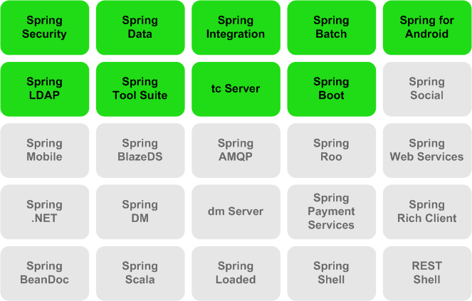

Spring Projects

Slide 28
























Java EE Ecosystem

Slide 29
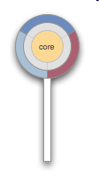


























CDI Ecosystem
Implementations
Portable Extensions
Runtimes
Weld
CanDI
Tools

Slide 30
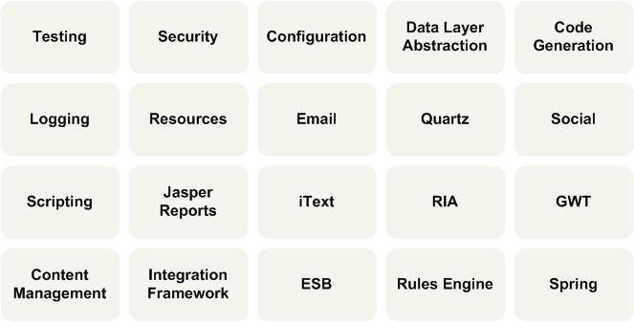
CDI Extensions

Slide 31
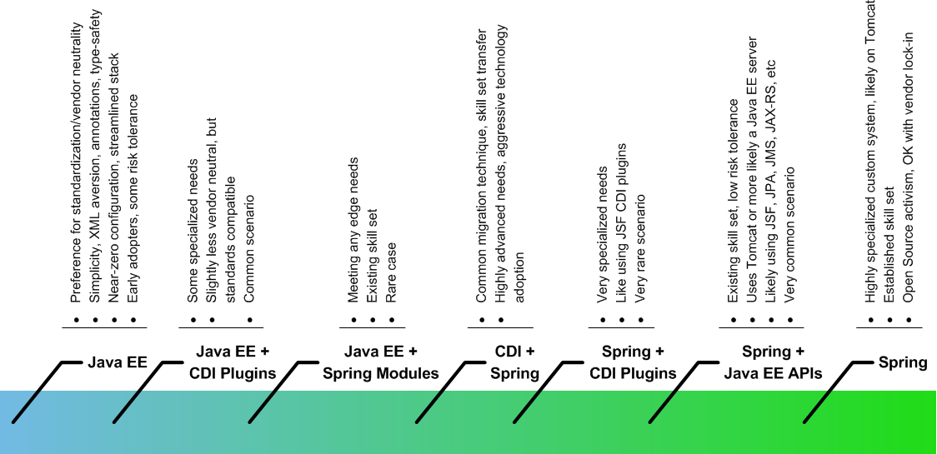
Decisions, decisions…

Slide 32
A Bird’s Eye View

