Slide 1
Pod IP Exhaustion
GKE and EKS
Olga Mirensky Platform Engineer - ANZ Plus

Slide 2
Agenda
Explore k8s IPAM (IP Address Management) by understanding Pod IP exhaustion mitigation strategies.
GKE vs EKS: highly adopted managed k8s that implement networking model in very different ways.
Out of Scope
Node IPs, Services IPs, IPv6, Cluster rebuild

Slide 3
Kubernetes Network Model and IPAM

Slide 4
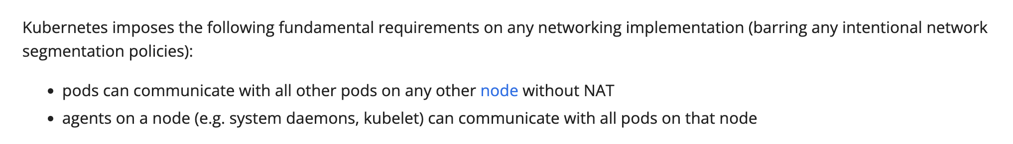
The Kubernetes Network Model
Every Pod in a cluster gets its own unique cluster-wide IP address
https://kubernetes.io/docs/concepts/services-networking/
The implementation of this model is left out to CNIs - Container Network Interface, e.g. Cilium, Calico, AWS VPC CNI and more.

Slide 5
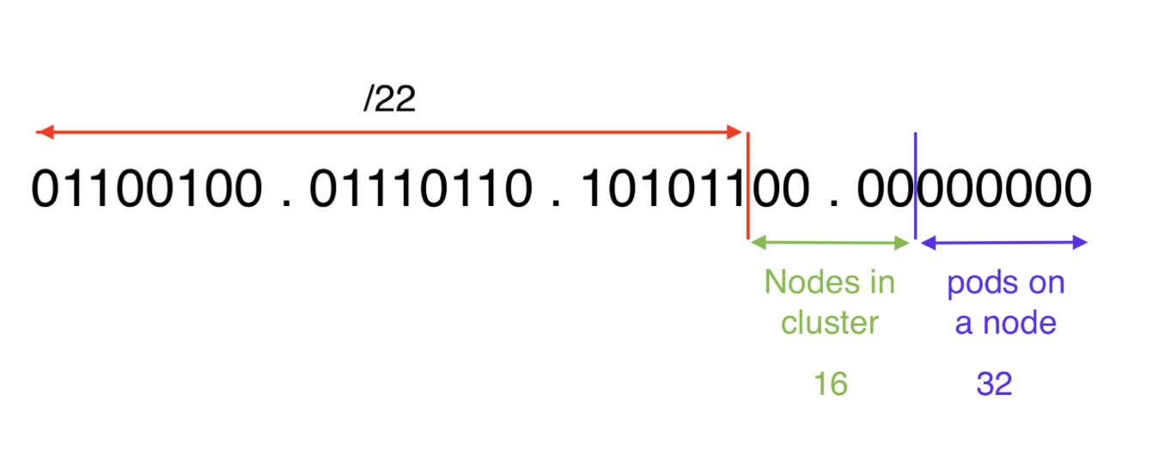
Anatomy of Pod IPs
Applicable when `kube-controller-manager` is configured with `--allocate-node-cidrs`
Pod range CIDR is allocated when node is created
At least x2 as many IPs reserved as max number of pods per node (6 bits for 32 pods)
Wasted Pod IPs for hostNetwork pods (ouch, all these daemonsets!)
Example Pod IP range: 100.118.172.0/22
2^10 - 2 = 1022 hosts
Network view
k8s view
32 max-pods-per-node

Slide 6
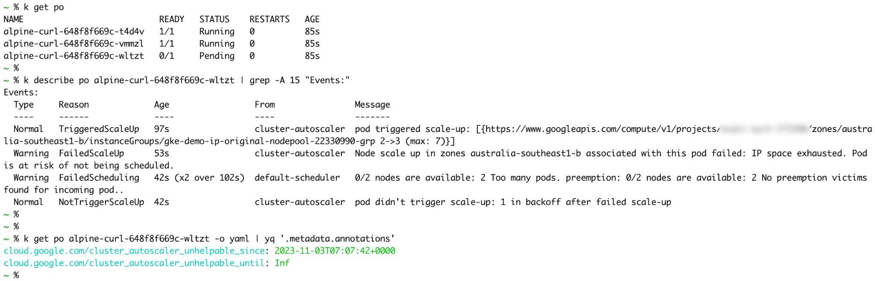
Pod IP Exhaustion (k8s IPAM)
When a new pod triggers a scale-up and there is no more free blocks left in Pod IP space, the result is a failure to provision a node

Slide 7
Mitigation
Review current state
Max-pods-per-node
Machine type
Daemonset overhead
Mix of machine types or nodepools with different max-per-node
Notes:
Managed k8s provide many ways to mitigate pod IP exhaustion by utllising compute and networking constructs unique to the cloud

Slide 8
Vendor Specific Mitigations - GKE

Slide 9
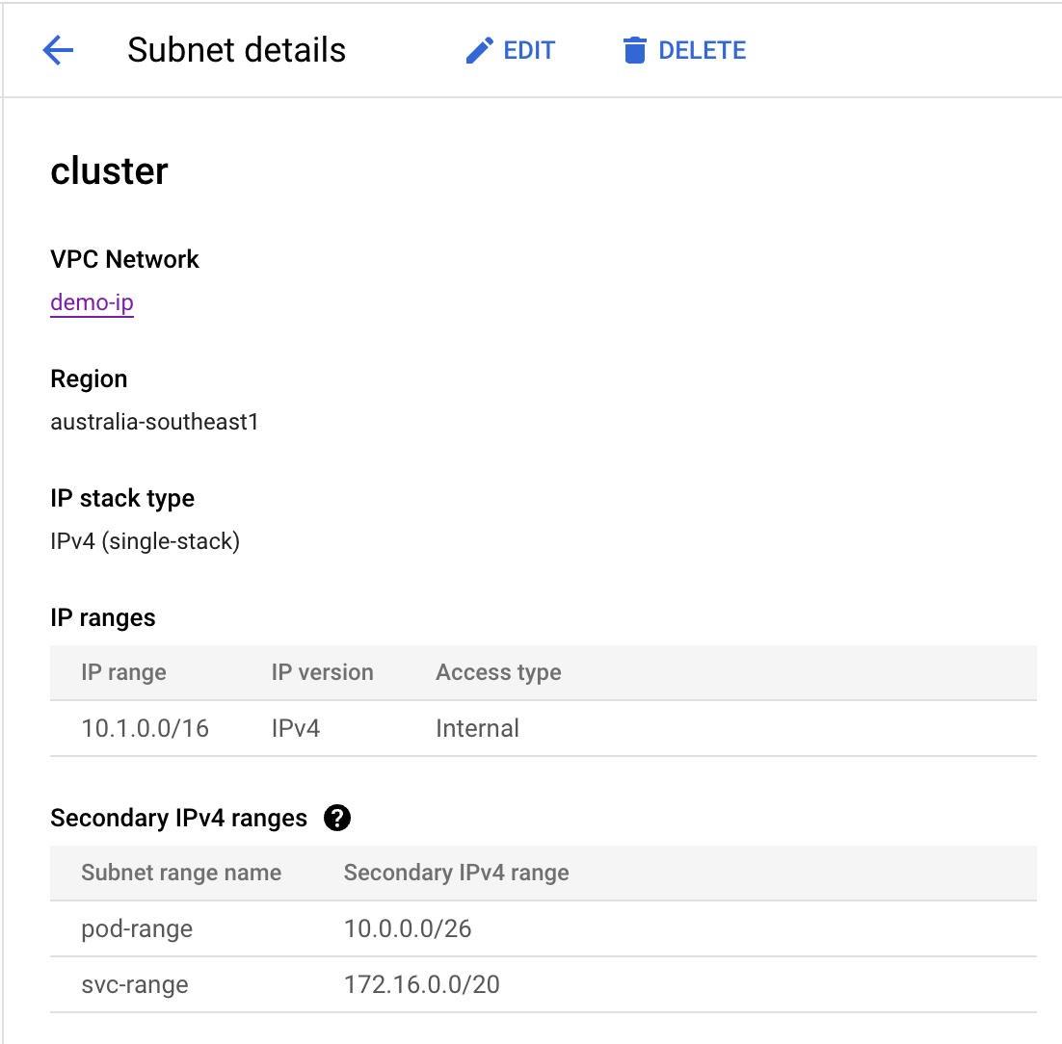
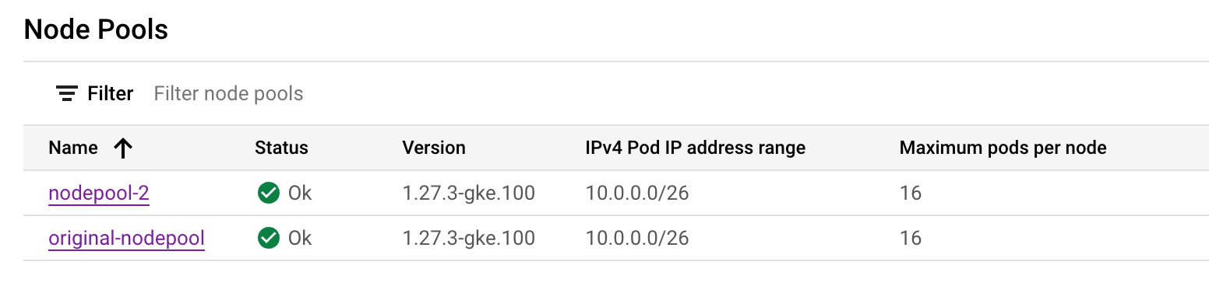
GKE Setup
IP Range
IPs allocated to VMs (nodes)
Secondary IPv4 Ranges
Alias IPs - can be used for services running on a VM
0 - 30 ranges per subnet
In k8s - Pod IPs and ClusterIP services.
All ranges, both primary and secondary, must be unique across all subnets in the VPC network and in any attached networks

Slide 10
GKE: Discontiguous Multi-Pod CIDR
Create and assign additional secondary ranges to the cluster (new in v1.26)
Create a node pool with a new secondary Pod IP address range (GKE manages subnet)
Create a node pool using an existing secondary Pod IP address (you manage subnet)
Each nodepool always has one and only one subnetwork secondary range associated with it.
Cluster option is similar to nodepool except that secondary range is assigned by GKE.
Notes:
https://cloud.google.com/kubernetes-engine/docs/how-to/multi-pod-cidr

Slide 11
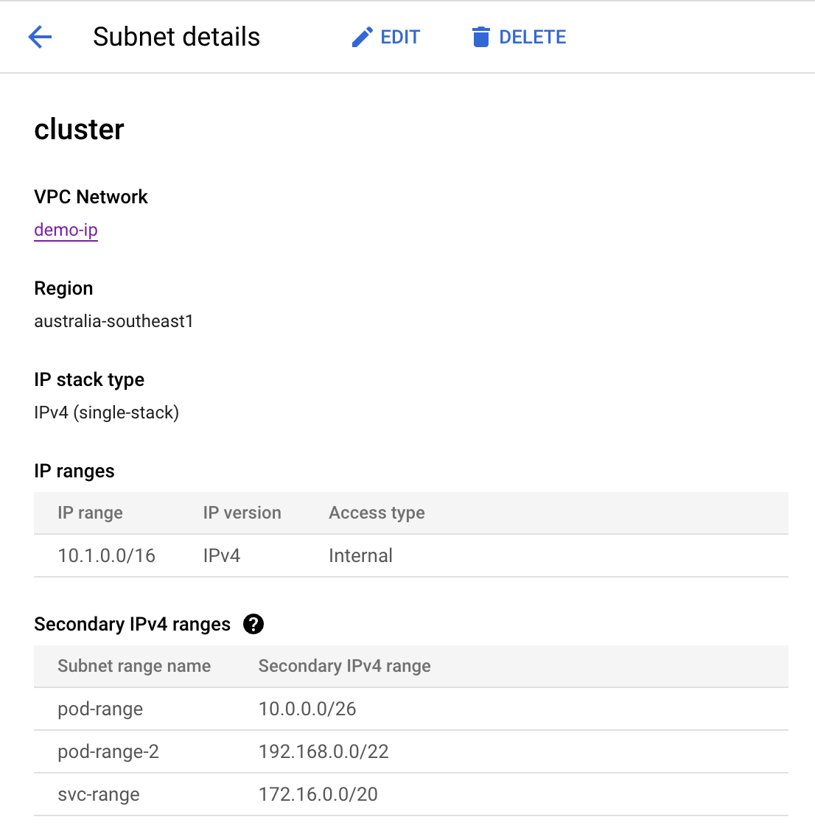
Step 1 - Add new Secondary Range to the subnet
Original State
New State
Notes:
https://cloud.google.com/vpc/docs/configure-alias-ip-ranges#subnet_commands

Slide 12
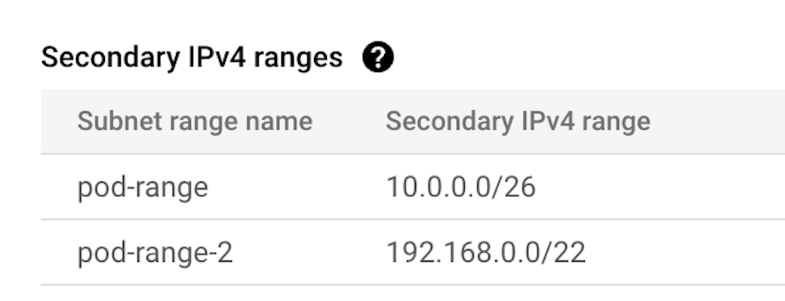
Step 2 - Add new nodepool
$ gcloud container node-pools create new-nodepool \
--cluster=demo-ip \
--node-locations=$az \
--location-policy=BALANCED \
--enable-autoscaling \
--total-max-nodes=10 \
--max-pods-per-node=32 \
--pod-ipv4-range=pod-range-2
$ k get node -o yaml | yq '.items[]|{"name": .metadata.name, "podCIDRs": .spec.podCIDRs}'
name: gke-demo-ip-new-nodepool-ca0b68f2-4jtg
podCIDRs:
- 192.168.0.64/26
name: gke-demo-ip-new-nodepool-ca0b68f2-6p7z
podCIDRs:
- 192.168.0.128/26
name: gke-demo-ip-new-nodepool-ca0b68f2-cj94
podCIDRs:
- 192.168.0.0/26
name: gke-demo-ip-original-nodepool-22330990-8f44
podCIDRs:
- 10.0.0.32/27
name: gke-demo-ip-original-nodepool-22330990-zzzt
podCIDRs:
- 10.0.0.0/27

Slide 13
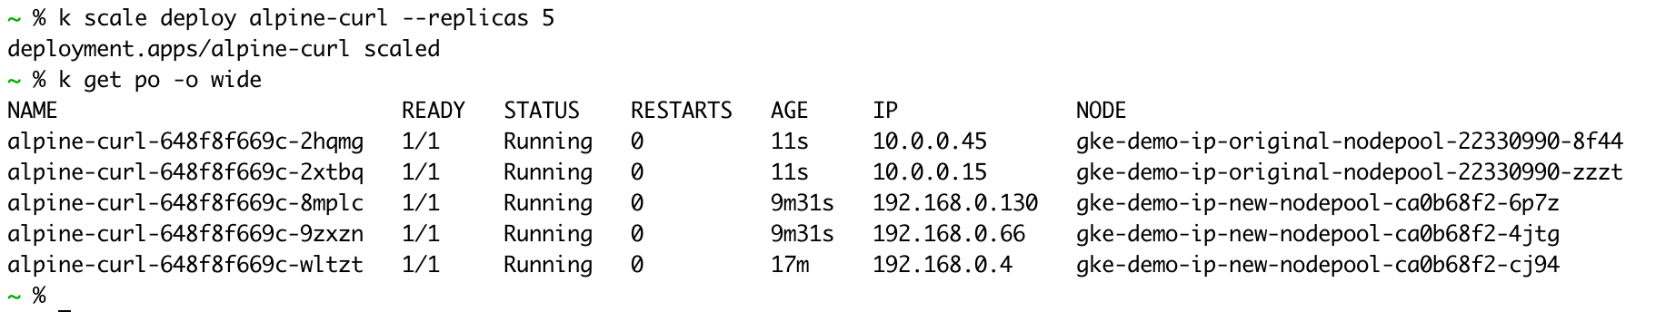
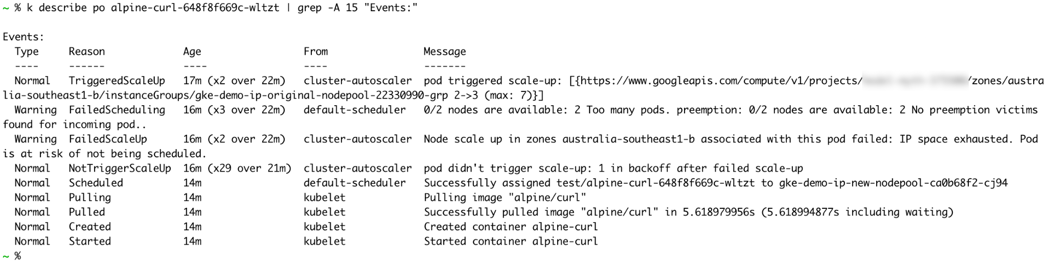
Happy End

Slide 14
Vendor Specific Mitigations - EKS

Slide 15
EKS IPAM
AWS VPC CNI consists of two components:
CNI Daemonset `aws-node`
`ipamd` daemon running on the host
No Pods CIDR allocation at node creation
ENIs are attached to the node as needed
Pod IPs are allocated to each ENI as needed
WARM_ENI_TARGET, WARM_IP_TARGET - ENI/IP allocation headroom

Slide 16
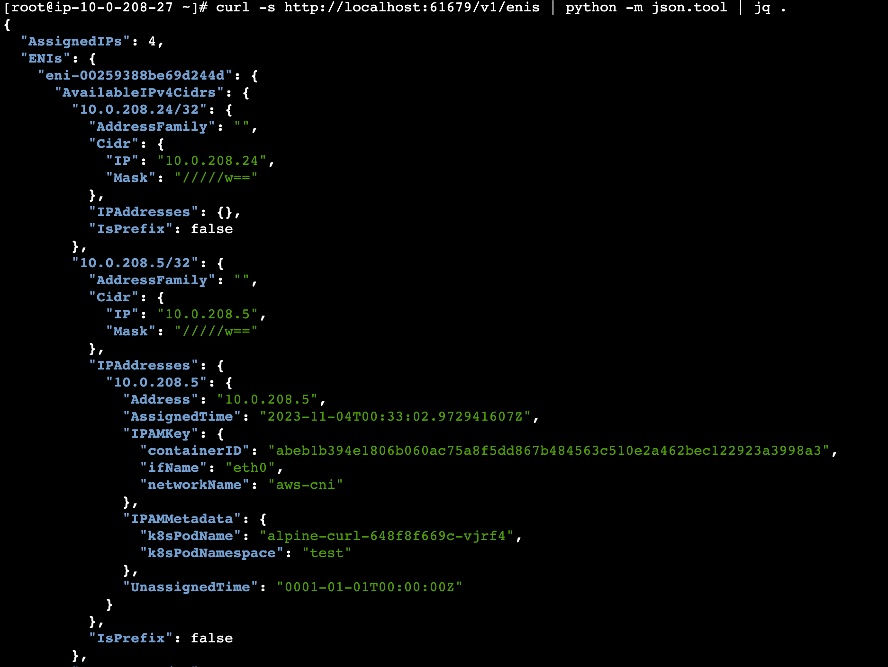
Secondary IP
ipamd provided debug tools on the host VM (amazon-vpc-cni-k8s repo) docs/troubleshooting.md
Available IP, not assigned to a pod
Assigned to a pod

Slide 17
EKS: Pod IP exhaustion
Manifests at pod startup time:
NAME READY STATUS RESTARTS AGE
mydeploy-6bdbfc484d-2frv4 0/1 ContainerCreating 0 9m52s
- Warning FailedCreatePodSandBox 7m26s kubelet Failed to create pod sandbox: rpc error: code = Unknown desc = failed to setup network for sandbox <id>: plugin type="aws-cni" name="aws-cni" failed (add): add cmd: failed to assign an IP address to container

Slide 18
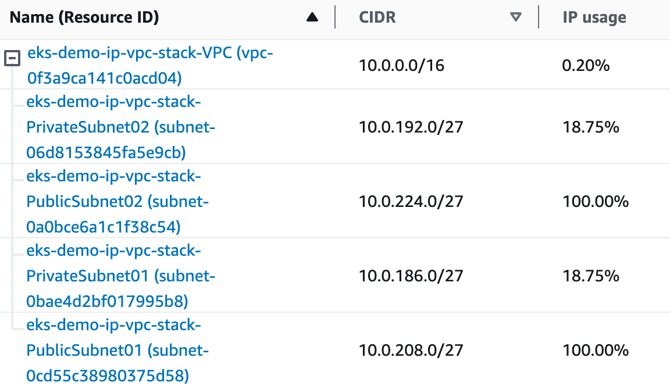
Demo EKS Network Setup
EKS requires at least 2 AZs
The demo cluster uses 2 public and 2 private subnets in a VPC with `10.0.0.0/16` CIDR.
$ aws ec2 describe-subnets
--filters Name=vpc-id,Values=$vpc_id
--query 'Subnets[*].{SubnetId: SubnetId,AvailabilityZone: AvailabilityZone,CidrBlock: CidrBlock}'
--output table
-------------------------------------------------------------------
| DescribeSubnets |
+------------------+-----------------+----------------------------+
| AvailabilityZone | CidrBlock | SubnetId |
+------------------+-----------------+----------------------------+
| ap-southeast-2a | 10.0.208.0/27 | subnet-0cd55c38980375d58 |
| ap-southeast-2a | 10.0.186.0/27 | subnet-0bae4d2bf017995b8 |
| ap-southeast-2b | 10.0.192.0/27 | subnet-06d8153845fa5e9cb |
| ap-southeast-2b | 10.0.224.0/27 | subnet-0a0bce6a1c1f38c54 |
+------------------+-----------------+----------------------------+

Slide 19
EKS Custom Networking for Pods
Associate new CIDR range to the VPC
$ aws ec2 associate-vpc-cidr-block --vpc-id $vpc_id --cidr-block 100.64.0.0/20
Create subnets in each AZ with CIDRs from the new range
$ aws ec2 create-subnet --vpc-id $vpc_id --availability-zone $az_1 --cidr-block 100.64.1.0/24
$ aws ec2 create-subnet --vpc-id $vpc_id --availability-zone $az_2 --cidr-block 100.64.2.0/24
Configure AWS VPC CNI to Custom Networking
$ kubectl set env daemonset aws-node AWS_VPC_K8S_CNI_CUSTOM_NETWORK_CFG=true
Provide subnets data via ENIConfig CRD
Create Node Group
Notes:
https://docs.aws.amazon.com/eks/latest/userguide/cni-custom-network.html

Slide 20
EKS Custom Networking for Pods (cont)
ENI Config - 1 for each AZ
apiVersion: crd.k8s.amazonaws.com/v1alpha1
kind: ENIConfig
metadata:
name: $az_1
spec:
securityGroups:
- $cluster_security_group_id
subnet: $new_subnet_id_1
New NodeGroup (eksctl config)
managedNodeGroups:
- name: managed-ng-new
availabilityZones: [$az_1, $az_2] …

Slide 21
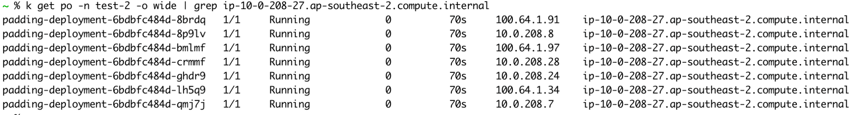
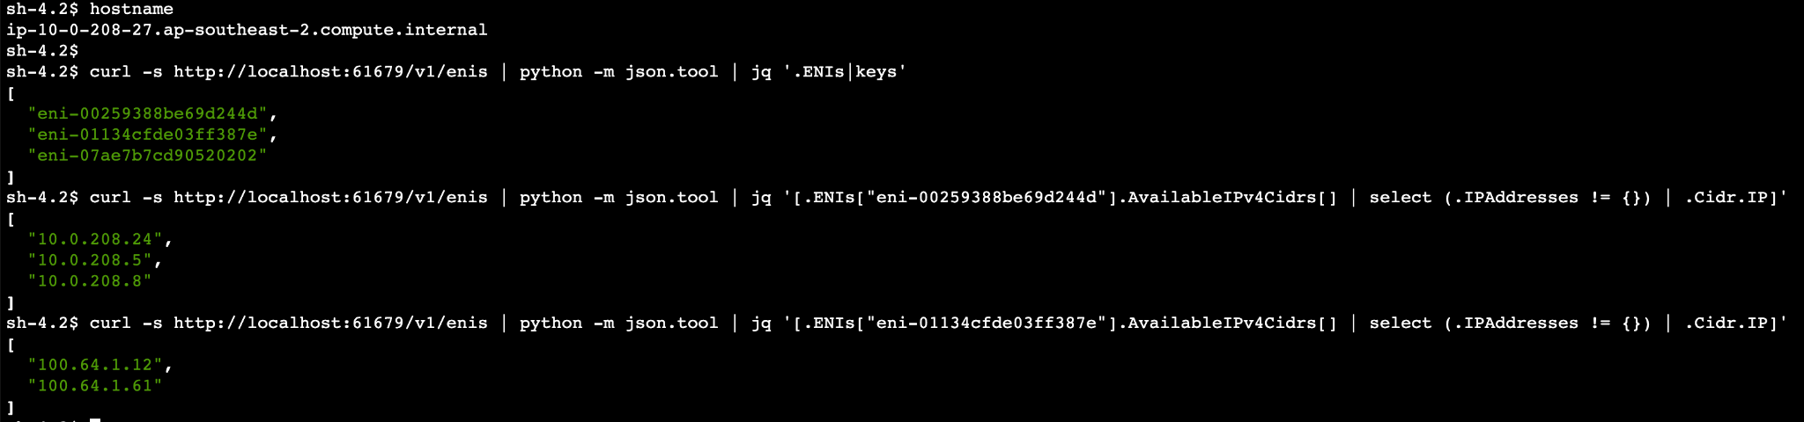
Any Pod IP on Any Node

Slide 22
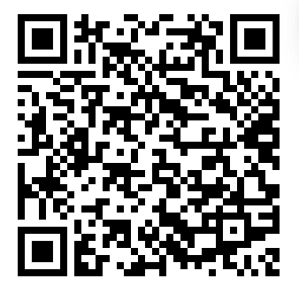
Questions?
Demo source code and references
https://github.com/olga-mir/k8s/tree/main/demo/2023-gke-eks-pod-ip-exhaustion

