Slide 1

Data 607, Fall 2017 Project 3 - Most Valued Data Science Skills
Group 7
Albina Gallyavova, John Grando, Mehdi Khan, Olga Fornicheva, Yijian Lu

Slide 2
Data 607, Fall 2017 Project 3 - Most Valued Data Science Skills
Introduction:
The online job site Indeed.com was used for this project. Job were search within 100 miles of 10 largest cities in USA by population.
Scraping Setup:
Data was collected from the following sections:
Actual job posting
Desired Experience section
Study was set up to return job postings from the 10 largest cities by population
Efforts were taken to automatically exclude duplicate postings
Data was then tokenized and common words (traditional stop words and custom selection of words) were removed.
Simple frequency distributions for single, bigram (two word groups), and trigrams (three word groups), were then performed and resulting data was saved to CSV files on Github.
Data exists on the following levels:
Individual Posting
By location
Full study
Group 7
Albina Gallyavova, John Grando, Mehdi Khan, Olga Fornicheva, Yijian Lu,

Slide 3
Data 607, Fall 2017 Project 3 - Most Valued Data Science Skills
Tidy operations and visualization in R:
Soft Skills:
CSV containing data for soft skills was brought into R for tidy operations and analysis.
A soft skill lexicon was created with the words that are typically used to construct and describe soft skill sets, which was compared with the dataset and only the rows with matching combination of words were selected.
since soft skills are a bit descriptive in nature, they are better expressed through combination of words. Therefore trigrams were used to find soft skills.
Since same soft skills can be expressed through different words, rows belong to specific soft skills are combined under specific categories
Group 7
Albina Gallyavova, John Grando, Mehdi Khan, Olga Fornicheva, Yijian Lu,

Slide 4
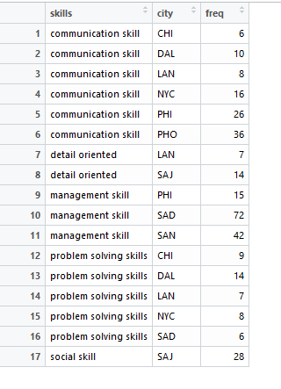
Data 607, Fall 2017 Project 3 - Most Valued Data Science Skills
Data frame used for soft skill:
Group 7
Albina Gallyavova, John Grando, Mehdi Khan, Olga Fornicheva, Yijian Lu,

Slide 5
Data 607, Fall 2017 Project 3 - Most Valued Data Science Skills
Tidy operations and visualization in R:
Technical Skills:
CSV containing data for technical skills was brought into R for tidy operations and analysis.
since technical skills can clearly be identified by a single word (such ‘python’ refers to programming skill in python) unigrams were used to find technical skills.
A data frame was created with columns for all technical skill types and various ngrams
Group 7
Albina Gallyavova, John Grando, Mehdi Khan, Olga Fornicheva, Yijian Lu,

Slide 6
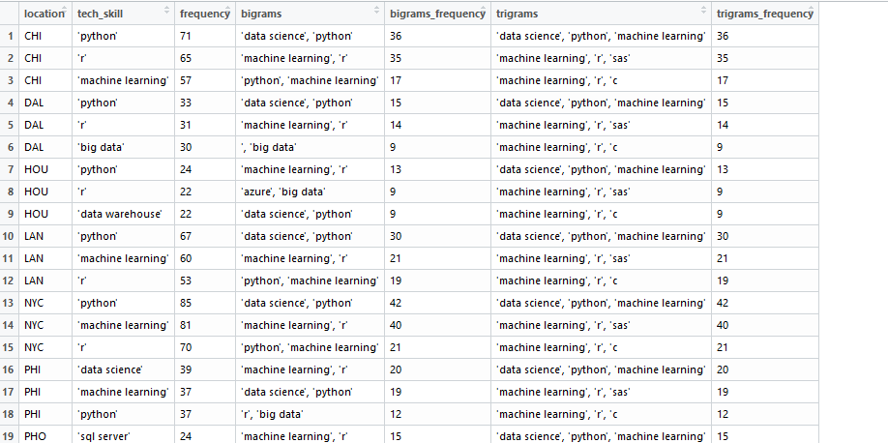
Data 607, Fall 2017 Project 3 - Most Valued Data Science Skills
Data frame used for technical skill:
Group 7
Albina Gallyavova, John Grando, Mehdi Khan, Olga Fornicheva, Yijian Lu,

Slide 7
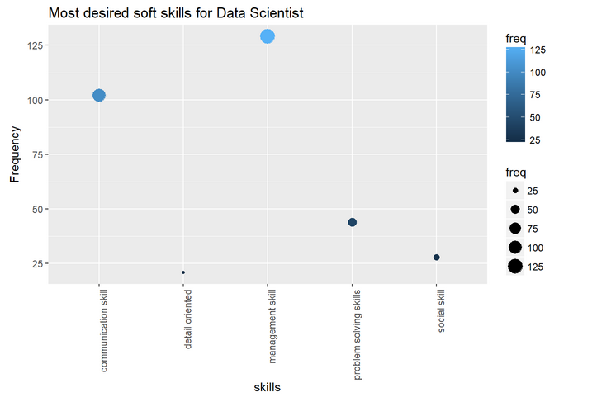
Data 607, Fall 2017 Project 3 - Most Valued Data Science Skills
Visualization:
Figure depicts management and communication are the two most sought after soft skills for data scientist job in general.
Group 7
Albina Gallyavova, John Grando, Mehdi Khan, Olga Fornicheva, Yijian Lu,

Slide 8
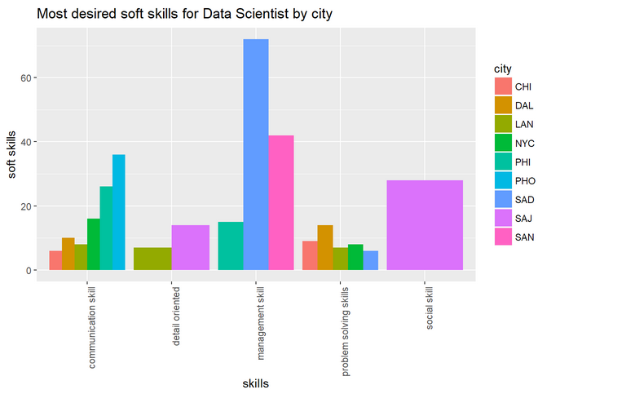
Data 607, Fall 2017 Project 3 - Most Valued Data Science Skills
Visualization:
Figure shows different desired soft skills for data scientist in the cities of interest. It is interesting to find that San Diego had a huge emphasis on management skill while San Jose is the only city that focused on social skill.
Group 7
Albina Gallyavova, John Grando, Mehdi Khan, Olga Fornicheva, Yijian Lu,

Slide 9
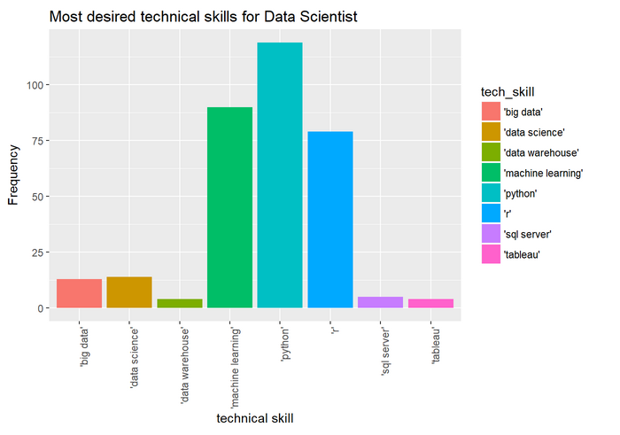
Data 607, Fall 2017 Project 3 - Most Valued Data Science Skills
Visualization:
'machine learning', 'r' and 'python' are the winners for most sought after technical skills for data scientist as depicted in the figure.
Group 7
Albina Gallyavova, John Grando, Mehdi Khan, Olga Fornicheva, Yijian Lu,

Slide 10
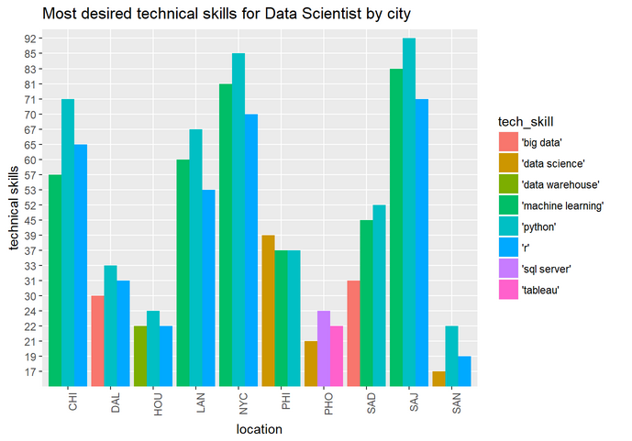
Data 607, Fall 2017 Project 3 - Most Valued Data Science Skills
Visualization:
As in the general case 'machine learning', 'r' and 'python‘ are also the most desired technical skills in most cities. If we ignore "data science" as too broad - all cities sought after only those three skills except Phoenix that surprisingly did not need any of those three technical skills.
Group 7
Albina Gallyavova, John Grando, Mehdi Khan, Olga Fornicheva, Yijian Lu,

