Slide 1

Data 607, Fall 2017 Project 3 - Most Valued Data Science Skills
Group 7
Albina Gallyavova, John Grando, Mehdi Khan, Olga Fornicheva, Yijian Lu

Slide 2
Data 607, Fall 2017 Project 3 - Most Valued Data Science Skills
Introduction:
The online job site Indeed.com was used for this project. Job were search within 100 miles of 10 largest cities in USA by population.
Scraping Setup:
For each location, the job postings from the first page (50) were scraped and all data within the <p> and <li> tags were returned. Common words found by observation were dropped using the drop_l list
If the link selected had already been scraped (based on the first 100 characters of the url) then the link was passed over. For each object returned, a single list was compiled for the entire job posting and then tokenized.
Common "stop words" were then removed along with the drop_l words.
Frequency distributions were then performed on the resulting list, the resulting list in bigrams form, and the resulting list in trigrams form.
Group 7
Albina Gallyavova, John Grando, Mehdi Khan, Olga Fornicheva, Yijian Lu,

Slide 3
Data 607, Fall 2017 Project 3 - Most Valued Data Science Skills
Scraping Setup (contd.):
The location, job title, link, processed list, and frequency distribution results (50 most common for single, bigram, trigram) were then saved in several CSV files based on the job posting, location and for the entire study.
Those CSV files were further processed and finally two CSVs were created with filtered information specific to soft skills and technical skills.
Group 7
Albina Gallyavova, John Grando, Mehdi Khan, Olga Fornicheva, Yijian Lu,

Slide 4
Data 607, Fall 2017 Project 3 - Most Valued Data Science Skills
Tidy operations and visualization in R:
Soft Skills:
CSV containing data for soft skills was brought into R for tidy operations and analysis.
A soft skill lexicon was created with the words that are typically used to construct and describe soft skill sets, which was compared with the dataset and only the rows with matching combination of words were selected.
since soft skills are a bit descriptive in nature, they are better expressed through combination of words. Therefore trigrams were used to find soft skills.
Since same soft skills can be expressed through different words, rows belong to specific soft skills are combined under specific categories
Group 7
Albina Gallyavova, John Grando, Mehdi Khan, Olga Fornicheva, Yijian Lu,

Slide 5
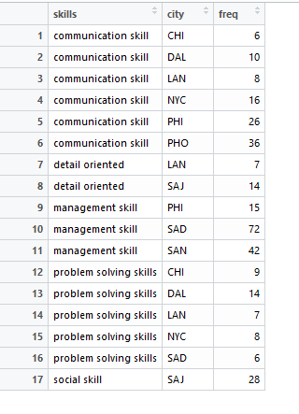
Data 607, Fall 2017 Project 3 - Most Valued Data Science Skills
Data frame used for soft skill:
Group 7
Albina Gallyavova, John Grando, Mehdi Khan, Olga Fornicheva, Yijian Lu,

Slide 6
Data 607, Fall 2017 Project 3 - Most Valued Data Science Skills
Tidy operations and visualization in R:
Technical Skills:
CSV containing data for technical skills was brought into R for tidy operations and analysis.
since technical skills can clearly be identified by a single word (such ‘python’ refers to programming skill in python) unigrams were used to find technical skills.
A data frame was created with columns for all technical skill types and various ngrams
Group 7
Albina Gallyavova, John Grando, Mehdi Khan, Olga Fornicheva, Yijian Lu,

Slide 7
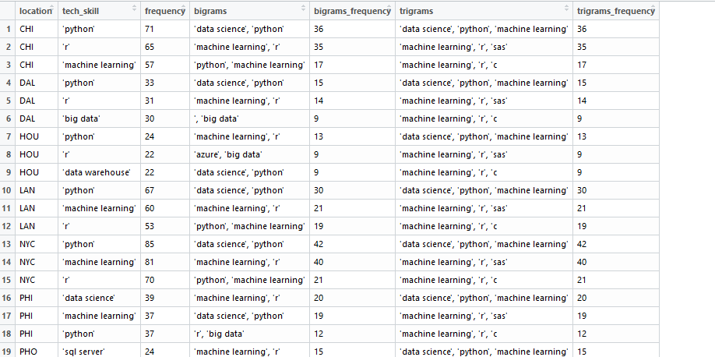
Data 607, Fall 2017 Project 3 - Most Valued Data Science Skills
Data frame used for technical skill:
Group 7
Albina Gallyavova, John Grando, Mehdi Khan, Olga Fornicheva, Yijian Lu,

Slide 8
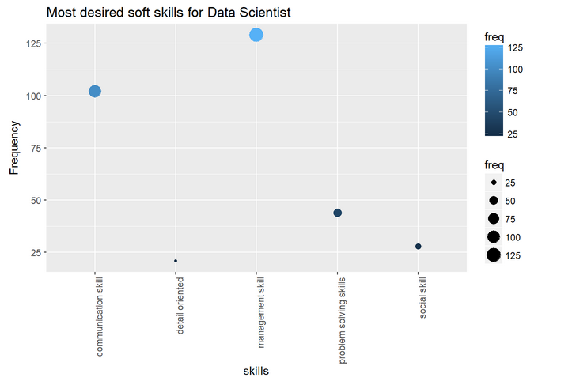
Data 607, Fall 2017 Project 3 - Most Valued Data Science Skills
Visualization:
Figure depicts management and communication are the two most sought after soft skills for data scientist job in general.
Group 7
Albina Gallyavova, John Grando, Mehdi Khan, Olga Fornicheva, Yijian Lu,

Slide 9
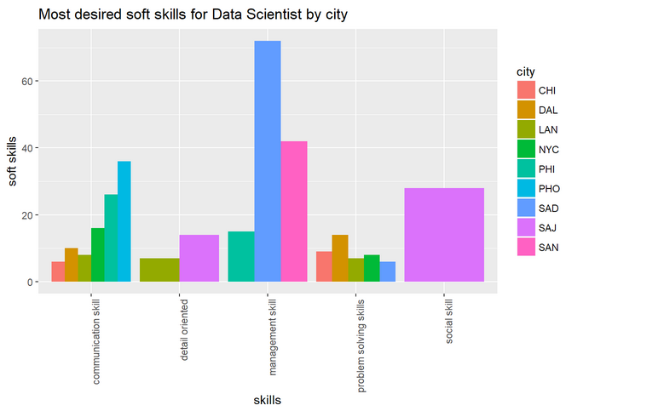
Data 607, Fall 2017 Project 3 - Most Valued Data Science Skills
Visualization:
Figure shows different desired soft skills for data scientist in the cities of interest. It is interesting to find that San Diego had a huge emphasis on management skill while San Jose is the only city that focused on social skill.
Group 7
Albina Gallyavova, John Grando, Mehdi Khan, Olga Fornicheva, Yijian Lu,

Slide 10
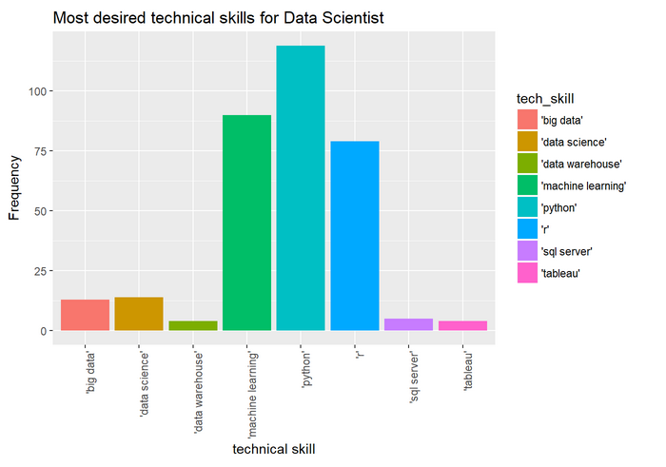
Data 607, Fall 2017 Project 3 - Most Valued Data Science Skills
Visualization:
'machine learning', 'r' and 'python' are the winners for most sought after technical skills for data scientist as depicted in the figure.
Group 7
Albina Gallyavova, John Grando, Mehdi Khan, Olga Fornicheva, Yijian Lu,

Slide 11
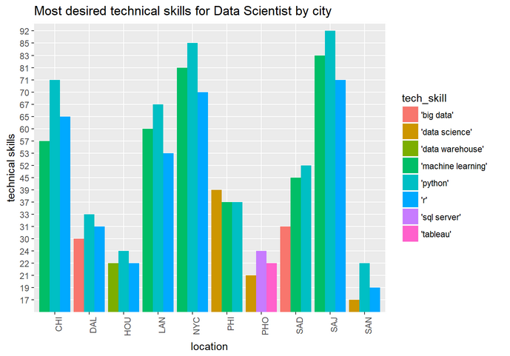
Data 607, Fall 2017 Project 3 - Most Valued Data Science Skills
Visualization:
As in the general case 'machine learning', 'r' and 'python‘ are also the most desired technical skills in most cities. If we ignore "data science" as too broad - all cities sought after only those three skills except Phoenix that surprisingly did not need any of those three technical skills.
Group 7
Albina Gallyavova, John Grando, Mehdi Khan, Olga Fornicheva, Yijian Lu,

