Slide 1
TERRA FERRA
The AI-native marketplace for affordable luxury fashion drops.
Pre-seed · June 2026
1

Slide 2




PROBLEM
Emerging fashion can't launch without big risk. Consumers can’t find their unique style.
Brands can't launch without risk
Today's platforms are affiliate-only
Producing inventory upfront is expensive, and marketplaces take 25–52% of every sale.
They need products already in stock and charge brands thousands a year upfront — no pre-order, no try-on.
The influencers who sell are shut out
Consumers can't discover
89.5% of influencers — the nano and micro tiers under 50K whose communities actually buy — don't fit those platforms.
No fashion-native place to find emerging brands or their own look — just the same mass-market trends.
2

Slide 3




SOLUTION
An AI-native drops platform where
brands, influencers & consumers meet
Pre-order drops
AI virtual try-on
Brands sell before they produce — no inventory risk, no upfront fees. They fulfil; we provide the platform.
Influencers try the look on virtually — just like consumers — then share. Every share spreads the drop and pulls new users onto the platform.
Niche-style discovery
Built to share
Consumers find their own niche style and discover new emerging brands — not the most-hyped or mass market item.
Early access, sold-out moments, founding-member status turn consumers into superfans — and every micro-influencer earns a real cut. The growth spiral runs itself.
3

Slide 4
WHY NOW
The window is open now
2024
$5.25B
40%
AI just arrived
Flowing to micro
Gen Z by 2035
Virtual try-on went from enterprise-only (2023) to any platform via API (2024). Closing micro-influencers is now automatable too.
About 50% of all creator spend now flows to nano & micro influencers — yet platforms route around them.
Gen Z drives ~40% of fashion spend by 2035 — discovering via micro-influencers and prizing unique over mass-market.
The gap is open and unbuilt — no platform combines open global access, pre-order drops, AI try-on and shared influencer upside. The window won't stay open.
7

Slide 5





PRODUCT - HOW IT WORKS
A loop that grows itself
Brands
Influencers
Consumers
Viral growth
Launch a drop — no inventory, no stock risk.
Up-sale with regular collection
Promote to their own audience and earn a cut.
Try on, pre-order, and share for identity & access.
Every share pulls in new consumers, influencers and brands.
Viral, native growth — every drop feeds the next, with no paid acquisition.
4

Slide 6
PRODUCT - HOW IT WORKS
The AI-native fashion marketplace
Three AI capabilities — newly affordable to the platform — at the core of every drop.
Virtual Try-On
Niche-style discovery
Creator Match
See any piece on yourself — and on the influencer sharing it — before you pre-order.
Surfaces emerging brands matched to your own taste, not the most-hyped or mass-market items.
AI – native matching finds the nano & micro influencers whose audience will actually buy each drop.
THE MOAT An AI agent runs brand & influencer outreach and closes the deals — automating work that was slow and expensive to do by hand.
5

Slide 7
MARKET OPPORTUNITY
A large, fast-growing wedge
Top-down and bottom-up both point to a multi-billion-dollar opportunity by 2030.
TAM
SAM
SOM
~$540B
~$72–110B
~$900M–4B
by 2030 · from $359B in 2025
by 2030 · from $36–54B in 2025
by 2030 · from $360M–1.6B in 2025
CAGR 8.5%
CAGR 15%
CAGR 20%
USA + Europe fashion e-commerce
Creator-native fashion · 10–15% of TAM
Emerging-brand pre-order & ambassador · 1–3% of SAM
Sources: ECDB · Mordor Intelligence · eMarketer US social commerce · ResearchAndMarkets ·
6

Slide 8
MARKET OPPORTUNITY
US counts 32K and EU 50K-70K fashion brands. Listed platforms accommodate under 20%
 | Terra Ferra | ShopMy | LTK | Wolf & Badger | Farfetch
Platform type | AI-native drops marketplace | Creator affiliate | Creator affiliate | Small-brand marketplace | Luxury, invite-only
Brands onboarded | Pre-launch | ~1,200 | ~6,000 | ~2,000 | ~1,400
Platform monthly fee | $500 | $399 - $2,800 | Free -manual ~$400 - $4,100 | $150 | None
Onboarding fee | $250 | $0 | $2,400 | None | $1,000–5,000+
Commission to platform | 10% | ~4% | ~5–10% | 25% (up to 52% after forced markdown) | 25–33%
Influencer earns (% of revenue) | 10–20% | 10–30% | 10–25% | — | —
TERRA FERRA TO WIN with lower fees, inclusivity and AI-native technology
9

Slide 9
BUSINESS MODEL DIFFERENTIATOR
Built for enabling drops & emerging brands others overlook
 | Terra Ferra | LTK | ShopMy | TikTok Shop | Instagram
Built for brands | Emerging | Established | Established | All | All
Emerging brands focus | Core | — | — | — | —
Niche influencers · no min | ✓ | 5K+ | 1K+ | ✓ | ✓
Sells stock + drops | Stock + drops | Stock only | Stock only | Stock only | Stock only
AI virtual try-on | ✓ | — | — | — | —
AI style discovery | Native | — | Partial | Partial | Partial
Tailored storefront | ✓ | — | — | Partial | Partial
Checkout | On platform | On brand site | On brand site | In-app | In-app
Geography | Global | US / UK | US | Global | Global
8

Slide 10
GO-TO-MARKET
Land – Activate - Compound
1
2
3
Land
→
Activate
→
Compound
FOUNDING COHORT
BRANDS AMBASSADORS
VIRAL LOOP + AI
5–10 emerging brands
Europe based
Overlapping influencers audience creating the vibe & demand
Every shared try-on pulls in new consumers, influencers and brands.
AI fuels the loop
CHANNELS Warm network intros · AI influencer sourcing · Organic share loop.

Slide 11




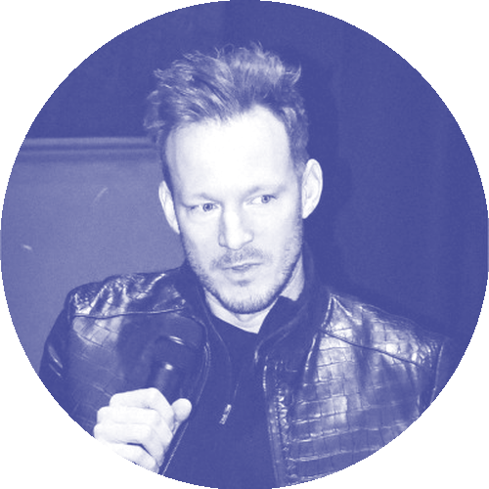
TEAM
Operators who've built retail
and the creator economy
Olga Bressers
Alex Khrushchev
Maxim Nogotkov
Chris Kirik
Alex Hofmann
CEO &
CO-FOUNDER
CTO &
CO-FOUNDER
STRATEGY &
CO-FOUNDER
CREATIVE DIR &
CO-FOUNDER
ADVISOR
E-commerce, operations & transformation at Richemont, Adidas, Nike on EU scale. Ran a €150M P&L
Founder of MVP Lab — 100+ MVPs built 0→1. Ex-Aviasales / Jetradar.
Built Svyaznoy (3,300+ stores) & Pandora Russia (0→200+ stores, ~$80M EBITDA). Forbes Russia.
Fashion and accessory designer. Founder fashion agency. Co-founder of The Fashion School.
Former President of musical.ly (later TikTok).
12

Slide 12
INVESTMENT REQUEST
Raising $500K pre-seed
13

Slide 13
That’s about it. Thanks

