Slide 1
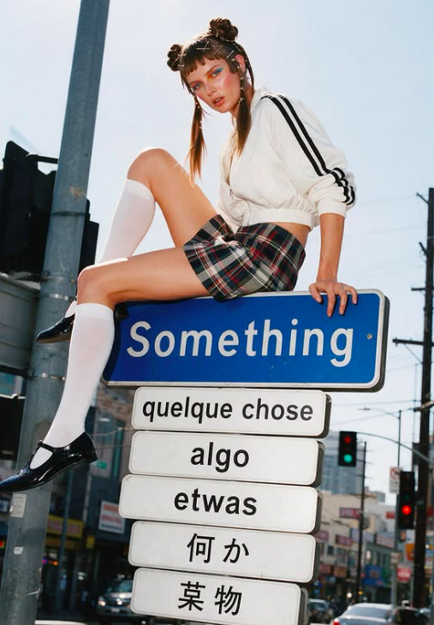
smthg.
Find the people who’ll
love what you make.
A community built around your label.
@smthg.us

Slide 2
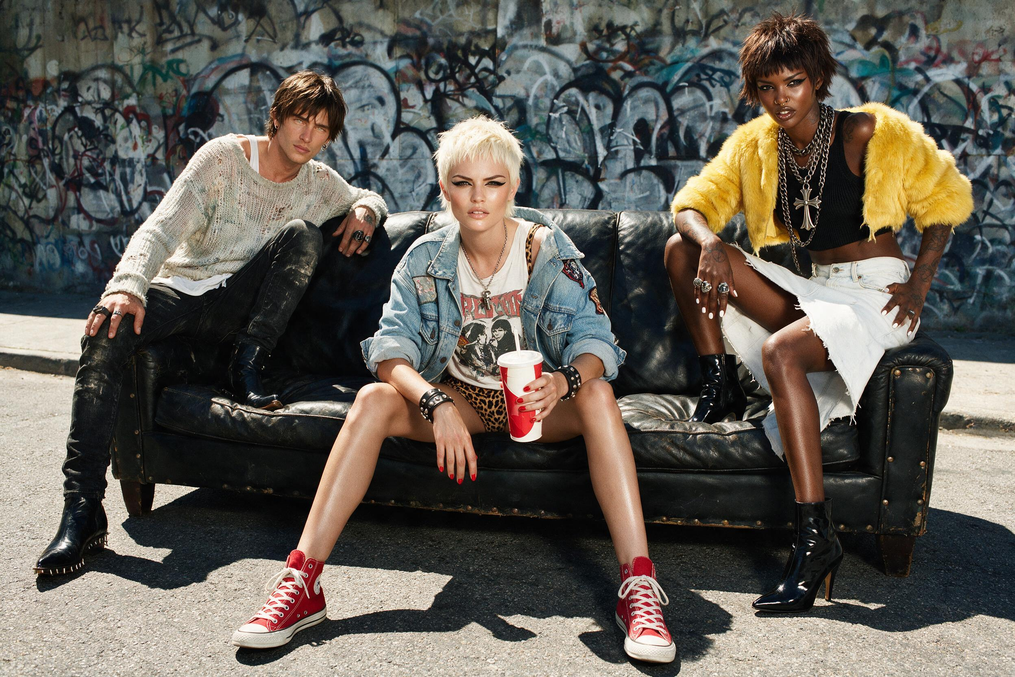
smthg. playbook
01 The smthg concept
A new sales channel · Try-on · Community · Brands together
02 The problem smthg solves for brands
Reach · Conversion · Growing alone · Marketplaces
03 Working together
How a drop works · Your designs
04 The pilot
10 brands · 500 members · Creators

Slide 3
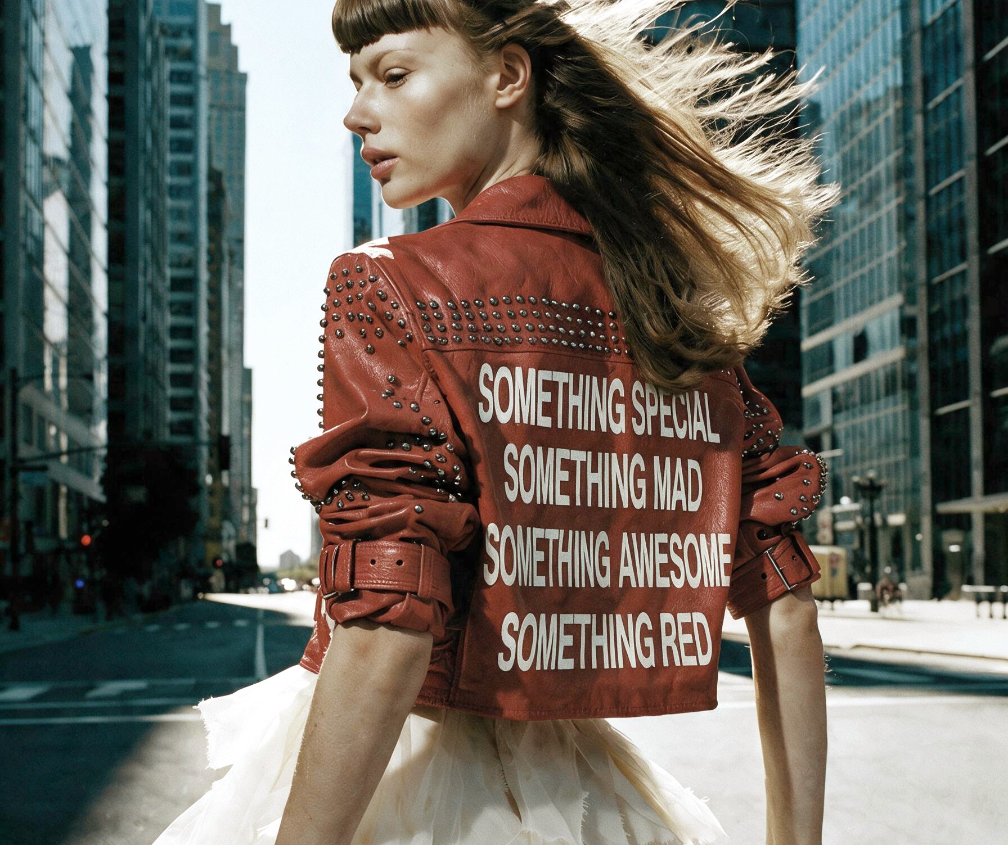
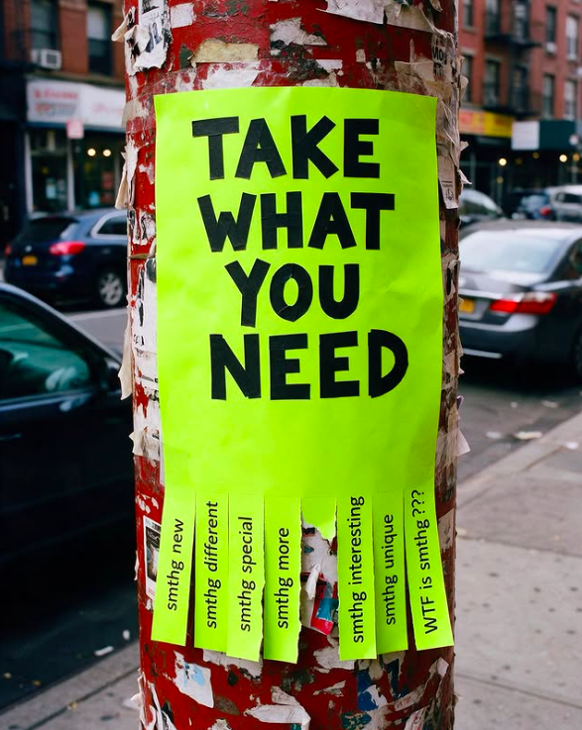
01 / THE SMTHG CONCEPT
One concept. Three layers.
Each layer grows the next.
01
A new sales channel
02
A community driven by creators and members
03
Brands that grow together

Slide 4
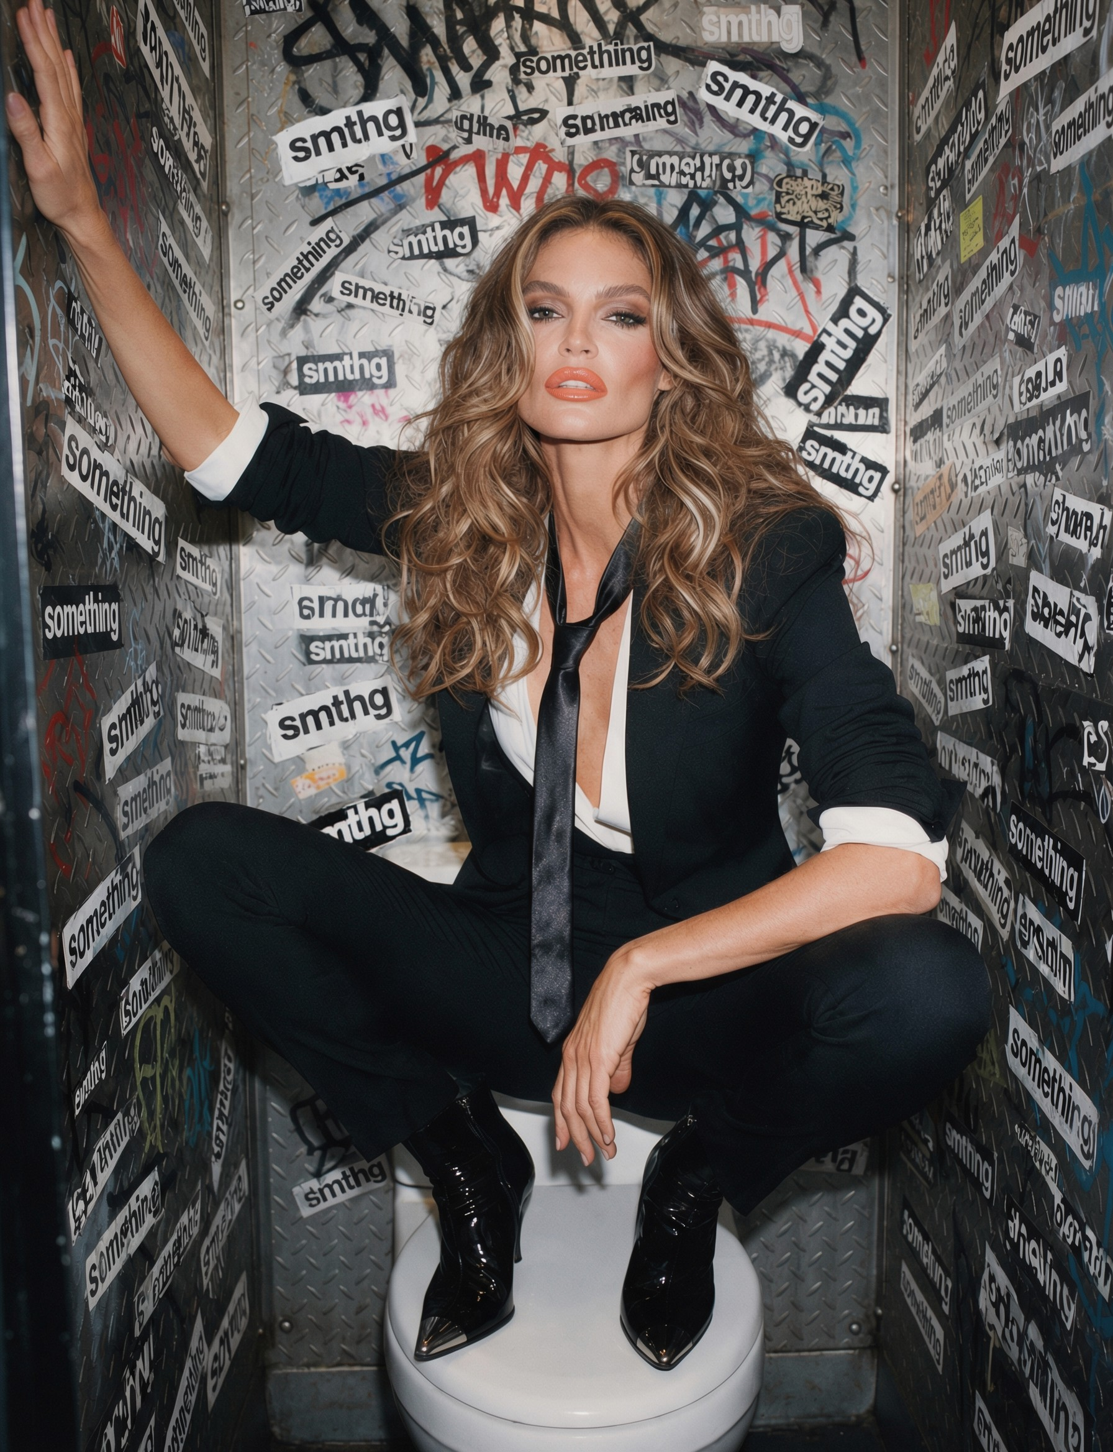
01 / THE SMTHG CONCEPT · 01
A new channel
for your sales.
It starts with a drop.
Limited drops, available for a limited time.
We take care of the creators. You don’t need to think about it.
Add your regular collection when you are ready.

Slide 5
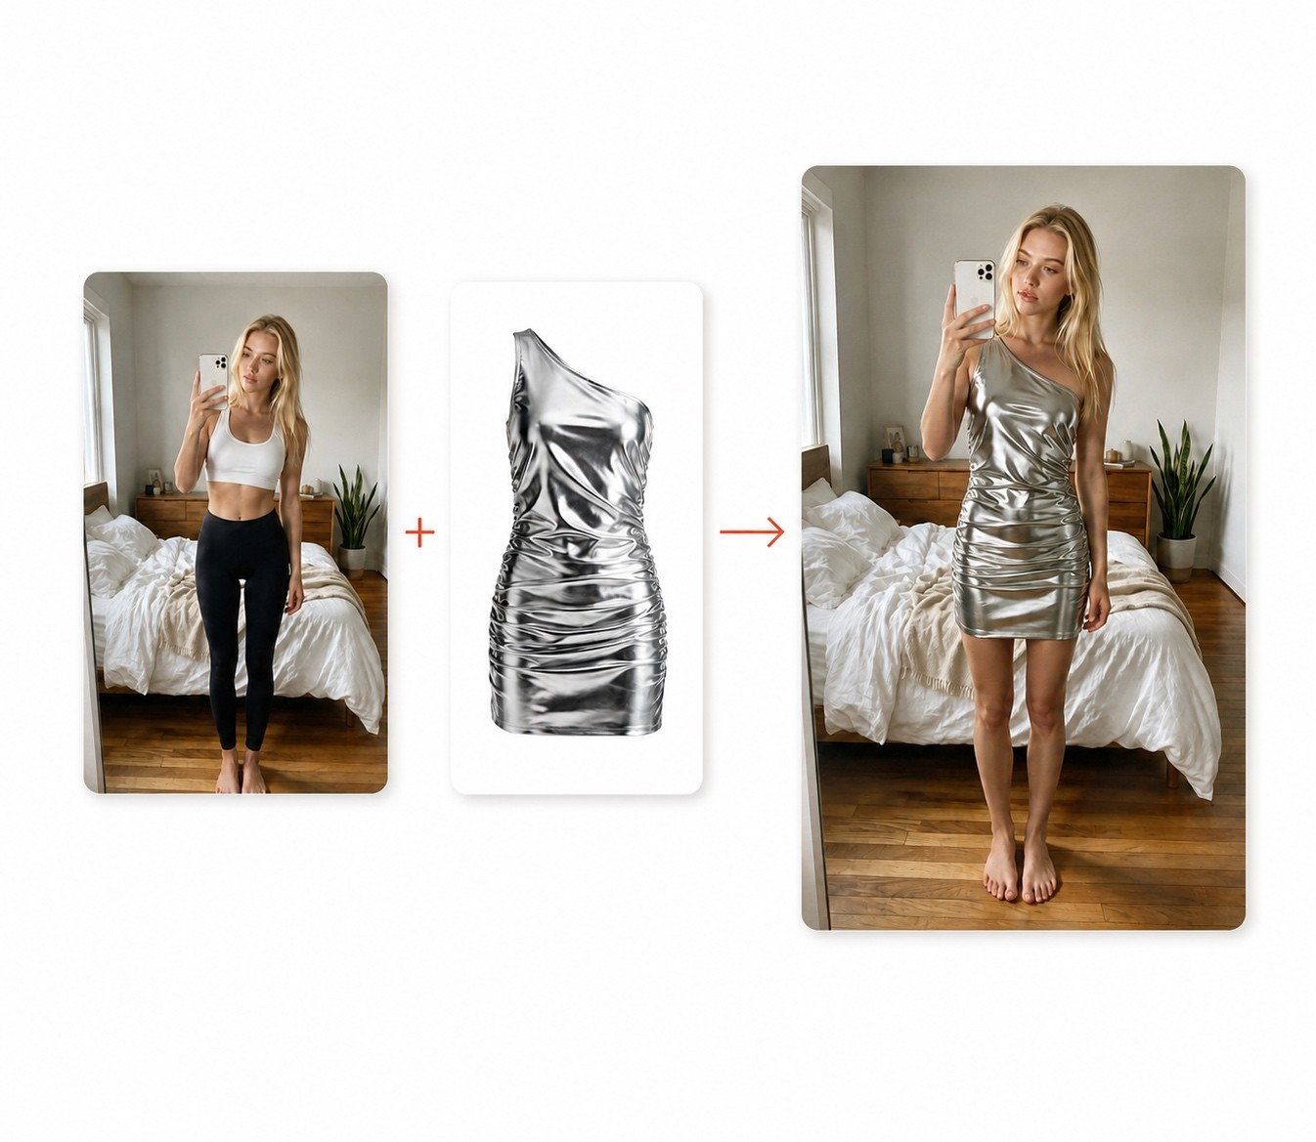
01 / THE SMTHG CONCEPT · 01
Your piece, on a real body.
Virtual try-on, for creators and shoppers.
For creators
Show your pieces without a sample.
For shoppers
See it on your own body before buying.
True to the piece
Colour, fit and materials as they are.

Slide 6
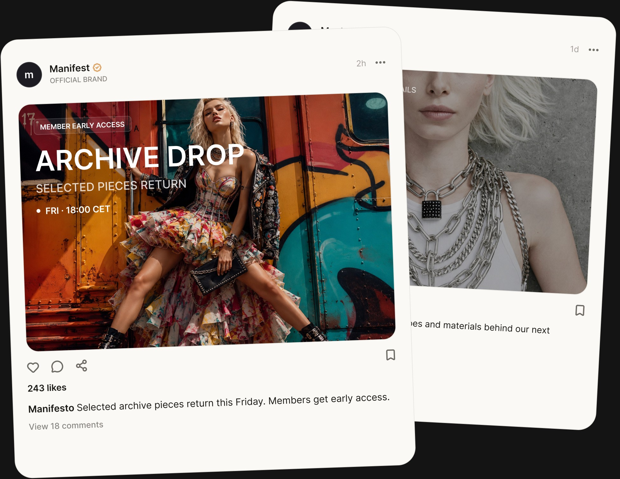
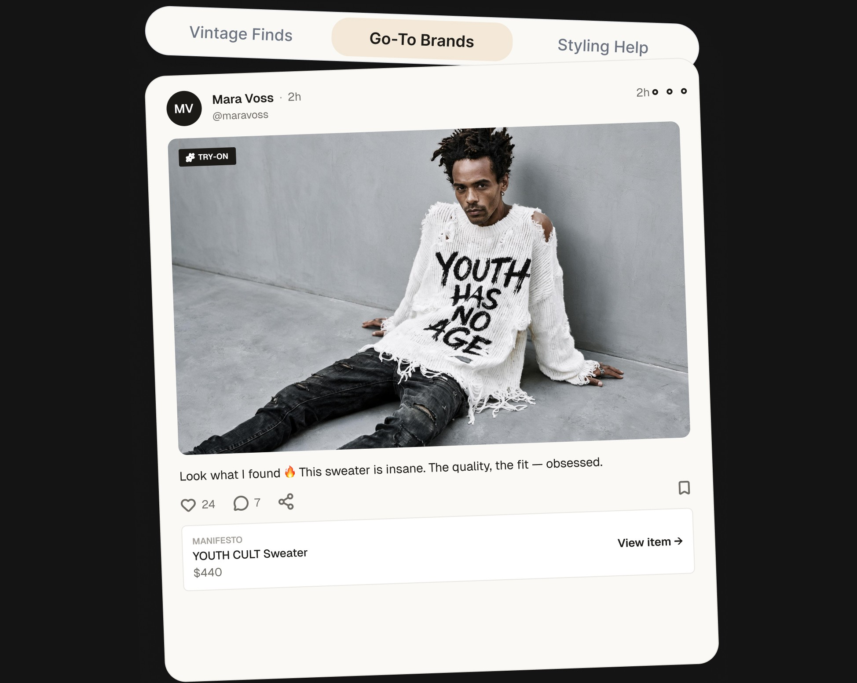
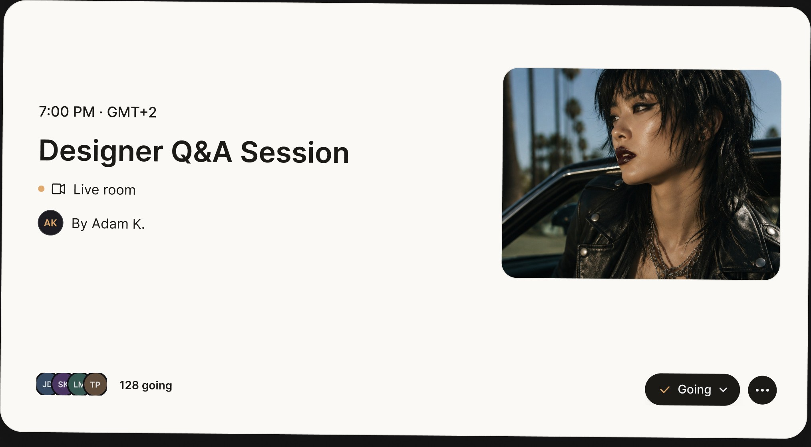
01 / THE SMTHG CONCEPT · 02
Driven by creators and members.
Creators bring their followers. Fashion lovers keep it going.
Brand Space
Style Space
Live sessions
Your drops and your story.
Members share what they love.
Run live sessions with your brand ambassadors and grow them.

Slide 7
01 / THE SMTHG CONCEPT · 03
Brands that grow
together.
Cross-pollination between labels of a similar style.
Labels with a similar style share their audiences.
Shoppers who love one label discover the next.
Their buyers discover you. Your buyers discover them.

Slide 8

02 / THE PROBLEM SMTHG SOLVES FOR BRANDS
Great labels
stay unseen.
Being found is the hardest part.
5.5%*
reach per post, as a share of followers
1.3%**
of store visitors buy
Alone
no shared audience, no community
* Socialinsider, 2025–2026 ** Littledata, 2026

Slide 9

02 / THE PROBLEM SMTHG SOLVES FOR BRANDS
Old-fashioned
marketplaces
don’t fix it.
A listing alone does not get you found.
Shoppers search a catalogue. Nobody introduces your label.
Getting seen takes heavy marketing investment.
The marketplace itself needs samples.

Slide 10
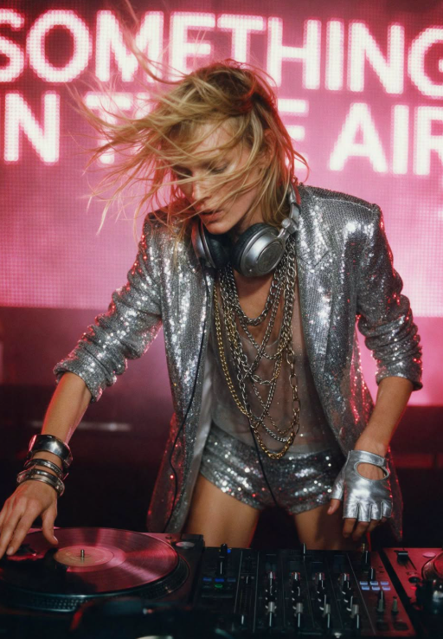
03 / WORKING TOGETHER
How a drop
works.
You make it. smthg sells it.
You set the drop window and the quantities.
Creators and the community build demand.
smthg takes payment and handles tax.
When orders close, you ship to each buyer and handle returns.
Then add your regular collection.

Slide 11

03 / WORKING TOGETHER
30%. Only when
you sell.
Creators, marketing, payments and platform, all in.
$500/mo $250/mo Free for brands that join now.

Slide 12

03 / WORKING TOGETHER
Your designs
stay yours.
From the smthg Designer Terms.
You keep all intellectual property.
You set your own prices.
Set up your Brand Space in your own style, to show who you are.

Slide 13
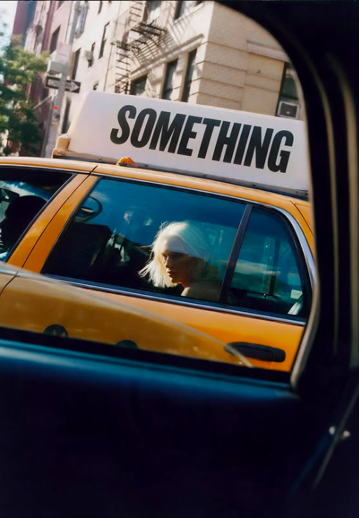
04 / THE PILOT
The pilot.
The first drops on smthg.
10
500
brands launching together in the pilot
fashion lovers in the pilot community
US
Creators
consumers first. EU is optional.
bring your first brand enthusiasts, who become your buyers. We take care of them.

Slide 14
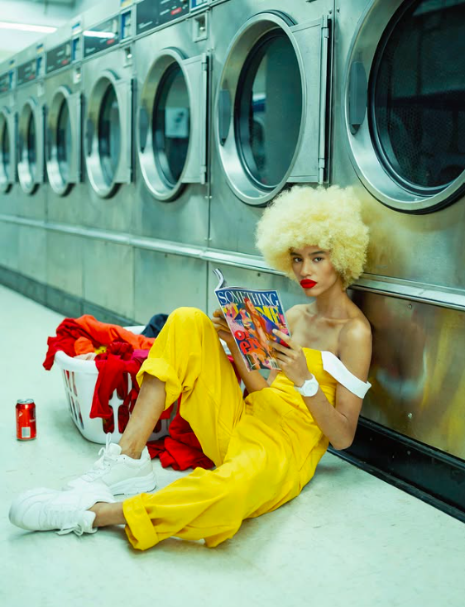
smthg. it’s so me!
Your world deserves
its people.
Become a Founding Brand.
smthg.us/for-designers

