Slide 1
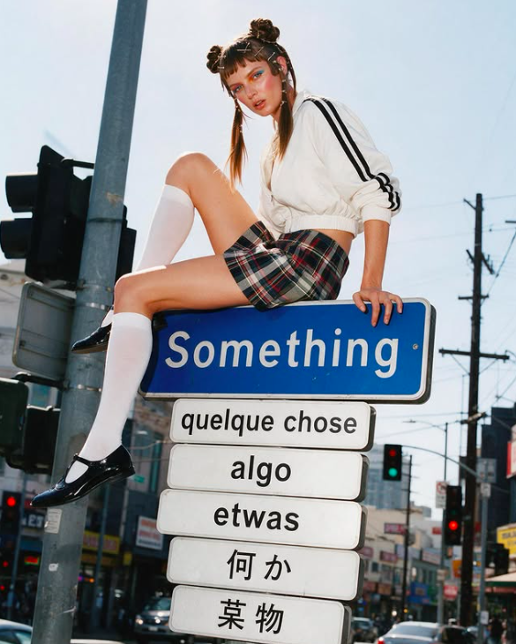
smthg.
Find the
people who’ll
love what
you make.
A community built around your label.
@smthg.us

Slide 2
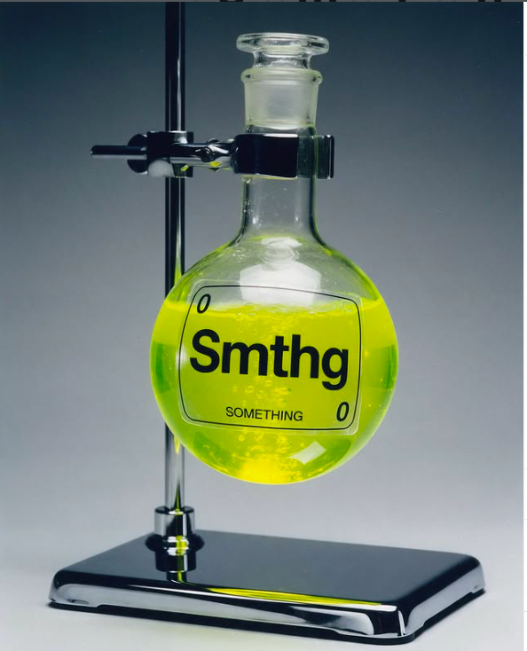
smthg.
01 / THE SHIFT
It’s about
being found.
Your audience is bigger than your followers.
320 of 10,000 followers see a brand’s post
Even fewer make it to the product. Fashion stores turn 1.9% of visitors into buyers.
Discovery stops at your followers
Most people find fashion through the same feeds and circles. On smthg, shoppers of brands like yours discover you too.
Creators need samples
Samples slow campaigns down and add cost and waste. With virtual try-on, creators and your ambassadors show your pieces without one.

Slide 3
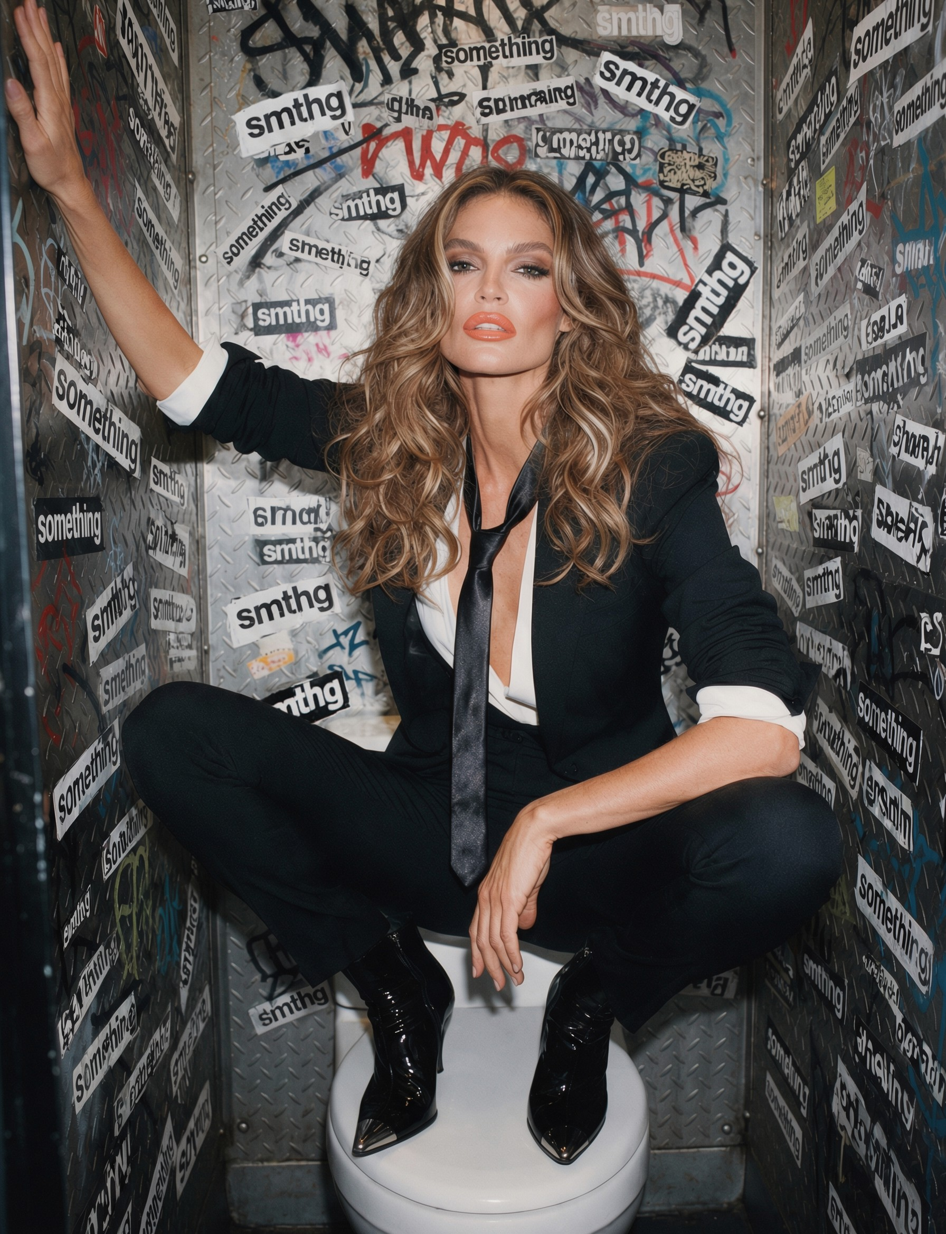
smthg.
02 / WHAT SMTHG IS
Unique fashion,
found together.
Community-led social commerce for fashion.
Emerging brands, found through people you trust.
Limited drops. Collections available for a limited time.
Spaces and events keep members here between drops.
Fashion moves through people.
“Where did you get that?”

Slide 4
smthg.
03 / DISCOVERY, REWIRED
We find the audience
for your drop.
You don’t have to build another audience. Meet the one that already exists.
01
02
03
We find your audience
Your Brand Space
Try-on instead of samples
Creators whose followers already collect labels like yours.
Grows your ambassadors. They wait for the next drop, or buy from your regular assortment.
Your pieces seen on a real body before ordering.

Slide 5
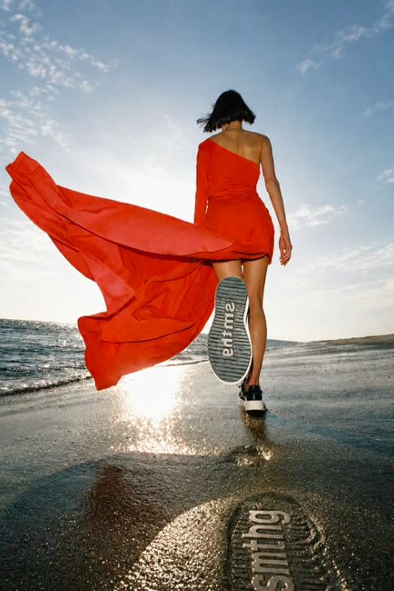
smthg.
04 / YOUR BRAND SPACE
Not another
product page.
Your world.
Where people discover your label, follow your drops and come back.
Brand Space
Live sessions, and every drop at its source.
Style Space
Members share looks and find their people.
Events
The drop calendar keeps the community in sync.
Space to grow your ambassadors — included.

Slide 6
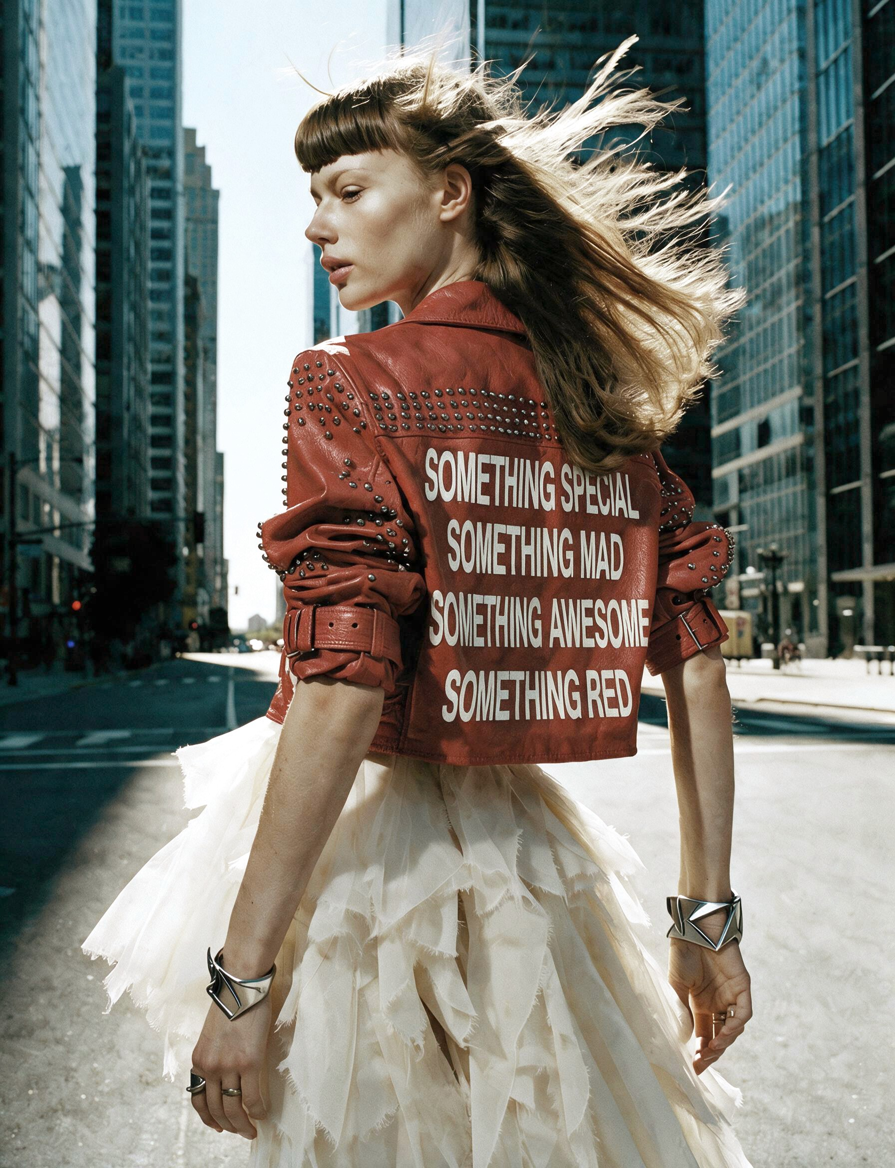
smthg.
05 / CREATOR COLLABORATION
We find the
creator who fits
your brand.
Selection, brief and campaign, run by smthg.
Creators whose audience already follows labels like yours.
They present your pieces through virtual try-on.
No samples to ship.

Slide 7
smthg.
06 / THE LOOP
Each drop grows the next one.
People who find you through a drop stay, and buy again.
Drop
Space
Assortment
Creators bring new audiences to your drop.
Buyers and visitors stay in your Brand Space.
They keep buying your full assortment between drops.
AND THE NEXT DROP OPENS TO A BIGGER SPACE
$250/mo
30% on GMV
Space included
Founding Brand rate. Standard rate $500/mo.
All-in, on sold orders only. Most of it promotes your brand; a small part goes to the platform.
Grow your ambassadors inside it.

Slide 8
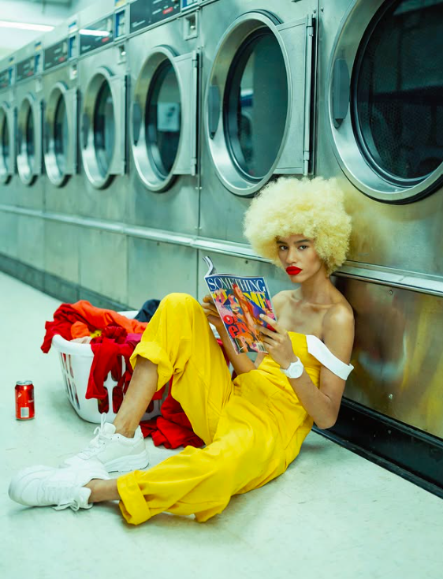
smthg.
FOUNDING BRAND
Your world
deserves
its people.
Become a Founding Brand.
smthg.us/for-designers →
smthg. it’s so me!

