Slide 1
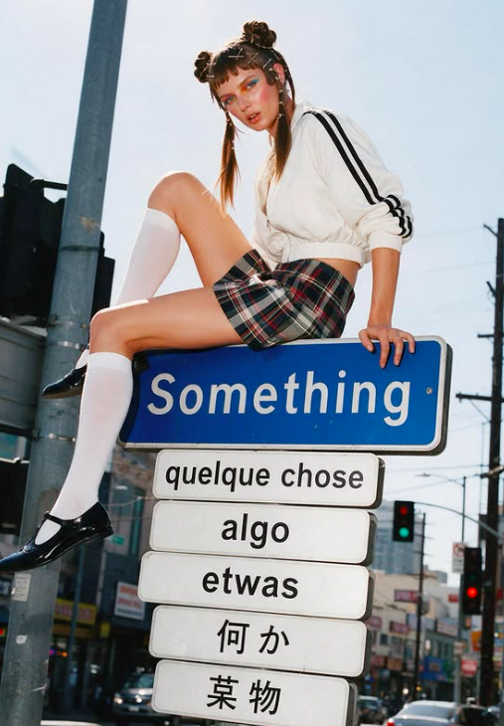
smthg.
Find the people who’ll
love what you make.
A community built around your label.
@smthg.us

Slide 2
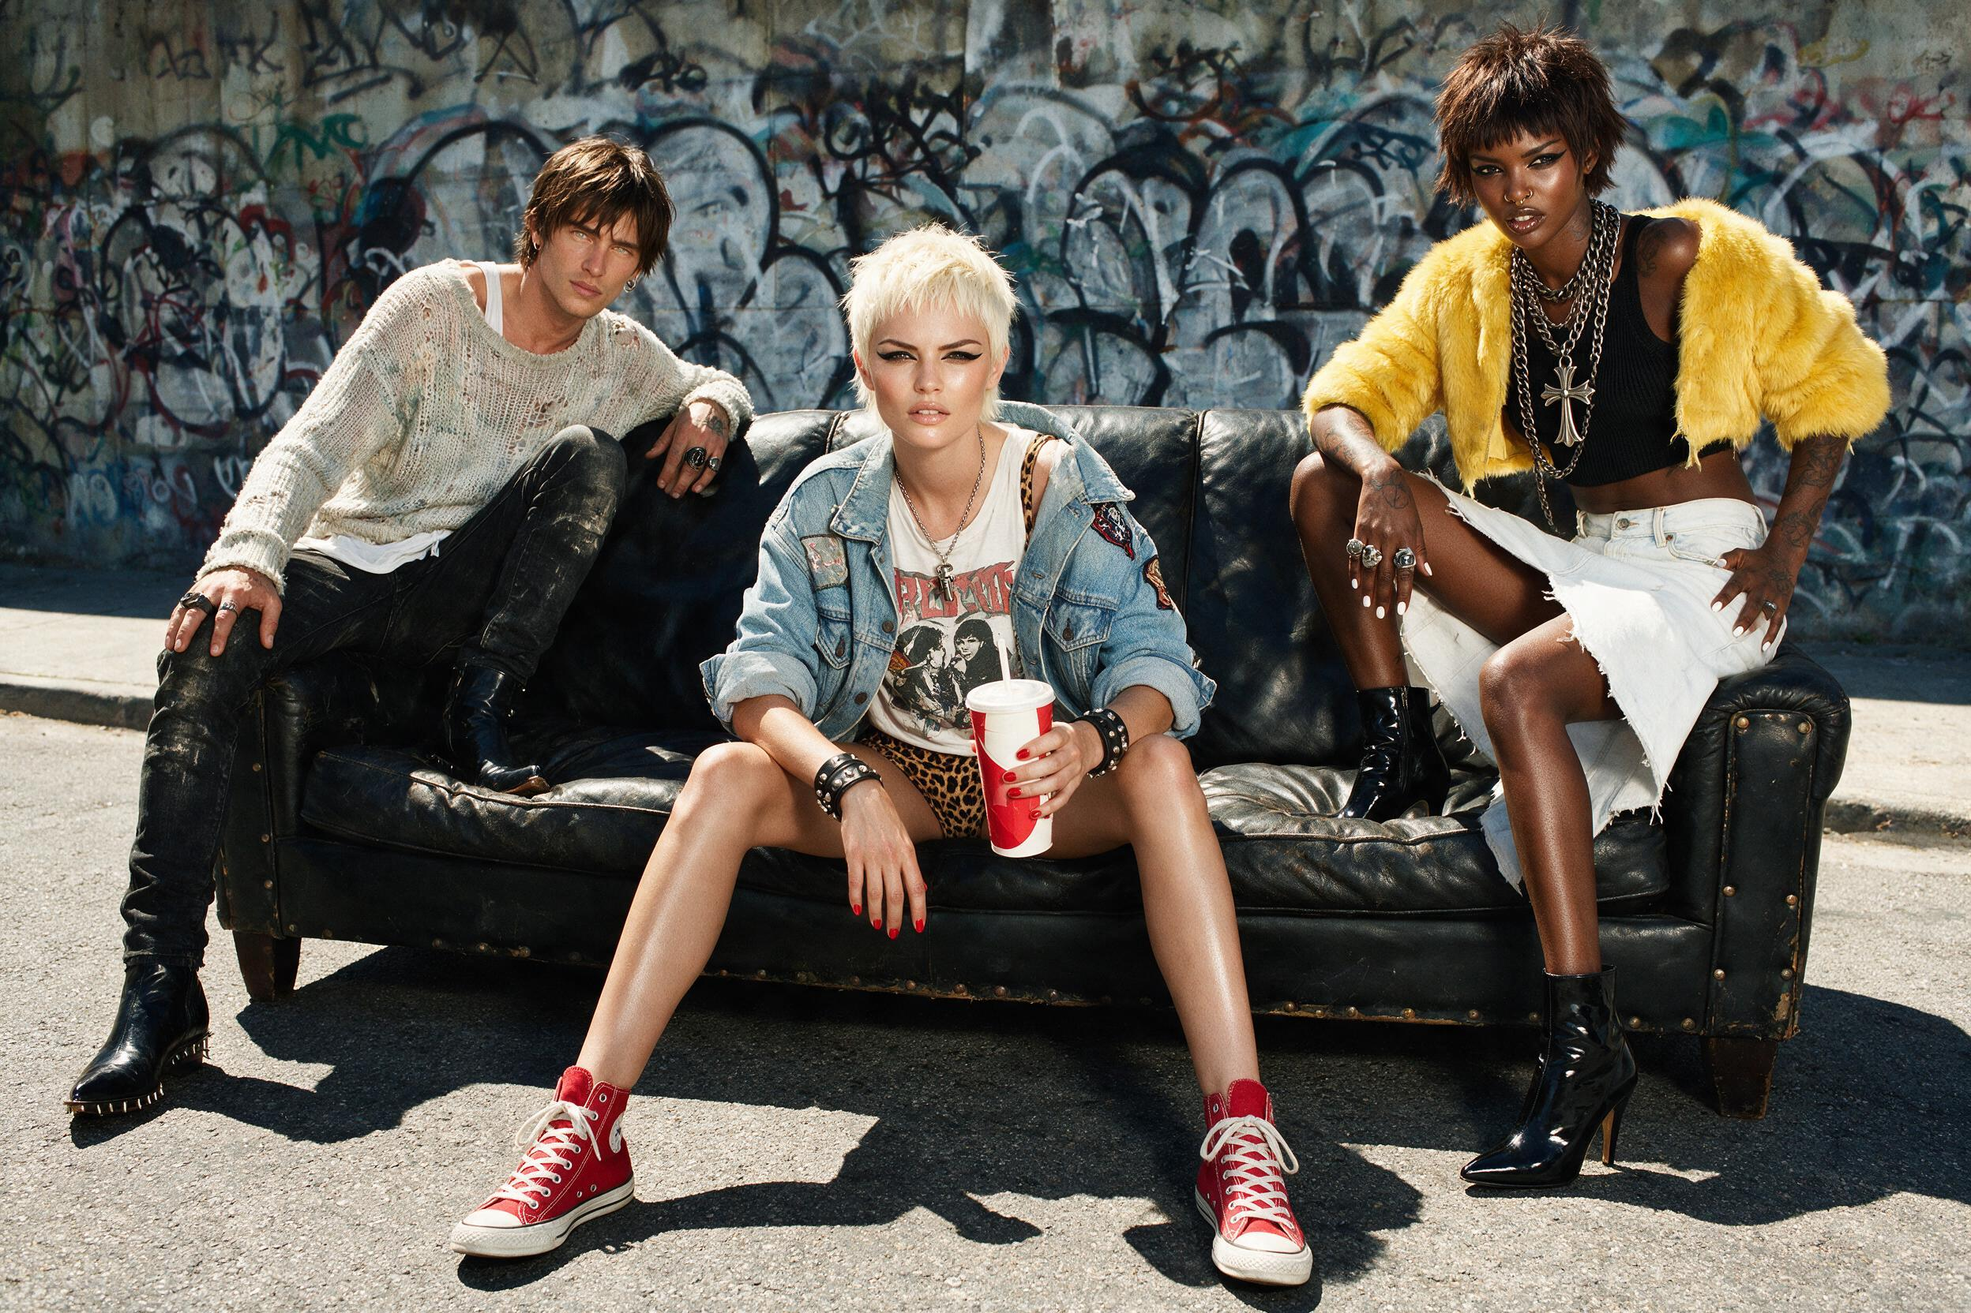
smthg. playbook
01 The problem
Reach · Conversion · Growing alone · Marketplaces
02 The smthg concept
A new sales channel · Try-on · Community · Brands together
03 Working together
How a drop works · Your designs · The plan

Slide 3
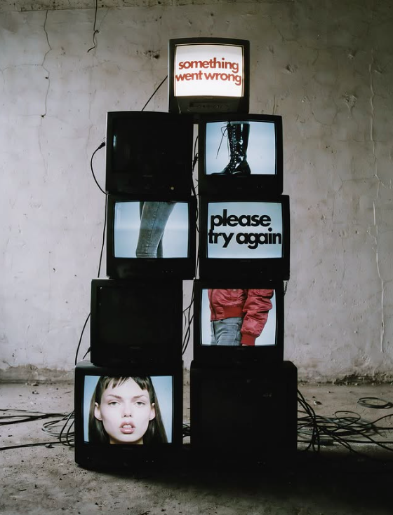
01 / THE PROBLEM
Great labels
stay unseen.
Being found is the hardest part.
5.5%*
reach per post, as a share of followers
1.3%**
of store visitors buy
Alone
no shared audience, no community
* Socialinsider, 2025–2026 ** Littledata, 2026

Slide 4

01 / THE PROBLEM
Marketplaces
don’t fix it.
A listing alone does not get you found.
Shoppers search a catalogue. Nobody introduces your label.
Getting seen takes heavy marketing investment.
The marketplace itself needs samples.

Slide 5
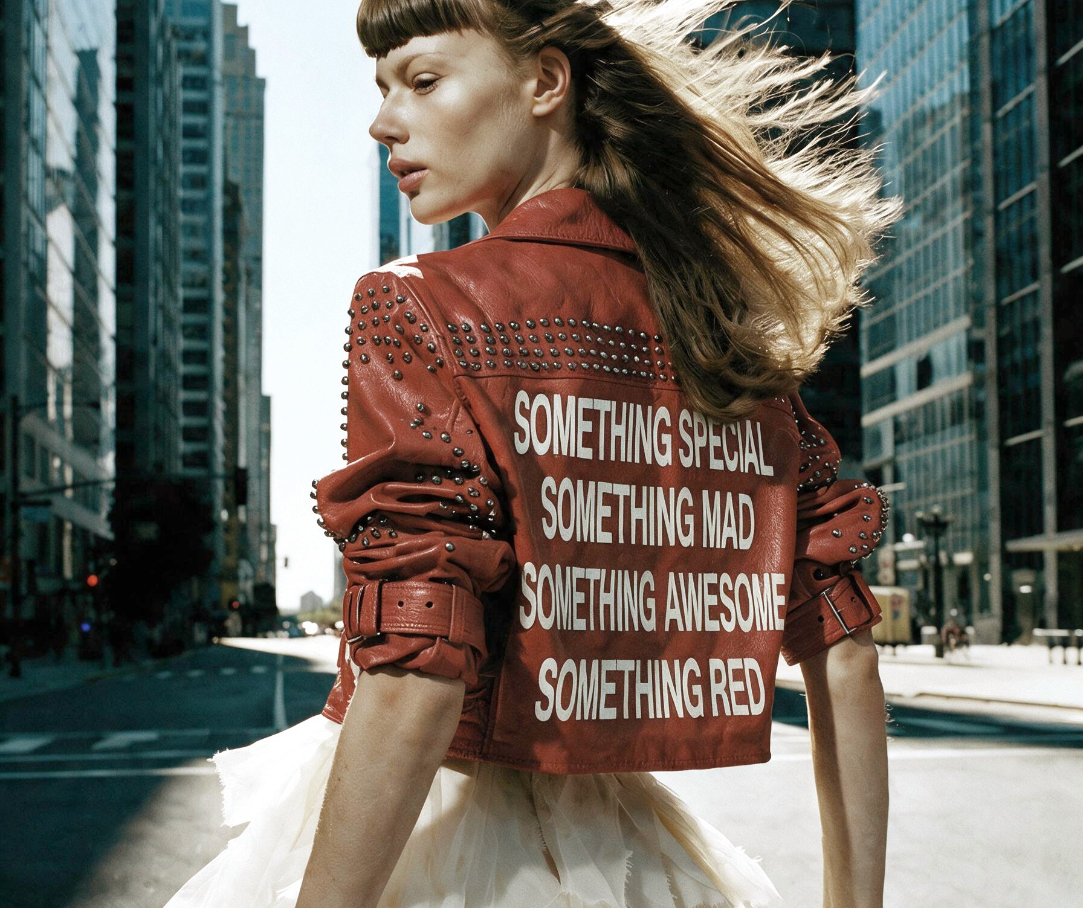
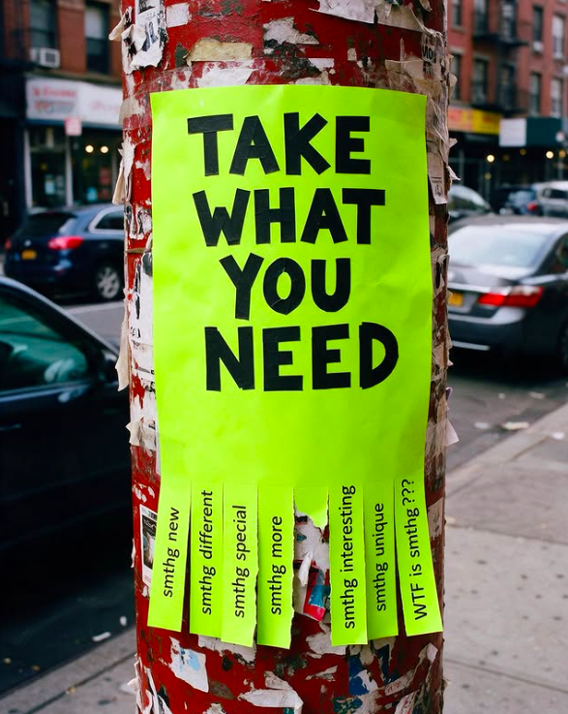
02 / THE SMTHG CONCEPT
One concept. Three layers.
Each layer grows the next.
01
A new sales channel
02
A community driven by creators
03
Brands that grow together

Slide 6
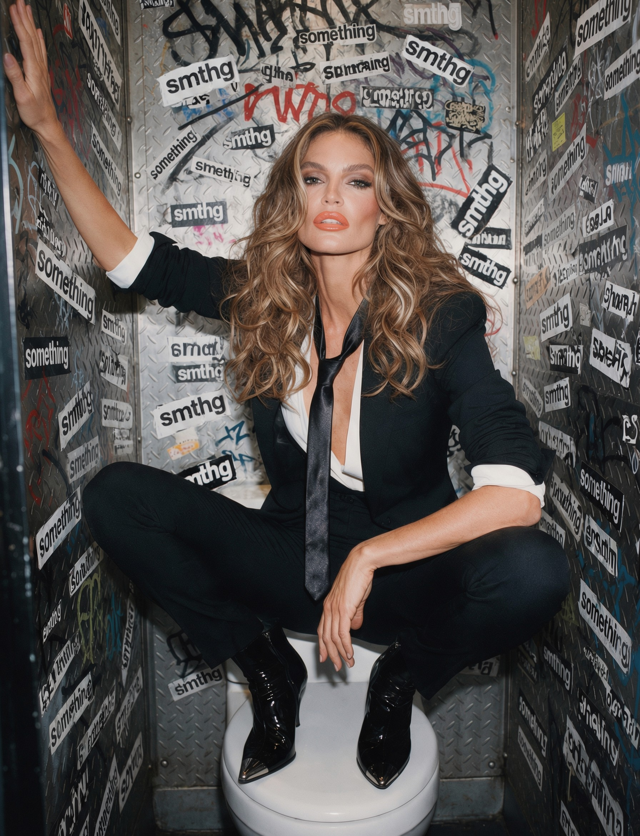
02 / THE SMTHG CONCEPT · 01
A new channel
for your sales.
It starts with a drop.
Limited drops, available for a limited time.
We take care of the creators. You don’t need to think about it.
Add your regular collection when you are ready.

Slide 7
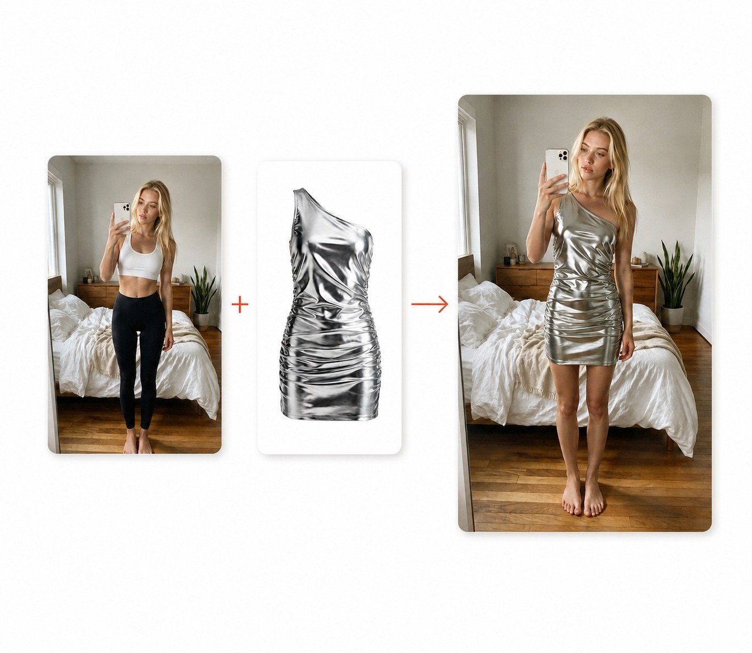
02 / THE SMTHG CONCEPT · 01
Your piece, on a real body.
Virtual try-on, for creators and shoppers.
For creators
Show your pieces without a sample.
For shoppers
See it on your own body before buying.
True to the piece
Colour, fit and materials as they are.

Slide 8
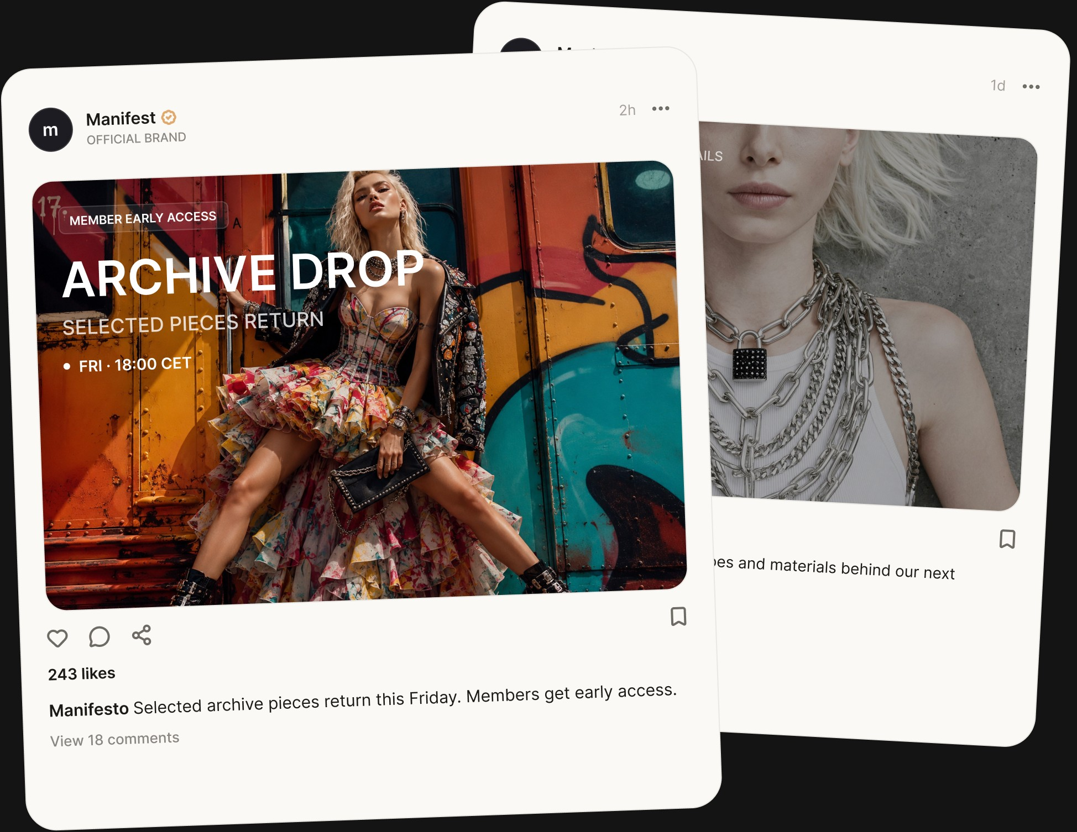
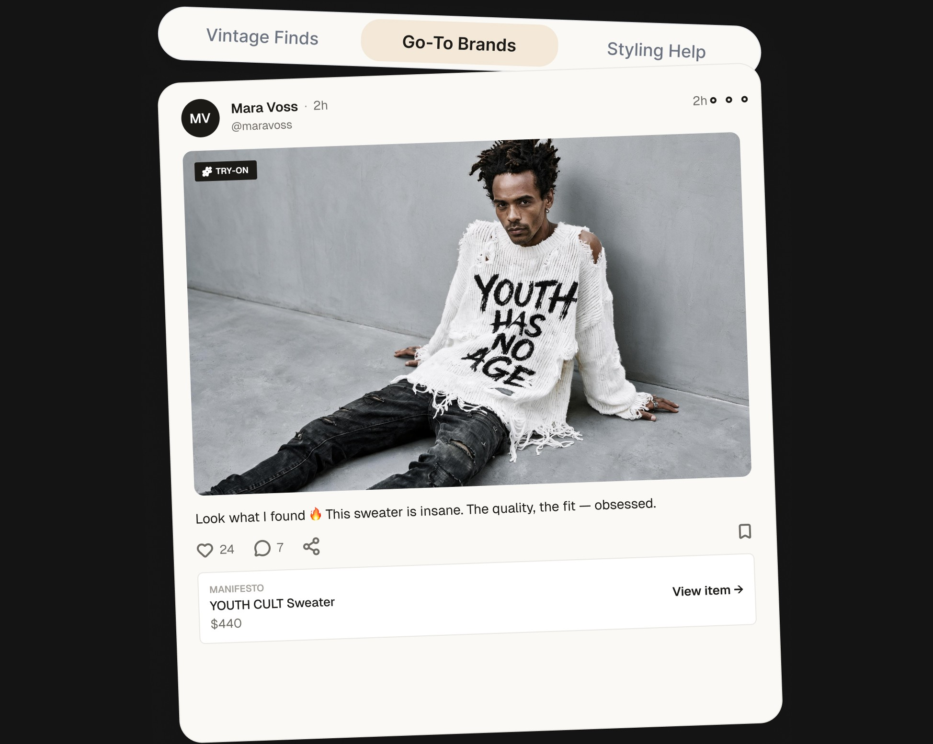
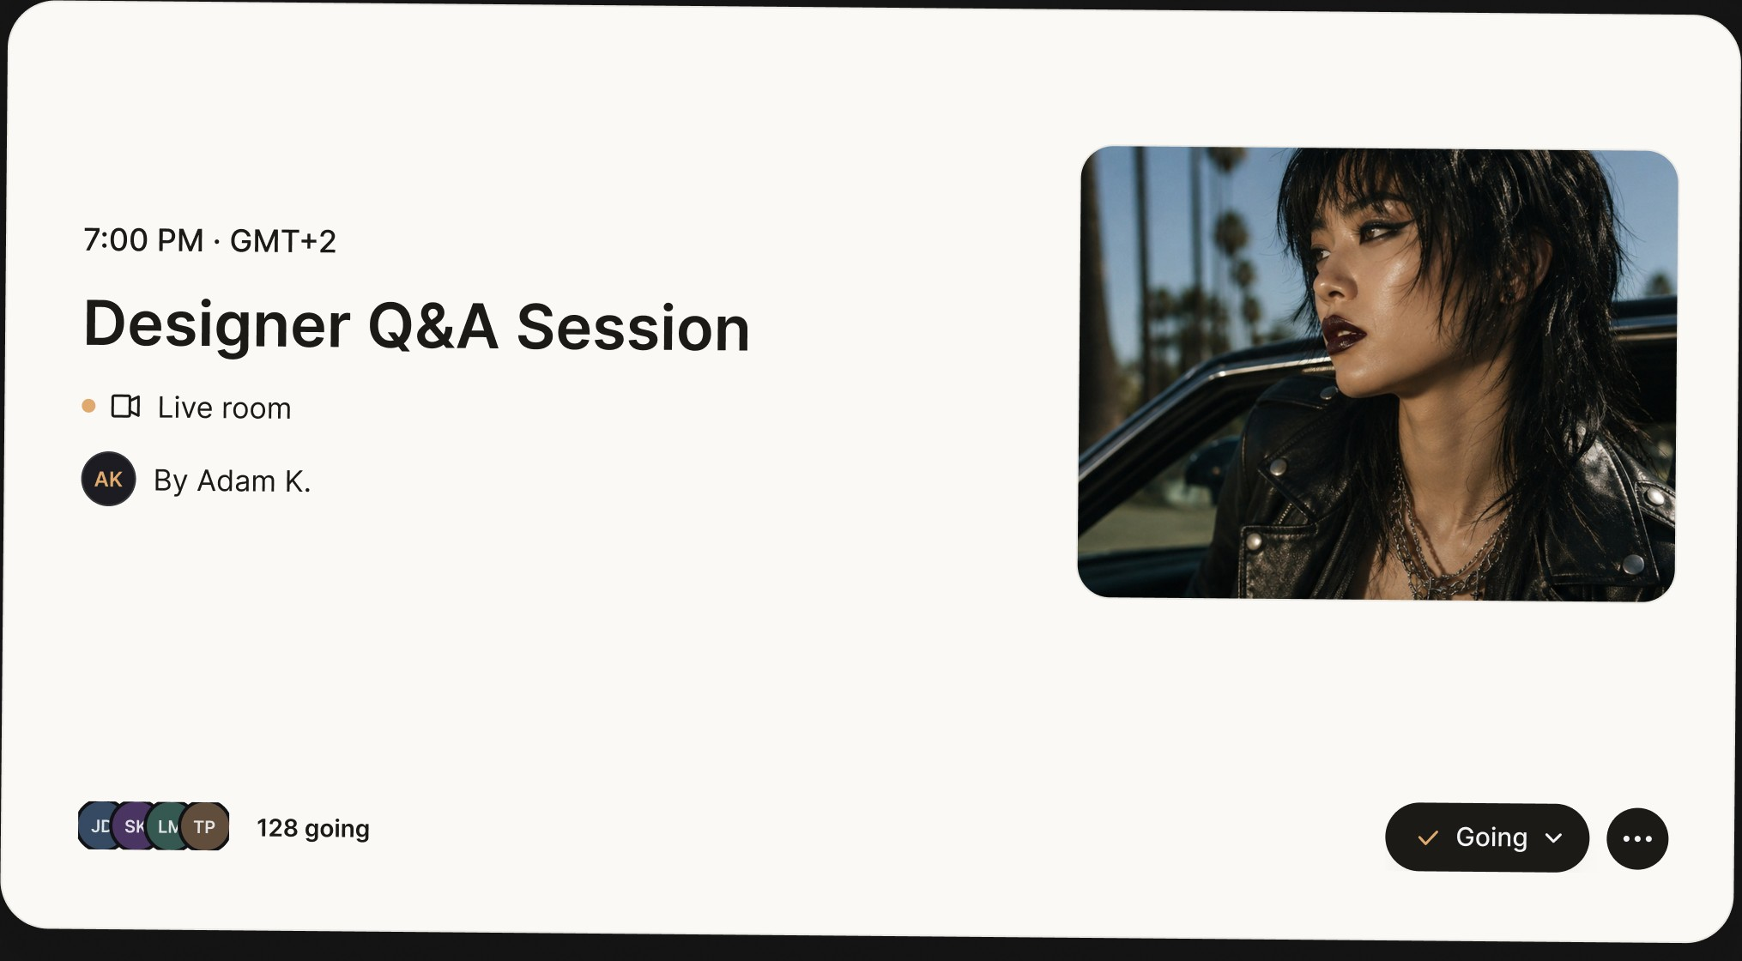
02 / THE SMTHG CONCEPT · 02
A community, driven by creators.
Creators bring their followers. Members stay, share and come back.
Brand Space
Style Space
Live sessions
Your drops and your story.
Members share what they love.
Meet the people behind the label.

Slide 9
02 / THE SMTHG CONCEPT · 03
Brands that grow
together.
Cross-pollination between labels of a similar style.
Labels with a similar style share their audiences.
Shoppers who love one label discover the next.
Their buyers discover you. Your buyers discover them.

Slide 10
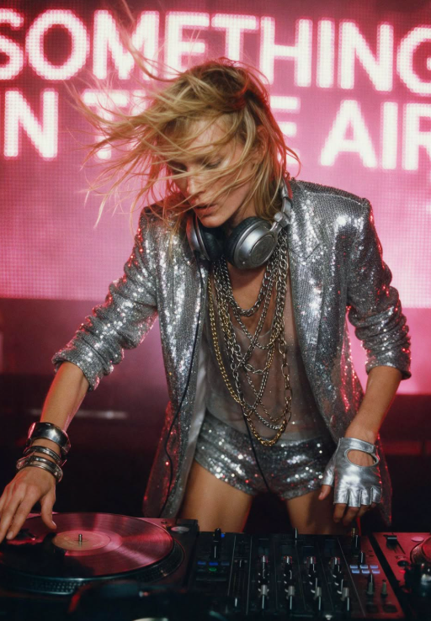
03 / WORKING TOGETHER
How a drop
works.
You make it. smthg sells it.
You set the drop window and the quantities.
Creators and the community build demand.
smthg takes payment and handles tax.
When orders close, you ship straight to each buyer.
Then add your regular collection.

Slide 11
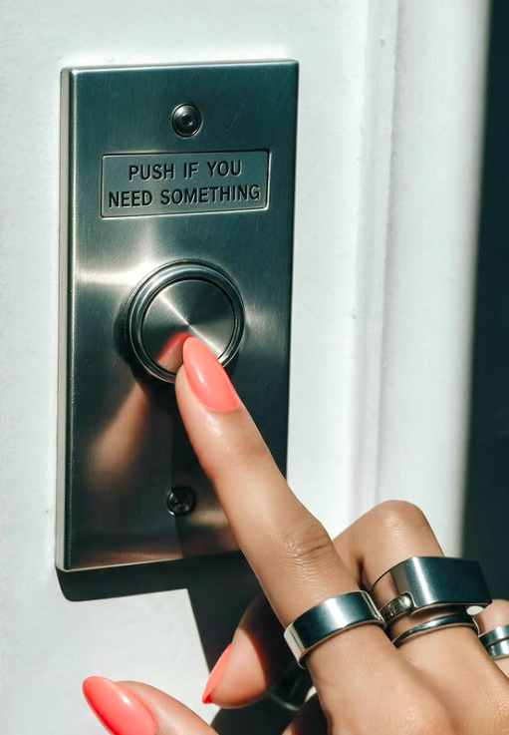
03 / WORKING TOGETHER
30%. Only when
you sell.
Creators, marketing, payments and platform, all in.
$250/mo platform fee as a Founding Brand, instead of $500.
It covers your Brand Space, your storefront and your dashboard.

Slide 12

03 / WORKING TOGETHER
Your designs
stay yours.
From the smthg Designer Terms.
You keep all intellectual property.
You set your own prices.
smthg shows your images only to list and promote your pieces.

Slide 13
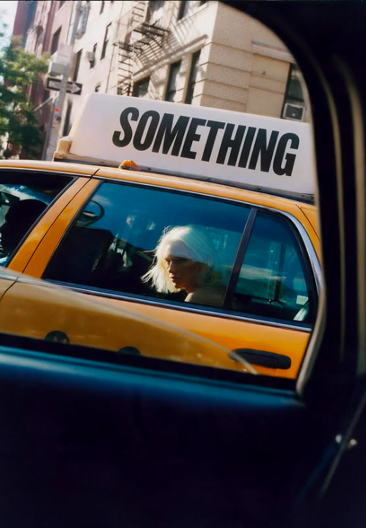
03 / WORKING TOGETHER
Where we’re
going.
Our first year.
500
5,000
community members at launch
registered users, end of Year 1
25
Creators
brands, end of Year 1
we take care of them. You don’t need to think about it.

Slide 14
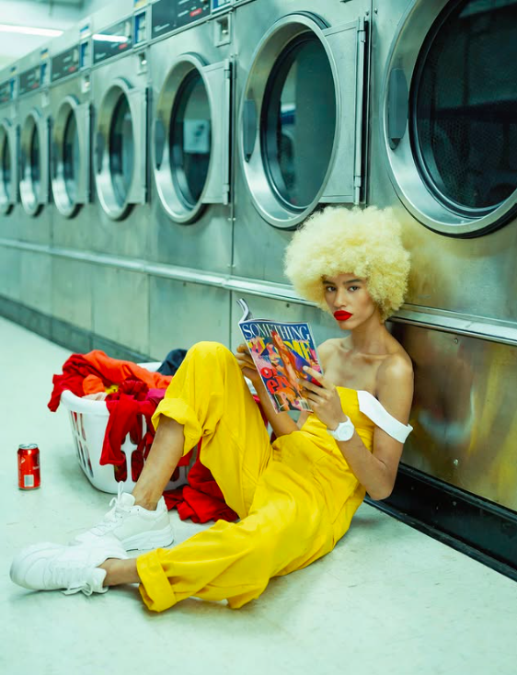
smthg. it’s so me!
Your world deserves
its people.
Become a Founding Brand.
smthg.us/for-designers

