Slide 1
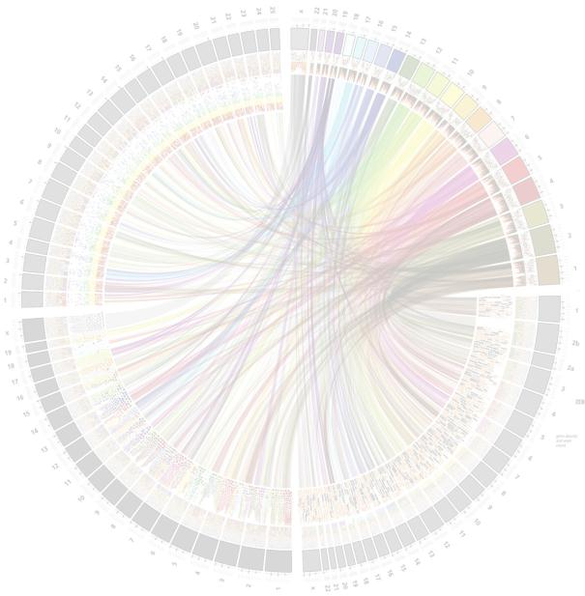
Evolutionary patterns of piRNA-generating clusters in human genome
Olga Dolgova
MSc in Bioinformatics: Thesis · 10/10/17
Notes:
Good morning everyone! The name of my Master Thesis is Evolutionary patterns of piRNA-generating clusters in human genome.

Slide 2
Outline
Introduction
piRNA clusters
Hypothesis
Objectives
Methodology
pipeline for data mining and analysis
Results
diversity and patterns of selection in piRNA clusters
Conclusions
MSc in Bioinformatics: Thesis · 10/10/17
Olga Dolgova
Notes:
My talk will include 5 parts. Beginning with short introduction where I will give you a definition of piRNA clusters and the description of the main hypothesis behind this study. Then we will move to objectives and methodology with description of the pipeline for data mining and analysis, followed by results with estimation of diversity and patterns of selection in piRNA clusters. I will finish this presentation with conclusion remarks.

Slide 3
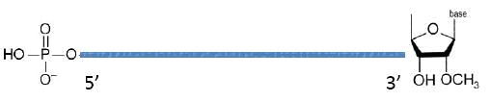
Introduction: Piwi-interacting RNA (piRNA)
Proposed piRNA structure
The largest class of small non-coding RNA molecules.
26-31 nucleotides long and highly expressed in the germline of animals from worms to humans.
Most piRNA-generating loci are found in a small number of genomic regions (clusters).
Function: the genome defense against transposable elements by both epigenetic and post-transcriptional gene silencing of retrotransposons.
Many aspects of their biology and evolution remain unknown.
MSc in Bioinformatics: Thesis · 10/10/17
Olga Dolgova
Notes:
Piwi- interacting RNA is the largest class of small non-coding RNA molecules. They are 26-31 nucleotides long and are highly expressed in the germline of animals from warms to humans. Most piRNA-generating loci are found in a small number of genomic regions named clusters. Their function is the genome defense against TE by both epigenetic and post-transcriptional gene silencing of retrotransposons. But still many aspects of their biology and evolution remain unknown.

Slide 4
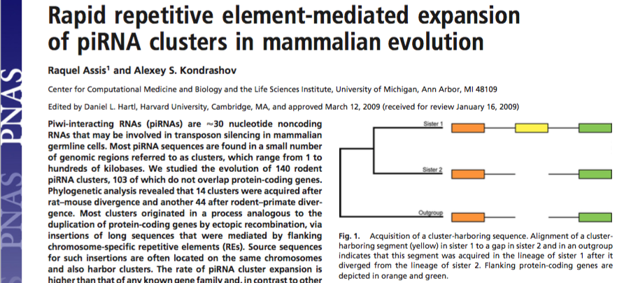
Introduction: Hypothesis
“If piRNAs are indeed involved in transposon silencing, it is natural to assume that selection for cluster acquisitions is caused by an arms race between expanding families of mammalian transposons and piRNA clusters.”
Assis and Kondrashov 2009
MSc in Bioinformatics: Thesis · 10/10/17
Olga Dolgova
Notes:
In their fist study of piRNA evolution in mammalian genomes Assis and Kondrashov proposed the idea that iff piRNAs are indeed involved in transposon silencing, it is natural to assume that selection for cluster acquisitions is caused by an arms race between expanding families of mammalian transposons and piRNA clusters.

Slide 5

Introduction: Hypothesis
Driven by
positive
selection
MSc in Bioinformatics: Thesis · 10/10/17
Olga Dolgova
Notes:
The main question have raised from that study: if the piRNA evolution is driven by positive selection?

Slide 6
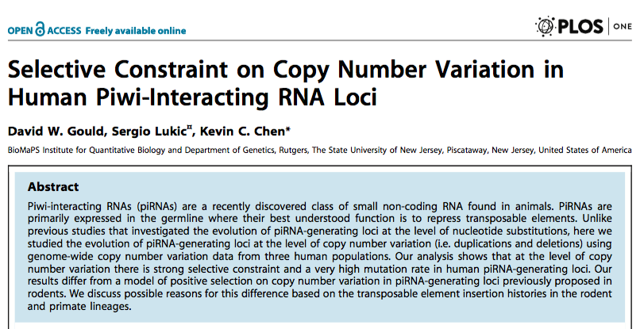
Introduction: Evidence
The most recent literature on CNV of piRNA-generating regions in humans showed the evidence for negative selection (Gould et al. 2012), using modified MKT and basing on copy number variation in several piRNA clusters and in limited human sample.
MSc in Bioinformatics: Thesis · 10/10/17
Olga Dolgova
Notes:
This hypothesis was tested in the study of Gould et al. who used modified McDonald and Kreitman test to detect selection in CNV. They found that negative selection was driving the CNV in piRNA clusters.

Slide 7
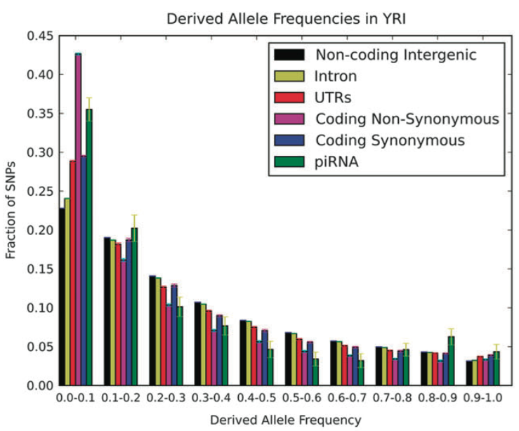
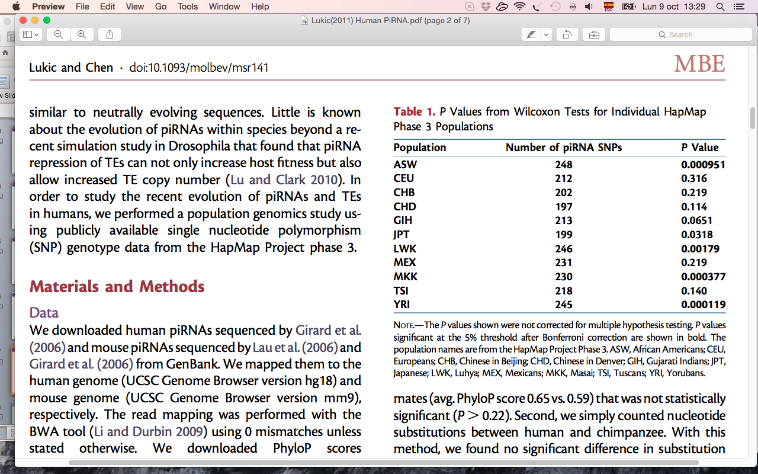
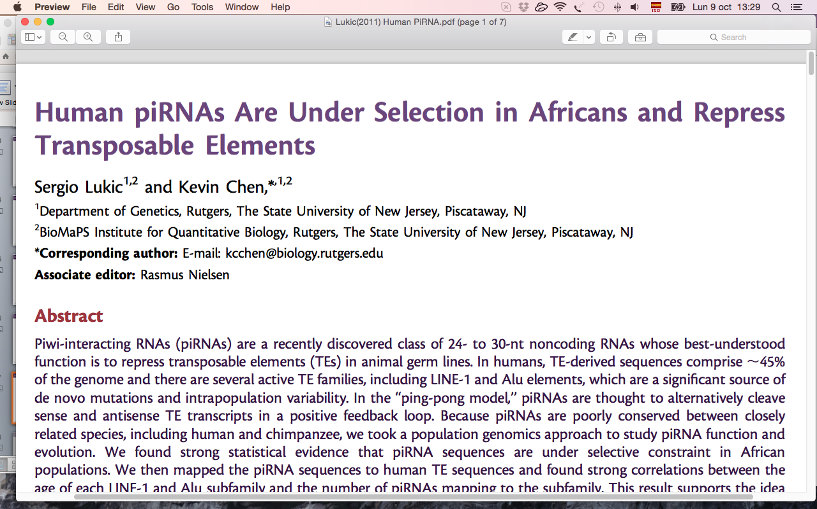
Introduction: Evidence
A recent study of 36 broad clusters based on derived allele frequency spectrum suggested that there is strong negative selection at the sequence level for human piRNAs but only in the three African populations and not in any of the seven non-African populations studied (Lukic and Chen 2011).
MSc in Bioinformatics: Thesis · 10/10/17
Olga Dolgova
Notes:
One more study was conducted, this time basing on allele frequency spectrum using 36 clusters from 10 human populations. They found the evidence for strong negative selection in African populations, but not in any of the 7 non-African populaitons.

Slide 8
Aim
To develop a pipeline for examination of the genome-wide patterns of nucleotide polymorphism and divergence in piRNA clusters from different populations in order to elucidate which are the main selective forces acting on piRNA cluster regions in the human genome at the nucleotide level.
MSc in Bioinformatics: Thesis · 10/10/17
Olga Dolgova
Notes:
The main goal of this project was:

Slide 9
Objectives
Data of piRNA clusters and intergenic regions retrieval, filtering and processing.
Estimation and comparison of genetic diversity within the human species between piRNA clusters and intergenic regions.
Estimation and comparison of divergence from the chimpanzee genome between piRNA clusters and intergenic regions.
Estimation and comparison of evolutionary rates between piRNA clusters and intergenic regions.
F_{ST} analysis to estimate differentiation between several human populations.
Application of different neutrality and selection tests, using chimpanzee genome as outgroup.
MSc in Bioinformatics: Thesis · 10/10/17
Olga Dolgova
Notes:
To achieve that aim we had to fulfill the following smaller objectives.

Slide 10
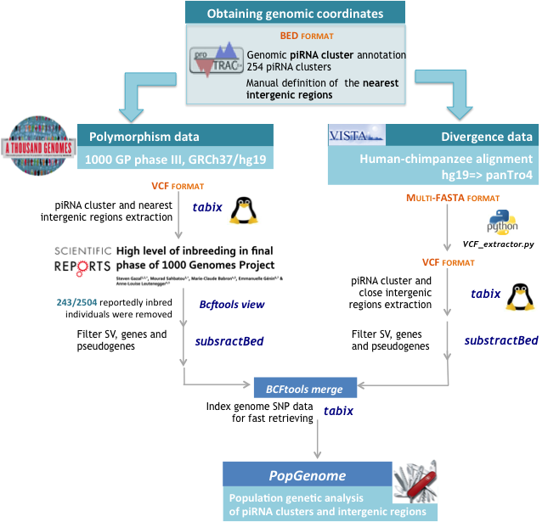

Methodology: Schematic pipeline
Olga Dolgova
Notes:
All procedures for data retrieval and analysis are summarized in this scheme of pipeline.
First of all the genomic coordinates of piRNA clusters were obtained with proTRAC software, resulting in annotation of 254 piRNA clusters. Intergenic regions were defined using GeneCode annotation data and bedtools. The nearest to piRNA clusters intergenic regions were chosen manually.
piRNA clusters and intergenic regions were extracted from 1000GP with tabix tool in Linux environment. Then 243 inbreed individuals were removed using last version of Bcftools view. The regions were simultaneously filtered for structural variants, genes and pseudogenes using substractbed tool.
For divergence estimation we used human-chimp alignment from Vista browser stored in multi-fasta format, which was converted into vcf format using custom python script. The n using tabix and substractBed tools the piRNA clusters and intergenic regions of chimp genome were extracted and filtered. The last step in Linux shell was to merge human and chimpanzee data inplementing Bcftools merge and to index them with tabix for fast retrieval.
For the population genomics analysis we used the Popgenome package for R environment along with custom scripts in R.

Slide 11
Results: Nucleotide Diversity
Chi-square test for the difference in number of segregating sites (S) between piRNA clusters and intergenic regions
 | AFR | AMR | EAS | EUR | SAS | Overall
χ² | 17635.432 | 8581.359 | 14907.057 | 12804.936 | 13352.603 | 26376.17
p-value | <E-22 | <E-22 | <E-22 | <E-22 | <E-22 | <E-22
S (piRNA clusters) | 34,020 | 35,766 | 30,732 | 28,184 | 28,196 | 48,002
S (intergenic regions) | 94,295 | 78,686 | 83,343 | 75,210 | 75,900 | 135,256
145 piRNA clusters (2.24Mb) and intergenic regions (2.77Mb) from 2261 human samples.
MSc in Bioinformatics: Thesis · 10/10/17
Olga Dolgova
Notes:
After filtering step we remained with 145 piRNA clusters with overall length of 2.24Mb and nearest to them intergenic regions of 2.77Mb from 2261 human samples.
The numbers of segregating sites were compared between supposedly neutral intergenic regions and piRNA clusters using chi-square test for each population.
The difference was strongly significant in all cases, with numbers of segregating sites in intergenic regions being 2-3 times larger than that in piRNA clusters, suggesting the selective constraint in the latter ones with lower variability.

Slide 12
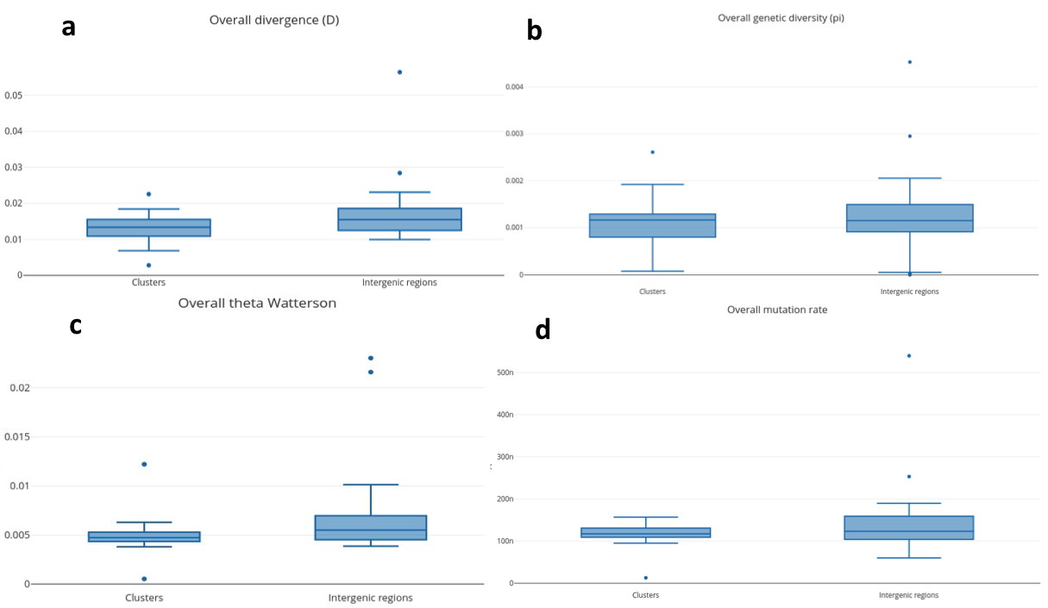
Results: Nucleotide Diversity
Overall divergence (D)
Overall genetic diversity (π)
Clusters
Intergenic regions
Clusters
Intergenic regions
Overall theta Watterson (Θ)
Overall mutation rate (μ)
Clusters
Intergenic regions
Clusters
Intergenic regions
MSc in Bioinformatics: Thesis · 10/10/17
Olga Dolgova
Notes:
The values of overall divergence and theta were higher for intergenic regions, while mutation rates and pi of genetic diversity lagerly overlapped. This pattern didn’t change considerably when each population was analyzed separately.

Slide 13
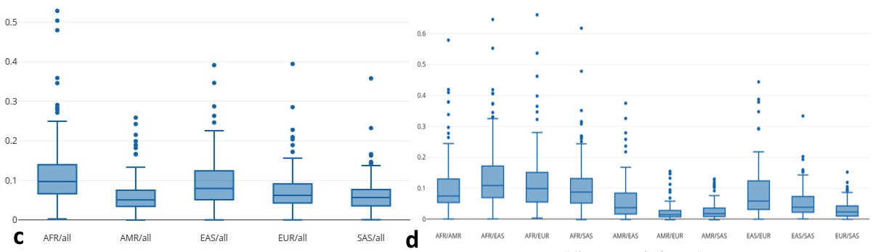
Results: Genetic differentiation (F_{ST})
F_{ST} between each population vs. the rest
F_{ST} in each pair of populations
MSc in Bioinformatics: Thesis · 10/10/17
Olga Dolgova
Notes:
We detected strong differences in the variability between populations further confirmed by fixation index estimations. African and East Asian populations were the most differentiated ones.

Slide 14
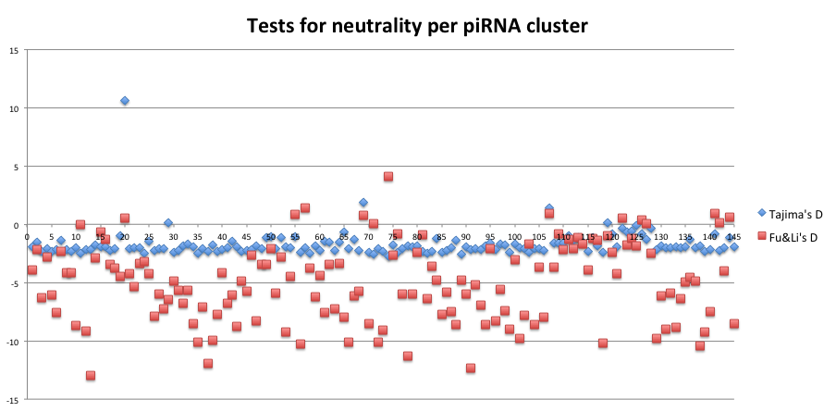
Results: Neutrality tests
MSc in Bioinformatics: Thesis · 10/10/17
Olga Dolgova
Notes:
To estimate the deviation from neutrality in each cluster we used Tajima’s D and Fu&Li’s D tests. The worth majority of the clusters attained negative values suggesting an excess of weakly deleterious alleles maintained at low friquences by slightly negative selection. Some of the clusters also attained the positive values suggesting rather balancing selection with heterozygote advantage might be maintaining the nucleotide variability.

Slide 15
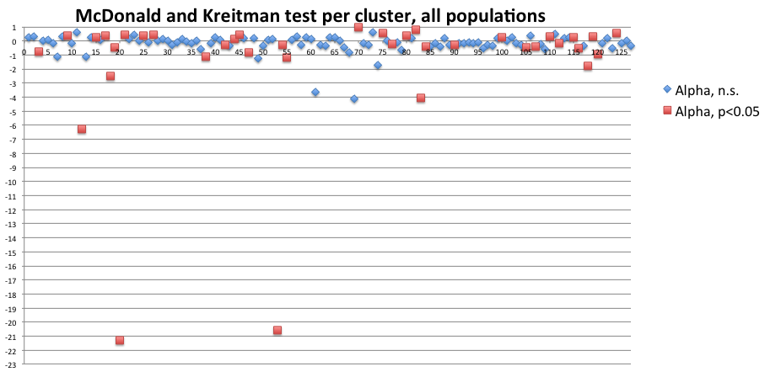
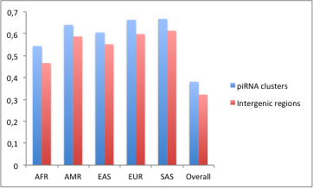

Results: McDonald and Kreitman test
40% (AFR) - 46.7% (EUR) of significant α were positive depending on particular population.
Divergence/Polymorphism
α= 1-NI
12% (AFR) - 20% (EUR) of α were significant depending on particular population. 30% in joint dataset.
NI = P_{non-n}/P_{neut.}
MSc in Bioinformatics: Thesis · 10/10/17
Olga Dolgova
Notes:
To detect the selection fingerprint with MKT first Neutral Index was calculated as a proportion of two proportions of non-neutral to neutral polymorphism divided by non-neutral to neutral divergence divergence. In our case intergenic regions played the role of putatively neutral regions. Alpha was calculated as the deviation of Neutral Index from 1. So that positive values of alpha indicate directional selection driving the advantageous alleles to fixation, while negative values of alpha are indicative of negative selection.
12 to 20% of alpha values were significant across populations, achieving 30% of significant values in the pooled dataset. Most of them had negative values suggesting purifing selection. Nevertheless, 40 to 47% of significant alpha values had positive sign for that clusters that supposed to be maintained by directional selection.
We also compared the proportions of divergent to polymorphic sites between piRNA clusters and intergenic regions for each population, finding that in all cases the proportion of div/pol sites attained higher values in the piRNA clusters due to relative excess of divergent alleles, indicating higher fixation rates of advantageous alleles in these regions.

Slide 16
Conclusions
1
The pipeline for the data retrieval from the 1000 Genomes Project, filtering, processing and analysis of piRNA clusters and intergenic regions was developed.
2
A strong difference in the levels of polymorphism was found between piRNA clusters and intergenic regions, the latter being more diverse. Some differences were also found in the mutation rates and divergence from chimpanzee, with higher values for intergenic regions.
3
Heterozygosity expected under neutrality (Θ of Watterson) was much higher than observed heterozygosity (Nei’s π), suggesting the action of purifying selection on weakly deleterious alleles segregating in all populations at low frequencies. This observation was confirmed by Tajima’s D and Fu&Li’s D tests, which in most of the cases attained negative values due to an excess of rare alleles.
4
The values of alpha in the McDonald and Kreitman test were negative in most of the cases, being significant in 12-20% of piRNA clusters depending on the super-population. Nevertheless, in 40-47% of significant results a positive alpha was detected, suggesting recurrent directional selection fixing new advantageous alleles.
5
The African super-population was the most differentiated one, attaining highest values of fixation index F_{ST} in all pairwise comparisons, as well as versus all remaining populations taken together. It showed higher selective constraint (60% of significant values have negative alphas), which is in accordance with the previous findings.
MSc in Bioinformatics: Thesis · 10/10/17
Olga Dolgova
Notes:
To finish this presentation I would like to make several concluding remarks.

Slide 17


