Slide 1


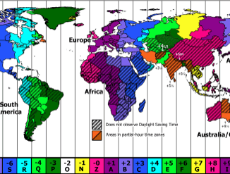
MySQL for Data Analysis
Working with Time Series

Slide 2



Time series analysis is one of the most common types of analysis done with SQL.
A time series is a sequence of measurements or data points recorded in time order, often at regularly spaced intervals. There are many examples of time series data in daily life, such as the daily high temperature, the closing value of the S&P 500 stock index, or the number of daily steps recorded by your fitness tracker.
Time series analysis is used in a wide variety of industries and disciplines, from statistics and engineering to weather forecasting and business planning.
Time series analysis is a way to understand and quantify how things change over time.

Slide 3
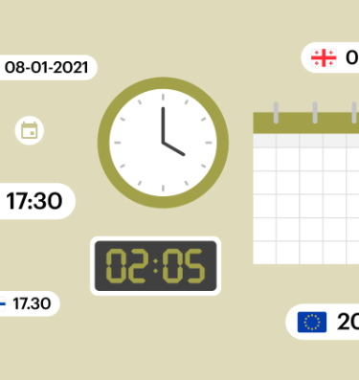
Date, Datetime, and
Time Manipulations
Dates and times come in a wide variety of formats, depending on the data source. We often need or want to transform the raw data format for our output, or to perform calculations to arrive at new dates or parts of dates.
SQL has powerful functions and formatting capabilities that can transform just about any raw input to almost any output we might need for analysis.

Slide 4

Time Zone Conversions
Understanding the standard time zone used in a data set can prevent misunderstandings
and mistakes further into the analysis process.
Many databases are set to Coordinated Universal Time (UTC), the global standard
used to regulate clocks, and record events in this time zone. It replaced Greenwich
Mean Time (GMT), which you might still see if your data comes from an older database.
UTC does not have daylight savings time, so it stays consistent all year long.
This turns out to be quite useful for analysis.

Slide 5
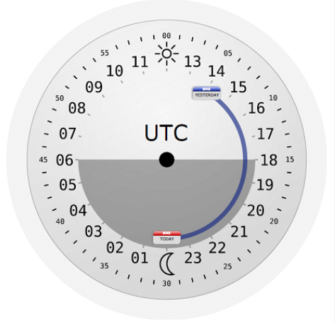
Often timestamps in the database are not encoded with the time zone, and you will need to consult with the source or developer to figure out how your data was stored.
UTC has become most common in the data sets , but that is certainly not universal.
All local time zones have a UTC offset. For example, the offset for PDT is UTC – 7 hours, while the offset for PST is UTC – 8 hours.
Timestamps in databases are stored in the format YYYY-MM-DD hh:mi:ss (for years-months-days hours:minutes:seconds).
Timestamps with the time zone have an additional piece of information for the UTC offset, expressed as a positive or negative number.

Slide 6

MySQL has several data types for representing dates and times, and many functions for operating on them.
MySQL stores dates and times in specific formats,
and it’s important to understand them to avoid surprises in results from manipulating temporal data.
This presentation covers the following aspects of
working with date and time values in MySQL:
1 Choosing a temporal data type
MySQL provides several temporal data types to choose from when you create tables. Knowing their properties enables you to choose them appropriately.
2 MySQL displays temporal values using specific formats by default. You can produce other formats by using the appropriate functions.

Slide 7


Changing the client time zone
The server interprets TIMESTAMP and DATETIME values in the client’s current time zone, not its own. Clients in different time zones should set their zone so that the server can properly interpret TIMESTAMP values for them.
Determining the current date and time
MySQL provides functions that return the date and time. These are useful for applications that must know these values or need to Calculate other temporal values in relation to them.
Tracking row modification times.
The TIMESTAMP and DATETIME data types have special properties that enable you to record row-creation and last-modification times automatically.
Breaking dates and times into component values and creating dates and times from component values
You can split date and time values when you need only a component, such as the month part of a date or the hour part of a time. Conversely, you can combine component values to synthesize dates and times.
Converting between dates or times and basic units some temporal calculations such as date arithmetic operations
are more easily performed using the number of days or seconds represented by a date or time value than by using the value itself. MySQL can perform conversions between date and time values and more basic units such as days or seconds.
Date and time arithmetic
You can add or subtract temporal values to produce other temporal values or calculate intervals between values. Applications include age determination, relative date computation, and date shifting.
Selecting data based on temporal constraints
The calculations discussed in the preceding sections to produce output values can also be used in WHERE clauses to specify how to select rows using temporal conditions.

Slide 8

This presentation covers several MySQL functions for operating on date and time values, but there are many others.
To familiarize yourself with the full set, consult the MySQL Reference Manual.
The variety of functions available to you means that it’s often possible to perform a given temporal calculation more than one way.
Many of the problems addressed in this presentation can be solved in ways other than those shown here.
You can find other solutions. You may find a method that’s more efficient or that you find more intuitive.

Slide 9

1 Choosing a Temporal Data Type
Problem
You need to store temporal data but aren’t sure which is the most appropriate data type.
Solution
Choose the data type according to the characteristics of the information to be stored and how you need to use it.
To choose a temporal data type, consider questions such as these:
Do you need times only, dates only, or combined date and time values?
What range of values do you require?
Do you want automatic initialization of the column to the current date and time?

Slide 10

MySQL provides DATE and TIME data types for representing date and time values separately, and DATETIME and TIMESTAMP types for combined date-and-time values. These values have the following characteristics:
DATE values have YYYY-MM-DD format,
where YY, MM, and DD
represent the year, month, and day parts of the date. The supported range
for DATE values is 1000-01-01 to 9999-12-31.
TIME values have hh:mm:ss format, where
hh, mm, and ss
are the hours, minutes, and seconds parts of the time.
TIME values can often be thought of as time-of-day values,
but MySQL actually treats them as elapsed time.
Thus, they may be greater than 23:59:59 or even negative.
(The actual range of a TIME column is -838:59:59 to 838:59:59.)
DATETIME and TIMESTAMP are combined date-and-time values in
YYYY-MM-DD
hh:mm:ss format.

Slide 11

The DATETIME and TIMESTAMP data types are similar in many respects, but watch out for these differences:
— DATETIME
has a supported range of
1000-01-01 00:00:00 to 9999-12-31 23:59:59,
whereas TIMESTAMP values are valid only from the year
1970 partially through 2038.
— TIMESTAMP and DATETIME have special auto-initialization and auto-update properties , but for DATETIME, they are not available before MySQL 5.6.5.
— When a client inserts a TIMESTAMP value, the server converts it from the time zone associated with the client session to UTC and stores the UTC value. When the client retrieves a TIMESTAMP value, the server performs
the reverse operation to convert the UTC value back to
the client session time zone.

Slide 12
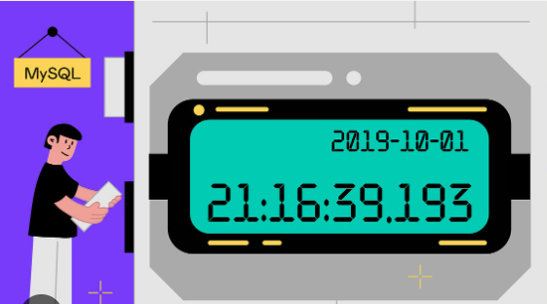
2 Using Fractional Seconds Support
Problem
Your application requires subsecond resolution of time values.
Solution
Specify fractional seconds.
MySQL supports fractional seconds for temporal types that include a time part:
DATETIME, TIME, and TIMESTAMP.
For applications that require subsecond resolution of time values, this enables you to specify fractional seconds with precision down to the microsecond level.
The default is to have no fractional seconds part, so to include it for
temporal types that support this capability, specify it explicitly in the
column declaration: include (fsp) after the data type name in a column
definition. fsp can be from 0 to 6 to indicate the number of fractional
digits.
0 means “none” (resolution to seconds); 6 means resolution to microseconds.

Slide 13
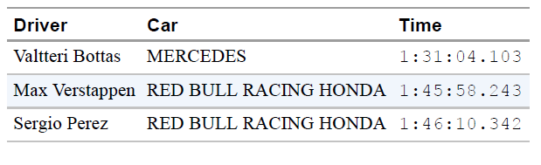
Table 1 . Formula 1 Rolex Turkish Grand Prix 2021–Race results
A precision timing is crucial for specific events such as races. One of the most popular and time-sensitive events worldwide are the Formula 1 races as seen in Table. Time tracking for the fastest motorsport requires detailed timekeeping and technology. In short, the necessary time to be tracked is within ten thousandths of a second which is accomplished by using multiple transponders.
Temporal functions that return current time or date-and-time values also support fractional seconds. The default without an argument is no fractional part. Otherwise, the argument specifies the desired resolution.
Permitted values are 0 to 6, the same as when declaring temporal columns:
mysql> SELECT CURTIME(), CURTIME(2),CURTIME(6);
+-----------+-------------+-----------------+
| CURTIME() | CURTIME(2) | CURTIME(6) |
+-----------+-------------+-----------------+
| 18:07:03 | 18:07:03.24 | 18:07:03.244950 |

Slide 14

3. Changing MySQL’s Date Format
Problem
You want to change the ISO format that MySQL uses for representing date values.
Solution
You can’t. However, you can rewrite non-ISO input values into ISO Format when storing dates, and you can rewrite ISO values to other formats for
display with the DATE_FORMAT() function.
The YYYY-MM-DD format that MySQL uses for DATE values
Follows the ISO 8601 standard for representing dates.
Because the year, month, and day parts have a fixed length
and appear left to right in date strings, this format has the useful
property that dates sort naturally into the proper temporal
order.
ISO format, although common, is not used by all database systems,
which can cause problems if you move data between different systems.
Moreover, people commonly like to represent dates in other formats, such as MM/DD/YY or DD-MM-YYYY. This too can be a source of trouble, due to mismatches between human expectations of how dates should look and how MySQL actually represents them.

Slide 15
One way to rewrite non-ISO values for date entry is to use the
STR_TO_DATE() function,
which takes a string representing a temporal value and a format string that specifies the “syntax” of the value.
Within the formatting string, use special sequences of the form %c, where
c specifies which part of the date to expect.
For example, %Y, %M, and %d
signify the four-digit year, the month name, and the two-digit day of the month.
To insert the value
May 13, 2007 into a DATE column, do this:
mysql> INSERT INTO t (d) VALUES(STR_TO_DATE('May 13, 2007',’%M d,%Y'));
mysql> SELECT d FROM t;
+------------+
| d |
+------------+
| 2007-05-13 |
+------------+

Slide 16
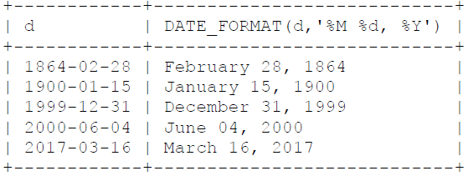
For date display, MySQL uses ISO format (YYYY-MM-DD) unless you tell
it otherwise. To display dates or times in other formats, use the
DATE_FORMAT() or TIME_FORMAT() function to rewrite them.
If you require a more specialized format those functions cannot provide, write a
stored function.
The DATE_FORMAT() function takes two arguments:
a DATE, DATETIME, or TIMESTAMP value and a string describing how to display
the value.
The format string uses the same kind of specifiers as STR_TO_DATE().
The following statement shows the values in the date_val table,
both as MySQL displays them by default and as reformatted with DATE_FORMAT():
mysql> SELECT d, DATE_FORMAT(d,'%M %d, %Y') FROM date_val;

Slide 17
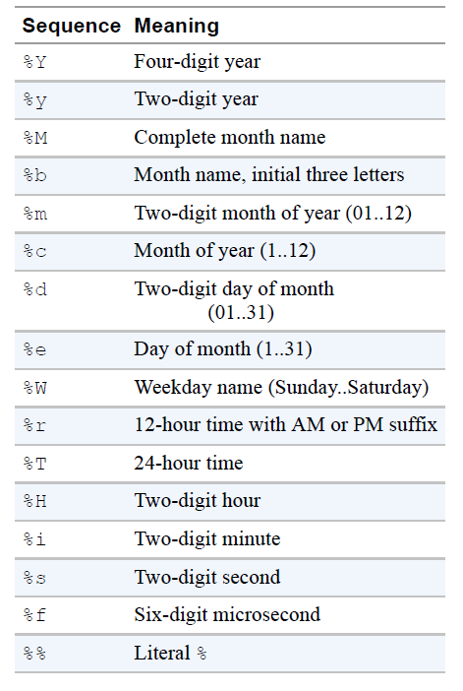
The MySQL Reference Manual provides a complete list of format sequences to use with DATE_FORMAT(), TIME_FORMAT(), and STR_TO_DATE().
Table 2 shows some of them.

Slide 18
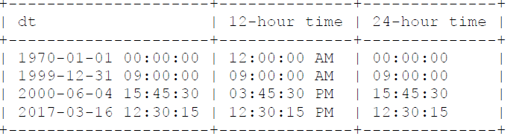
TIME_FORMAT() is similar to DATE_FORMAT().
It works with TIME, DATETIME, or TIMESTAMP values
but understands only time-related specifiers in the format string:
mysql> SELECT dt,
-> TIME_FORMAT(dt, '%r') AS '12-hour time',
-> TIME_FORMAT(dt, '%T') AS '24-hour time'
-> FROM datetime_val;

Slide 19
4 Setting the Client Time Zone
Problem
You have a client application that connects from a time zone different from the server.
Consequently, when it stores TIMESTAMP values, they don’t have the correct Coordinated Universal Time (UTC) values.
Solution
The client should set the time_zone system variable after connecting to the server.
5 Setting the Server Time Zone
Problem
You have a localized application to serve customers, but you want to have a global time zone setting.
Solution
The server should set the time_zone system variable to SYSTEM at the server.
This setting should point to UTC value.
Accordingly, the system_time_zone value should be set to UTC.
6 Shifting Temporal Values Between Time Zones
Problem
You have a date-and-time value but need to know what it would be in a different time zone. For example, you’re having a teleconference with people in different parts of the world, and they need to know the meeting time in their local time zones.
Solution
Use the CONVERT_TZ() function

Slide 20
7 Extracting Parts of Dates or Times
Problem
You want to obtain just a part of a date or a time.
Solution
Invoke a function specifically intended for extracting part of a temporal value, such as MONTH() or MINUTE().
This is usually the fastest method for component extraction if you need only a single component of a value.
Alternatively, use a formatting function such as DATE_FORMAT() or TIME_FORMAT() with a format string that includes a specifier for the part of the value you want to obtain.
Functions: YEAR(), MONTH(), DAY(), HOUR(), MINUTE(), SECOND()
Example: SELECT YEAR('2023-05-15'), HOUR('12:45:00');
Explanation: Extracts the year from a date and the hour from a time.
Using DATE_FORMAT and TIME_FORMAT
Example: SELECT DATE_FORMAT('2023-05-15', '%Y-%m-%d'), TIME_FORMAT('12:45:00', '%H:%i:%s');
Explanation: Formats the date and time according to specified patterns.
Extracting Using EXTRACT Function
Example: SELECT EXTRACT(YEAR FROM '2023-05-15'), EXTRACT(HOUR FROM '12:45:00');
Explanation: Directly extracts the year from a date and the hour from a time component.

Slide 21
Specialized Date Functions
Examples:
DAYNAME(): Returns the name of the weekday.
DAYOFYEAR(): Returns the day number of the year.
Example:
SELECT DAYNAME('2023-05-15'), DAYOFYEAR('2023-05-15');
Explanation: Retrieves the name of the weekday and the day number of the year for the specified date.
Combining Date and Time Components
Example:
SELECT CONCAT(EXTRACT(YEAR FROM '2023-05-15'), '-', EXTRACT(MONTH FROM '2023-05-15'), '-01');
Explanation: Constructs a new date string by combining extracted year and month components, specifically setting the day to the first of the month.

Slide 22
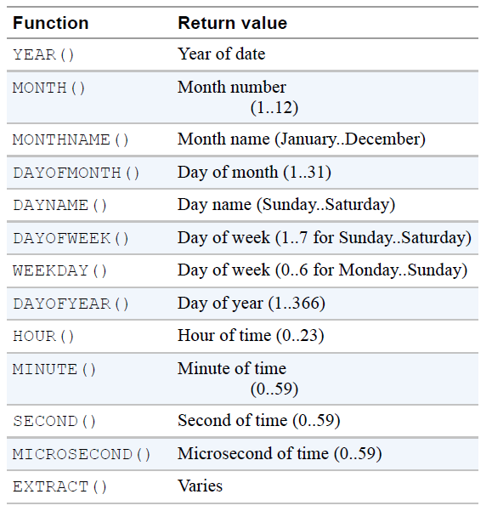
Table shows several component-extraction functions; consult the MySQL Reference Manual for a complete list. The date-related functions work with DATE, DATETIME, or TIMESTAMP values.
The time-related functions work with TIME, DATETIME, or TIMESTAMP values.

Slide 23

8 Synthesizing Dates or Times from
Component Values
Problem
You want to combine the parts of a date or time to produce a complete date or time value. Or you want to replace parts of a date to produce another date.
Solution
You have several options:
Use MAKETIME() to construct a TIME value from hour, minute, and second parts.
Use DATE_FORMAT() or TIME_FORMAT() to combine parts of the existing value with parts you want to replace.
Pull out the parts that you need with component-extraction functions and recombine the parts with CONCAT().

Slide 24

Creating Dates from Year, Month, and Day
SELECT CONCAT(YEAR('2023-05-15'), '-', LPAD(MONTH('2023-05-15'), 2, '0'), '-01');
Explanation: Constructs a date representing the first day of the month for a given date, ensuring the month part is two digits.
Use Case: Useful when you need to generate monthly report start dates from existing dates.
Standardizing Dates to ISO Format
SELECT DATE_FORMAT(CONCAT(YEAR('2023-05-15'), '-', MONTH('2023-05-15'), '-01'), '%Y-%m-%d') AS iso_date;
Explanation: Converts a synthesized date string into a standardized ISO format.
Use Case: Ensuring date formats are consistent for storage or comparison purposes.
Combining Year, Month, Day to Form a Date
SELECT MAKEDATE(2023, 1) + INTERVAL (15-1) DAY;
Explanation: Generates a specific date ('2023-01-15') by starting from the first day of the year and adding the necessary days.
Use Case: Useful in scenarios where you have year and day-of-year data that need to be converted into standard dates.

Slide 25
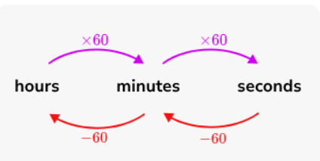
9 Converting Between Temporal Values and Basic Units
Problem
You want to convert a temporal value such as a time or date to basic units such as seconds or days. This is often useful or necessary for performing temporal arithmetic operations.
Solution
The conversion method depends on the type of value to be converted:
To convert between time values and seconds, use the TIME_TO_SEC() and SEC_TO_TIME() functions.
To convert between date values and days, use the TO_DAYS() and FROM_DAYS() functions.
To convert between date-and-time values and seconds, use the
UNIX_TIMESTAMP() and FROM_UNIXTIME() functions.

Slide 26
Conversion Between Time Values and Seconds
Functions: TIME_TO_SEC() and SEC_TO_TIME()
Example:
Convert time to seconds: SELECT TIME_TO_SEC('15:00:00') AS seconds;
Convert seconds back to time: SELECT SEC_TO_TIME(54000) AS time;
Explanation:
TIME_TO_SEC() converts a TIME value to the equivalent number of seconds.
SEC_TO_TIME() converts seconds back into a TIME format.
Use Case: Useful for calculations involving durations or comparisons between times.
Conversion Between Date Values and Days
Functions: TO_DAYS() and FROM_DAYS()
Example:
Convert date to days: SELECT TO_DAYS('2023-01-01') AS days_since_year_zero;
Convert days back to date: SELECT FROM_DAYS(738061) AS date;
Explanation:
TO_DAYS() converts a date to the number of days since year zero.
FROM_DAYS() converts the number of days back to a date.
Use Case: Useful for calculations over long periods, like historical data analysis.

Slide 27
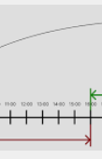
10 Calculating Intervals Between Dates or Times
Problem
You want to know how long it is between two dates or times, that is, the interval between them.
Solution
To calculate an interval, use one of the temporal-difference functions, or convert your values to basic units and take the difference.
The permitted functions depend on the types of the values for which you want to know the interval.

Slide 28
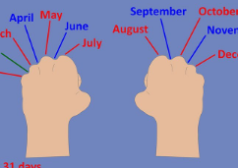
DATEDIFF
SELECT DATEDIFF('2023-12-31', '2023-01-01') AS days_between;
Explanation: Calculates the number of days between two dates.
Use Case: Useful for calculating age in days, or days until an event.
TIMEDIFF
SELECT TIMEDIFF('23:00:00', '08:00:00') AS time_diff;
Explanation: Calculates the difference between two times within a day.
Use Case: Ideal for calculating the duration of events that occur within a single day.
TIMESTAMPDIFF
SELECT TIMESTAMPDIFF(MONTH, '2023-01-01', '2023-12-31') AS months_between;
Explanation: Calculates the difference between two timestamps in various units (seconds, minutes, hours, days, weeks, months, or years).
Use Case: Versatile for tasks like calculating the number of months until a project deadline or years between dates.

Slide 29

11 Adding Date or Time Values
Problem
You want to add temporal values. For example, you want to add a given number of seconds to a time or determine what the date will be three weeks from today.
Solution
To add date or time values, you have several options:
Use one of the temporal-addition functions.
Use the + INTERVAL or - INTERVAL operator.
Convert the values to basic units, and take the sum.
The applicable functions or operators depend on the types of the values.

Slide 30
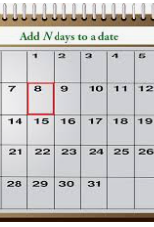
Adding Days to a Date
SELECT DATE_ADD('2023-01-01', INTERVAL 5 DAY);
Explanation: Adds 5 days to the specified date, resulting in '2023-01-06'.
Use Case: Useful for calculating due dates or deadlines that are a specific number of days from a given date.
Adding Months to a Date
SELECT DATE_ADD('2023-01-01', INTERVAL 3 MONTH);
Explanation: Adds 3 months to the date, adjusting the day part if necessary (e.g., January 1 plus 3 months equals April 1).
Use Case: Important for financial calculations like credit terms or service periods extending over months.
Adding Hours to a Time
SELECT ADDTIME('08:00:00', '3:00');
Explanation: Adds 3 hours to a time, resulting in '11:00:00'.
Use Case: Useful for scheduling and managing time-specific events in applications.
Using INTERVAL with Different Units
SELECT DATE_ADD('2023-01-01 14:00:00', INTERVAL '2:30' HOUR_MINUTE);
Explanation: Adds 2 hours and 30 minutes to the datetime value.
Use Case: Handy for more complex scheduling tasks that require precise time management over the course of a day.

Slide 31
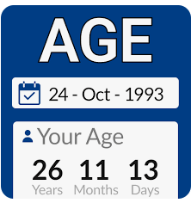
12 Calculating Ages
Problem
You want to know how old someone is.
Solution
This is a date-arithmetic problem.
It amounts to computing the interval between dates but with a twist.
For an age in years, it’s necessary to account for the relative placement of the start and end dates within the calendar year.
For an age in months, it’s also necessary to account for the placement of the months and the days within the month.

Slide 32
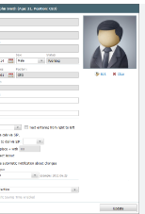
Using TIMESTAMPDIFF
SELECT TIMESTAMPDIFF(YEAR, birthdate, CURDATE()) AS age FROM profiles WHERE id = 1;
Explanation: Calculates the age by finding the difference in years between the stored birthdate and the current date.
Use Case: Ideal for calculating current age for user profiles or age-specific data analysis.
Date and Conditional Logic
SELECT YEAR(CURDATE()) - YEAR(birthdate) - (RIGHT(CURDATE(), 5) < RIGHT(birthdate, 5)) AS age FROM profiles WHERE id = 1;
Explanation: This method adjusts for whether the current month and day are before the birth month and day to ensure accurate age calculation.
Use Case: Useful when exact age calculation is critical, such as for legal or age verification processes.

Slide 33

13 Finding the First Day, Last Day, or
Length of a Month
Problem
Given a date, you want to determine the date for the first or last day of the month in which the date occurs, or the first or last day for the month n months away.
A related problem is to determine the number of days in a month.
Solution
To determine the date for the first day in a month, use date shifting (an application of date arithmetic). To determine the date for the last day, use the LAST_DAY()
function.
To determine the number of days in a month, find the date for its last day and use it as the argument to DAYOFMONTH().

Slide 34

Finding the First Day of a Month
SELECT LAST_DAY('2023-05-15') - INTERVAL DAY(LAST_DAY('2023-05-15'))-1 DAY;
Explanation: Determines the first day of the month for a given date by subtracting the number of days in the month minus one day from the last day of the month.
Use Case: Useful for generating reports or calculating monthly cycles starting from the first day.
Finding the Last Day of a Month
SELECT LAST_DAY('2023-05-15');
Explanation: Returns the last day of the month that contains the specified date.
Use Case: Essential for end-of-month financial calculations, such as accruals or credit terms.
Calculating the Length of a Month
SELECT DAY(LAST_DAY('2023-05-15'));
Explanation: Calculates the number of days in the month by retrieving the day component of the last day of the month.
Use Case: Helpful for dynamic billing systems or services where charges are based on the number of days in a month.

Slide 35
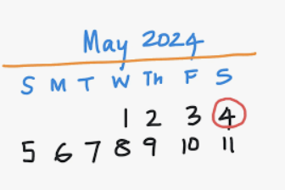
14 Finding the Day of the Week for a Date
Problem
You want to know the day of the week on which a date falls.
Solution
Use the DAYNAME() function.
Function: DAYNAME()
SELECT DAYNAME('2023-10-15') AS weekday;
Explanation: Returns the name of the day for the given date. For '2023-10-15', it would return 'Sunday'.
Use Case: Essential for generating reports that summarize activities by the day of the week, planning weekly tasks, or setting schedules based on specific weekdays

Slide 36

15 Selecting Rows Based on Temporal Characteristics
Problem
You want to select rows based on temporal conditions.
Solution
Use a date or time condition in the WHERE clause. This
may be based on direct comparison of column values with known values. Or it may be necessary to apply a function to column values to convert them to a more appropriate form for testing, such as using MONTH() to test the month part of a date.

Slide 37

Using DATE and TIME Functions for Filtering
SELECT * FROM events WHERE DATE(event_date) = '2023-01-01';
Explanation: Selects all events occurring on January 1, 2023. The DATE() function extracts the date part of a datetime expression.
Use Case: Useful for extracting entries for specific dates from a dataset that includes datetime values.
Temporal Range Queries
SELECT * FROM log_entries WHERE time_stamp BETWEEN '2023-01-01' AND '2023-01-31';
Explanation: Retrieves all log entries with timestamps in January 2023.
Use Case: Ideal for generating reports or analyses over specific periods, such as monthly or yearly reviews.
Using Temporal Data in JOIN Conditions
SELECT a.*, b.* FROM table_a a JOIN table_b b ON DATE(a.created_at) = DATE(b.created_at);
Explanation: Joins two tables based on the date part of their respective datetime columns.
Use Case: Synchronizing data from different tables that were logged on the same dates, useful in correlating events or activities logged separately.
Filtering by Time Components
SELECT * FROM transactions WHERE HOUR(transaction_time) BETWEEN 9 AND 17;
Explanation: Selects all transactions that occurred between 9 AM and 5 PM.
Use Case: Useful for businesses analyzing transactions during regular working hours.
Advanced Date Calculations
SELECT * FROM posts WHERE DATEDIFF(NOW(), post_date) <= 30;
Explanation: Selects all posts made within the last 30 days.
Use Case: This approach is handy for applications like dashboards or content management systems where recent activity is prioritized.

Slide 38
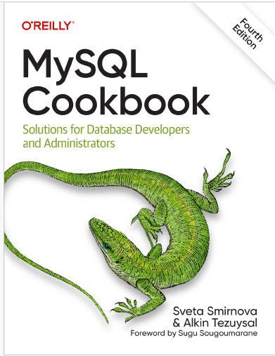

SOURCES

