Slide 1
AI-assisted Coding with Codeium
Presenters: Giulia Crocioni, Netherlands eScience center
Olga Minaeva, NWO-I

Slide 2
Workshop agenda
Introduction to AI in coding (30 min)
Codeium and VS Code setup (15 min)
Lunch break (60 min)
Code generation and optimization (75 min)
Command function and practical exercises
Chat function and practical exercises
Autocomplete function and practical exercises
Coffee break (15 min)
Ethical and security considerations (20 min)
Wrapping up and Q&A (10 min)

Slide 3



Main objectives:
Familiarize with the concept of AI coding assistants, available tools, and capabilities
Learn to generate code and optimize its performance using an AI coding assistant
Recognize, evaluate, and mitigate ethical and security considerations when using AI coding assistant

Slide 4
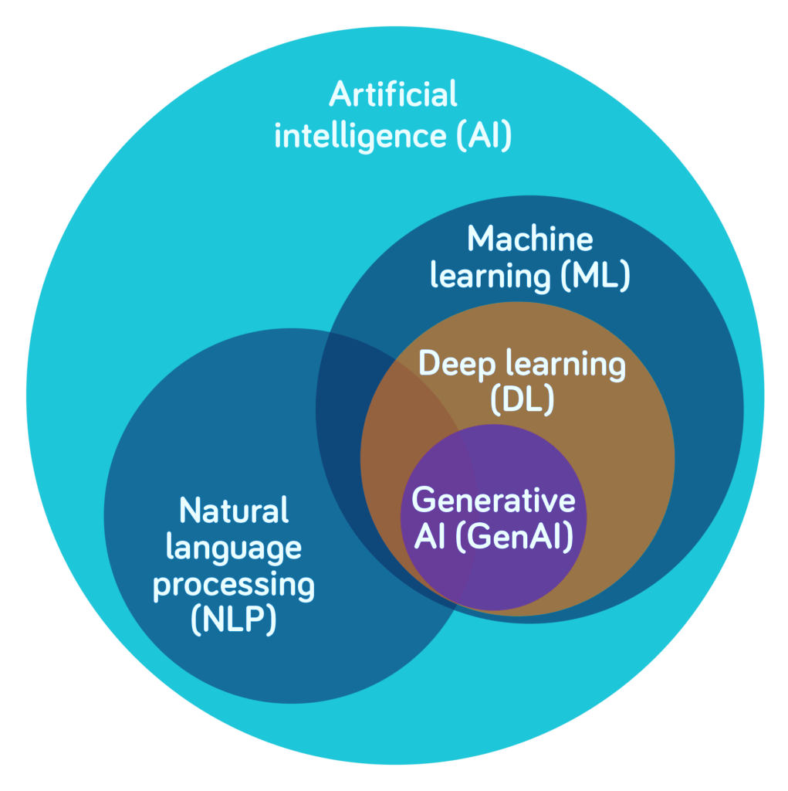
AI is a set of technologies that can reason and learn to solve problems or perform tasks that traditionally require human intelligence
ML uses algorithms trained on data to predict outcomes and perform specific tasks
DL, a subfield of ML, uses artificial neural networks to mimic the human brain
GenAI uses DL models to generate text, images, video or other media that mimic human-generated content
NLP enables computers to understand spoken and written language

Slide 5

AI coding assistants rely on ML techniques (deep learning and NLP)
Trained on public code and documentation to understand patterns, syntax, and code logic
Data collection
Gathering a large amount of code, documentation, and natural language conversations to train the Al model on.
Model architecture design
Designing the neural network architecture that will power the AI code assistant.
Pre-training the Al model on the collected data to develop a general understanding of code, programming concepts, and natural language.
Fine-tuning
Evaluation and iteration
Pre-training
Further training the pre-trained model on specific datasets and tasks related to code generation, code completion, and natural language programming.
Testing the AI code assistant on a variety of use cases, then iterating on the model architecture and training process to improve performance.
Note. AI coder might be fine-tuned from a foundation model instead of trained from scratch

Slide 6
AI coding assistants rely on ML techniques (deep learning and NLP)
Trained on public code and documentation to understand patterns, syntax, and code logic
Context awareness to suggest relevant code
NLP to interpret natural language
Learning from user interaction
Code generation and refactoring
Multilanguage support

Slide 7
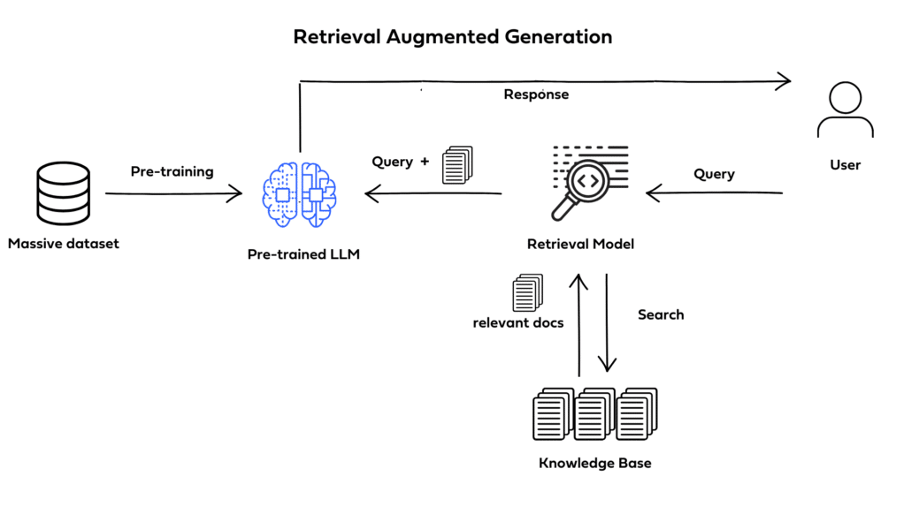
Context Awareness - Retrieval-Augmented-Generation
Augments LLMs with external knowledge
→ more factual consistency, improves reliability, and prevents "hallucination"
Useful in domain-specific applications
RAG can be fine-tuned without retraining of the entire model
Notes:
Augments LLMs with external knowledge such as databases.
→ more factual consistency, improves reliability of the generated responses, and helps to prevent "hallucination"
Particularly useful in domain-specific applications that require knowledge that's continually updating.
RAG can be fine-tuned and its internal knowledge can be modified without retraining of the entire model

Slide 8
Areas of application
Intelligent code completion
Reducing the time spent on routine typing tasks
Real-time error detection
Allows to fix issues before execution, enhancing code reliability
Code refactoring suggestions
Analyze existing code and propose optimizations
Automated documentation generation
Can generate documentation snippets based on the code, reducing manual effort
Code and error explanation
Collaboration enhancement
Version control integration and shared code analysis promote teamwork
Can explain code functions or errors in code and help fix them
Notes:
Intelligent Code Completion:
Al-powered code editors offer advanced suggestions to complete code snippets, reducing the time developers spend on routine typing tasks.
Context-aware completions improve accuracy by considering variable names, function calls, and relevant syntax patterns.
2. Real-time Error Detection:
Immediate identification of syntax errors and potential bugs allows developers to rectify issues before execution, enhancing code reliability.
3. Code Refactoring Suggestions:
Al algorithms analyze existing code and propose optimizations, suggesting improvements in terms of readability, efficiency, and adherence to coding standards.
Automated refactoring assists developers in maintaining clean and maintainable codebases.
4. Automated Documentation Generation:
Al-powered code editors can generate documentation snippets based on the code, reducing the manual effort required for documentation.
Ensures that code changes are consistently documented, promoting better collaboration and knowledge sharing.
5. Collaboration Enhancement:
Features such as version control integration and shared code analysis promote seamless teamwork.

Slide 9
Small-scale Tasks - Simple Automation, with a focus on accelerating individual coding steps.
Mid-scale Tasks - Intelligent Code Synthesis, indicating a stronger understanding of context.
Large-scale Tasks - Modular Development, showing how AI helps manage and integrate project components.
Future Capabilities - Project-Level Insights, suggesting strategic capabilities in project architecture and planning.
Code autocompletions, syntax suggestions, code snippets, and basic refactoring.
Larger code generation (e.g., function or class templates), testing code, debugging assistance, and minor performance optimizations.
Context-aware refactoring, multi-component code generation (e.g., module or API structures), advanced debugging, and performance tuning.
Encompassing full project scaffolding, contextually-aware adjustments across codebases, and strategic project optimizations.

Slide 10

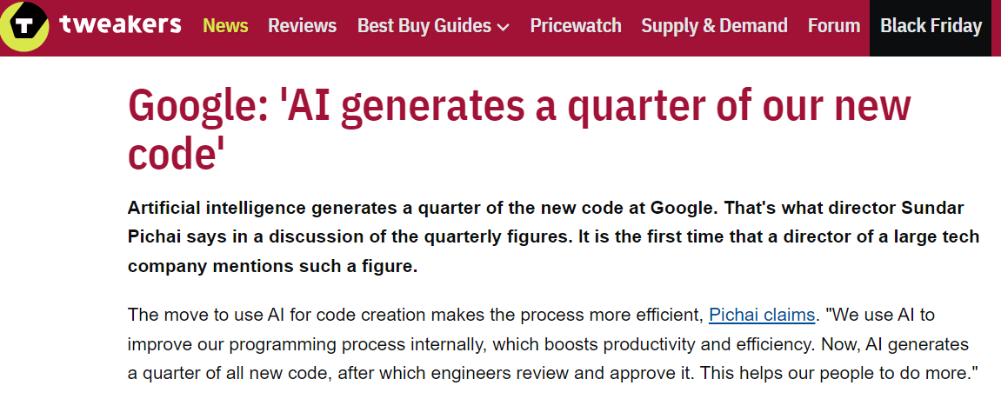
https://tweakers.net/nieuws/228140/google-ai-genereert-kwart-van-onze-nieuwe-code.html

Slide 11
Challenges
Balancing accuracy and speed
Adaptability to different coding styles
Ensuring user privacy and security
Limited context awareness
Unclear Al behavior
Notes:
1. Balancing Accuracy and Speed:
Striking a balance between providing accurate suggestions and maintaining a responsive user interface is a key challenge.
3. Adaptability to Different Coding Styles:
A. Developers often have varied coding styles and preferences. Al-powered code editors need to adapt to these differences to provide personalized and effective assistance.
4. Ensuring User Privacy and Security:
A. Handling sensitive code and ensuring the privacy of proprietary algorithms pose significant challenges.
5. Limited Context Awareness:
B. Inability to understand the intent and purpose behind code can result in irrelevant or unhelpful completions.
3. Opaque Al Behavior:
A. Many editors lack transparency in how Al works, leaving developers unsure of the rationale behind suggestions or potential biases in the models.
B. This lack of explainability can hinder trust and acceptance of Al assistance.

Slide 12






 | GitHub Copilot | Codeium | Amazon Q Developer | Tabnine | Hugging Chat | Cline
Key Features | Integration with GitHub ecosystem Code completion and context-aware suggestions Multiline functionality | Advanced code completions Code refactoring capabilities Chat, Command, and Autocomplete function | Code recommendations Security scans for vulnerabilities | Robust autocompletion AI-powered chat using multiple models | Open-source model integration High flexibility in deployment | Terminal integration for executing commands Browser interaction for debugging and testing
Supported languages | ~40 (primarily Python, Ruby, JS, C#) | 70+ languages, including Python, R, Ruby, HTML, Java, C#, SQL | 18+ languages, including Python, Java, JS, C# | 25+ languages | Various languages, including Python and Java | Various programming languages
Security | Processes code snippets locally, code remains private and secure | Never train generative model on private code | Doesn't use customer content for service improvement | Never train generative model on private code | Private repositories, access tokens, commit signatures, malware scanning | Human-in-the-loop approach
Pricing | Both free and paid versions | Both free and paid versions | Both free and paid versions | Both free and paid versions | Both free and paid versions | Free, open-source

Slide 13
Using Codeium as a Coding Assistant
Command
Autocomplete
Chat
Notes:
Command: With Command, you can tell Codeium what changes you want to make to your code in plain language. Codeium will then suggest the changes, which you can choose to accept, reject, or adjust as needed.
Chat: This feature allows you to ask questions and get answers using simple, everyday language. You can access Chat from the side panel in your coding tool. It’s great for when you’re working with new or unfamiliar code and need quick guidance or explanations.
Autocomplete: This feature is always working in the background of your coding tool (IDE). It gives suggestions as you type, shown in light gray text. Autocomplete is most helpful when you already have a rough idea of what you want to code and just need to finish it quickly. It helps you stay focused and keeps your work flowing smoothly.

Slide 14

Break

