Slide 1

Introducing html
Full stack Skills Bootcamp

Slide 2
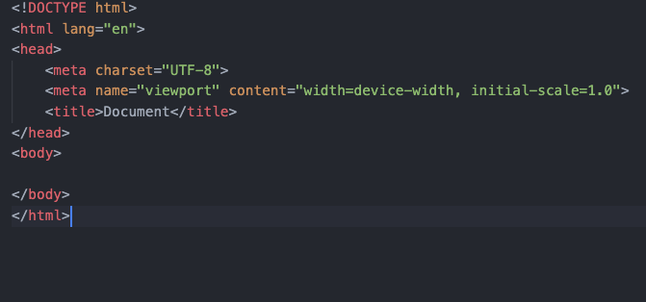
Introduction to the Terminal, GitHub, and VSCode
Lesson Overview:
In this lesson, we will learn how to create our first web page using VSCode, understand the differences between the <head> and <body> sections, and explore basic HTML elements and attributes. The lesson will also introduce semantic HTML and HTML forms, with practical examples using the Live Server extension in VSCode for real-time previewing.

Slide 3
Creating OUR First Web Page in VSCode
Learning Objective: We will create our first HTML file in VSCode and learn about the common markup tags

Slide 4
Setting Up VSCode
Introduction to Visual Studio Code (VSCode) as a code editor.
Key features: IntelliSense, built-in terminal, extensions (like Live Server), and ease of use.

Slide 5
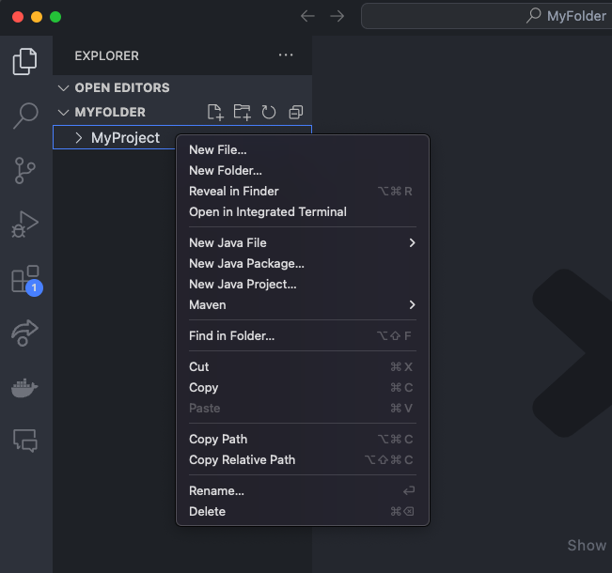
Creating a New HTML File
Steps to create a new HTML file:
Open VSCode.
Create a new folder for your project (use the terminal or file explorer).
Inside the folder, create a new file: index.html.
Command: Right-click on the folder > New File > name it index.html.

Slide 6
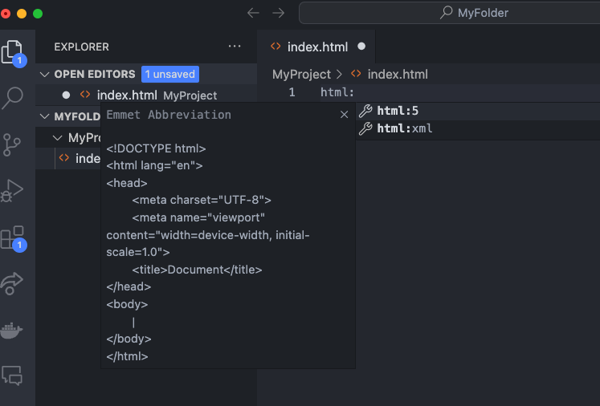
Using the HTML:5 Shortcut
Steps to use the html:5 shortcut: In the index.htm file, type html:5 and press Tab or Enter.
This will automatically generate the basic structure of an HTML document.

Slide 7
Understanding the <head> and <body> Sections
Learning Objective: Students will learn the roles of the <head> and <body> sections in an HTML document.

Slide 8
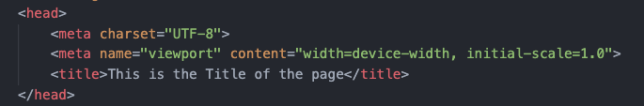
The <head> Section
The <head> element contains metadata and links to resources like CSS and JavaScript files.
Key elements in the <head>:
<title>: Sets the title of the webpage (what appears in the browser tab).
<meta>: Provides metadata about the webpage (e.g., charset, description).
<link>: Links to external resources like stylesheets.
<script>: Links or embeds JavaScript.
Note: Elements in the <head> do not appear visually on the webpage.

Slide 9

The <body> Section
The <body> contains the visible content of the webpage (headings, paragraphs, images, etc.).
Key point: Everything that is displayed in the browser window goes in the <body> section.

Slide 10
Previewing the Page Using the Live Server
Learning Objective: We will install and use the Live Server extension in VSCode to preview their HTML file in real-time.

Slide 11
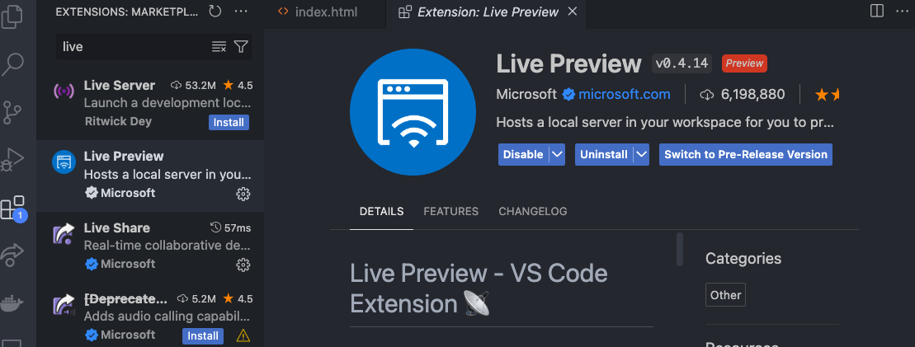
Installing the Live Preview Extension
Live Preview allows real-time reloading of the webpage as students make changes. Steps to install Live Preview :
Go to the Extensions tab in VSCode.
Search for "Live Preview".
Click "Install".

Slide 12
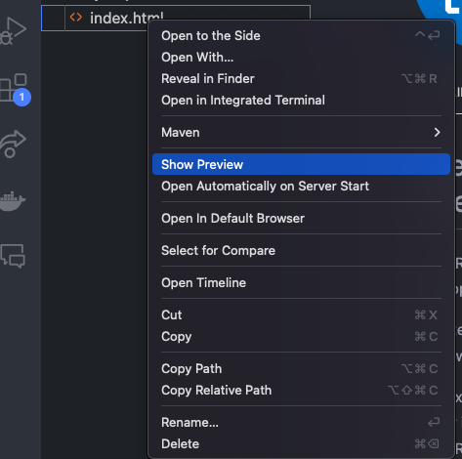
Previewing Your Web Page
How to launch Live Preview: Right-click on the index.html file.
Select ”Show Preview".
The browser will open the webpage, and any changes saved in VSCode will automatically refresh.

Slide 13
Basic HTML Elements and Attributes
Learning Objective: Students will learn the structure and usage of basic HTML elements and attributes to build simple content.

Slide 14
Basic HTML Elements
Headings:<h1>: Main heading, <h2>, <h3>, etc. for subheadings.
Example: <h1>This is the main heading</h1>
Paragraphs:<p>: Defines a block of text.
Example: <p>This is a paragraph of text.</p>
Divisions:<div>: A block-level container for other content.
Example: <div>Some content inside a div</div>
Span:<span>: An inline container for text or other elements.
Example: <span>Inline text</span>

Slide 15
Links and Images
Anchor (<a>): Creates hyperlinks. Example: <a href="https://www.example.com">Visit Example</a>
Image (<img>): Displays images. Example: <img src="image.jpg" alt="An image">
Attributes: src (source), alt (alternative text for accessibility).

Slide 16

Attributes in HTML
Attributes provide additional information about an element (e.g., href for <a>, src for <img>, class and id for styling).

Slide 17
What is Semantic HTML?
Semantic HTML uses meaningful tags to structure content (e.g., <header>, <nav>, <section>, <article>, <footer>).
Key Point: Semantic tags improve accessibility, SEO, and readability for both developers and browsers.

Slide 18
Key Semantic HTML Elements
<header>: Defines a header for a document or section.
<nav>: Contains navigation links.
<section>: Defines a section of content.
<article>: Represents independent, self-contained content.
<footer>: Defines a footer for a document or section.

Slide 19
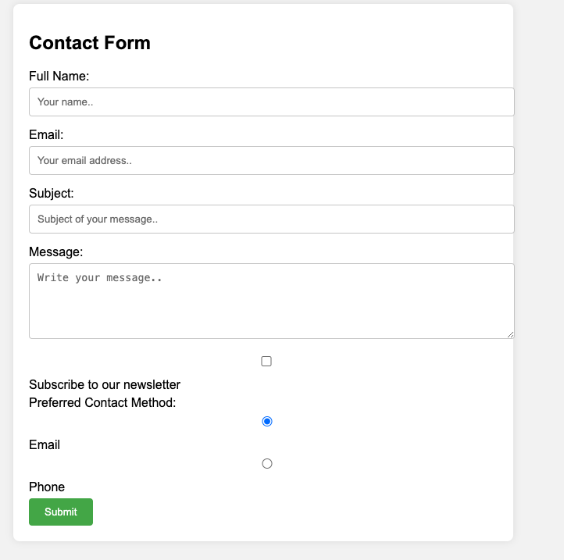
Introduction to Forms
Forms allow users to input data and send it to a server.
Key elements in a form:<form>: The container for the form.
<input>: Collects user data.
<label>: Provides a label for form elements.
<button>: Submits the form.

Slide 20
Common Input Elements
Text input: <input type="text">
Password input: <input type="password">
Email input: <input type="email">
Submit button: <input type="submit">
Radio buttons: <input type="radio">
Checkbox: <input type="checkbox">

Slide 21
Recap
Creating and structuring HTML files.
Using the <head> and <body> sections.
Previewing the page with Live Preview.
Basic HTML elements and attributes.
Semantic HTML.
Forms and input elements.
W3Schools HTML Guide: https://www.w3schools.com/html/
MDN Web Docs: HTML: https://developer.mozilla.org/en-US/docs/Web/HTML

Slide 22
Questions?

