Slide 1

Advanced CSS Elements
Full stack Skills Bootcamp

Slide 2
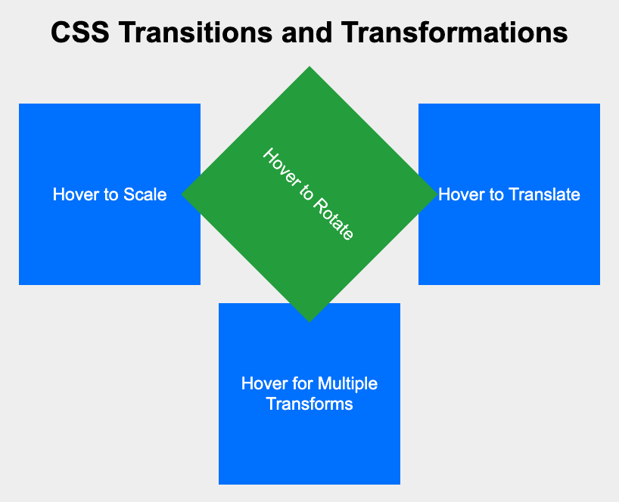
Advanced CSS Elements
Lesson Overview:
In this lesson, we will be introduced to:
CSS position: Absolute, Fixed, Sticky, and Relative
Pseudo Elements
Pseudo Classes
Simple CSS Transitions and Transformations

Slide 3
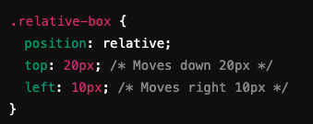
CSS position
Definition: CSS position defines how an element is placed in relation to its normal document flow and its surrounding elements. position: relative Positions the element relative to its original (normal) position. Moves the element without affecting the layout of other elements.

Slide 4
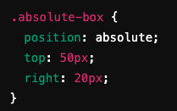
position: absolute
position: absolute The element is positioned relative to its nearest positioned ancestor (other than static).
Removes the element from the normal document flow. In this example, the box will be placed 50px from the top and 20px from the right of its container.

Slide 5
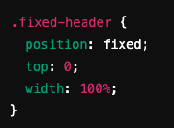
position: fixed
position: fixed Positioned relative to the browser window.
Remains in the same position even when scrolling.
Useful for sticky navigation bars or fixed headers.

Slide 6
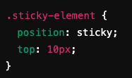
position: sticky
position: sticky Hybrid between relative and fixed positioning.
Element "sticks" to a defined position when scrolling until its containing block scrolls out of view.
Stays 10px from the top of the viewport when scrolling.
Example…

Slide 7
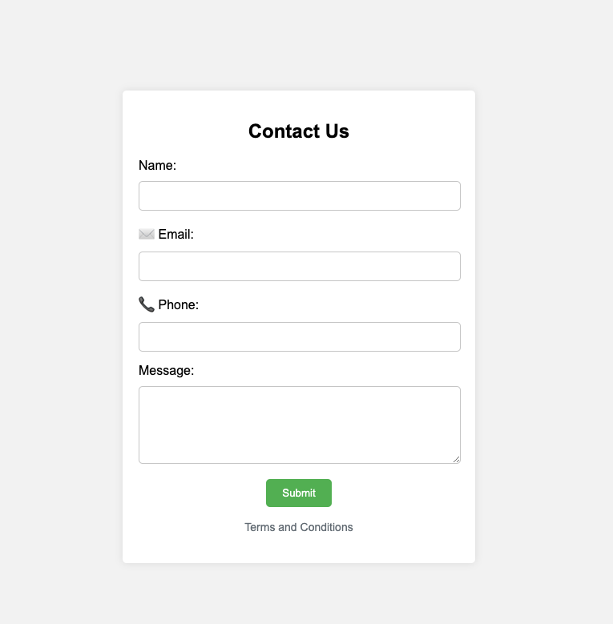
Pseudo Elements
Why use pseudo elements?
Decorative elements without adding extra HTML.
Create complex layouts and styles with minimal code.
Example: Adding icons, quotes, or shapes with ::before and ::after.

Slide 8

Pseudo Classes
Pseudo classes target elements based on their state, position, or interaction with the user.
For example:
:hover: Styles an element when the user hovers over it. :focus: Styles an element when it has keyboard or mouse focus. :nth-child(n): Targets the nth child of a parent element.
This example changes the button background when hovered. Example…

Slide 9

Advanced Pseudo Classes
:first-child: Targets the first child of a parent element.
:last-child: Targets the last child of a parent.
:not(selector): Selects all elements that do not match the given selector.
This example selects all <p> elements that don’t have the highlight class.

Slide 10
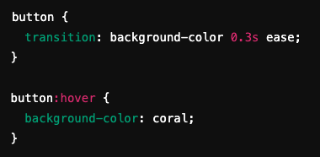
CSS Transitions
CSS transitions allow smooth changes between styles when an element’s state changes. With this example; when hovered, the button smoothly transitions to the new background color over 0.3 seconds.

Slide 11
CSS Transition Properties
transition-property: The CSS property to animate (e.g., background-color).
transition-duration: How long the transition lasts (e.g., 0.3s).
transition-timing-function: The speed curve (ease, linear, etc.).
transition-delay: Delay before the transition starts.

Slide 12

CSS Transformations
CSS transform allows you to move, rotate, scale, and skew elements. In this example, the element grows 20% larger when hovered.

Slide 13
Common Transform Functions
scale(n): Enlarges or shrinks the element.
rotate(deg): Rotates the element by a specified degree.
translate(x, y): Moves the element along the X and Y axis.
skew(x, y): Skews the element along the X and Y axis.

Slide 14
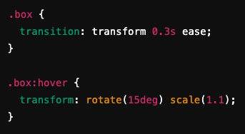
Combining Transitions and Transforms
You can combine transitions with transforms for smooth animations. In this example, the element rotates and scales when hovered, and the transition makes it smooth.

Slide 15
Recap
CSS Positioning: Control where elements appear in relation to others.
Pseudo Elements and Classes: Style elements dynamically based on state or parts of the element.
Transitions and Transformations: Create smooth animations and dynamic effects with minimal effort.
MDN Web Docs – CSS Box Model: https://developer.mozilla.org/en-US/docs/Web/CSS/position
CSS-Tricks – CSS Box Model: https://developer.mozilla.org/en-US/docs/Web/CSS/Pseudo-elements

Slide 16
Recap
Border Styling
We explored different ways to style borders in CSS. Key properties include:
border-width: Sets the thickness of the border.
border-style: Defines the type of border (e.g., solid, dashed, dotted).
border-color: Sets the color of the border.
MDN Web Docs – Border Styling: https://developer.mozilla.org/en-US/docs/Web/CSS/border-style CSS-Tricks – Border Styling: https://css-tricks.com/almanac/properties/b/border/

Slide 17
Recap
CSS Variables
CSS Variables, also known as custom properties, allow you to define reusable values in your stylesheets.
This helps maintain consistency and makes future changes easier.
MDN Web Docs – position: https://developer.mozilla.org/en-US/docs/Web/CSS/Using_CSS_custom_properties
MDN – Pseudo-elements: https://css-tricks.com/a-complete-guide-to-custom-properties/
CSS tricks – Animation https://css-tricks.com/almanac/properties/a/animation/

Slide 18
Questions?

