Slide 1

Flexbox and Git Collaboration
Full stack Skills Bootcamp

Slide 2
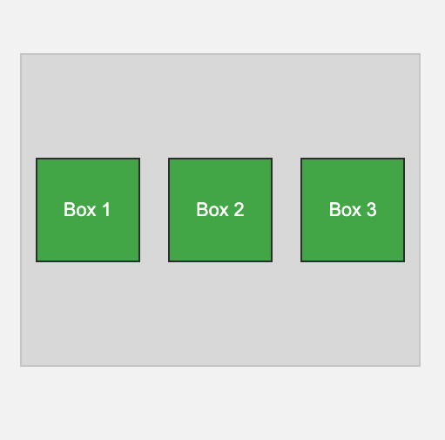
Flexbox and Git Collaboration
Lesson Overview:
In this lesson, we will be introduced to:
Wireframing and layout planning using Microsoft Excel or Google Sheets.
Flexbox fundamentals: display: flex, flex-direction, and flex-wrap.
Flexbox alignment: justify-content, align-items, and understanding the flex axis.
Git collaboration using branches and pull requests.

Slide 3
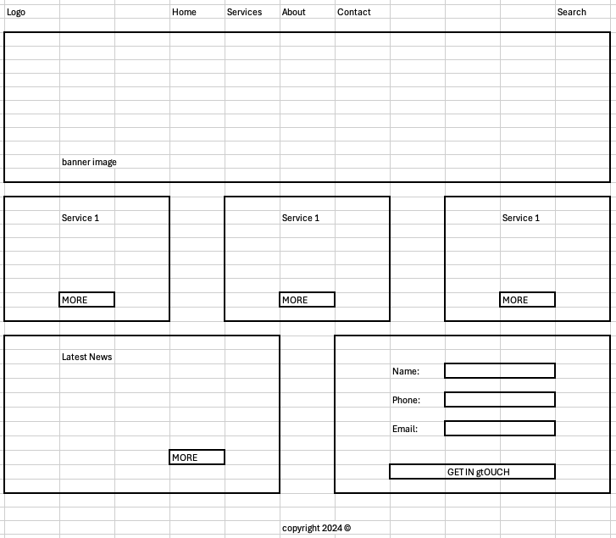
Wireframing and Layout Planning
Definition: Wireframing is an essential step in designing the structure of your website before diving into code.
This gives you a visual blueprint of where elements will be placed and how they will be grouped.

Slide 4
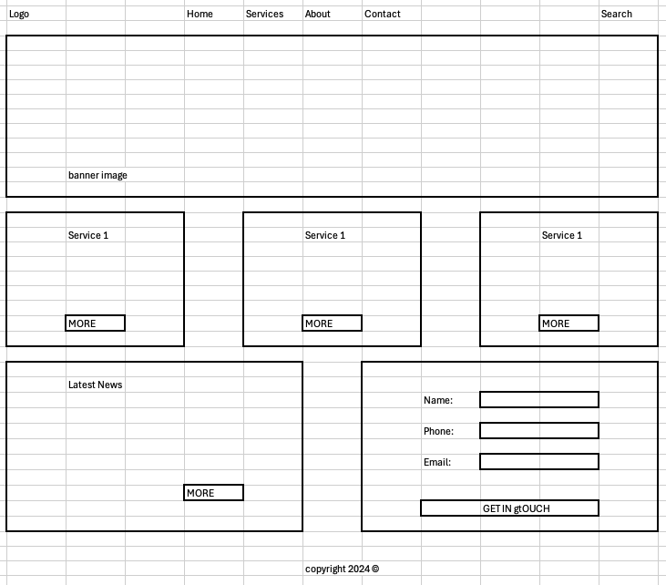
Tools for Wireframing
Why use tools like Microsoft Excel or Google Sheets?
Simple, grid-based layout planning.
Easy to modify and collaborate on.
Quick to set up without learning new design software. Example: Create a 3x3 grid to represent the website structure. Plan for a header, content sections, and footer. Demo…

Slide 5
Flexbox Basics
Flexbox is a powerful tool for creating responsive layouts.
It allows you to align elements dynamically across different screen sizes.

Slide 6

display: flex
display: flex display: flex turns a container into a Flexbox container.
This affects how its child elements are laid out.
Items inside .container will now follow Flexbox rules for alignment and positioning.

Slide 7
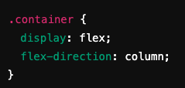
flex-direction
flex-direction: defines the direction in which the flex items are placed in the flex container.
row (default): Horizontal layout.
column: Vertical layout.
row-reverse: Reverses the order of items horizontally.
column-reverse: Reverses the order of items vertically.
Example:

Slide 8
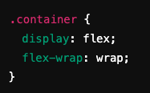
flex-wrap
By default, Flexbox tries to fit items on a single line. flex-wrap allows items to wrap onto multiple lines.
nowrap: All items stay on one line.
wrap: Items will wrap to the next line if they overflow.
wrap-reverse: Items wrap in reverse order. Demo…

Slide 9
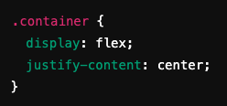
Flexbox Alignment
justify-content aligns flex items along the main axis (horizontal if flex-direction: row, vertical if flex-direction: column).
flex-start: Align items to the start.
center: Center items.
space-between: Distribute items with space between them.
space-around: Space around items, with even margins.

Slide 10
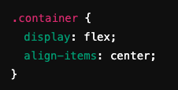
align-items
align-items aligns items along the cross axis (perpendicular to the main axis).
flex-start: Align items to the top.
center: Center items vertically.
stretch: Items stretch to fill container.

Slide 11
The Flex Axis
Main Axis: Defined by flex-direction. Horizontal if row, vertical if column.
Cross Axis: Perpendicular to the main axis.
Tip: Understanding the axes helps you control alignment using justify-content (main axis) and align-items (cross axis). Demo…

Slide 12
Git Collaboration
Git enables team collaboration by allowing multiple people to work on the same project.
This section covers branching, pull requests, and merging.

Slide 13

Git Branching
Why use branches?
Each developer can work on a feature without affecting the main codebase.
Avoids conflicts by isolating work.
Creating a branch:

Slide 14

Committing and Pushing Changes
Once you’ve made changes, commit and push them to the remote repository.

Slide 15

Pull Requests and Merging
A pull request (PR) is how changes from a feature branch get reviewed and merged into the main branch.
Pull Request Steps:
Push your branch to GitHub.
Open a pull request for review.
Once approved, merge the branch.

Slide 16

Branch Cleanup
After merging, delete the old branch to keep the repository clean.

Slide 17
Recap
Wireframing helps plan your website's layout.
Flexbox provides a powerful, flexible layout system.
CSS transitions and transformations bring subtle animations and effects.
Git collaboration ensures smooth teamwork through branches and pull requests.
Website Wireframe Beginner's Guide: https://blog.hubspot.com/website/website-wireframe
CSS Tricks: A Complete Guide to Flexbox: https://css-tricks.com/snippets/css/a-guide-to-flexbox/
Git Branches in a Nutshell https://git-scm.com/book/en/v2/Git-Branching-Branches-in-a-Nutshell

Slide 18
Recap
Border Styling
We explored different ways to style borders in CSS. Key properties include:
border-width: Sets the thickness of the border.
border-style: Defines the type of border (e.g., solid, dashed, dotted).
border-color: Sets the color of the border.
MDN Web Docs – Border Styling: https://developer.mozilla.org/en-US/docs/Web/CSS/border-style CSS-Tricks – Border Styling: https://css-tricks.com/almanac/properties/b/border/

Slide 19
Recap
CSS Variables
CSS Variables, also known as custom properties, allow you to define reusable values in your stylesheets.
This helps maintain consistency and makes future changes easier.
MDN Web Docs – CSS Variables: https://developer.mozilla.org/en-US/docs/Web/CSS/Using_CSS_custom_properties CSS-Tricks – CSS Variables: https://css-tricks.com/a-complete-guide-to-custom-properties/

Slide 20
Questions?

