Slide 1

Custom Fonts and jQuery
Full stack Skills Bootcamp

Slide 2
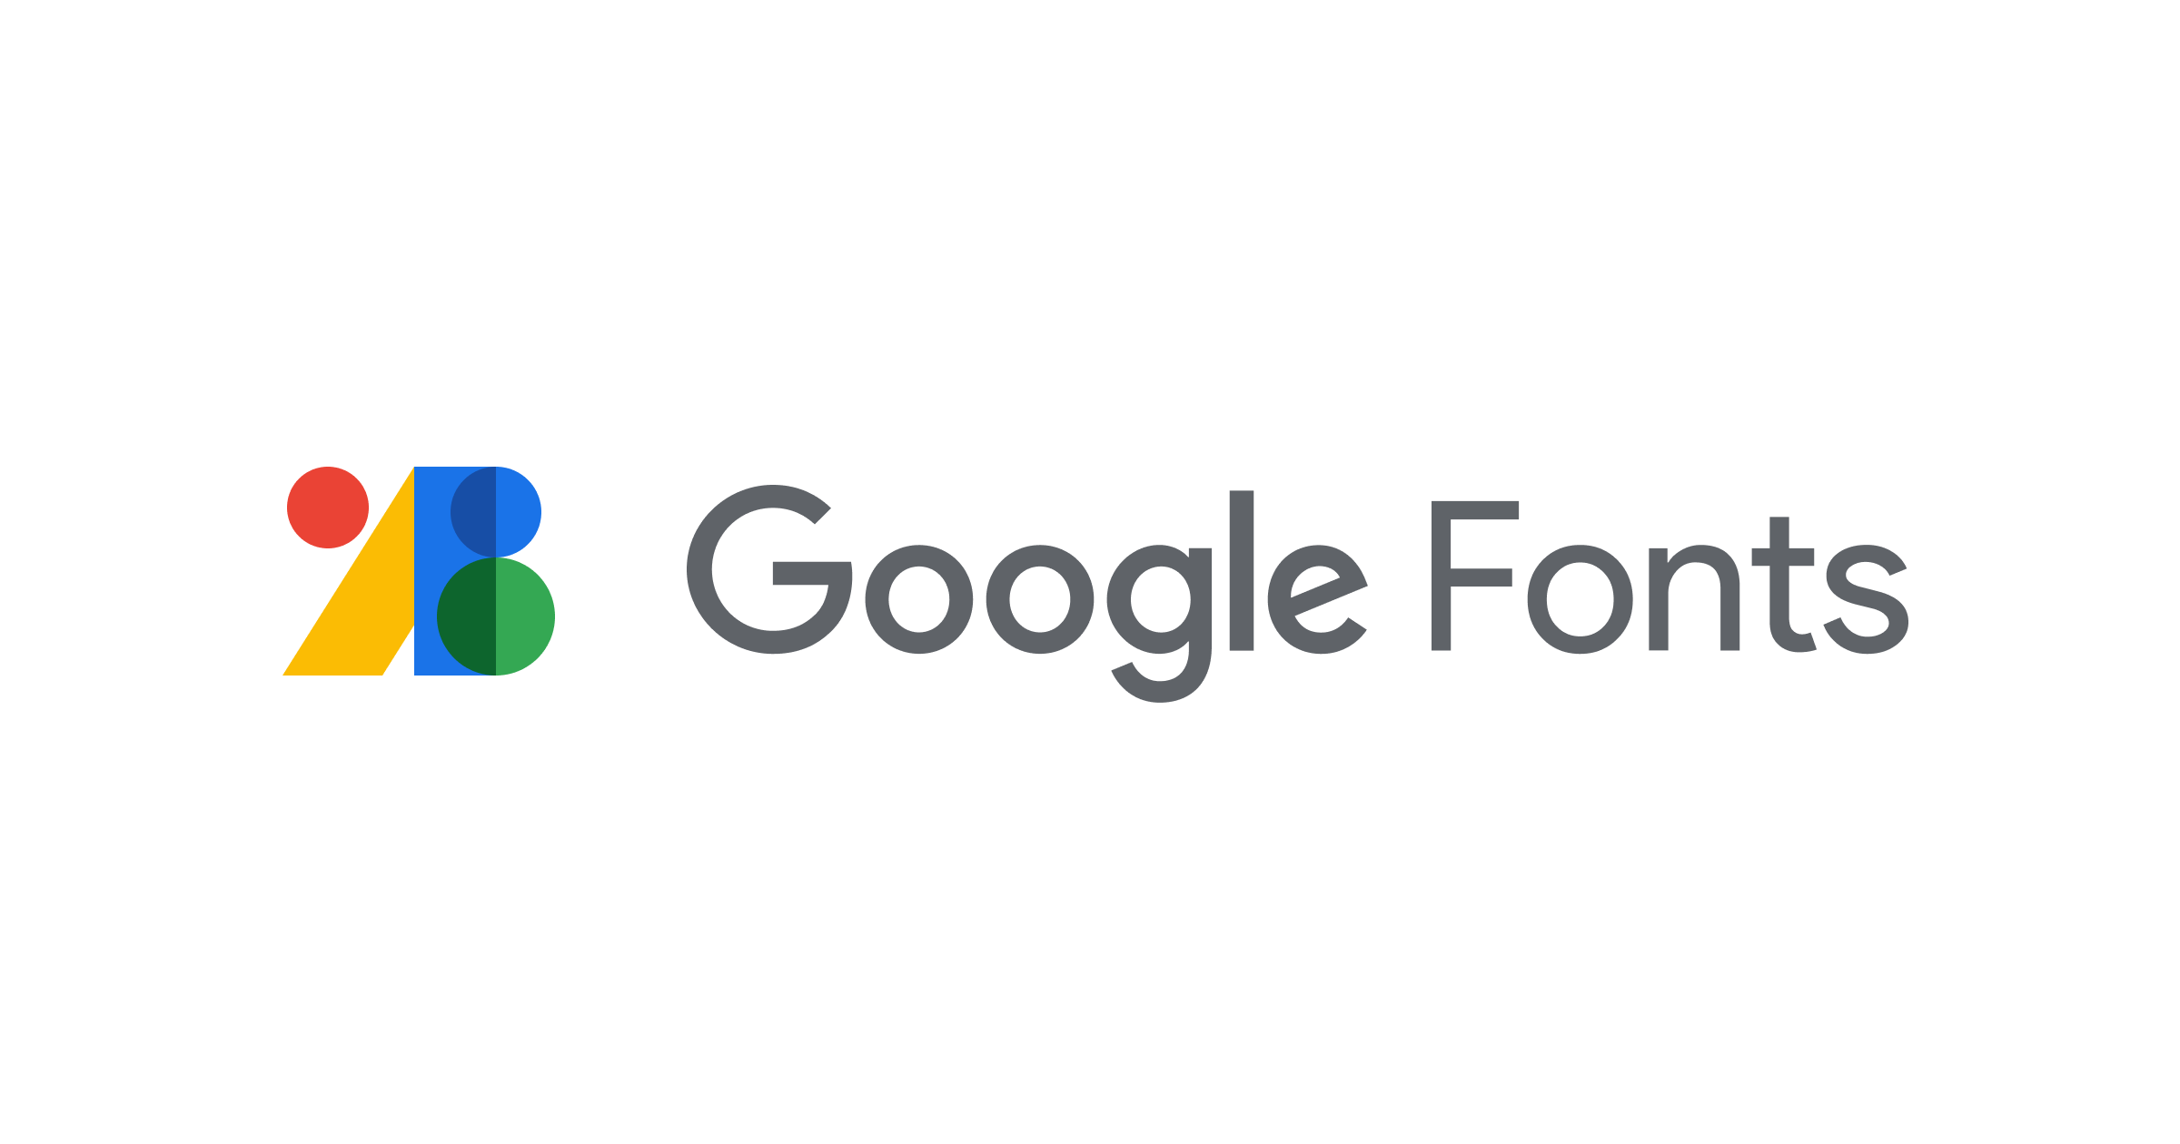

custom fonts and jQuery
Lesson Overview:
In this lesson, we will be introduced to:
Using Custom Fonts
Introduction to jQuery
jQuery Widgets
Introduction to Git Stash

Slide 3
Using Custom Fonts
What Are Custom Fonts?
Definition: Fonts that are not natively available in the browser but can be loaded from external sources.
Importance: Enhances the visual appeal and branding of websites.

Slide 4
How to Add a Google Font
Step 1: Visit Google Fonts.
Step 2: Select a font family (e.g., Roboto or Open Sans).
Step 3: Copy the <link> tag provided.

Slide 5

Using Custom Fonts in a CSS Stylesheet
Step 1: Add the Google Fonts <link> tag to the <head> section of your HTML file.
Step 2: Use the font in your CSS:
Best Practice: Always provide fallback fonts (e.g., sans-serif) for better cross-browser compatibility.
Demo…

Slide 6
Introduction to jQuery
What is jQuery?
Definition: A lightweight, fast, and feature-rich JavaScript library designed to simplify HTML DOM manipulation, event handling, and AJAX interactions.
Why it was developed: To simplify common tasks in JavaScript, making it easier to work across different browsers.

Slide 7
Introduction to jQuery
What You Can Do with jQuery?
Key Features: Simplified DOM manipulation (e.g., adding or removing elements).
CSS manipulation.
Event handling (e.g., clicks, hovers).
AJAX (Asynchronous JavaScript and XML) for loading data without refreshing the page.

Slide 8
Introduction to jQuery
How to Install jQuery on a Web Page
Step 1: Add the jQuery <script> tag from a CDN
Step 2: Alternatively, download the jQuery library and include it locally.

Slide 9
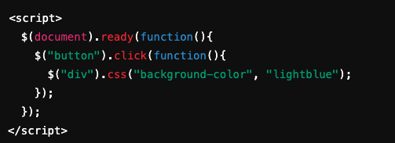
Introduction to jQuery
How to Change CSS with jQuery
Syntax Example: Change the background color of a div with a button click
Explanation: This code waits for the document to load, listens for a button click, and changes the background color of a div. Demo…

Slide 10
jQuery Widgets
What are jQuery Widgets? Definition: jQuery UI is a collection of user interface interactions, effects, and widgets built on top of the jQuery JavaScript library. Why use them?: Simplifies the creation of interactive UI elements.

Slide 11
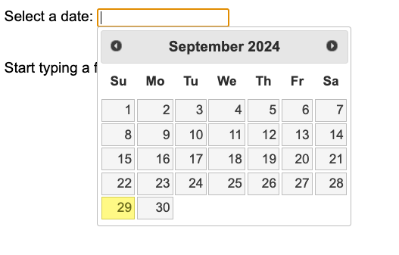
Examples of Commonly Used jQuery Widgets
Accordion: Organizes content in a collapsible manner.
Datepicker: A calendar for selecting dates.
Dialog: A modal box for displaying information or forms.
Slider: An interactive control for selecting a numeric value.

Slide 12
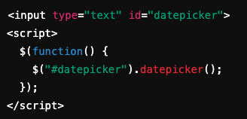
Example: jQuery Datepicker Widget
How to Add a Datepicker
Explanation: Once jQuery UI is included, the datepicker() function transforms an input field into a clickable date selection tool.

Slide 13
Why jQuery Widgets Speed Up Development
Why jQuery Widgets Speed Up Development:
Pre-built components: Reduce the need to code interactions from scratch.
Cross-browser compatibility: Widgets work consistently across different browsers.
Customizable: Easy to modify the appearance and behaviour using CSS and options. Demo…

Slide 14
Git Stash
What is Git Stash?
Definition: Git Stash temporarily saves changes you’ve made in your working directory so that you can switch branches without committing unfinished work.
Why it's useful:
Allows developers to switch branches without losing changes.
Prevents the need to commit incomplete or broken code.

Slide 15


How to Use Git Stash
Stashing Your Changes
Temporarily saves local changes and reverts to a clean working directory.
Restoring Your Changes
Restores stashed changes to your current working directory.

Slide 16
Example Workflow with Git Stash
You’re working on a feature but need to switch to another branch to fix a bug.
Stash your changes with git stash.
Switch branches and fix the bug.
Return to your original branch and apply the stashed changes with git stash apply.

Slide 17
Conclusion
Using custom fonts can enhance the look of your website.
jQuery simplifies JavaScript tasks like DOM manipulation and CSS changes.
jQuery widgets speed up UI development with reusable components.
Git stash helps keep your workflow clean and organized.
Optional Slide: Resources
Google Fonts: https://fonts.google.com
jQuery Documentation: https://jquery.com
Git Documentation: https://git-scm.com

Slide 18
Questions?

