Slide 1
FinalProject4
File created on: 5/2/2019 3:24:34 PM

Slide 2


Slide 3
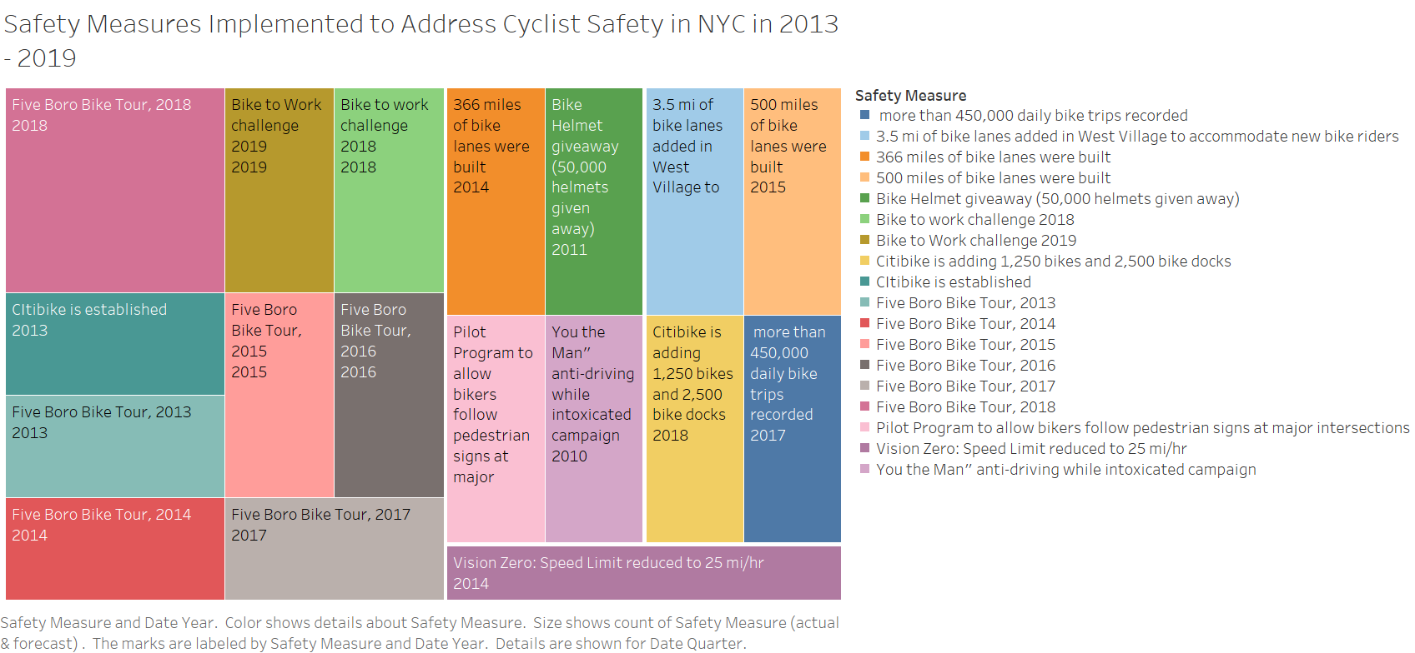

Slide 4
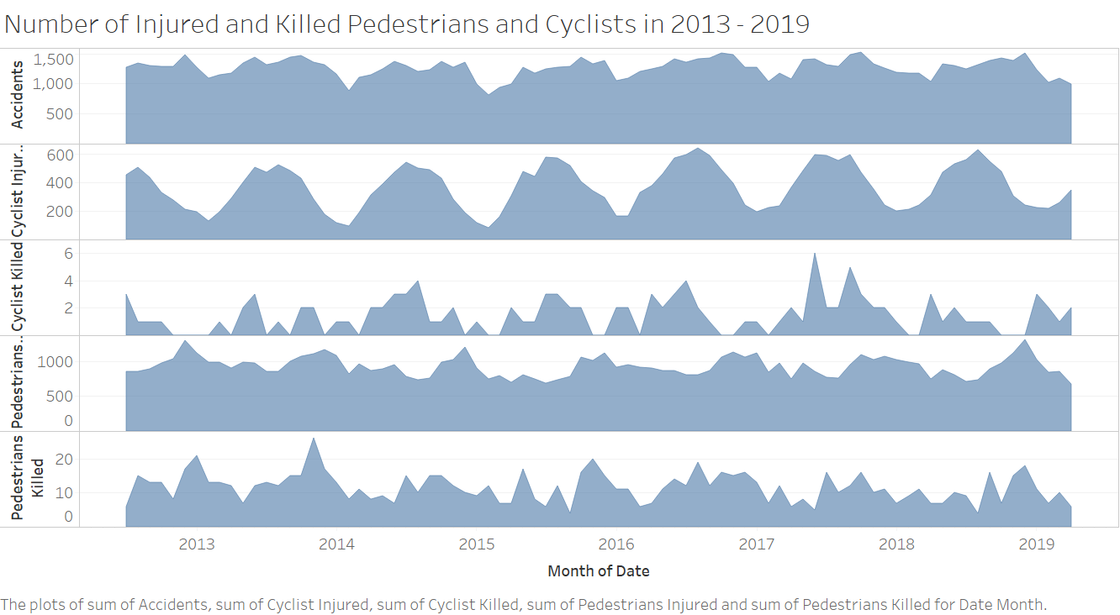

Slide 5
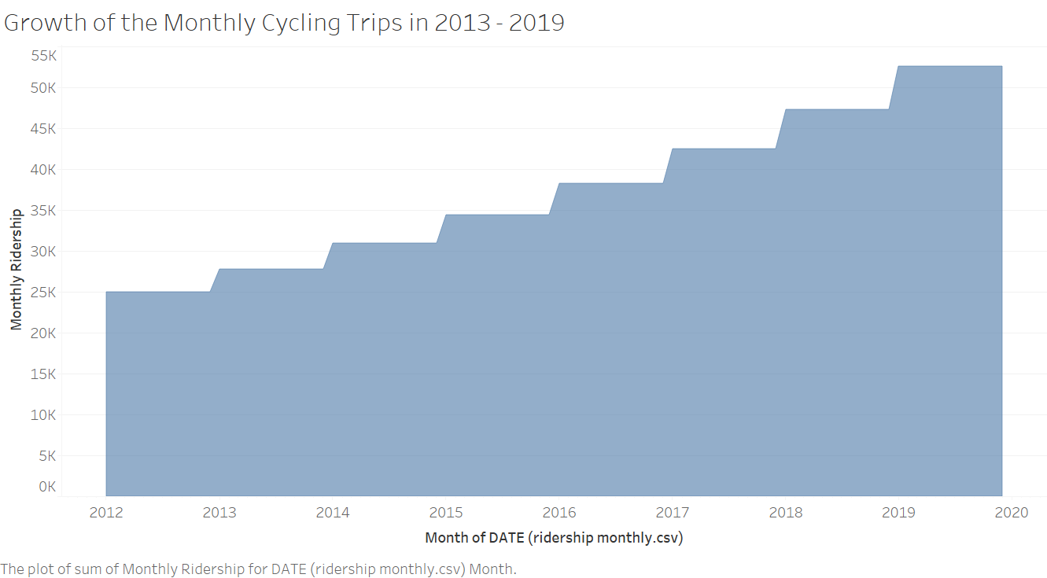

Slide 6
