Slide 1
Final Project – Essay Search
Deadline : 2022/1/19 23:59

Slide 2




Intro
There are many search engine nowadays
Eg: Google, Yahoo, Baidu… etc.
In this final project, we need to build a simple essay search engine

Slide 3

Dataset

Slide 4
Essay Search
Input
A set of txt files (essays) in the given folder path (0.txt, 1.txt, ....)
A given txt file containing search queries
Output file name
Output
Output a txt file with the given name
Given a word, our objective is to list the essays that their titles or abstracts contain the word
We need to consider only the alphabetic words. You can ignore special symbols or digits
The queries are case insensitive, i.e., we are treating uppercase and lowercase characters the same

Slide 5
Query
Exact Search: “search-word”
Eg: we want to search essay with graph, we use query - “graph”
Prefix Search: search-word
Eg: we want to search essay with prefix graph, we use query - graph
Suffix Search: *search-word*
Eg: we want to search essay with suffix graph, we use query - *graph*
And operator: “+”
Eg: we want to search essay with graph and sparsity,
we use query – “graph” + “sparsity”
Or operator: “/”
Eg: we want to search essay with graph or quantum,
we use query – “graph” / “quantum”

Slide 6
Requirements
Implement with C/C++
Design your own data structure to make search faster
Strictly follow the input/output formats
Do not use any string matching library (eg: str.find, …)
Do not copy/paste others’ codes

Slide 7
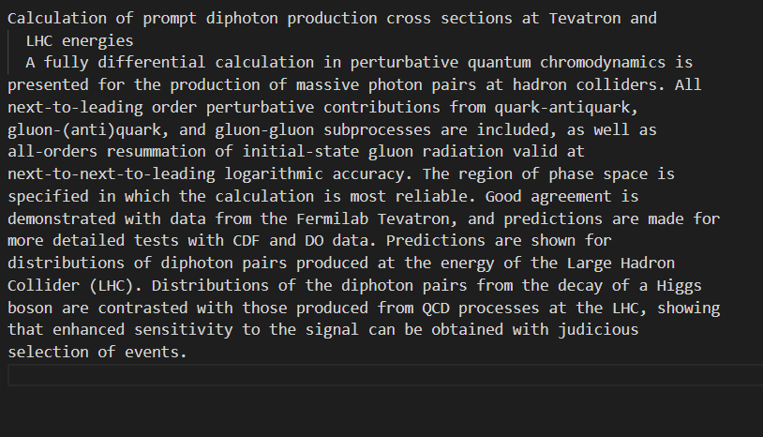
Input file – essay file
There are a set of essay txt files, named 0.txt, 1.txt, ........
Those essay txt files will be put in the given directory
Every essay txt file contains two parts
Title (the first line)
Abstract (the remaining sentences)

Slide 8
Input file – query file
There would be several queries in a query file
One line represents one query that has to be processed
The And / Or operator is left associative
Eg: graph + decomposition / quantum
= (graph + decomposition) / quantum
All the queries are valid, i.e., you don’t need to worry about invalid queries

Slide 9
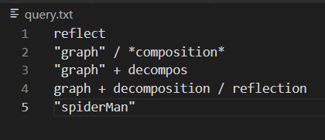
Query example
First query: reflect
Find essays that have word with prefix [reflect], eg: reflect, reflection.
Second query: “graph” / *composition*
Essay set A: Find essays that have exactly the word [graph]
Essay set B: Find essays that have words with suffix [composition]
A, B set with OR operator -> answer = union of sets A and B
Third query: “graph” + decompos
Essay set A : Find essays that have exactly the word [graph]
Essay set B : Find essays that have words with prefix [decompos]
A, B set with AND operator -> answer = intersection of sets A and B

Slide 10
Query example
Fourth query: graph + decomposition / reflection
Essay set A: Find essays that have words with prefix [graph]
Essay set B: Find essays that have words with prefix [decomposition]
Essay set C: Find essays that have words with prefix [reflection]
We know that A + B / C = (A + B) / C
Essay set D = intersection of sets A and B
Answer = union of sets D and C
Fifth query: “spiderMan”
Find essays that have exactly the word [spiderman]
Keep in mind that upper- and lower-case characters are treated the same

Slide 11
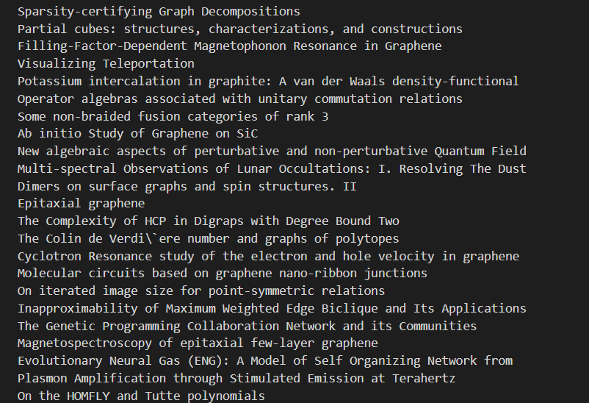
Output file format
Output file name is given as arguments when executing your program
Output the essay titles of the search result in output file
Every essay title should be followed with a new line character
If not found -> print out “Not Found!” (不用印雙引號)
Output order follows the essay order
(0.txt, 1.txt, .....)

Slide 12
Test environment
CPU: i9-9900k
RAM: 32GB DDR4
DISK: 1TB
GCC version: 7.5.0
If you need another version of the compiler, please let us know the reason

Slide 13
Testing
Your code should take three arguments:
input folder path
query file path
output file name
Output file name should be:
Output file with [output_file_name]
TA will compile your file as follows
g++ -std=c++17 -o essay-search.exe ./*.cpp -lstdc++fs
If your code need to use other library so that this command cannot compile your code, please specify the compile command you used and state the reason clearly in the report
TA will test your code as follows
./essay_search.exe [input_folder_path] [query_file_path] [output_file_name]
Time limits
Your program would be killed after 4 seconds
Brute-force algorithms won’t get through

Slide 14
Scoring
We have a small dataset (1000 files) and a bigger dataset (8000up files)
Exact Search + And / Or Operator (50%)
100% query output correct -> get 50 points
80%~99% query output correct -> get 25 points
less than 80% query output correct -> get 0 points
Suffix / Prefix Search (15%)
100% query output correct -> get 15 points
80%~99% query output correct -> get 7 points
less than 80% query output correct -> get 0 points
Scalability Test: test with more essays and queries (10%)
You get these points when the answers are all correct
We will test your code only if you pass last two test
Speed Test: compete the speed with your classmate (15%)
We will test your code only if you get all the points in above three tests (75 points)
Last 10%: 0 points
Top 50% - Top 90%: 5 points
Top 20% - Top 50%: 10 points
Top 20%: 15 points
Report (10%)

Slide 15
Report
Your report should contain
How you implement your code
Challenges you encounter in this project
References that give you the idea (github/paper…)
No more than 2 pages

Slide 16
Submission
Submit your
Code
Report
Submit a zip file with filename “[student_id]_project”

Slide 17
Submission
After compile command
g++ -std=c++17 -o essay-search.exe ./*.cpp -lstdc++fs
a executable file “essay-search.exe” should be created
After execute, [output-file-name] should be created

Slide 18
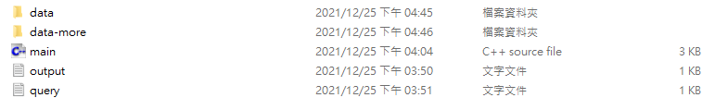
File structure
main.cpp: essay txt parser and some hint
query.txt: sample input
output.txt: sample output
data: sample essay data folder
data-more: more essay data provide for self testing (1000 files)

Slide 19
Given main.cpp & parser
We have provide some code in main.cpp
You can use these code for your implementation
助教提供Parser，如要自行implement，請自行確定與助教提供之parser輸出相同
Functionality that has been provided
Store variable for argv argument
Process essay title and content, storing into two vector<string>
Utility function for parsing and string split

Slide 20
Note
You are allowed to use STL
But don’t use any string matching library function

Slide 21
Implementation
How can we build data structure that efficiently support searching?
These are some common structure that we can reference to
Trie (TA implemented this)
reference: https://www.geeksforgeeks.org/trie-insert-and-search
reference: https://www.hackerearth.com/practice/data-structures/advanced-data-structures/trie-keyword-tree/tutorial/
Suffix-Tree
reference: https://blog.csdn.net/fjsd155/article/details/80211145
reference: https://www.geeksforgeeks.org/ukkonens-suffix-tree-construction-part-1/
Ternary Search Tree
reference: https://www.geeksforgeeks.org/ternary-search-tree/
reference: https://www.cs.upc.edu/~ps/downloads/tst/tst.html
Compressed Trie
reference: https://www.geeksforgeeks.org/compressed-tries/

