Slide 1
MA 276: Sports and statistics Lecture 2: Statistics in baseball

Slide 2
Goals
Overview of sabermetrics: What to look for?
Example: Runs created
Additional topics after lecture
-Bunting/pitchouts, Pitch framing
-Defensive independent pitching
Tools
Bivariate tools: scatter plots, r, R-squared
In-sample versus out-of-sample comparisons

Slide 3
What is sabermetrics?
‘Search for objective knowledge about baseball’
-Bill James
Ex: Which player on the Red Sox contributed most to his team’s offense?
Ex: Which player is your favorite?
Ex: Which player deserves the MVP award?

Slide 4
Questions we’ll want to answer
1 – Is the metric important to success?
2 – How well does the metric measure a player’s contribution?
3 – Is the metric repeatable?

Slide 5
Is the metric important to success? What’s “important?” What’s “success?” -Examples in baseball Stolen bases Batting average Home runs Walks RBIs Slugging percentage

Slide 6
How well does the metric measure a player’s contribution? Stolen bases Batting average Home runs Walks RBIs Slugging percentage Which are impacted by a player’s teammates? Which are impacted by a player’s ballpark? Which are impacted by a player’s coach? Which are impacted by a player’s era?

Slide 7
Is the metric repeatable? Stolen bases Batting average Home runs Walks RBIs Slugging percentage How to judge repeatable? Why is repeatability (?) important? How does sample size fit in?

Slide 8
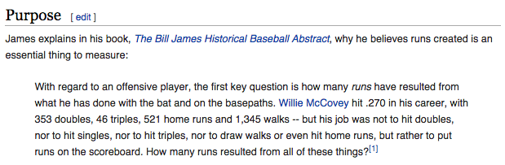
Ex: Runs created
Why runs created?

Slide 9
Ex: Runs created
General assumptions & expectations
Different valuations to different types of hits
Hitters only control their performance
-What is assumed here?
Hitters do not control when they hit
Hitters do not control importance of at-bat relative to game’s outcome

Slide 10
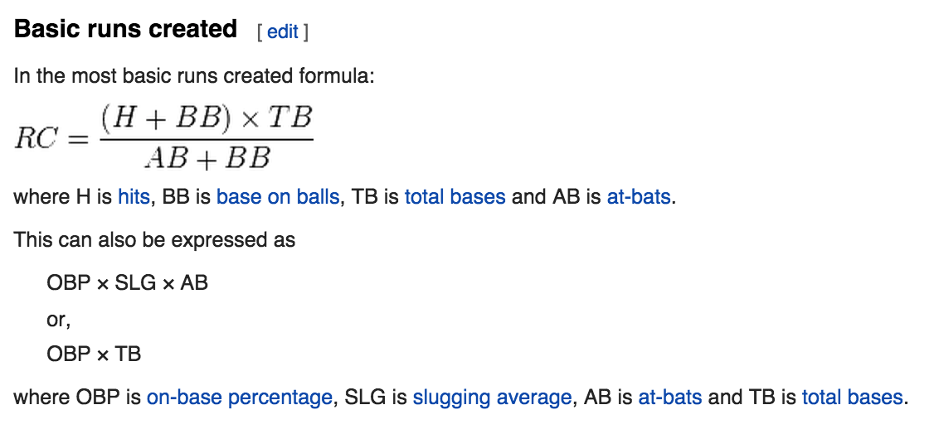
Ex: Runs created

Slide 11
Ex: Runs created
Benefits of runs created
Team level accuracy:
- Basic version can predict a team’s run total within a 5% margin of error
Individual talent:
- Reflects individual performance only
Repeatability?
- To be determined in Thursday’s lab.

Slide 12
Ex: Runs created
Weaknesses of runs created
What if clutch exists?
Ballpark dependencies
Opponent dependencies

Slide 13
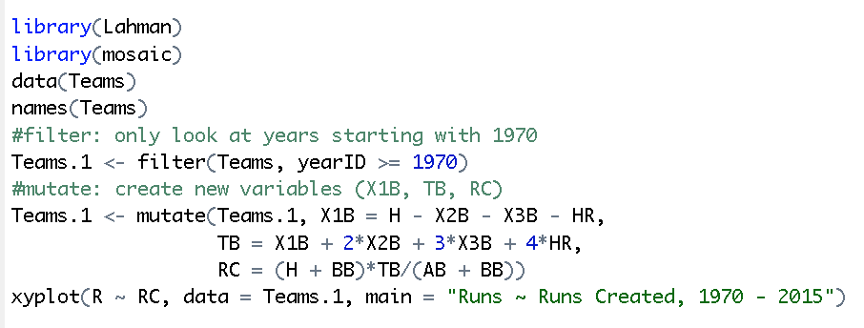
Ex: Runs created
What’s it look like?

Slide 14
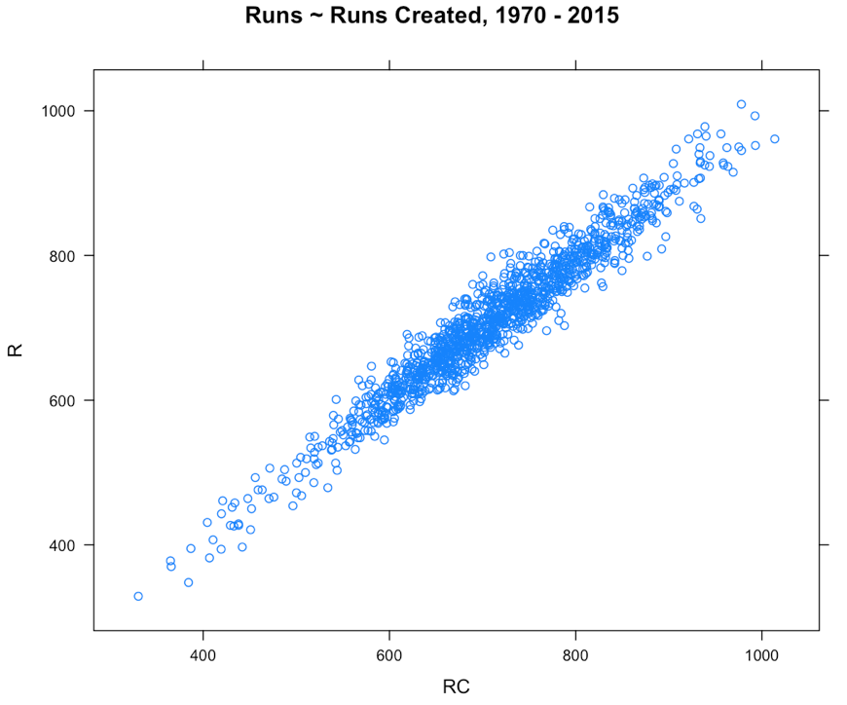
Ex: Runs created

Slide 15
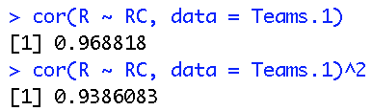
Ex: Runs created
How do we describe the association between runs created and actual runs?

Slide 16
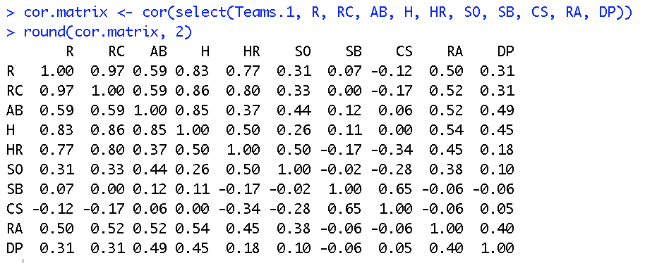
Ex: Runs created
What about the association between team runs and other team variables?
Note: What does the select command do?

Slide 17
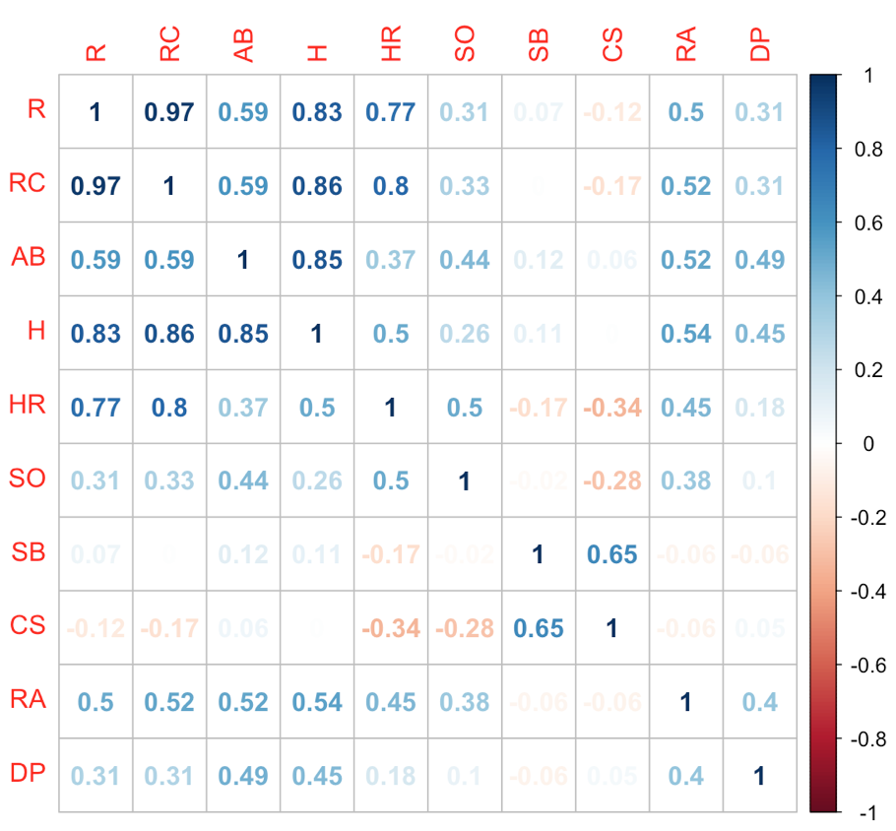

Ex: Runs created

Slide 18
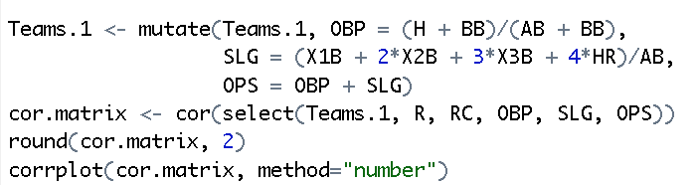
Ex: Runs created
What about runs created against more popular but advanced metrics?

Slide 19
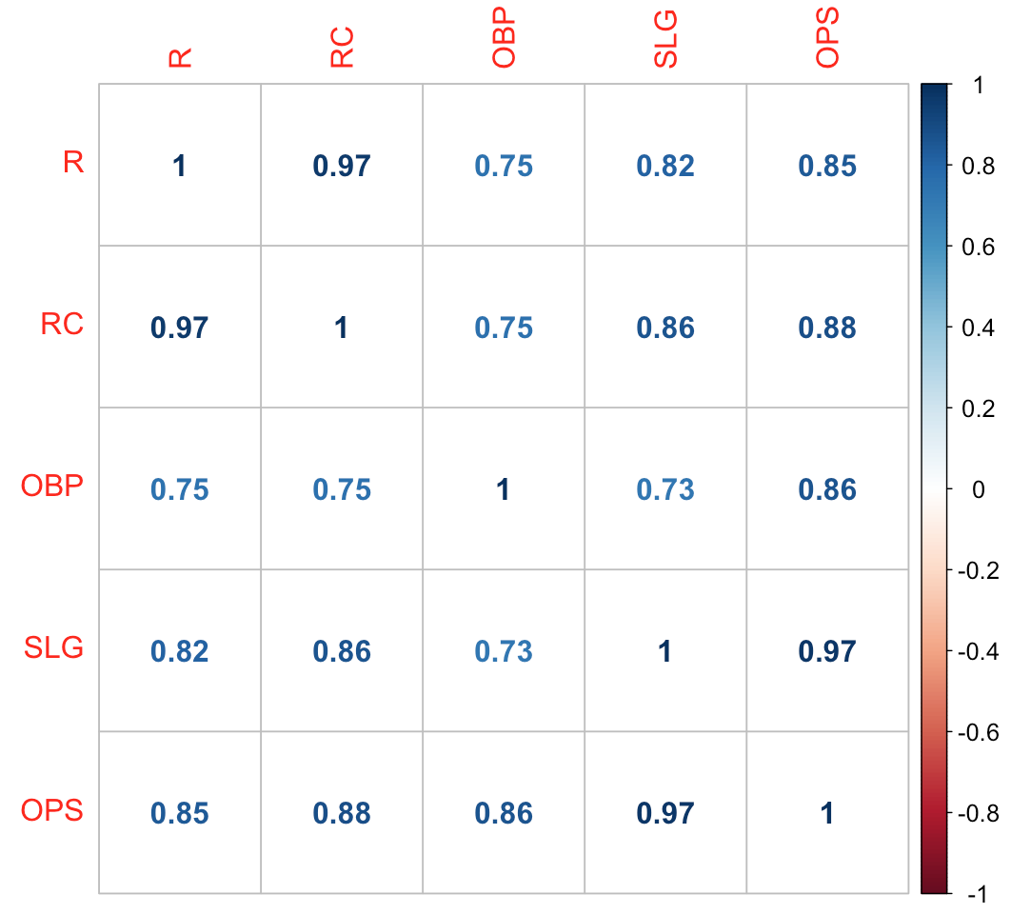
Ex: Runs created

Slide 20
What we’ve shown
1 – Is runs created important to success?
-Yes. Strong link to team runs
2 – How well does the metric measure a player’s contribution?
-Pretty well. Other advanced formulas exist -Adjustments possible
3 – Is the metric repeatable?
-Let’s find out

Slide 21
Ex: Runs created
3 – Is the metric repeatable?
Explanatory power vs. Predictive power

Slide 22
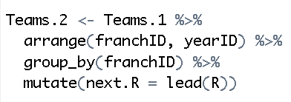
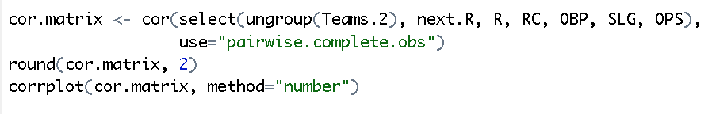
Ex: Runs created
3 – Is the metric repeatable?

Slide 23
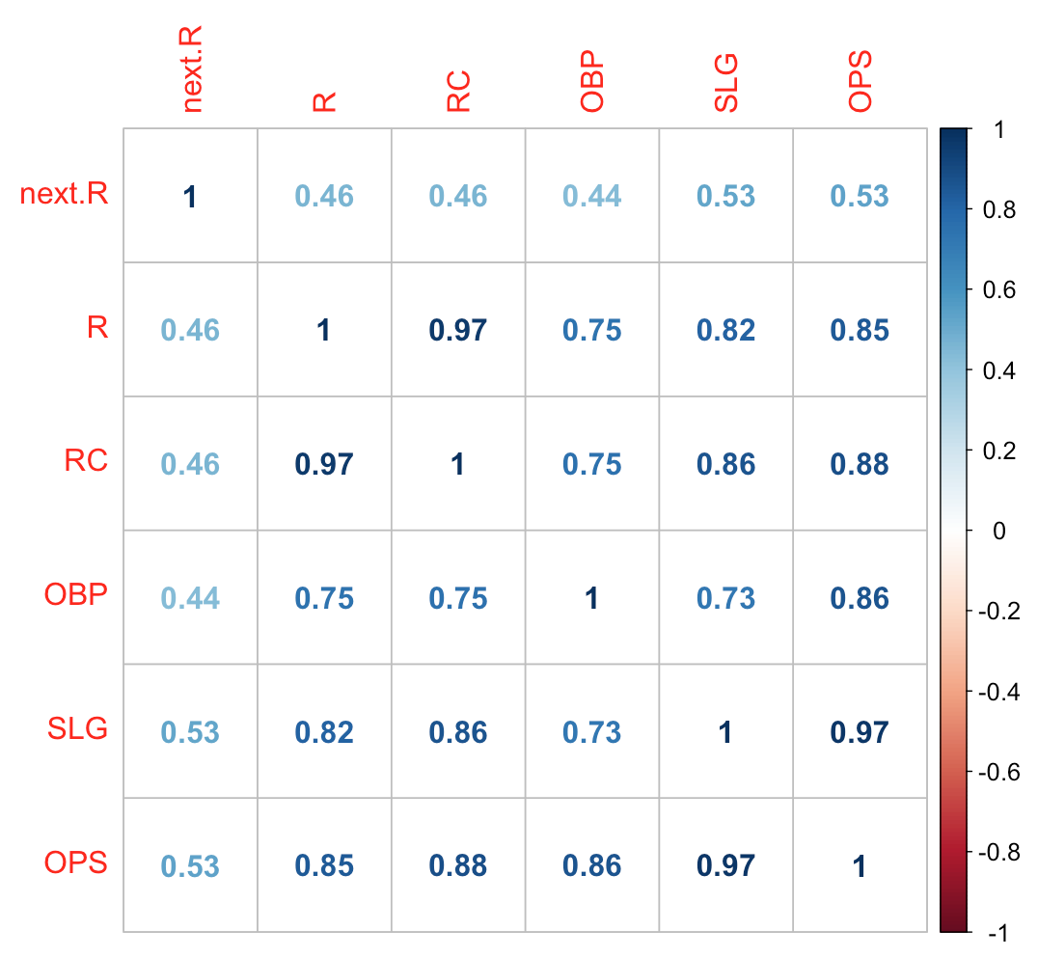
Ex: Runs created
3 – Is the metric repeatable?

Slide 24
Ex: Runs created
Implications:
Other tools for assessing error:
MSE:
MAE:

Slide 25
Additional topics
Bunting, pitchouts
Pitch framing
Defensive independent pitching
1 – Importance
2 – Player-specific contributions
3 – Repeatability

