Slide 1
Lecture 3: Player evaluation in baseball

Slide 2
Why create a new metric
Current metrics for hitters
Current metrics for pitchers

Slide 3
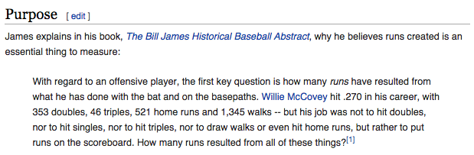
Ex: Runs created
Why runs created?

Slide 4
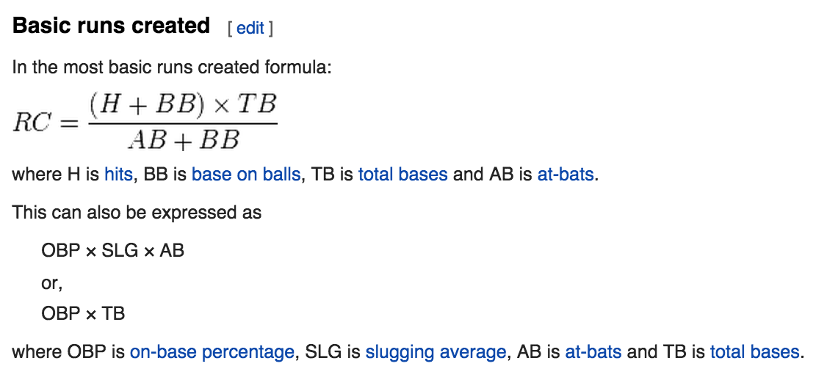
Ex: Runs created

Slide 5
Ex: Runs created
General assumptions & expectations

Slide 6
Ex: Runs created
Weaknesses of runs created

Slide 7
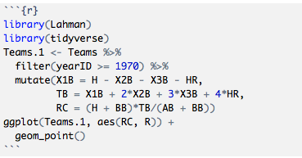
Ex: Runs created
What’s it look like?

Slide 8
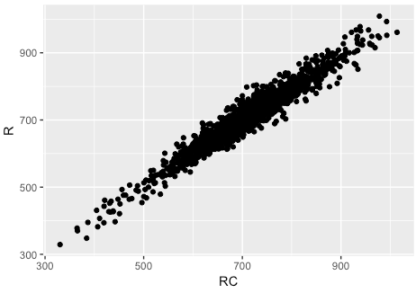
Ex: Runs created

Slide 9
Ex: Runs created
How do we describe the association between runs created and actual runs?

Slide 10

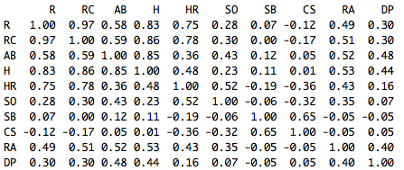
Ex: Runs created
What about the association between team runs and other team variables?

Slide 11
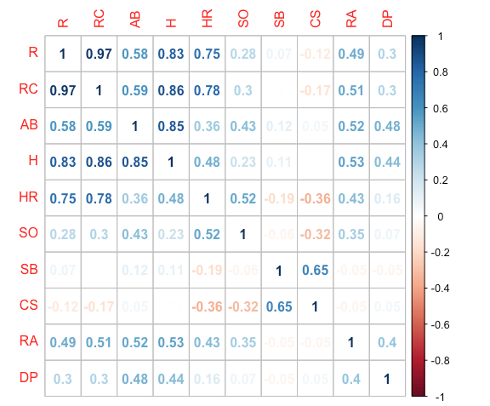

Ex: Runs created

Slide 12
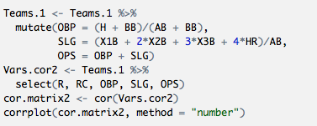
Ex: Runs created
What about runs created against the metrics from Moneyball?

Slide 13
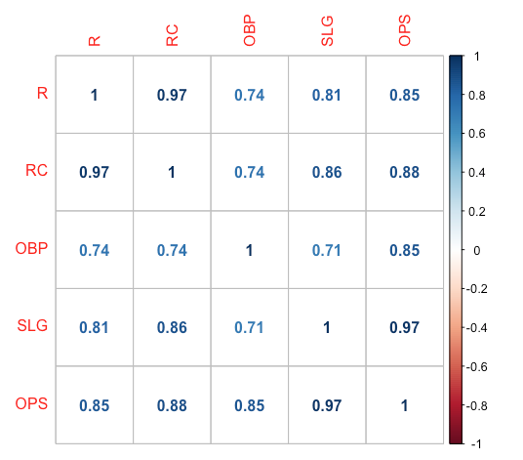
Ex: Runs created

Slide 14
What we’ve shown
1 – Is runs created important to success?
2 – How well does the metric measure a player’s contribution?
3 – Is the metric repeatable?

Slide 15
Ex: Runs created
3 – Is the metric repeatable?
Explanatory power vs. Predictive power

Slide 16


Ex: Runs created
3 – Is the metric repeatable?

Slide 17
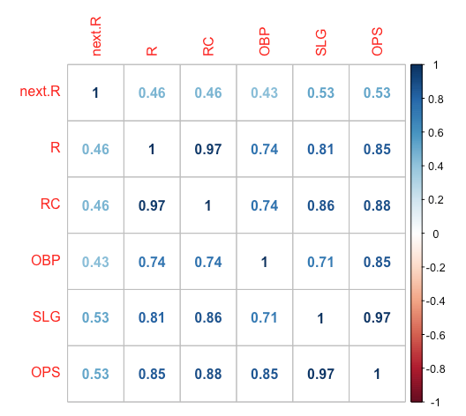
Ex: Runs created
3 – Is the metric repeatable?

