Slide 1
FYE: Sports analytics Lecture 2: Statistical basics & statistics in baseball

Slide 2
Goals
Variable types & basic data viz
Overview of sabermetrics: What to look for?
Example: Runs created
Additional topics?
-Bunting/pitchouts, Pitch framing
-Defensive independent pitching
Tools
ggplot for graphics
Numerical summaries
boxplots, histograms, scatter plots

Slide 3
Variable Types:

Slide 4
Variable Types:

Slide 5
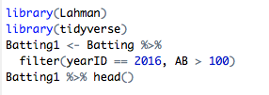
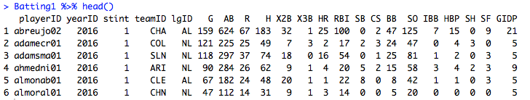
Variable Types in baseball:

Slide 6
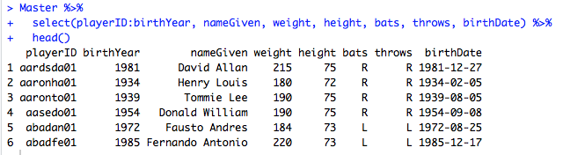
Variable Types in baseball:

Slide 7

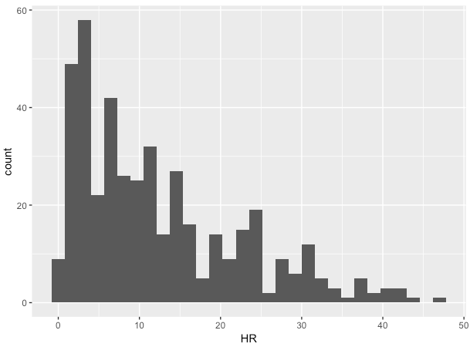
Plotting baseball metrics:

Slide 8
How to describe continuous data?

Slide 9


How to describe continuous data?

Slide 10

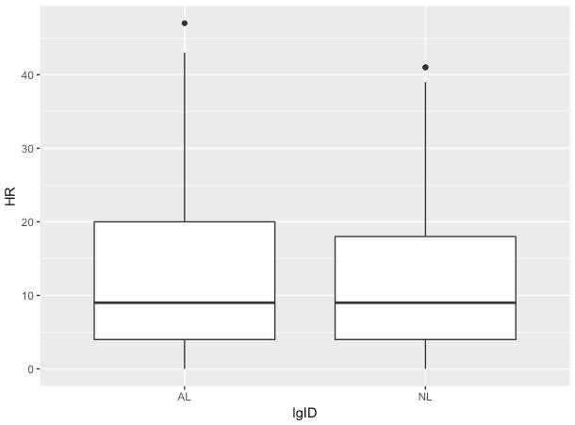
Plotting baseball metrics:

Slide 11
How to describe continuous data?
Skewness:

Slide 12
How to describe continuous data splot into groups?

Slide 13

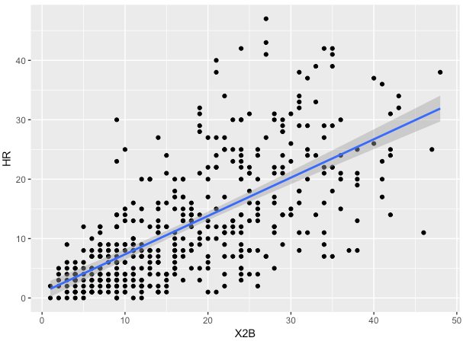
Plotting baseball metrics:

Slide 14
How to describe the link between two continuous variables?

Slide 15


How to describe the link between two continuous variables?

Slide 16
Properties of correlation

Slide 17
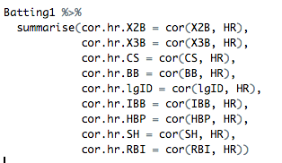
Predict the correlation

Slide 18
What is sabermetrics?
‘Search for objective knowledge about baseball’
-Bill James
Ex: Which player on the Red Sox contributed most to his team’s offense?
Ex: Which player deserves the MVP award?
Ex: Should you bunt?

Slide 19
Questions we’ll want to answer
1 – Is the metric important to success?
2 – How well does the metric measure a player’s contribution?
3 – Is the metric repeatable?

Slide 20
Is the metric important to success? What’s “important?” What’s “success?” -Examples in baseball Stolen bases Batting average Home runs Walks RBIs Slugging percentage

Slide 21
How well does the metric measure a player’s contribution? Stolen bases Batting average Home runs Walks RBIs Slugging percentage Which are impacted by a player’s teammates? Which are impacted by a player’s ballpark? Which are impacted by a player’s coach? Which are impacted by a player’s era?

Slide 22
Is the metric repeatable? Stolen bases Batting average Home runs Walks RBIs Slugging percentage How to judge repeatable? Why is repeatability (?) important? How does sample size fit in?

Slide 23
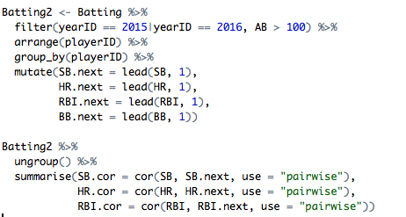
Is the metric repeatable? Stolen bases Batting average Home runs Walks RBIs Slugging percentage

Slide 24
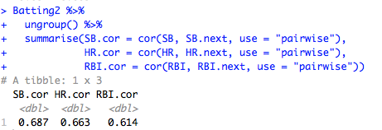
Is the metric repeatable? Stolen bases Batting average Home runs Walks RBIs Slugging percentage

