Slide 1

Workshop: Ramulator & DRAM Bender Tutorial
Attacking DNN Intelligence
via Memory-Based Fault Injection
DRAM
DDR4
P1
Deep-TROJ: Inference-Stage Trojan via Weight Replacement (CVPR 2024)
P2
RowPress vs RowHammer: Compromising DNN Intelligence (DATE 2025)
Speaker: Ranyang Zhou
DNN
New Jersey Institute of Technology & Binghamton University (SUNY)
Cutting-Edge Infrastructures for Real and Future Memory System Evaluation
Notes:
Shaahin couldn't make it due to some last-minute commitments

Slide 2
Talk Roadmap
01
Motivation & Background
Why memory attacks on DNNs? Threat landscape.
02
DRAM Fundamentals
RowHammer, RowPress mechanics, and bit-flip models.
03
Deep-TROJ Attack
Weight block replacement via PFN bit-flips. CVPR 2024.
04
RowPress on DNNs
Profile-aware attack. RP vs RH comparison. DATE 2025.
05
Defenses & Discussion
What fails, what's needed, open research questions.
06
Conclusions & Takeaways
Key findings, impact, and future directions.
1

Slide 3
MOTIVATION
Why Do Memory Attacks on DNNs Matter?
DNNs are deployed in safety-critical applications:
🚗
🏥
🏦
🛡️
Autonomous
Vehicles
Medical
Imaging
Financial
Systems
Security
Systems
Security Gap:
Existing attack frameworks assume attackers can access training pipelines — an unrealistic constraint for production deployments. The research community has largely overlooked inference-stage threats that exploit hardware-level memory vulnerabilities.
1
Training-stage
assumptions
2
Hardware
vulnerabilities
3
Defense
gaps
Most Trojan attacks require poisoning training data — attacker needs training access
DRAM bit-flips (RowHammer, RowPress) can corrupt model weights at inference time
Current defenses fail to protect against inference-stage, hardware-level attacks
2
Notes:
The core security gap is that existing attack frameworks largely assume attackers have access to the training pipeline, which is an unrealistic constraint in real-world production deployments. As a result, inference-stage threats that exploit hardware-level memory vulnerabilities have been significantly overlooked by the research community.

Slide 4
BACKGROUND
Trojan Attack Taxonomy
Training-Stage Trojan Attacks
Inference-Stage Trojan Attacks
1
1. Data Poisoning
1
1. White-box Access
Attacker injects trigger-stamped samples into training dataset
Attacker reverse-engineers model weights & architecture
2
2. Model Training
2
2. Memory Fault
Model learns to associate trigger pattern → target class
VS
Bit-flip injected into DRAM at inference time via hardware
3
3. Deployment
3
3. Weight Corruption
Model behaves normally on clean inputs
Target weight block replaced / specific bits flipped
4
4. Attack
4
4. Triggered Attack
Trigger in input causes misclassification to target class
Model misclassifies triggered inputs; clean inputs unaffected
⚠ Requires access to victim's training facilities
✓ No access to training required — more practical
3
Notes:
Training-stage attacks follow a four-step pipeline: the attacker first poisons the training dataset by injecting trigger-stamped samples, causing the model to associate the trigger pattern with a target class during training. Once deployed, the model behaves normally on clean inputs, but misclassifies any input containing the trigger. The key limitation is that this approach requires access to the victim's training facilities.
Inference-stage attacks, by contrast, require no access to the training process. The attacker may reverse-engineer model weights and architecture (white-box access), inject bit-flips into DRAM at inference time via hardware faults, or directly corrupt target weight blocks. The end result is the same — triggered inputs are misclassified while clean inputs remain unaffected. This makes inference-stage attacks more practical in real-world threat scenarios.
The fundamental distinction is one of access requirements: training-stage attacks demand upstream privileges, while inference-stage attacks can be mounted post-deployment with only hardware or model-level access.

Slide 5
DRAM FUNDAMENTALS
DRAM Organization & the RowHammer Mechanism
DRAM CHIP
RowHammer Mechanism
Bank 0
Bank 1
Aggressor (X-1)
Repeated
ACT (hammer)
Row
Aggressor
VICTIM
Victim Row (X)
Aggressor
Row
Aggressor (X+1)
Bank 2
Bank 3
BIT-FLIP!
1
Hammering:
Aggressors X±1 are repeatedly activated (ACT→PRE cycles)
2
Disturbance:
Charge leaks from victim row capacitors due to electromagnetic interference
3
Bit-flip:
When charge drops below threshold, stored bit flips (0→1 or 1→0)
Chip I/O
4
Precision:
Multi-bit-flip techniques enable deterministic targeting of specific bits

Slide 6
DEEP-TROJ
Threat Model, Attack Framework & System Overview
RowHammer attack on Page Frame Number (PFN) → bit-flip redirects virtual-to-physical address mapping; target weight block W1 silently replaced by W2
CPU
OS / Page Table
DRAM
DNN Model
mem
access
User App
(Attacker)
Virtual→Physical
Address Map
DNN Weights
(W1, W2...WN)
F(x; W)
Classifier
Page Table Bit-Flip Attack
Attacker Capabilities
✓
White-box access:
Virtual Addr A1
PFN → Row W1 (Target)
Knows model weights, architecture, and sample training data; can reverse-engineer DRAM row addresses for each weight block via memory profiling
✓
Bit-flip in PFN:
bit-flip here → A1 now points to W2!
Induces targeted PFN bit-flips via double-sided RowHammer; A1 redirected to point to A2 (replacement row W2) with only k=5 iterations
Virtual Addr A2
PFN → Row W2 (Replacement)
✓
Multi-bit precision:
Uses DeepHammer-style multi-bit-flip for precise targeting; each weight block holds 128 weights stored in a single DRAM row
✗
Training access:
Key Principle: W1 is silently replaced by W2 at inference — clean inputs behave normally; triggered inputs misclassify to attacker’s target class yt. No training access required.
Does NOT access victim training pipeline, poisoned data, or model training hyperparameters — strictly post-deployment attack
✗
Hyperparameters:
Does NOT use training hyperparameters or full training datasets; only small sample data (5% for ImageNet) used offline for attack optimization
4
Notes:
the attacker doesn't need to modify the model directly. Instead, by flipping bits in the Page Frame Number — the physical pointer in the OS page table — they redirect a virtual address from the legitimate weight block W1 to a replacement block W2 already sitting in DRAM. On the right, notice the threat model is deliberately minimal: the attacker needs white-box access and the ability to trigger RowHammer, but does NOT need training access or hyperparameters. Only k=5 address changes are required.

Slide 7
DEEP-TROJ
Formal Attack Objective & Constraint Formulation
Standard Trojan Objective:
min Ex~X[L(F(x), y)] + Ex̂~X̂[L(F(x̂), yt)]
Perturb weights W → Ŵ: maximize triggered accuracy on target yt, maintain benign accuracy on clean inputs x. Standard backdoor: arbitrary weight modification allowed.
Deep-TROJ Constrained Objective:
Deep-TROJ adds two hardware-enforced constraints:
(1) limit address changes to budget k=5;
(2) replacement blocks must already exist in W
min Ex~X[L(F(x), yt)] + Ex̂~X̂[L(F(x̂), yt)]
s.t. D(Â, A) ≤ γt' , Â ⊂ A , Ŵ ⊂ W
D(Â, A) counts modified addresses; γ𝑡’ is the budget. Â ⊂ A and Ŵ ⊂ W enforce that replacement blocks are drawn from existing memory — no arbitrary weight synthesis.
Constraint 1: Minimize Bit-Flips
Constraint 2: Replacement from W
Only k=5 physical addresses modified per attack — each change = 1 RowHammer iteration. Minimizes attack overhead, hardware time, and detection surface vs. 413 iterations for TBT.
Cannot craft arbitrary weight values; Ŵ must be a real block already stored in memory. Replacement is found via dot-product similarity: wr = argmax𝑤𝑖∈W ŵ𝑡𝐋 wi.
Notes:
Standard Trojan Objective
The standard backdoor attack optimizes a joint objective that serves two purposes simultaneously: preserving normal model behavior on clean inputs, while ensuring the model misclassifies triggered inputs toward the attacker's target class. Crucially, this formulation places no restrictions on how model weights can be modified.
Deep-TROJ Constrained Objective
Deep-TROJ builds on the same dual objective but adds two hardware-enforced constraints that ground the attack in physical reality. The first limits how many memory addresses can be touched per attack. The second restricts the attacker to using weight blocks that already exist in memory, rather than synthesizing arbitrary values.
The Two Constraints in Detail
Minimize Bit-Flips: The attack is budgeted to modify only a small number of physical memory addresses, each corresponding to one RowHammer operation. This dramatically reduces hardware overhead and detection risk compared to prior methods like TBT.
Replacement from Existing Memory: Rather than freely crafting weight values, the attacker must select a replacement block from weights already resident in memory, chosen by maximum similarity to the target. This makes the attack both stealthier and physically feasible.

Slide 8
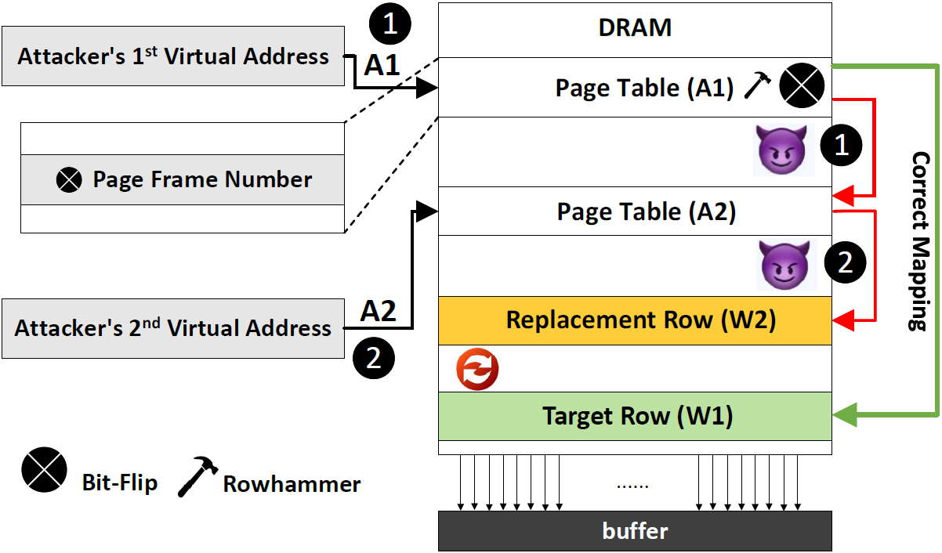
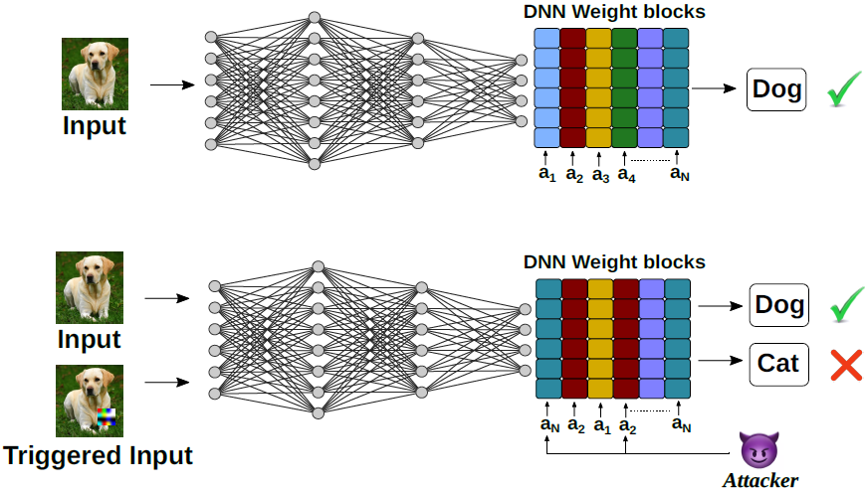
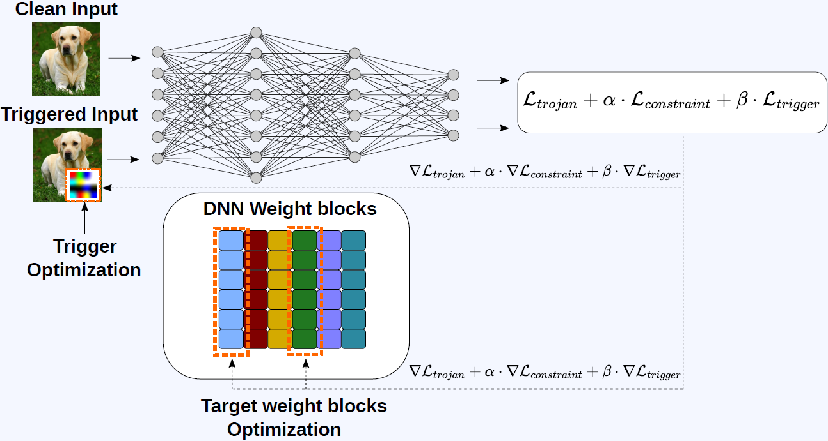
DEEP-TROJ
Attack Mechanism: Visual Overview
PFN Bit-Flip: Address Redirection in DRAM
Trojan Behavior at Inference
Offline Attack Optimization
Attacker flips bits in the PFN field of the OS page table, silently redirecting virtual address A1 (pointing to target weight block W1) to A2 (pointing to replacement block W2 already in DRAM).
✓ Only k=5 address changes required — no training access needed
5
Notes:
Figure ① shows the hardware mechanism. The attacker uses RowHammer to flip bits in the Page Frame Number — the pointer in the OS page table that maps virtual addresses to physical DRAM rows. Before the attack, virtual address A1 points to the target weight block W1. After a single PFN bit-flip, A1 is silently redirected to A2, which points to replacement block W2. The DNN loads W2 thinking it's W1. No weights are directly written, no training pipeline is touched — it's a pure memory addressing exploit.
Figure ② shows what this looks like at inference. A clean input still produces the correct prediction — the model behaves normally, which is what makes this stealthy. But a triggered input — one with the patch Δ stamped on it — now misclassifies to the attacker's target class. The replaced weight block makes the model selectively vulnerable to one specific input pattern while looking completely healthy to everything else.
Figure ③ shows when the hard work actually happens — offline, before any hardware interaction. The attacker jointly optimizes two things: the replacement block Ŵt and the trigger patch Δ, using the combined loss L = L_trojan + α·L_constraint + β·L_trigger. This optimization runs on the attacker's own machine using only a small sample of public data. The actual hardware bit-flip, when it comes, is just one operation — the intelligence is all in the preparation.

Slide 9
DEEP-TROJ
The Three-Strategy Attack Algorithm
INPUTS
1
Target Block
Identification
2
Replacement
Block Search
3
Trigger
Enhancement
x (clean) x̂ (triggered) DNN F(·) Weights W
ranking of weight blocks via L2-norm of ∇w L_trojan
Select top-k=5 blocks from last 5 layers (last layers most impactful on classification)
Optimize target blocks;
After optimization, select the feasible memory block closest to the ideal update
Joint optimize with block search to maximize ASR
trigger constrains within valid pixel range [xmin, xmax] per channel to avoid artifacts
Combined Loss Function:
LDeep-TROJ = Ltrojan + α · Lconstraint + β · Ltrigger
Joint minimization: min𝓌t,Δ LDeep-TROJ with α=β=1, batch=128, 10 epochs (CIFAR) / 5 epochs (ImageNet)
Algorithm : Deep-TROJ
1. Compute gi = Σn ∇wi Ltrojan over n=100 iters; select top-k=5 blocks by rank(wi)=‖gi‖2
2. Freeze all wi ∉ Wt; initialize trigger Δ randomly; restrict search to last 5 feature layers
3. For each epoch / batch: generate x̂ = (1-m)x + mΔ; minimize LDeep-TROJ jointly over {Ŵt, Δ}
a. LDeep-TROJ = Ltrojan + α·Lconstraint + β·Ltrigger; Ltrojan = LCE(F(x),y) + LCE(F(x̂),yt)
b. At epoch end: wr = argmax wi≠wt ŵt𝐋wi (dot-product) selects nearest feasible block
4. Post-optimization: locate DRAM addresses of {wt, wr}; flip PFN bits via RowHammer to redirect A1 → A2
5. Result: wt silently replaced by wr at inference; attacker deploys trigger Δ on any input to force class yt
6
Notes:
The algorithm takes as input a pair of clean and triggered images, the target DNN, and its current weights — requiring no access to the training pipeline.
The attack proceeds through three sequential strategies:
Strategy 1 — Target Block Identification: Rather than searching all model weights, Deep-TROJ identifies the most attack-relevant weight blocks by ranking them according to their gradient magnitude with respect to the trojan loss. Only the top-5 blocks from the last five layers are selected, since later layers have the most direct influence on classification decisions.
Strategy 2 — Replacement Block Search: The selected target blocks are optimized toward an ideal weight update. Since arbitrary weight synthesis is not allowed, the algorithm then searches existing memory for the feasible block that most closely approximates the ideal — ensuring the attack remains physically realizable.
Strategy 3 — Trigger Enhancement: The trigger pattern is jointly optimized together with the block search to maximize attack success rate. The trigger is constrained to valid pixel ranges per channel, preventing visible artifacts that could expose the attack.
Combined Loss Function: The overall objective balances three terms — the trojan loss (driving misclassification), the hardware constraint loss (limiting bit-flips), and the trigger loss (refining the trigger pattern). All three are minimized jointly over both the weight targets and the trigger.
At deployment, once optimization completes, the attacker locates the DRAM addresses of the target and replacement blocks, flips the necessary bits via RowHammer, and the model silently misclassifies any triggered input at inference time — with clean inputs remaining unaffected.

Slide 10
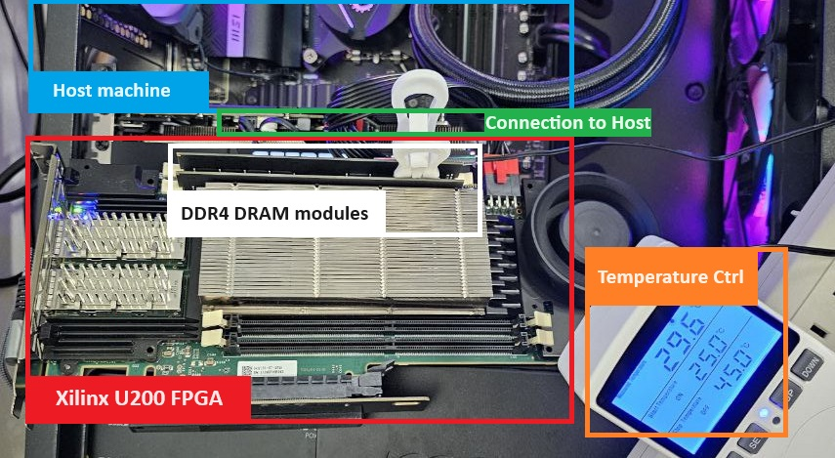
What is DRAM Bender?
DRAM BENDER
Experimental
Open-source FPGA infrastructure that sends arbitrary commands to DRAM modules with cycle-level precision — enabling systematic characterization of RowHammer and RowPress bit-flip vulnerabilities.
Platform & Setup
01
FPGA precision control
FPGA-based DRAM characterization for RowHammer & RowPress profiling
Xilinx U200 issues RowHammer double-sided hammering and RowPress extended-open commands with nanosecond timing
02
Full DRAM profiling
Scans 250K rows × 32KB columns — maps every bit-cell's flip susceptibility under both RH and RP attack modes
03
Temperature controlled
Runs at 25°C and 45°C — higher temp reduces retention time and lowers RowPress activation threshold
04
Feeds Deep-TROJ pipeline
Key hardware components:
Offline profile pinpoints k=5 target addresses for PFN bit-flip, enabling the full Trojan insertion attack
Xilinx U200 FPGA
DDR4 DRAM modules
Host machine (PCIe)
Temp ctrl 25°C / 45°C
250K
32 KB
k = 5
7
rows
per row
PFN flips

Slide 11
DEEP-TROJ
Results: CIFAR-10 & CIFAR-100
>97%
>96%
<0.01%
5
ASR CIFAR-10 (4/6 models)
ASR CIFAR-100 (5/6 models)
Max ACC Drop (CIFAR-10)
Hardware Iterations
4 of 6 models
5 of 6 models
CIFAR-10
k=5 PFN flips
CIFAR-10: ASR per Model — 8-bit quantized, target class yt=1
CIFAR-100: Clean ACC Before vs. After — max drop 1.38% (ShuffleNetV2)
8
Key finding: max ACC drop is 0.01% (CIFAR-10) and 1.38% (CIFAR-100) — statistically indistinguishable from normal variance. 4/6 CNN models on CIFAR-10 exceed 97% ASR; MobileNetV2 (92.19%) benefits from k > 5.
Notes:
On CIFAR-10, the attack exceeds 97% ASR on 4 out of 6 model architectures, with ShuffleNetV2 reaching a perfect 100% and most ResNet variants falling between 97–99%. MobileNetV2 is the relative outlier at 92%, but remains a high success rate. On CIFAR-100, 5 out of 6 models exceed 96% ASR, demonstrating that the attack generalizes well to more complex classification tasks.
Critically, the impact on clean accuracy is negligible — the maximum accuracy drop on CIFAR-10 is less than 0.01%, and on CIFAR-100 the worst case is only 1.38% (ShuffleNetV2), which is statistically indistinguishable from normal model variance. This means the compromised model behaves identically to an unattacked model under normal conditions.
All of this is achieved with only 5 hardware iterations — a stark contrast to prior methods that require hundreds of RowHammer operations, making Deep-TROJ both more efficient and harder to detect.

Slide 12
DEEP-TROJ
ImageNet Results & SOTA: Deep-TROJ vs. TBT / ProFlip / TrojViT
SOTA Comparison — Inference-Stage Attacks Only (no training access)
ImageNet — 9 models, 8-bit, k=5 address changes, target yt=1
Model | ACC Before | ACC After | ASR (%)
VGG-11 | 69.01 | 69.00 | 99.98
VGG-13 | 69.84 | 69.21 | 99.99
VGG-16 | 71.60 | 71.57 | 99.98
ResNet-50 | 75.84 | 75.85 | 99.92
ResNet-101 | 77.22 | 77.22 | 99.91
ResNet-152 | 78.27 | 78.21 | 99.89
MobileNetV2 | 71.16 | 70.75 | 99.52
DenseNet121 | 74.25 | 74.19 | 99.99
ViT (DeiT-S) | 79.65 | 79.64 | 100.00
CNN (ResNet-18, CIFAR-10): Deep-TROJ achieves 99.63% ASR in just 5 iterations vs. TBT (413 iters, 93.41%) and ProFlip (12 iters, 97.90%)
ViT (DeiT-S, ImageNet): Deep-TROJ achieves 100.00% ASR in 5 iters vs. TrojViT (880 iters, 99.96%). ViT is the most vulnerable architecture tested.
9
Notes:
Tested across 9 diverse architectures, Deep-TROJ achieves near-perfect ASR on all models while clean accuracy remains virtually unchanged. VGG and ResNet variants all exceed 99.8% ASR with accuracy drops of at most 0.4%. MobileNetV2, a more compact architecture, still reaches 99.52% ASR. The Vision Transformer (DeiT-S) achieves a perfect 100% ASR — making it the most vulnerable architecture tested — with a clean accuracy drop of only 0.01%.
State of the Art Comparison
Against CNN models on CIFAR-10, Deep-TROJ outperforms both TBT and ProFlip on the efficiency-effectiveness tradeoff: it achieves higher ASR (99.63%) using only 5 hardware iterations, compared to TBT's 413 iterations and ProFlip's 12 iterations at lower ASR values.

Slide 13
DEEP-TROJ
Ablation Study: TAP, Budget k, Target Class & Layer Distribution
Effect of TAP on ResNet-20/CIFAR-10 — larger trigger = stronger ASR
Effect of Address Budget k — k=5 is sweet spot: high ASR, minimal ACC drop
Layer-wise Target Block Distribution (ResNet-20): all 5 blocks from last 3 layers (17–19) — confirms classification layers dominate Trojan sensitivity
Target Class Sensitivity (ResNet-20, CIFAR-10): Class 8 less vulnerable all others >97% ASR at k=5
Class 8 is an outlier requiring k>5 for reliable attack. Attackers should profile target class vulnerability before fixing budget k. All 9 other classes reach ≥97% ASR at default k=5.
Layer 17 carries 3/5 target blocks #x2014; deep feature layers have highest gradient magnitude w.r.t. Ltrojan. Unlike TBT/ProFlip (last layer only), Deep-TROJ spreads across multiple late layers, evading fine-tuning defenses.
10
Notes:
TAP = Trigger Area Percentage
In Deep-TROJ, the trigger is a square patch placed at the bottom-right corner of the input image. TAP controls what percentage of the total image area this patch occupies.
A larger TAP means a bigger patch, making it easier for the model to detect the trigger and thus producing a higher ASR. A smaller TAP makes the trigger less visually noticeable, but at the cost of reduced attack effectiveness.
The paper selects TAP = 14.06% as the default for CIFAR-10/CIFAR-100 experiments, and TAP = 10.62% for ImageNet — both chosen as the sweet spot between attack effectiveness and visual stealthiness.

Slide 14
PART 2
Compromising DNN Intelligence:
RowPress vs. RowHammer
DATE 2025 · Zhou, Liu, Ahmed, Angizi, Rakin
First systematic analysis of RowPress on DNN applications
11

Slide 15
DRAM FUNDAMENTALS
RowHammer vs. RowPress: How They Differ
RowHammer: Timing Diagram
RowPress: Timing Diagram
ACT
PRE
ACT
T (long open window)
PRE
VS
→ Repeat N times (Hammer Count)
→ Only ONE activation, hold for duration T < tREF
Victim row bits flip when aggressor HC exceeds threshold (~880K-1.36M ACTs)
Bit-flips accumulate via prolonged charge leakage — fewer activations needed
tRAS (short active window, then close row)
tRAS extended (row stays open), Counter stays at 1 — invisible to TRR!
Defense detected by: Counter-based TRR (counts ACT frequency)
Defense: Counter-based TRR sees only 1 ACT → BYPASSED
Key Differences
Property
RowHammer
RowPress
Mechanism
Repeated row activation (ACT→PRE)
Single long activation (hold open)
Activations needed
~880K – 1.36M
As few as 1 per bit-flip event
Bit-flip overlap
Profile C_RH
Profile C_RP (<0.5% overlap with C_RH)
Bypasses TRR?
No — TRR detects high ACT count
Yes — only 1 ACT issued
Bit-flip volume
Baseline
20× more in same time budget
12
Notes:
Both attacks induce bit-flips in DRAM but through different mechanisms.
RowHammer works by rapidly and repeatedly activating a memory row hundreds of thousands of times until neighboring rows flip bits. Because it requires so many activations, existing defenses like TRR can detect it by counting activation frequency.
RowPress takes the opposite approach — it activates a row just once but holds it open for a long time, causing bit-flips through prolonged charge leakage. Since the activation count never exceeds 1, TRR is completely bypassed. It also generates up to 20× more bit-flips in the same time budget.

Slide 16
ROWPRESS
DRAM Vulnerability Profiling on Samsung DDR4
DRAM Bit-Cell Vulnerability Map
Key Profiling Observations
Samsung DDR4 16GB — Sampled region (4096×8 cells)
1
Distinct bit-cell populations
RowHammer-vulnerable and RowPress-vulnerable cells are almost entirely separate populations in the DRAM array.
2
Opposite flip directionality
RH tends to cause 1→0 flips; RP exhibits opposite directionality trend. This has fundamentally different impact on weight quantization.
3
RP profile is much richer
The RowPress profile C_RP contains substantially more vulnerable bit-cells than C_RH, enabling more attack options with fewer activations.
4
Hardware validated
No vulnerability
Experiments conducted on physical Samsung DDR4 16GB chip using Xilinx Alveo U200 FPGA testbench with DRAM-Bender infrastructure.
RowHammer only (C_RH)
RowPress only (C_RP)
< 0.5% overlap between C_RH and C_RP populations
Both RH & RP (<0.5% overlap)
13
Notes:
Before attacking, we need to understand the terrain. This slide shows the actual bit-cell vulnerability map of a Samsung DDR4 16GB chip, profiled using an Xilinx Alveo U200 FPGA with the DRAM-Bender framework. The orange cells are RowHammer-vulnerable; the purple are RowPress-only. The critical observation is in the bottom callout: less than 0.5% overlap. These are almost entirely separate populations. This matters because it means RowHammer-based defenses — which target orange cells — are completely blind to the purple ones. RowPress opens a new attack surface that existing protections cannot see.

Slide 17
ROWPRESS
DRAM-Profile-Aware Attack Algorithm
Attack Objective: Deplete DNN intelligence to random-guess level with minimum bit-flips
max L( f(x; {B̂ˡ}), y ) subject to: ∑ D(B̂ˡ, Bˡ) ∈ {0,1,...,nb} minimize D (# bit-flips)
1
Phase 1
2
Phase 2
3
Phase 3
DRAM Profiling
Constrained Weight Search
BFA Bit-Flip Execution
Profile entire DRAM chip under RH and RP attack models
Limit BFA search to weight-bits mapped to DRAM vulnerable cells
Intra-layer search: find bit with highest |∇BcˡL| gradient
Map all vulnerable bit-cell locations (page frame + offset)
Select feasible subset {Bcˡ} ⊂ {Bˡ} that can be physically flipped
Inter-layer search: compare candidates; pick max loss layer
Obtain profiles C_RH and C_RP for respective attacks
Constraint enforces attack physical realizability
Flip chosen bit; iterate until model drops to random-guess
Samsung DDR4: RP has substantially more vulnerable cells
Reformulated objective: max L(f(x; {B̂cˡ}), y)
RowPress: use prolonged ACT (T < tREF) instead of hammering
Hardware: Xilinx Alveo U200 FPGA · Samsung DDR4 16GB (2400MHz) · DRAM-Bender framework · T < 30°C controlled
14
Notes:
The attack runs in three phases. Phase 1 profiles the entire DRAM chip to build the C_RH and C_RP vulnerability maps. Phase 2 limits the bit-flip search to only those weight bits physically located on vulnerable cells — this is the profile-aware constraint that makes the attack both efficient and realistic. Phase 3 executes the actual bit-flips: intra-layer search finds the highest-gradient bit, inter-layer search picks the layer where flipping causes maximum loss, and then RowPress is used instead of RowHammer — a single prolonged activation with T < tREF, which never triggers counter-based defenses. All experiments run below 30°C to match real deployment conditions.

Slide 18
ROWPRESS
Bit-Flip Volume: RowPress vs. RowHammer
Empirical Bit-Flip Count vs. Time Budget (Samsung DDR4)
20×
more bit-flips per unit time
RowPress vs. RowHammer
20× more
bit-flips!
Equivalence Calculation
100M RP cycles @2400MHz
= 41.67ms
≈
885.5K RH hammer counts
(tREF=64ms baseline)
Takeaway 1:
Given the same attack time budget, RowPress produces 20× more bit-flips than RowHammer — enabling far more extensive DRAM disruption and making it a substantially stealthier and more potent attack vector.
15
Notes:
This is the most striking empirical result in the paper. Given the exact same time budget, RowPress produces 20 times more bit-flips than RowHammer. The chart makes this visual: the RowHammer curve stays near zero across the entire x-axis while RowPress grows steeply. The equivalence calculation on the right explains why: 100 million RowPress cycles at 2400MHz takes only 41.67ms, which is equivalent to roughly 885,000 RowHammer hammer counts. RowPress achieves in one activation what RowHammer needs nearly a million repetitions to do. This isn't a minor improvement — it's a fundamental shift in what's possible.

Slide 19
ROWPRESS
RowPress vs. RowHammer: DNN Results
Bit-Flips Required to Reduce DNN to Random-Guess Level
Architecture | Dataset | #Params | Acc. Before | RH Flips | RP Flips | Speedup
ResNet-20 | CIFAR-10 | 0.27M | 92.42% | 36 | 8 | 4.5×
ResNet-32 | CIFAR-10 | 0.47M | 93.44% | 60 | 11 | 5.5×
ResNet-44 | CIFAR-10 | 0.66M | 93.90% | 53 | 14 | 3.8×
ResNet-34 | ImageNet | 21.8M | 73.12% | 35 | 11 | 3.2×
ResNet-50 | ImageNet | 25.6M | 75.84% | 26 | 10 | 2.6×
ResNet-101 | ImageNet | 44.6M | 77.20% | 30 | 11 | 2.7×
DeiT-T | ImageNet | 5.7M | 71.95% | 143 | 45 | 3.2×
DeiT-S | ImageNet | 22M | 79.63% | 56 | 24 | 2.3×
DeiT-B | ImageNet | 86.6M | 81.70% | 47 | 13 | 3.6×
VMamba-T | ImageNet | 23M | 81.82% | 79 | 24 | 3.3×
M11 (Speech) | Google SC | 1.8M | 93.20% | 68 | 19 | 3.6×
16
Average 3.6× fewer bit-flips with RowPress · Max 45 bit-flips to deplete any tested model
Notes:
This table measures how many bit-flips each attack requires to degrade a model's accuracy down to random-guess level — a lower number means a more efficient attack.
Across all 11 tested architectures RowPress consistently outperforms RowHammer. On average, RowPress requires 3.6× fewer bit-flips to fully deplete a model's intelligence, and the maximum number of bit-flips needed under RowPress is just 45 — across every tested model.
The key takeaway is that RowPress is not only faster at inducing bit-flips in hardware, but also more strategically efficient — the bit locations it targets happen to be more damaging to model weights, making each individual flip more impactful on model performance.

Slide 20
ROWPRESS
DNN Accuracy Degradation: RP vs. RH
ResNet-50 / ImageNet
DeiT-B / ImageNet
VMamba-T / ImageNet
M11 / Google Speech
17
RP curves (purple) drop far steeper than RH (orange) — confirming higher attack efficiency across all architectures
Notes:
These four curves visualize how model accuracy drops as the number of bit-flips increases under each attack, across different architectures and data modalities.
The steeper slope of the RowPress curve reflects two compounding factors: the RowPress bit-flip profile contains more vulnerable bit locations than RowHammer, and the bits it targets tend to be more critical to model performance — so each individual flip causes greater accuracy damage.

Slide 21
DEFENSES
Existing Defenses: Evaluation & Gaps
Defense Methods & Their Applicability
Why All Defenses Fail
N/A
SSDA (Training-based)
[Deep-TROJ]
Training-based: attack happens AFTER training
Attack at inference — training defenses inapplicable
Detection-based: continuous runtime = exponential overhead
N/A
SPECTRE (Training-based)
[Deep-TROJ]
CLP destroys clean accuracy (30%) to cut ASR to 5%
Cannot detect inference-stage weight changes
RowHammer counters: blind to RowPress (1 ACT only)
N/A
NAD (Training-based)
[Deep-TROJ]
Neural attention distillation only effective at training
What Is Needed
FAILS
CLP (Detection-based)
[Deep-TROJ]
ACC drops to 30.08% while ASR only reduced to 4.62%
Runtime weight integrity verification
FAILS
TRR / MAC Counter
[RowPress]
RowPress-specific DRAM protections (monitor activation duration, not frequency)
Only 1 ACT issued → counter never triggered, bypassed
Lightweight online anomaly detection for inference-stage attacks
FAILS
ECC Memory
[Both]
Sufficient bit-flips accumulate to overwhelm ECC correction
Hardware-software co-design for memory security
18
Notes:
We tested every major defense category. The three training-based defenses — SSDA, SPECTRE, NAD — all receive N/A because they operate at training time and Deep-TROJ bypasses training entirely. CLP, a detection-based defense, fails: it drops clean accuracy to 30% while only reducing ASR to 4.62% — an unacceptable tradeoff that makes the model useless before it's even secure. TRR and MAC counters fail against RowPress because RowPress issues only one ACT command — the counter never reaches its threshold. ECC fails because with enough RowPress-induced bit-flips, accumulated errors overwhelm ECC's correction capacity. The right column tells you what would actually work: protections that monitor activation duration rather than frequency, and hardware-software co-design specifically for inference-stage threats.

Slide 22
SYNTHESIS
Cross-Paper Synthesis: Combined Attack Threat Landscape
Attack Comparison
DT
RP
Deep-TROJ
(PFN bit-flip)
RowPress
(prolonged ACT)
Attack Type
Trojan
Bit-Flip Degradation
Memory Fault
PFN bit-flip
Row bit-flip
DRAM
Hardware
Fault
Injection
Target
Weight block
Weight bits
DRAM method
RowHammer
RH or RowPress
Trojan
Insertion
Bit-Flip
Attack
Stealthiness
High
Higher (RP)
Training req.
None
None
# ops needed
k=5 addrs
8-45 bit-flips
ViT success
100% ASR
13-45 flips
Synergy Opportunity:
RowPress's 20× higher bit-flip volume could dramatically accelerate Deep-TROJ's PFN bit-flip,
reducing attack overhead below 5 iterations while maintaining 100% ASR.
19
Notes:
how do they relate? The diagram shows that both attacks share a common primitive — DRAM hardware fault injection — but diverge in objective and mechanism. Deep-TROJ uses PFN bit-flips for precise Trojan insertion; RowPress uses prolonged activation for broad intelligence destruction. The synergy opportunity in the bottom box is the most forward-looking point in the talk: RowPress's 20× higher bit-flip volume could dramatically accelerate Deep-TROJ's PFN bit-flip phase, potentially reducing attack overhead below 5 iterations while maintaining 100% ASR. That combination hasn't been studied yet and is a natural next step.

Slide 23
TAKEAWAYS
Key Findings from Both Papers
01
Inference-stage Trojans are practical without training access
Deep-TROJ achieves >97% ASR (CNN) and 100% ASR (ViT) using only k=5 memory address changes via PFN bit-flips — no training data, no hyperparameters required.
02
RowPress is a dramatically more potent DRAM attack than RowHammer
RowPress produces 20× more bit-flips per unit time, bypasses all counter-based defenses, and requires only 3.6× fewer bit-flips on average to destroy DNN intelligence.
03
Full-model targeting is far harder to defend than last-layer attacks
By targeting the last 5 layers (not just the classification head), Deep-TROJ defeats fine-tuning-based defenses that only examine the final layer.
04
All existing defenses fail against inference-stage hardware attacks
Training-based defenses are N/A; CLP destroys accuracy; TRR is invisible to RowPress; ECC is insufficient for large DNNs with many weight bits.
05
Vision Transformers are extremely vulnerable
DeiT-S yields 100% ASR (Deep-TROJ, 5 iters) and requires only 13-45 bit-flips (RowPress) to collapse — indicating ViTs as high-priority targets.
Notes:
Five takeaways, and I want to linger on two. Finding 01 — inference-stage Trojans are practical without training access — this is the core claim of Deep-TROJ and it holds across 15 architectures, 3 datasets, CNNs and ViTs. Finding 05 — Vision Transformers are extremely vulnerable — DeiT-S achieves 100% ASR with 5 iterations and collapses with 13–45 RowPress bit-flips. As ViTs become the default architecture for large-scale vision tasks, this is a significant security concern. Finding 04 is also worth stating plainly: no existing defense works against these attacks. That's not a weakness in our evaluation setup — it's a genuine gap in the field

Slide 24
Conclusions
Deep-TROJ (CVPR 2024)
RowPress on DNNs (DATE 2025)
First inference-stage Trojan using weight block replacement via PFN bit-flip manipulation
First systematic study of RowPress impact on DNN applications
Three-strategy algorithm: gradient ranking + constraint optimization + joint trigger learning
DRAM-profile-aware attack incorporates chip-specific C_RH and C_RP vulnerability maps
k=5 address changes sufficient for >97% ASR across 15 architectures on 3 datasets
RowPress produces 20× more bit-flips in same time — 3.6× fewer flips needed on average
Achieves 100% ASR on Vision Transformer (DeiT-S) on ImageNet
All 11 tested DNNs (CNNs, ViTs, VMamba, audio) collapsed within ≤45 bit-flips
Bypasses all training-based and detection-based defenses
RowPress completely bypasses counter-based TRR defenses
New benchmark for inference-stage Trojan insertion
Urgent call for new DRAM protection standards monitoring activation duration
20

Slide 25
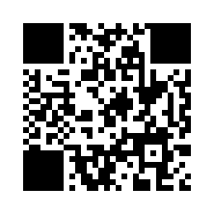
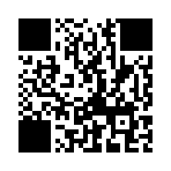
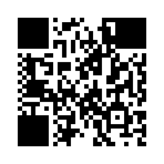
References & Resources
Primary Papers
[P1] S. Ahmed, R. Zhou, S. Angizi, A. S. Rakin. "Deep-TROJ: An Inference Stage Trojan Insertion Algorithm through Efficient Weight Replacement Attack." CVPR 2024.
[P2] R. Zhou, J. T. Liu, S. Ahmed, S. Angizi, A. S. Rakin. "Compromising the Intelligence of Modern DNNs: On the Effectiveness of Targeted RowPress." DATE 2025.
Key Related Works
Code & Resources
[TBT] Rakin et al., CVPR 2020 — First inference-stage Trojan via RowHammer
Deep-TROJ Code:
[ProFlip] Chen et al., ICCV 2021 — Progressive bit-flip Trojan attack
github.com/MLSecurity-Research-LAB/Deep-TROJ
[TrojViT] Zheng et al., CVPR 2023 — Trojan insertion for Vision Transformers
DRAM-Bender Infrastructure:
Olgun et al., TCAD 2023 — FPGA-based DRAM test framework
[DeepHammer] Yao et al., USENIX Security 2020 — Targeted bit-flip chain
Hardware Setup:
[BFA] Rakin et al., ICCV 2019 — Bit-flip attack via progressive search
Xilinx Alveo U200 FPGA
Samsung DDR4 16GB, 2400MHz
DDR4 module, Die Rev B, x8 org
[RowPress] Luo et al., ISCA 2023 — Original RowPress DRAM vulnerability
21

Slide 26
FUTURE WORK
Open Research Questions
?
Can RowPress amplify Deep-TROJ?
Offense
?
How to defend RowPress in DRAM?
Defense
RowPress's 20× higher bit-flip volume could reduce PFN flip iterations below 5. Combining both attack vectors is an unexplored but high-impact direction.
Counter-based TRR is blind to prolonged-activation attacks. New DRAM standards must monitor activation duration, not just frequency. JEDEC standards may need revision.
?
Black-box inference-stage attacks?
Threat Model
?
Are larger quantization widths safer?
Quantization
Current models require white-box access. Remote side-channels (cache timing, EM) can now extract model structure — how close are we to a fully remote black-box attack?
All results use 8-bit quantization. Fewer bits per weight means each flip has larger magnitude — how do 4-bit and 2-bit quantized models compare in vulnerability?
?
LLM / Generative model vulnerability?
New Targets
?
Hardware-level countermeasures?
System Design
Results cover CNNs and ViTs. Large language models and diffusion models store billions of weights in DRAM. Their vulnerability to weight block replacement is unstudied.
Can in-DRAM cryptographic signing or periodic weight-hash verification detect memory tampering at inference time with acceptable overhead?
22

Slide 27
Thank You!
Questions & Discussion
rz26@njit.edu · shaahin.angizi@njit.edu
https://github.com/CMU-SAFARI/DRAM-Bender
DRAM Bender source code & experiments
23
2
15+
3
Slides
Papers
DNN Models
Datasets
23

